Slide 1
SBCCD Governing Board Planning Session
Draft
Prepared and Presented by Dr. Keith Wurtz
Interim Executive Director of Institutional Effectiveness, Research, and Planning

Slide 2
Session Objectives
Review the Suggestions from last year from both the Governing Board and the District Strategic Planning Committee
Review SBCCD Strategic Planning Process
Review and Discuss ACCJC Standards Specific to Governing Board
Review Board Policies developed at other districts
Define Goals, Objectives, and Actions
Review Governing Board Imperatives
Review District Strategic Planning Goals
Review SBCCD District QEIs and Progress on Each
Review progress on goals and objectives from EDCT, KVCR, Crafton, and San Bernardino Valley College
Review Chancellor’s Cabinet approved objectives for the year
Review Board of Trustee objectives from prior year
Develop Board of Trustee objectives for the coming year
Notes:
I took out college specific goals because will not have time to do. Need to include for next time.

Slide 3
Planning Suggestions
Governing Board felt that they were not well informed or engaged on the progress being made on the District Strategic Plan
District Strategic Planning Committee felt that the communication between the Governing Board and the Committee needed to be improved
As a result, drafted the Governing Board Planning Process

Slide 4
Addressing Planning Suggestions
Gaps in the Strategic Plan, lack of integration in planning, and inconsistent data lead to the need to create the Executive Director of Institutional Effectiveness, Research, and Planning;
Chancellor directed the development of new planning process which would assure integration of planning and regular Governing Board participation throughout the planning process.

Slide 5
Background for developing the Governing Board Planning Process
Contacted three different colleges and planning consultant to get input on process
Input from Chancellor’s Cabinet
Need input from Governing Board
Need input from DSPC

Slide 6
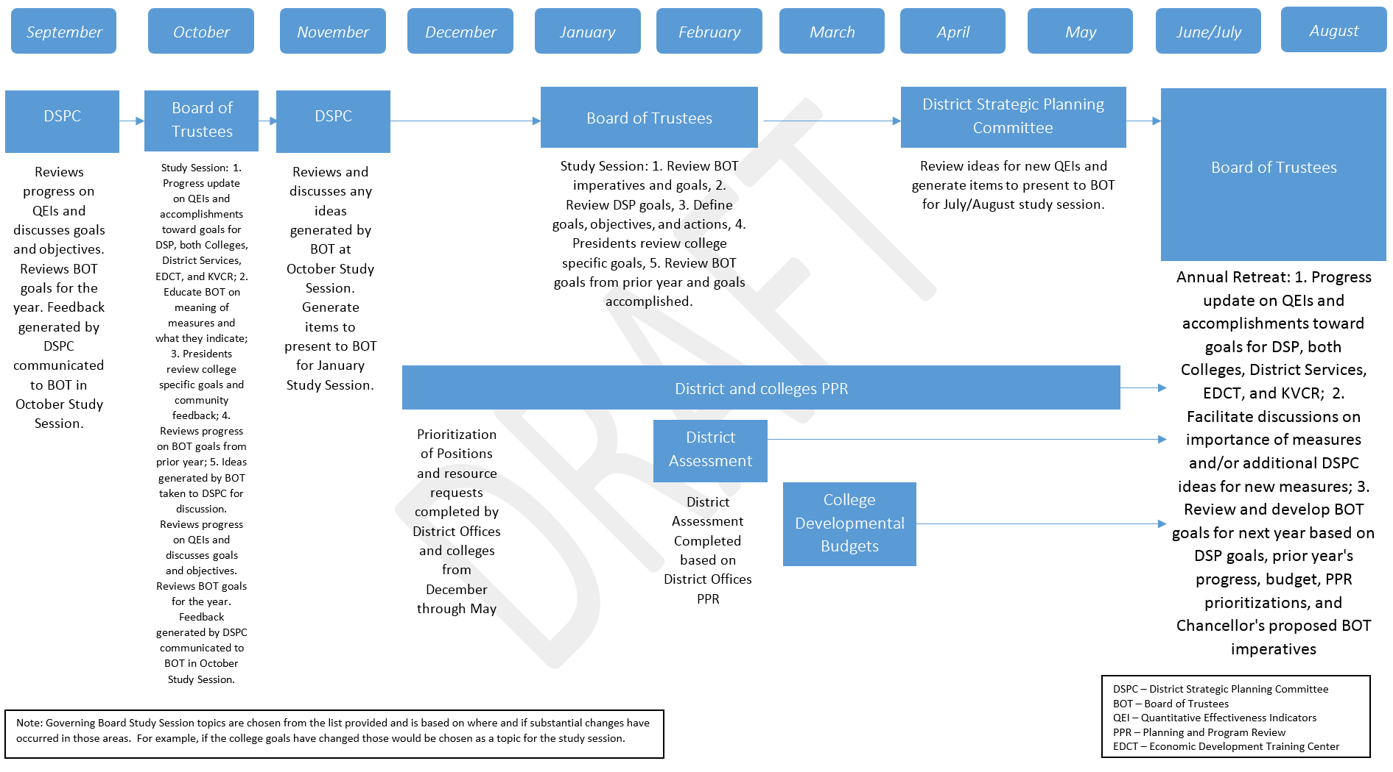
SBCCD Strategic Planning Process

Slide 7
ACCJC Standards
Standard I: Mission, Academic Quality and Institutional Effectiveness, and Integrity
Standard I.C.7
In order to assure institutional and academic integrity, the institution uses and publishes governing board policies on academic freedom and responsibility.
These policies make clear the institution’s commitment to the free pursuit and dissemination of knowledge, and its support for an atmosphere in which intellectual freedom exists for all constituencies, including faculty and students.
Notes:
To introduce this section want to connect the standards to planning. Accordingly, one of the components that informs the planning processes are the ACCJC standards that are specific to the Governing Board. As a result, want to continuously review these with the Governing Board. These are not all of the related standards, but these are the ones most specific to institutional effectiveness and planning.

Slide 8
ACCJC Standards
Standard IV: Leadership and Governance
Standard IV.A.5
Through its system of board and institutional governance, the institution ensures the appropriate consideration of relevant perspectives; decision-making aligned with expertise and responsibility; and timely action on institutional plans, policies, curricular change, and other key considerations.

Slide 9
ACCJC Standards
Standard IV: Leadership and Governance
Standard IV.C.2: The governing board acts as a collective entity. Once the board reaches a decision, all board members act in support of the decision.
Standard IV.C.3: The governing board adheres to a clearly defined policy for selecting and evaluating the CEO of the college and/or the district/system.
Standard IV.C.4: The governing board is an independent, policy-making body that reflects the public interest in the institution’s educational quality. It advocates for and defends the institution and protects it from undue influence or political pressure.

Slide 10
ACCJC Standards
Standard IV: Leadership and Governance
Standard IV.C.5:
The governing board establishes policies consistent with the college/district/system mission to ensure the quality, integrity, and improvement of student learning programs and services and the resources necessary to support them. The governing board has ultimate responsibility for educational quality, legal matters, and financial integrity and stability.

Slide 11
ACCJC Standards
Standard IV: Leadership and Governance
Standard IV.C.7: The governing board acts in a manner consistent with its policies and bylaws. The board regularly assesses its policies and bylaws for their effectiveness in fulfilling the college/district/system mission and revises them as necessary.
Standard IV.C.10: Board policies and/or bylaws clearly establish a process for board evaluation. The evaluation assesses the board’s effectiveness in promoting and sustaining academic quality and institutional effectiveness. The governing board regularly evaluates its practices and performance, including full participation in board training, and makes public the results. The results are used to improve board performance, academic quality, and institutional effectiveness.
Notes:
Developed a draft survey to examine how well Governing Board is meeting ACCJC standards.

Slide 12
ACCJC Standards
Standard IV: Leadership and Governance
Standard IV.C.11:
The governing board upholds a code of ethics and conflict of interest policy, and individual board members adhere to the code.
The board has a clearly defined policy for dealing with behavior that violates its code and implements it when necessary.
A majority of the board members have no employment, family, ownership, or other personal financial interest in the institution.
Board member interests are disclosed and do not interfere with the impartiality of governing body members or outweigh the greater duty to secure and ensure the academic and fiscal integrity of the institution.

Slide 13
ACCJC Standards
Standard IV: Leadership and Governance
Standard IV.C.12: The governing board delegates full responsibility and authority to the CEO to implement and administer board policies without board interference and holds the CEO accountable for the operation of the district/system or college, respectively.

Slide 14
ACCJC Standard Activity
Notes:
Let’s identify the standards that we just reviewed and pick two that are really important for you to focus on this year?
This could inform the development of Board goals for the upcoming year.
Develop handout with standards listed and have the Board prioritize the standards.

Slide 15
Standard IV: Leadership and Governance
Standard IV.C.5: The governing board establishes policies consistent with the college/district/system mission to ensure the quality, integrity, and improvement of student learning programs and services and the resources necessary to support them. The governing board has ultimate responsibility for educational quality, legal matters, and financial integrity and stability.
Notes:
One of main tasks is for the Board to be able to take an idea and draft a policies around those ideas. This is where we are going to work in Cheryl’s ideas.

Slide 16
Provide Examples of Board Policies from other Districts
Notes:
The focus here needs to be on Board Policies that started as ideas and how the Board Policies focus on the Policy level. For example if Board wants to create portal how do we funnel that into a BP that focuses on access.

Slide 17
Identify Components of Board Policy
Notes:
For example, at the 30,000 foot level

Slide 18
Board Policy Activity

Slide 19
Goals, Objectives, and Actions
What are goals, objectives, and actions?
Notes:
We also want to have an understanding of and speak the same language in terms of goals, objectives, and actions. The purpose of this section is to help with that process.

Slide 20
Goals
Overarching principle that guides decision making
Characteristics of a Sound Goal
Reflects the big picture
Cleary serves the interests of the program
Ambitious yet attainable in principle
Relatively long-range and stable over time
Example: Promote student success.
Notes:
Also make point that goal needs to connect mission and vision of program as well as the mission and vision and goals in the EMP.
A goal does not state that someone will be hired.

Slide 21
BHAG Goals
BHAG – Big Hairy Audacious Goals – a statement of bold ambition so clear that it requires little or no explanation
Reaches out and grabs us and captures our imagination
Short, strong, and easily remembered
Examples
“Become the Harvard of the West” (Stanford University, 1940s)
MIS/IT – Be known in all department offices for excellent service
Notes:
Took BHAG information from Matthews handout on goals. BHAGs are from Jim Collins who studied great visionary companies and found that these companies were more likely to have BHAGs

Slide 22
Objectives
A concrete, measurable outcome that represents a milestone on the way to achieving a goal
Characteristics of a Sound Objective
Relevant to the applicable goal
Specific and measurable
Reasonable with respect to scope and timeline
Lends itself to formulation of a coherent set of actions
Example: Increase access to data through the development of an Office of Research and Planning Web Page.
Notes:
If you feel that hiring someone will help meet a goal then this is where it would be stated.

Slide 23
Goals and Objectives
Goals | Objectives
Broad | Narrow
General Intentions | Precise
Intangible | Tangible
Abstract | Concrete
Generally difficult to measure | Measurable
Goal 1
Objective 1.1
Objective 1.2
Objective 1.3
Notes:
May only have 1-3 goals and multiple objectives for each.

Slide 24
Actions
A coherent set of specific steps that must be taken to achieve the objective
Characteristics of Actions/Tasks
Specific
Reasonable with respect to scope, timeline, and workloads
Completion of all the actions under an objective means achievement of that objective
List the actions in logical sequence
Example: Work with web developer to design a research web site.

Slide 25
Goals, Objectives, and Actions
Goal 1
Objective 1.2
Action 1.2.2
Action 1.2.1
Objective 1.1
Action 1.2.3
Action 1.1.1
Action 1.1.2
Action 1.1.3
Notes:
May only have 1-3 goals and multiple objectives for each.

Slide 26
Governing Board Imperatives
Institutional Effectiveness
Learning Centered Institution for Student Access, Retention, and Success
Resource Management for Efficiency, Effectiveness and Excellence
Enhanced and Informed Governance and Leadership

Slide 27
Alignment of the Governing Board Imperatives with the District Strategic Planning Goals
Governing Board Imperatives | SBCCD District Strategic Plan Goals
 | Goal 1: Student Success | Goal 2: Enrollment and Access | Goal 3: Partnerships of Strategic Importance | Goal 4: District Operational Systems
 | Provide the programs and services necessary to enable all students to achieve their educational and career goals. | Increase access to higher education for populations in our region. | Invest in strategic relationships and collaborate with partners in higher education, PK-12 education, business and workforce development, government, and other community organizations. | Improve the District systems to increase administrative and operational efficiency and effectiveness.
1. Institutional Effectiveness (Board Imperative I) | X
2. Learning-Centered Institution for Student Access, Retention and Success (Board Imperative II) |  | X
3. Resource Management for Efficiency, Effectiveness and Excellence (Board Imperative III) |  |  | X
4. Enhanced and Informed Governance, and Leadership (Board Imperative IV) |  |  |  | X
Notes:
Alignment documents have been completed for both colleges, EDCT, and TESS. Are almost done with KVCR. Still need to review fourth draft in DSPC. The planning consultant meeting have delayed this process.

Slide 28
Activity: Goals, Objectives, and Actions
Notes:
Take some time and ask each Board member to draft a goal, objective, and action. Develop and provide worksheet to help facilitate this process.

Slide 29
Review SBCCD District QEIs and Progress on Each

Slide 30
Entity Presentations on progress, goals, and objectives
EDCT
KVCR
Crafton
Valley

Slide 32
Review Chancellor’s Cabinet approved objectives for the year

Slide 34
Review Board of Trustee objectives from prior year

Slide 36
Develop Board of Trustee objectives for the coming year
Notes:
Will have activity for this.

Slide 38
Additional Questions/Discussion

