Slide 1
Redistricting, 2013
San Bernardino CCD
CVRA Analysis

Slide 2
What is the CVRA
definition
The California Voting Rights Act was signed in 2002 and ONLY impacts boards with at-large elections. These boards may need to transition to “by-area” elections if the district has Racially Polarized Voting and the creation of districts would create seats in which the minority group could influence elections.

Slide 3
What is CVRA Analysis
definition
CVRA Analysis is the process of determining the requirements for districts under the California Voting Rights Act. This analysis includes:
Overall ethnic makeup of the district
Analysis of key ballot measure and candidate races to determine the existence of and severity of RPV
Drawing of potential district lines to see if districts can be created that are Majority-Minority (Federal VRA) or Influence (State CVRA)

Slide 4
What is CVRA Analysis
definition
CVRA Analysis is the process of determining the requirements for districts under the California Voting Rights Act. This analysis includes:
Overall ethnic makeup of the district
Analysis of key ballot measure and candidate races to determine the existence of and severity of RPV
Drawing of potential district lines to see if districts can be created that are Majority-Minority (Federal VRA) or Influence (State CVRA)

Slide 5
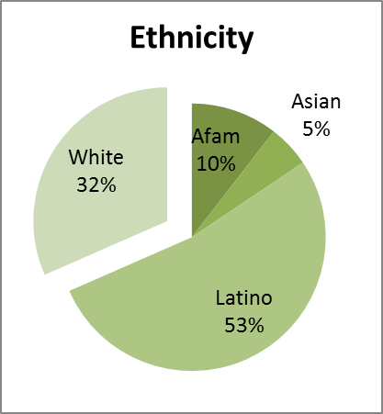
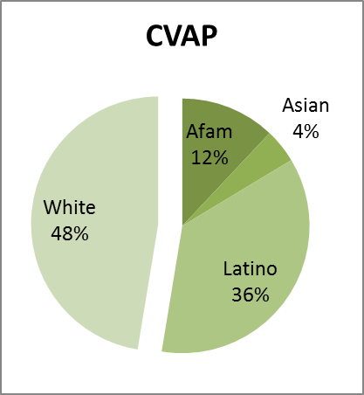
San Bernardino CCD
Ethnic Population
Total District Population:
704,668

Slide 6
What is CVRA Analysis
definition
CVRA Analysis is the process of determining the requirements for districts under the California Voting Rights Act. This analysis includes:
Review of past elections, board composition, overall ethnic makeup of the district
Analysis of key ballot measure and candidate races to determine the existence of and severity of RPV
Drawing of potential district lines to see if districts can be created that are Majority-Minority (Federal VRA) or Influence (State CVRA)

Slide 7
What is CVRA Analysis
definition
CVRA Analysis is the process of determining the requirements for districts under the California Voting Rights Act. This analysis includes:
Review of past elections, board composition, overall ethnic makeup of the district
Analysis of key ballot measure and candidate races to determine the existence of and severity of RPV
Drawing of potential district lines to see if districts can be created that are Majority-Minority (Federal VRA) or Influence (State CVRA)

Slide 8
Traditional Redistricting Principles
Should be followed by any Publicly Elected District
There are a number of criteria that have been used nationally and upheld by courts.
Relatively equal size - people, not citizens
Contiguous – districts should not hop/jump
Maintain communities of interest
Follow city/county/local government lines
Keep districts compact – appearance/function
Preserving voter choices (incumbents)

Slide 9
Traditional Redistricting Principles
Should be followed by any Publicly Elected District
While districts remain balanced by population, determinations of sub group % should be made by CVAP
Thornburg v. Gingles, 478 U.S. 30 (1986)
One person, one vote concept

Slide 10
Redistricting Plan 1
District | Pop | White % | Black % | Asian % | Hispanic % | CVAP | CVAP Asian % | CVAP Black % | CVAP White % | CVAP Hispanic %
1 | 100,772 | 49% | 7% | 4% | 72% | 52,924 | 4% | 9% | 25% | 60%
2 | 103,696 | 44% | 15% | 2% | 68% | 52,272 | 3% | 20% | 24% | 51%
3 | 102,632 | 42% | 14% | 2% | 73% | 44,437 | 3% | 22% | 16% | 57%
4 | 103,244 | 54% | 13% | 3% | 47% | 60,949 | 3% | 14% | 46% | 36%
5 | 101,103 | 58% | 7% | 15% | 31% | 67,126 | 11% | 6% | 55% | 24%
6 | 97,403 | 56% | 12% | 6% | 44% | 56,798 | 5% | 13% | 50% | 29%
7 | 102,268 | 80% | 2% | 3% | 25% | 69,135 | 2% | 2% | 77% | 16%

Slide 11
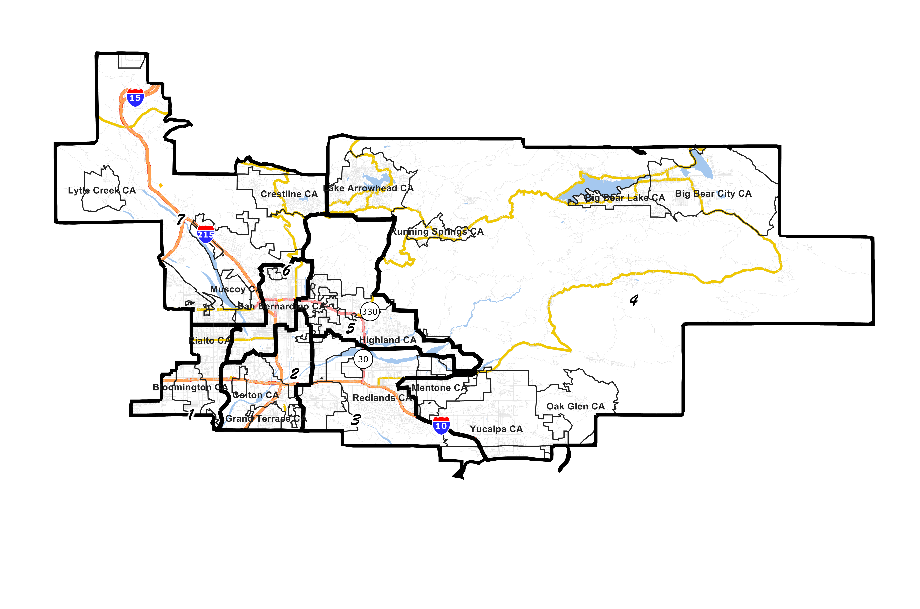
Redistricting Plan 2
District | Pop | White % | Black % | Asian % | Hispanic % | CVAP | CVAP Asian % | CVAP Black % | CVAP White % | CVAP Hispanic %
1 | 101,592 | 47% | 11% | 3% | 73% | 49,080 | 3% | 13% | 23% | 59%
2 | 97,746 | 46% | 10% | 5% | 65% | 50,653 | 6% | 12% | 27% | 53%
3 | 99,251 | 60% | 6% | 14% | 31% | 64,024 | 10% | 5% | 58% | 24%
4 | 108,249 | 81% | 2% | 2% | 24% | 72,808 | 2% | 2% | 78% | 16%
5 | 100,652 | 51% | 14% | 5% | 48% | 59,309 | 5% | 14% | 44% | 34%
6 | 104,823 | 47% | 12% | 2% | 67% | 53,184 | 2% | 18% | 28% | 49%
7 | 98,805 | 49% | 16% | 3% | 53% | 54,583 | 4% | 20% | 36% | 38%

Slide 12
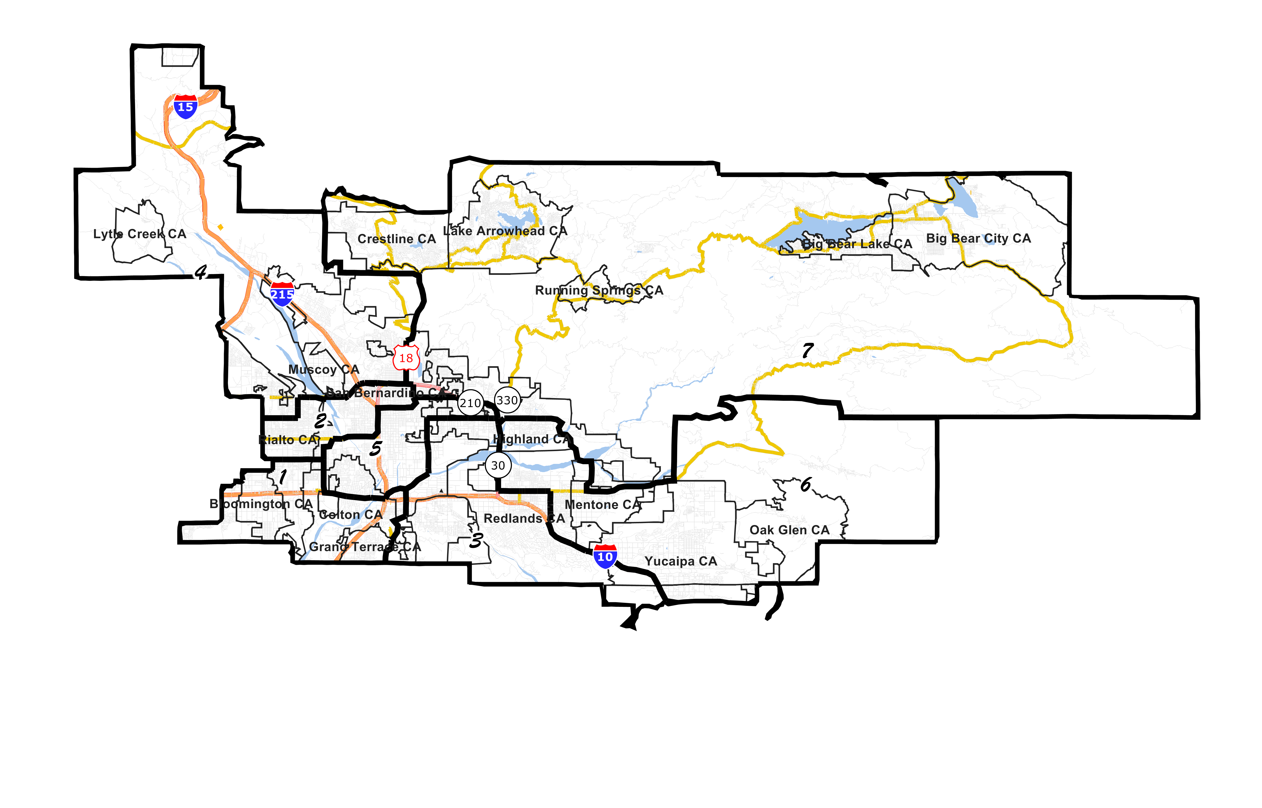
Redistricting Plan 3
District | Pop | White % | Black % | Asian % | Hispanic % | CVAP | CVAP Asian % | CVAP Black % | CVAP White % | CVAP Hispanic %
1 | 101,059 | 49% | 10% | 6% | 66% | 55,225 | 5% | 11% | 28% | 52%
2 | 100,888 | 43% | 16% | 2% | 71% | 48,717 | 2% | 24% | 20% | 52%
3 | 100,827 | 57% | 8% | 13% | 35% | 62,003 | 10% | 6% | 56% | 25%
4 | 101,669 | 48% | 15% | 3% | 54% | 58,868 | 4% | 17% | 38% | 39%
5 | 106,107 | 44% | 11% | 3% | 74% | 47,615 | 4% | 13% | 21% | 60%
6 | 100,207 | 74% | 3% | 5% | 29% | 66,645 | 4% | 3% | 70% | 21%
7 | 100,361 | 70% | 8% | 3% | 30% | 64,568 | 3% | 9% | 64% | 22%

