Slide 1
Sabbatical Report
Professor Mark Dennis McConnell
Crafton Hills College
January, 2014

Slide 2
Original Proposal
Sabbatical for Spring 2013
I will be writing three textbooks to be used in Crafton Hills College music classes to create practical instructional materials specifically designed to meet the academic needs of our students, while addressing the financial reality our students face.

Slide 3
Original Proposal
My sabbatical work will be evaluated by my completion of the projects as well as my implementation of the materials into our classes. The first class of students using the books will be part of the process of editing and proofing the materials to make them publishable for future classes, and eventually distribution to other institutions.

Slide 4
Progress
I completed three books:
  Piano Class Workbook: materials for adult beginner class or group piano study
  Music Notation Fundamentals
  Music Theory Workbook for Music Theory I and II

Slide 5
Progress
I implemented my books into the following classes:
  MUSIC 100 Fundamental Skills in Music
  MUSIC 101 Music Theory I
  MUSIC 135 Piano

Slide 6
Implementation cost
I offered the books, chapter by chapter, at no cost to the students. I paid for the photocopying costs.

Slide 7
Implementation findings
I offered to make the books available in .pdf form via Blackboard or in print. There were many students interested in electronic copies at first, but nearly all preferred print copies after the first few chapters. This surprised me. Most of the students explained that they preferred to have the print copies so they could use them to take notes on.

Slide 8
Implementation findings
Students responded very well to free books.
Students were eager to be involved in the process.
I left things out, but had the chance to add supplements and rewrite and reprint sections. This has been the best part of the whole process.
Our students don’t need the frills that publishers tell us they do. The simplicity of my materials was a benefit.
Students performed as well with my materials as with anything else I have assigned.

Slide 9
Student Success
I compared the semester that I assigned my own materials to other semesters to see if students were advantaged or disadvantaged without a standard published textbook.
  Grades were significantly better in MUSIC 100. There were many things that led to this; the textbook might have been some contribution.
  There was no significant difference in grades, retention, or success that I could relate to the textbook in MUSIC 101 or MUSIC 135.

Slide 10
Student Success-MUSIC 100

Slide 11
Student Success-MUSIC 101

Slide 12
Student Success-MUSIC 135

Slide 13
Samples
  The following images are from
  Music Notation Fundamentals

Slide 14
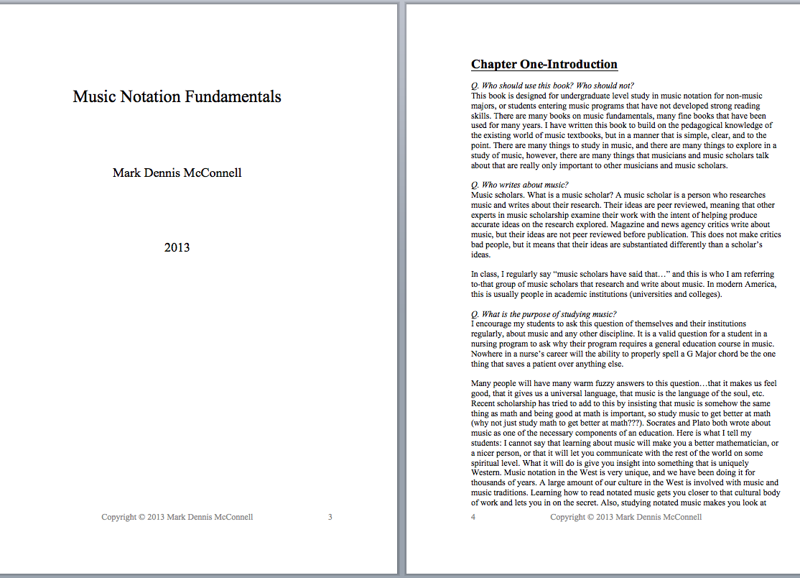

Slide 15
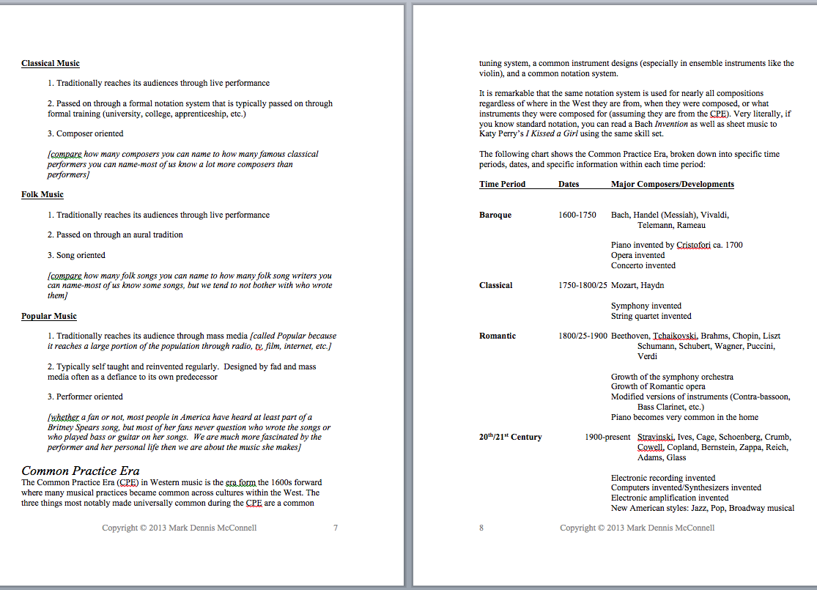

Slide 16
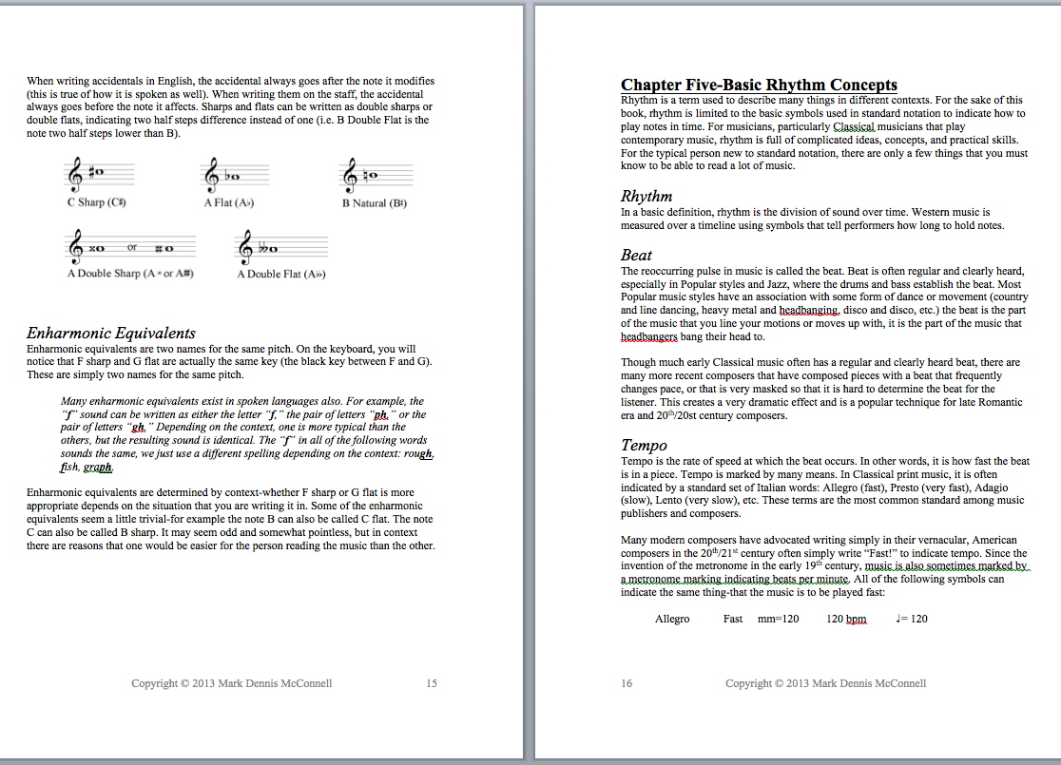

Slide 17
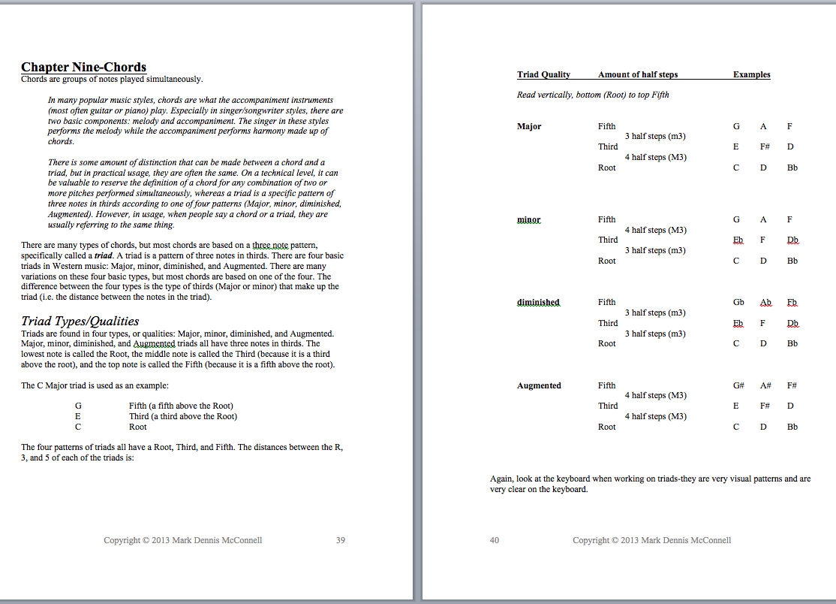

Slide 18
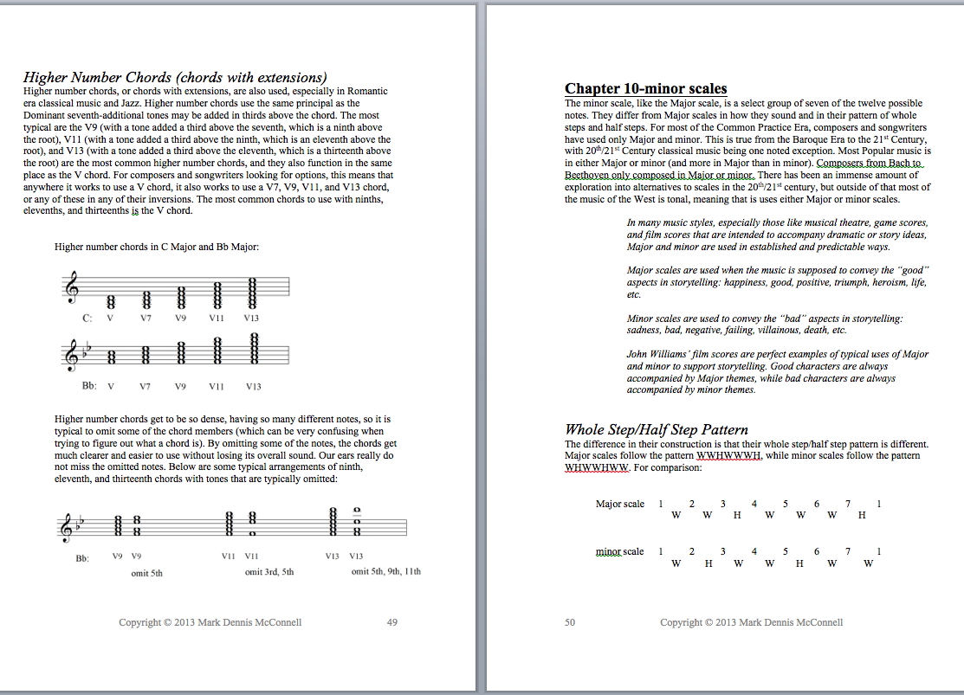

Slide 19
Samples
  The following images are from
  Music Theory Workbook for Music Theory I and II

Slide 20
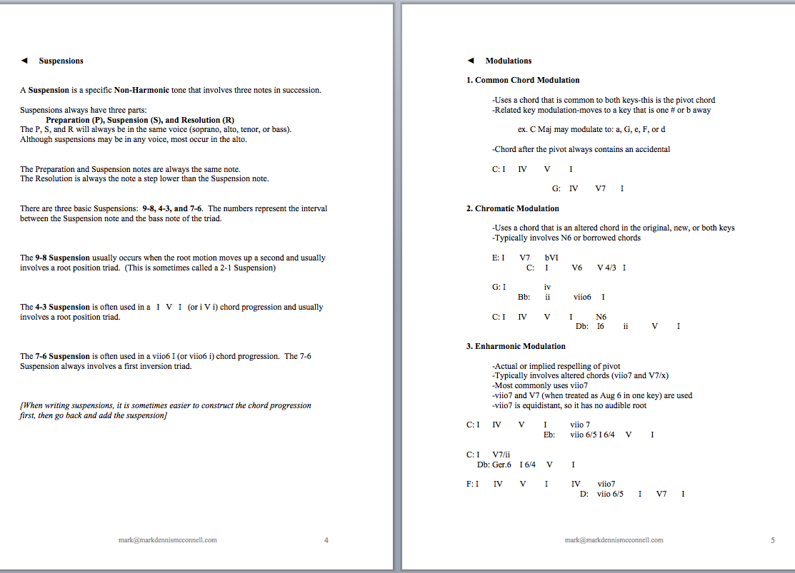

Slide 21
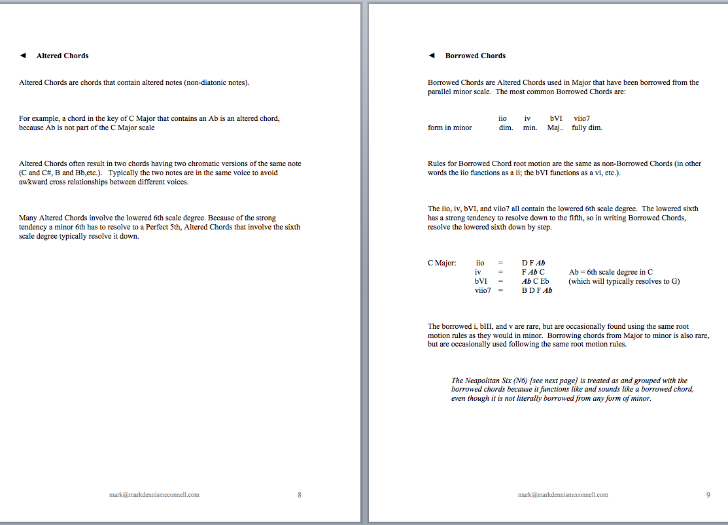

Slide 22
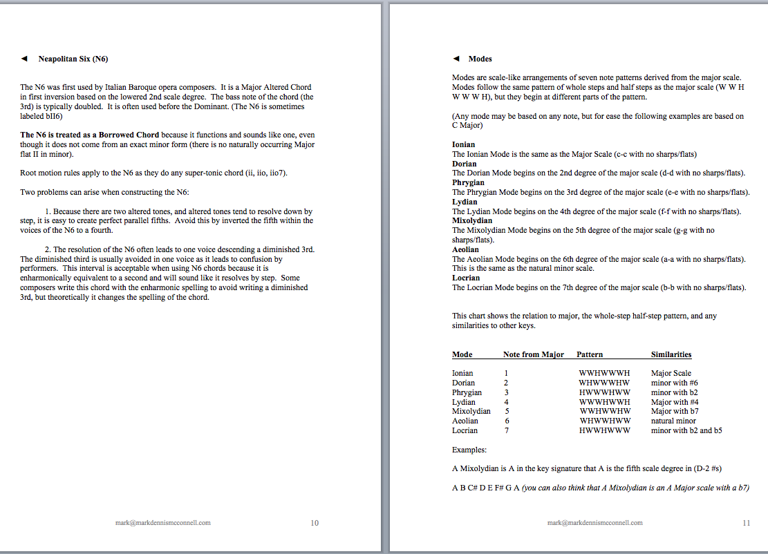

Slide 23
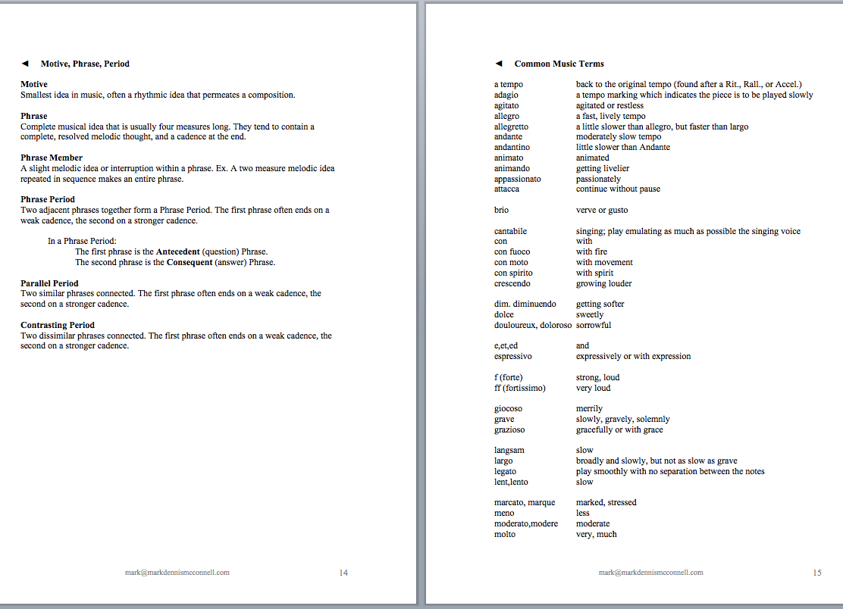

Slide 24
Samples
  The following images are from
  Piano Class Workbook:
  materials for adult beginner class or group piano study

Slide 25
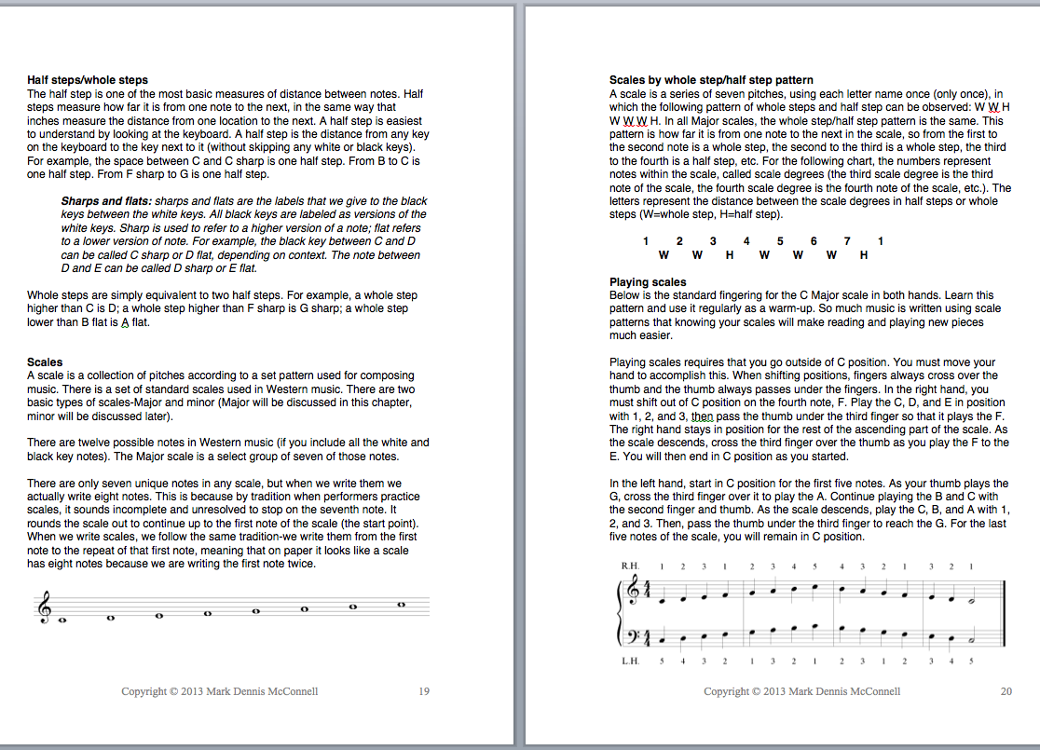

Slide 26
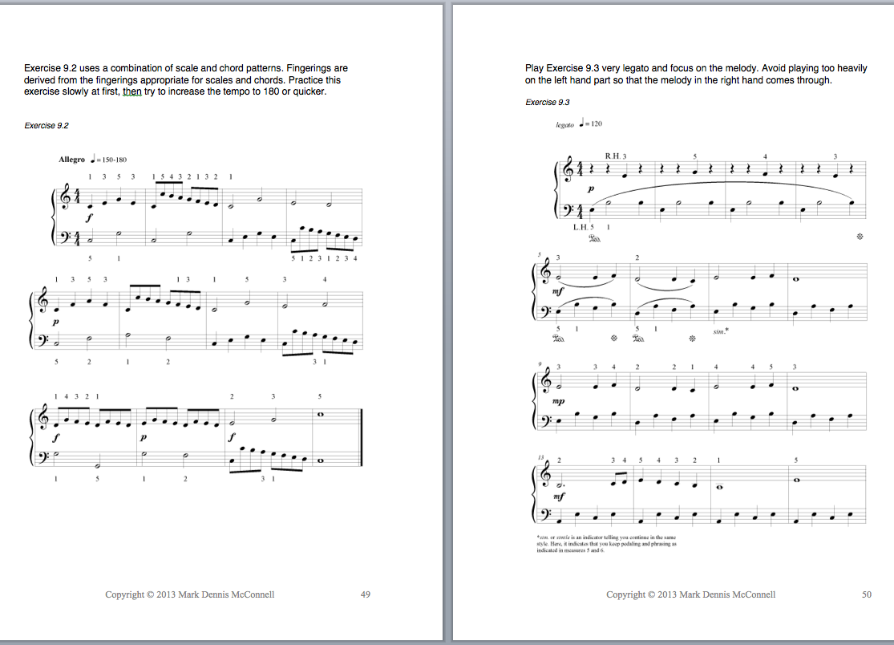

Slide 27
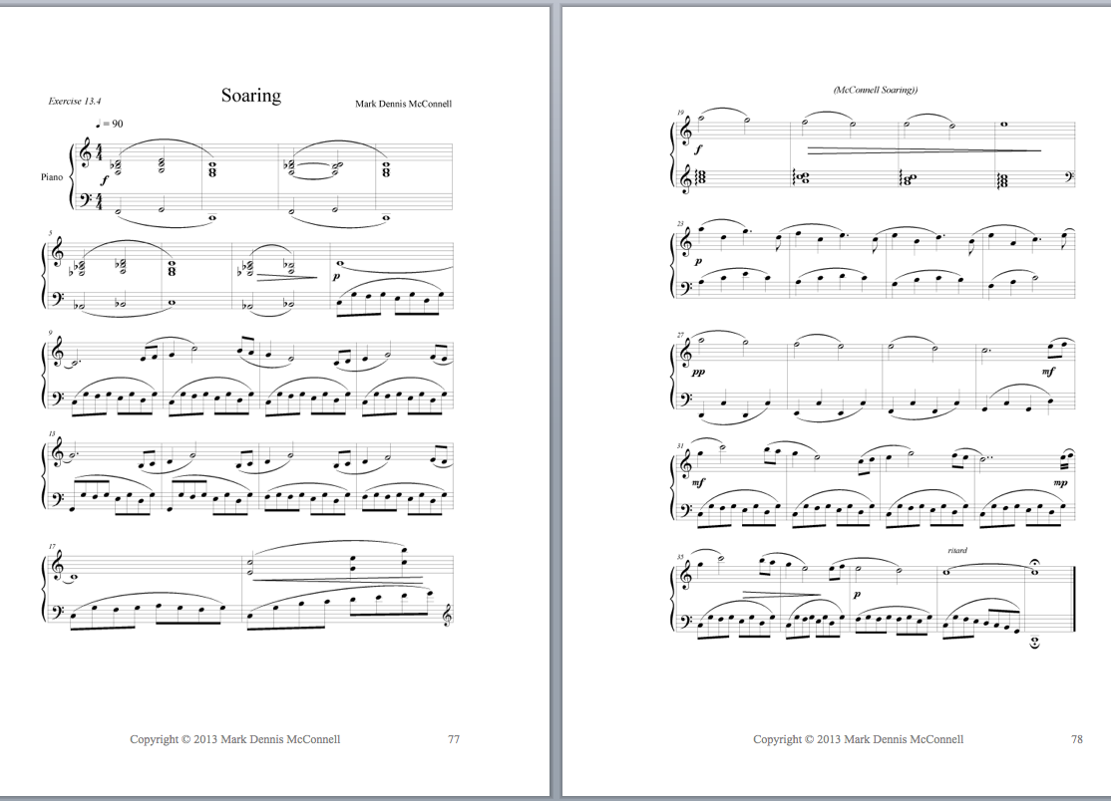

Slide 28
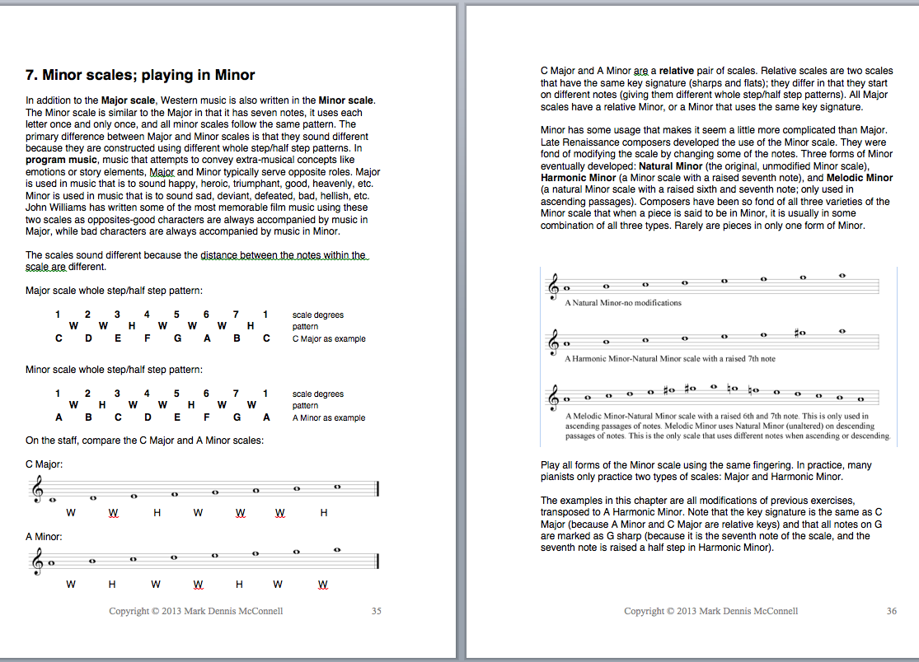

Slide 29
