Slide 1
STEM Programs
February 6, 2014 Board Meeting
Alec McLellan, Eric Quiroz, Jordon Von Helf

Slide 2
Program Objectives
To develop and strengthen a STEM community for the successful academic advancement of students.
STEM Academy
Enhances academic skills and strengthens student community partnerships.
STEM Trek
Offers academic, social, and co-curricular opportunities designed to support successful transfer to a 4-year institution.

Slide 3
STEM Program Requirements
1.) Attend STEM Program Informational
Meetings
2.) Complete a Full Educational Plan and meet with
a counselor for updates each semester.
3.) Submit mid-term progress reports
4.) Maintain a minimum 2.0 GPA with no D, F, or W
5.) Complete a minimum of 18hours of academic
support associated with STEM courses (tutoring,
supplemental instruction, etc.)

Slide 4
STEM Academy
Additional Requirements
Participate in five of the following workshops:
Critically Reading Science Textbooks
Exploring STEM Careers
Transferring to 4-Year University
Time management and Planning
Math Applications
Interpreting Figures
Financial Aid

Slide 5
STEM Trek
Additional Requirements
1) Participate in at least four co-curricular STEM activities or events.
2) Enroll in at least two STEM approved courses each semester. These courses include:
Biology
BIOL 130, BIOL 130H, BIOL 131
Chemistry
CHEM 150, CHEM 151, CHEM 212, CHEM 213
Computer Information Systems
CIS 104, CIS 111, CIS 113, CIS 114, CIS 116
Computer Science
CSCI 110, CSCI 120, CSCI 200, CSCI 230, CSCI 240
Engineering
ENGR 101
Geology
GEOL 100, GEOL 100H, GEOL 112
Mathematics
MATH 102, MATH 103, MATH 160, MATH 200, MATH 250, MATH 251, MATH
252, MATH 265, MATH 266
Physics
PHYSICS 110, PHYSICS 111, PHYSICS 200, PHYSICS 201

Slide 6
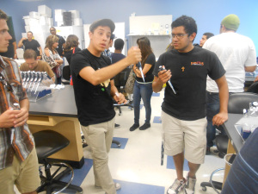
Co-Curricular Activities
University of California Riverside Science Labs Tour

Slide 7
Co-Curricular Activities
University of California Riverside, Genome Lab Tour

Slide 8
Co-Curricular Activities
Cal Poly Pomona Engineering Labs

Slide 9
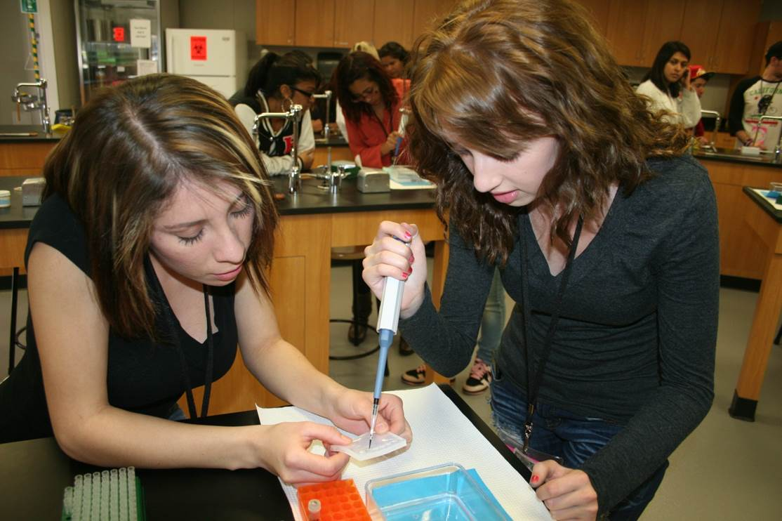
Co-Curricular Activities
SCIFRI
At Crafton
Notes:
Biology: electrophoresis

Slide 10
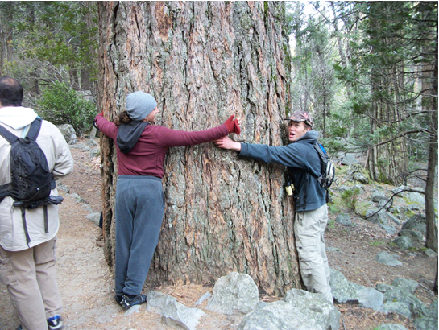
Co-Curricular Activities
Students viewing evidence of Tectonic uplift and intrusion
Learning how to estimate “circumference at breast height” in trees
Yosemite National Park

Slide 11
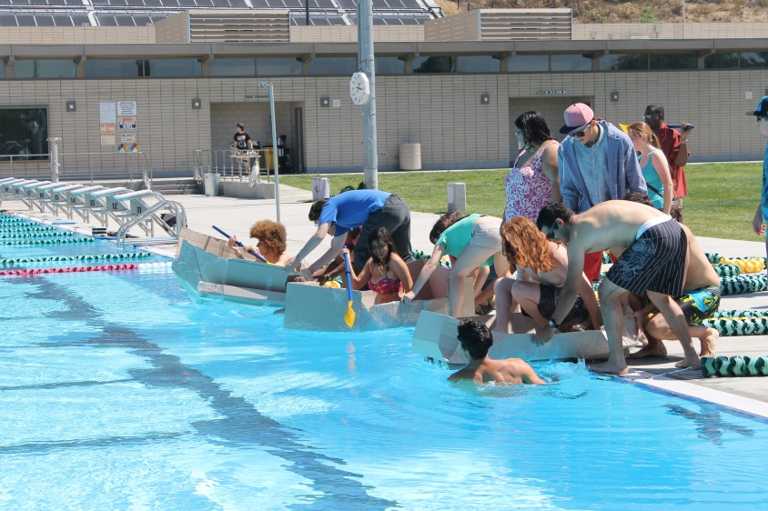
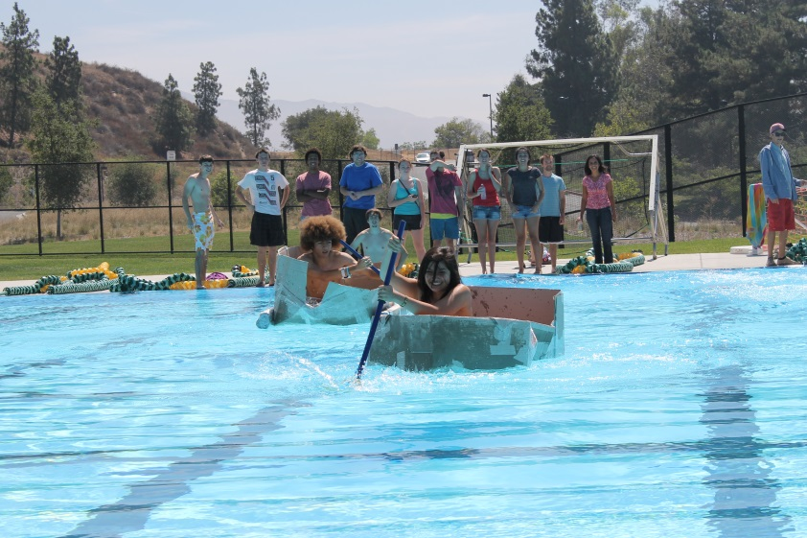
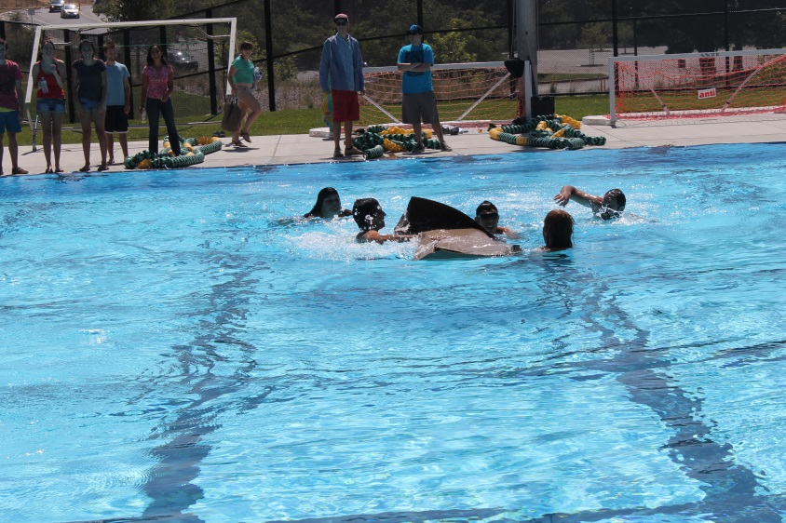
Co-Curricular Activities
Fall Orientation and Activity

Slide 12
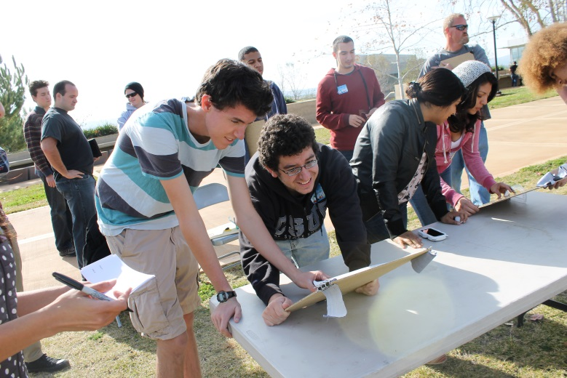
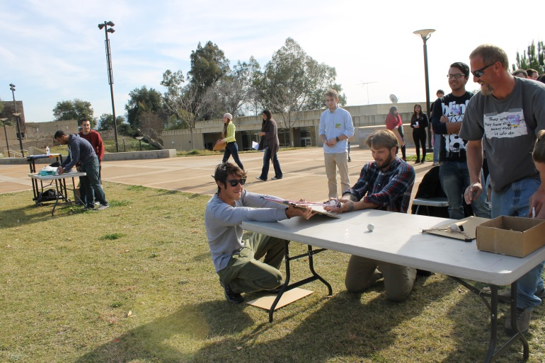
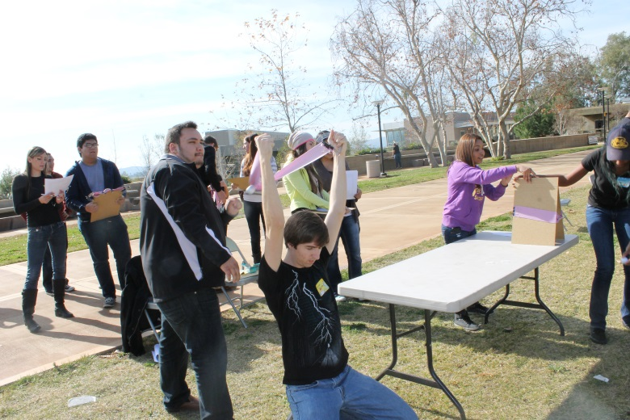
Co-Curricular Activities
Spring Orientation and activity

Slide 13
Student Voices

Slide 14
Activities in Progress
SCIFRI
Rocky Mountain Biological Research Laboratory
Cal State Fullerton tour
ESRI tour
Leadership Group
. . . And still planning.

Slide 15
Thank You For Your Time
Questions?

