Slide 1
KVCR FM/TV/FNX
Path to Increasing Service
and Sustainability

Slide 2
Boosting Revenues and Securing Ongoing Funding
Grow the Member Base
Maximize Underwriting Possibilities
Develop & Redefine KVCR Foundation
Explore Marketing Opportunities

Slide 3
Goal 1: Increasing Revenue
Grow Membership & Increase Underwriting
Identify and Pursue More Grants
Explore Additional Tribal Gifts
Optimize Fees – Maximize Income Potential from Facility Rentals and Use

Slide 4
Administrative Actions to Optimize Expenditures
Identify/Apply Overhead Costs To Grants
Itemize Expenses per Project
Develop Viable Multi-Year Financial & Staffing Plans

Slide 5
Goal 2: Build KVCR's Community Presence
ACTION:
Step Up Community Engagement
Embrace Community and Increase Visibility
Improve Diversity in TV/Radio Content to Proportionately Reflect Community

Slide 6
Goal 3: Strengthen KVCR’s Production Capacities
ACTION:
Increase In-House Productions
Increase Diversity of Local Content
Establish KVCR as a National Content Source

Slide 7
Goal 4: Grow FNX
ACTION:
Increase Community Engagement
Explore Funding Options
Increase in-House Productions
Expand Programming to 1500 hours
Establish FNX as a Major National Network

Slide 8
Goal 5: Optimize Organizational Structure
Study and Evaluate KVCR Staff Structure
Redefine KVCR Foundation Board
Create a Foundation Director Position

Slide 9
KVCR/TV Channel 24
KVCR/TV Programming and Audience is Healthy
Programming Continues to Evolve
Localism in Production is Increasing
Viewership Continues Growing

Slide 10
L.A. PBS Station Trends
2007 – 2013: KVCR Grows, Others Decline

Slide 11
FNX – First Nations Experience
Verizon, and Direct TV – Southern California, LA Area
WYCC-PBS – Chicago, IL / and Northwestern Indiana
KUAC – Fairbanks, Alaska
KEET TV – Northern California
KJHP-LP – Morongo Valley
LPTV – Lakeland, Minnesota
Reservation Transponder – Shoshoni, WY
Coming Soon: Utah, CATV-47 Cheyenne/Arapahoe, AZ, WI, Navajo Nation

Slide 12
FNX Acquisitions & Programming
Content Has Grown from 50 to 500 Hours
Need to Refresh Content thru End of FY14
Immediate = 1,500 to 4,000 Hours of Programming
Long Term = Establish FNX as Major National Network

Slide 14
KVCR/FM 91.9

Slide 15
KVCR/FM 91.9
Audience and Team Growth
Programming
Outreach
Grants
Cross Programming/Promotion

Slide 16
KVCR Radio Audience Growth

Slide 17
KVCR Radio Audience Growth

Slide 18
KVCR Membership/Development

Slide 19
Members in FY 2014 = 6-Month Snapshot of Current Members as of January 28, 2014
FY 2015 = 5% Projection Based on Membership Trends

Slide 20
Number of members in FY 2014 = 6 month snapshot of current members as of January 28, 2014
FY 2015 = 5% projection based on membership trends

Slide 21
Growing KVCR Membership in FY 2015
5% Projected Membership Growth by FY2015
Initial Tele-fundraising campaign target of Recapturing 900 Lapsed Members
Continue with Mail Campaign to Acquire New Donors, Averaging 600 New Donors per Campaign Year
Build and Launch Social Media Fundraising Campaign

Slide 22
KVCR Underwriting
For the Past Two Years, KVCR/FM/TV/FNX has had only one Underwriting Representative
Goal is to Maximize Potential Revenue thru Team Building

Slide 23
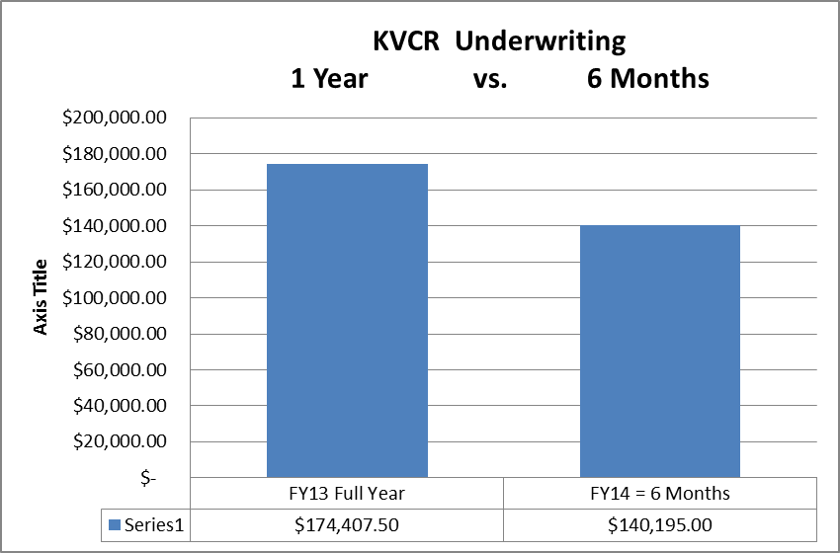
Underwriting Revenue
Income/Revenue

Slide 24
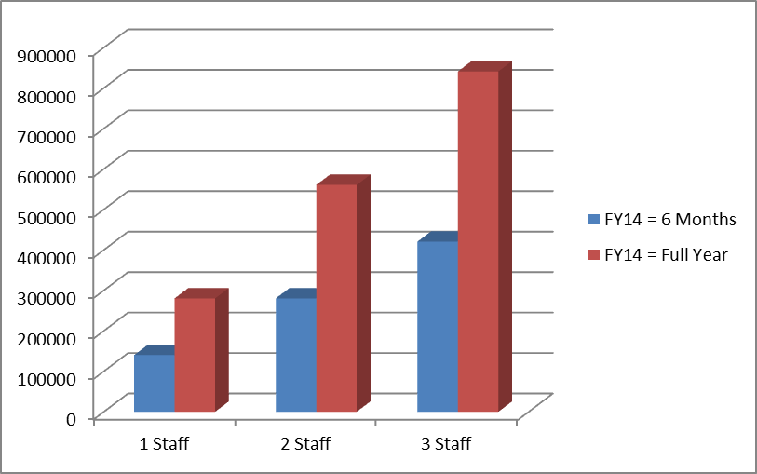
Underwriting Potential
Underwriting by $100,000
Revenue Projections Based on Current
Underwriting Trends

Slide 25
What We’re Doing
Increase Engagement with SBCCD and Community Sectors Increase Academic and Professional Support
Increasing Internship Opportunities
Cultivating HS Student Pipelines to SBVC
Developing New Partnerships with Additional Institutions – CSUSB, UCR, La Sierra Univ. and Others

Slide 26
Intern Program & Volunteers
Working with More Local Schools and Universities
Mentoring Students Through Current Projects Offering Hands-on Professional Experience
On-Air Promotion, Production and News Reporting
Web Development
Creating In-House Animation

Slide 27
In Review
Focus – Community Matters & Localism
Strengthen KVCR Service and Brand – Uniting KVCR FM/TV/FNX thru Cross-Promotion & Programming
Elevate KVCR Profile – More Civic Participation and Visibility, Polish the Gem of the I.E.
Increase Membership and Underwriting Revenues
Financial and Staff Planning for Sustainability

Slide 28
Path to The Future
Focus More on Community Content
Embrace and Reflect Diverse Communities
Reach Out to City and County Governments,
Local Schools, Colleges and Universities
Increase Partnerships with Other Cultural, Arts and Educational Institutions

