Slide 1
LEADERSHIP IN ENERGY AND ENVIRONMENTAL DESIGN (LEED)
San Bernardino Valley College
Chemistry and Physical Science
U.S. Green Building Council
“LEED CERTIFIED BUILDING”

Slide 2
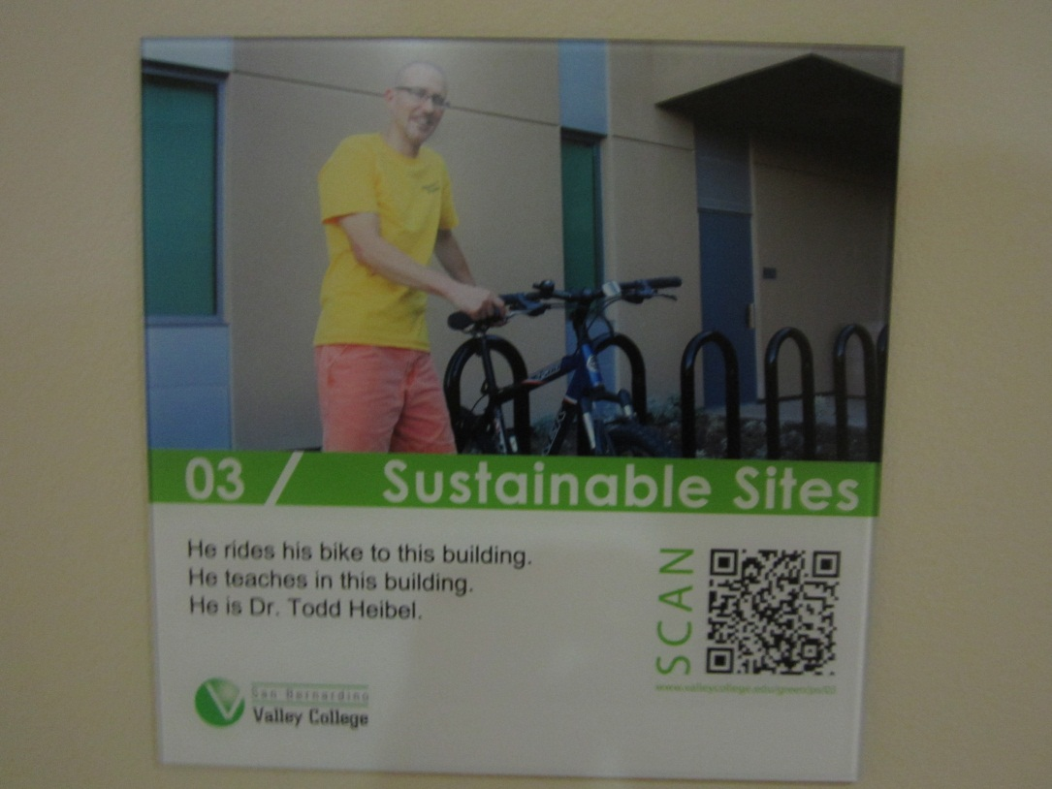
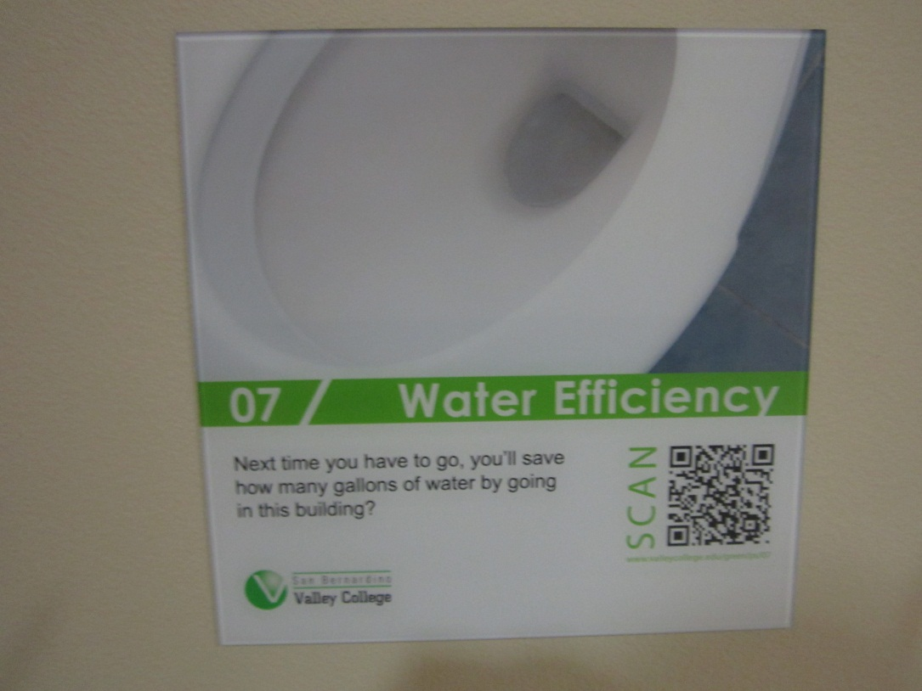
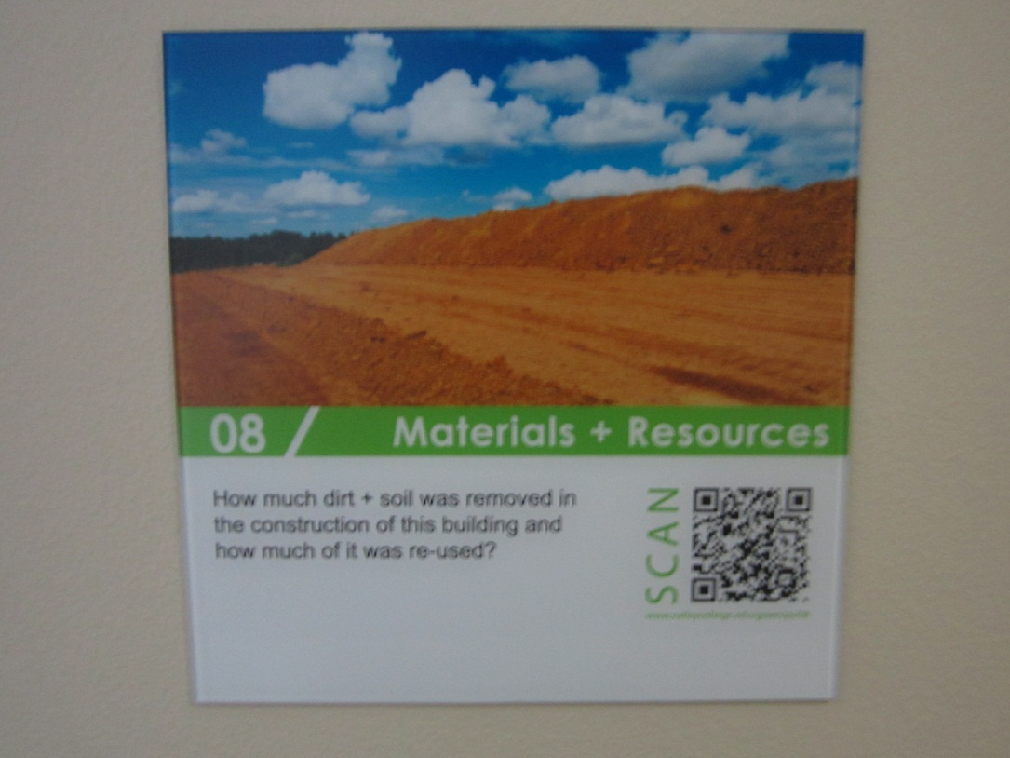
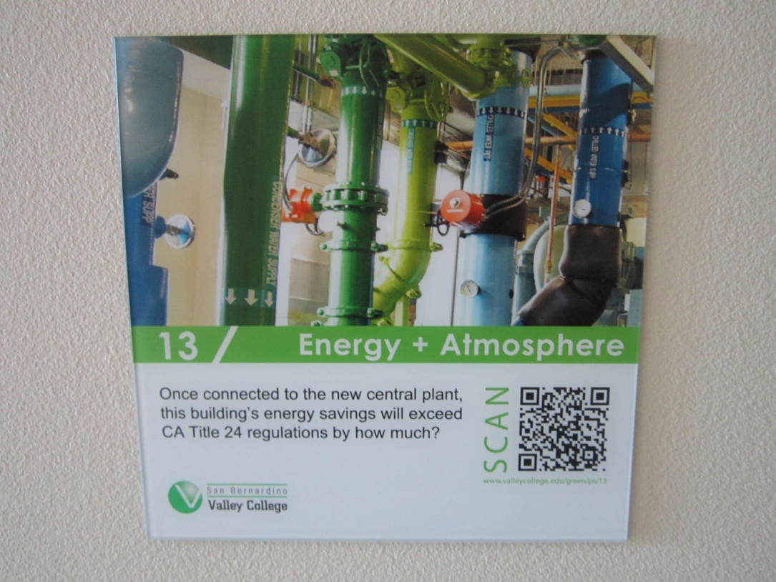
Chemistry and Physical Science Building
U.S. Green Building Council – “LEED Certified”
LEED-certified buildings cost less to operate, reducing energy and water bills by as much as 40%. Businesses and organizations across the globe use LEED to increase the efficiency of their buildings
LEED is helping to deliver energy and water efficient, healthy, environmentally-friendly cost saving buildings, homes and communities

Slide 3
Chemistry and Physical Science Building
Building Highlights – “LEED Certified”
Installation of low flow faucets and fixtures reduce building water consumption by 30%
Installation of native, drought tolerant landscaping
Installation of low emitting adhesives, paints, carpets and glues
Installation of building lighting controls
Diversion of construction waste/debris to landfills by 75%
Interactive educational building signage

Slide 4
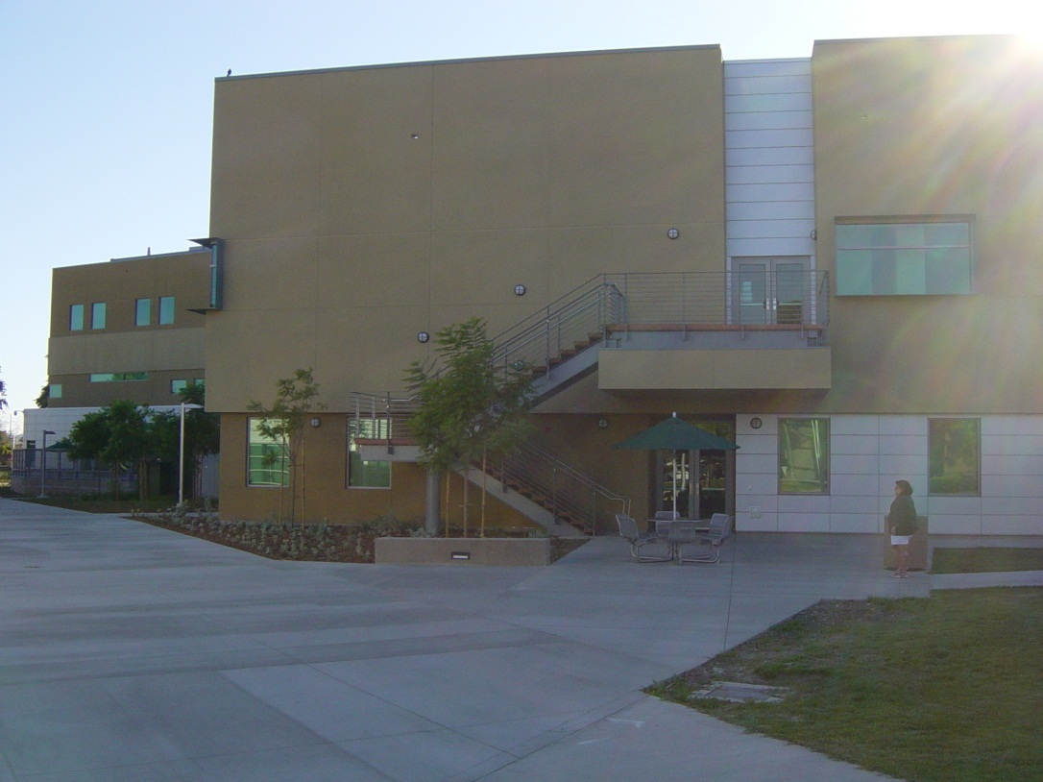
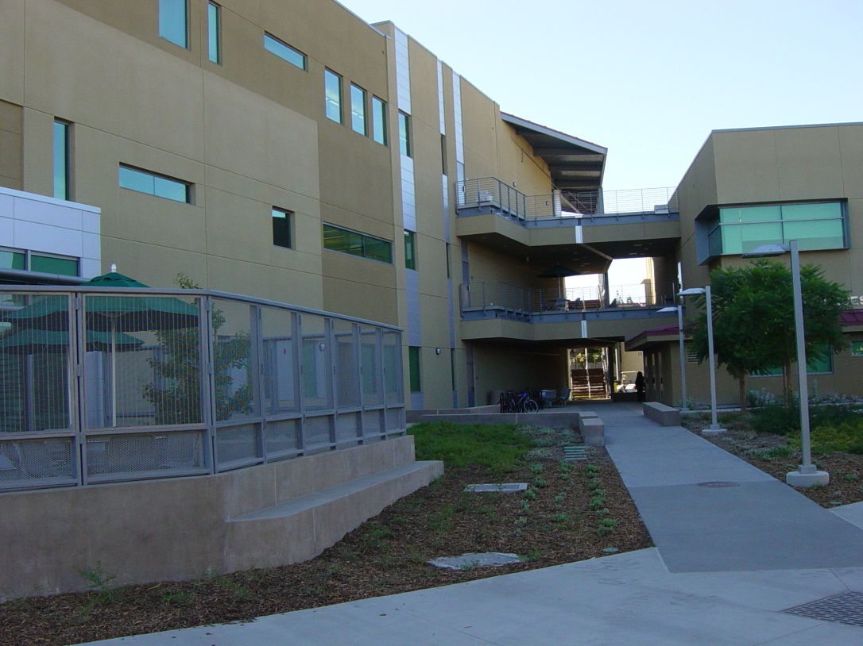
Chemistry and Physical Science Building
U.S GREEN BUILDING COUNCIL LEADERSHIP IN ENERGY AND ENVIRONMENTAL DESIGN (LEED)
LEED “CERTIFIED”

Slide 5
Chemistry and Physical Science Building
INTERACTIVE EDUCATIONAL DISPLAY
INNOVATION IN DESIGN CREDIT

