Slide 1
Labor Market and Curricular Alignment
San Bernardino Valley College
Crafton Hills College
EDCT
Presentation to the Board of Trustees
March 13, 2014

Slide 2
Objectives
Present highlights from Environmental Scan and other data sources showing job projections
Show alignment of existing programs
Provide an overview of opportunities in response to emerging trends

Slide 3
Curriculum process

Slide 4
Origination Points for Curriculum
SBCCD offers:
Short-term, rapid response training
Credit programs
Some fee-based, non-credit, and contract education
Advantages
Variety of “delivery methods” to meet regional needs

Slide 5
Origination Points for Curriculum
Advisory Boards & Industry Partners
Water Technology, GIS, Police Science, MICN
Grants
Nanotech, GIS, Logistics, HSI-STEM, Entrepreneurship
Legislation
TMC Degrees
Educational Partners
Common Core Alignment
4-Year Feeder Programs
Continuous Improvement
Pre-collegiate Courses
Labor Market Data

Slide 6
Labor market data

Slide 7
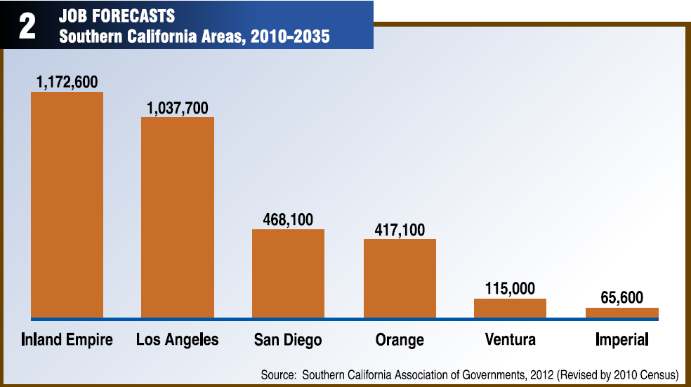
2010-2035 Job Forecasts
Source: IE Quarterly Economic Report. (2012). San Bernardino Associated Governments (SANBAG), 24(3), Retrieved October 18, 2012 from http://sanbag.ca.gov/news/publications/03-2012_QER.pdf
Notes:
The IE is expected to add more jobs (1,172,600) than other Southern California Areas.

Slide 8
Highest Annual Number of Openings Occupations Requiring AA/AS or Less
Occupational Area | Avg Annual Job Openings | 2020 Annual Employment | Median Annual Income
Office Support | 6,989 | 24,980 | $32,460
Sales | 6,854 | 26,840 | $24,320
Food Prep | 6,591 | 25,500 | $19,169
Transportation & Material Moving | 5,384 | 25,860 | $30,018
Education | 3,106 | 10,470 | $57,110
Personal Care | 2,762 | 14,620 | $20,949
Healthcare Practitioners &Technicians | 2,664 | 13,680 | $72,079
Management | 2,018 | 6,600 | $93,615

Slide 9
Curriculum Implications
Occupation | SBVC |  | CHC
 | Existing Program | Future Possibility | Existing Program | Future Possibility
Office Support | ●
Sales | ●
Food Prep | ●
Transportation & Material Moving | ● |  |  | ●
Education | ● |  | ●
Personal Care
Healthcare Practitioners &Technicians | ● |  | ●
Management | ● |  | ●

Slide 10
Training Implications
Occupation | EDCT Programs
Office Support | Microsoft Office Suite, Customer Service Advanced Office Skills, Team Building
Sales | Sales and Marketing , Customer Service Training, Oral and Written Communication
Food Prep | Food Safety Management Certification
Transportation & Material Moving | Forklift Training, Certified Logistics Associate (CLA) and Technician (CLT), Diesel Exhaust Familiarization
Education | Can create customized hybrid short-term program consisting of credit and not-for-credit, On-line training (Ed2Go)
Personal Care
Healthcare Practitioners &Technicians | CNA, ACNA, RNA, PCA, and Home Health Aid are being considered for offering
Management | Lean Management, Supervisory Skills Project Management, Leadership Skills etc.

Slide 11
Highest Annual Number of Openings Occupational Areas Requiring Transfer (BA/BS)
Occupational Area | Avg Annual Job Openings | 2020 Annual Employment | Median Annual Income
Education | 1,944 | 6,410 | $61,735
Business & Finance | 1,130 | 6,190 | $58,549
Management | 788 | 2,990 | $93,276
CIS/Math | 345 | 1,870 | $72,747
Arts & Entertainment | 288 | 800 | $51,736
Engineering and Architecture | 286 | 990 | $87,609
Community and Social Service | 271 | 1,050 | $50,898
Sales | 195 | 830 | $66,666
Science and Research | 140 | 430 | $68,500

Slide 12
Curriculum Implications
Occupational Area | SBVC |  | CHC
 | Existing Program | Future Possibility | Existing Program | Future Possibility
Education | ● |  | ●
Business & Finance | ● |  | ●
Management | ● |  | ●
CIS/Math | ● |  | ●
Arts & Entertainment | ●
Engineering and Architecture | ● |  | ●
Community and Social Service | ● |  |  | ●
Sales | ● |  |  | ●
Science and Research | ● |  | ●

Slide 13
Employers
Top 10 employers in SB/Riverside Counties
Stater Bros. Holdings Inc (16.5k)
Prime Healthcare Svc Inc (15k) Chino Valley Medical Center
Loma Linda University Medical Center (7,k)
Ontario Intl Airport (6k)
Kaiser Permanente Medical Care (5k) Insurance
Restoration Technologies Inc (5k)
Jacuzzi Brands Corp (4.9k)
San Manuel Indian Bingo & Casino (3k)
Kaiser Permanente (3k) Medical Centers
ESRI (2.7k)
Notes:
Source: CM p. 89
Possible implications include:
Develop strategic partnerships with employers to provide contract education or industry-specific programs (customer service, healthcare, logistics, GIS, etc.)
Resource development and alternate funding sources

Slide 14
Doing what matters for jobs and the economy (cccco)

Slide 15
Doing What Matters for Jobs and the Economy (CCCCO)
Priority Sectors:
Advanced Manufacturing
Health
Global Trade & Logistics
Emerging Sectors:
Advanced Transportation and Renewables
ICT/Digital Media
Other:
Small Business

Slide 16
Industry Sectors & Programs at CHC
Industry Sector | Related Programs | Job Data |  | Emerging Programs
 |  | Perkins Placement Data | Salary Surfer
Healthcare | Resp Care Rad Tech Health Sciences | 84-94% 70-100% | 81% 90%
Public Safety | Fire EMT Paramedic | 74-95% 75-92% 95-100% | 79% 86% 96% | Emergency Management

Slide 17
Industry Sectors & Programs at CHC
Industry Sector | Related Programs | Job Placement Data |  | Emerging Programs
 |  | Perkins | Salary Surfer
Advanced Manfct | None |  |  | Pre-Engineering
Global Trade & Logistics | Business | 70-87% | 65% | Revise degree
ICT & Digital Media | CIS | 66-85% | Not Available | Digital Media
Adv Trans & Renewables | Environmental Science | 6,100 new jobs in IE over next 3 yrs |  | Revise degree
Small Business | None

Slide 18
Industry Sectors & Programs at SBVC
Industry Sector | Related Programs | Job Data |  | Emerging Programs
 |  | Perkins 2012-13 | Wage finder match-rate
Healthcare | Nursing Psychtech Pharmacy tech | 88% 91% 76% | 94% 91% n/a
Public Safety | *Administration of Justice | 92% | 83%
Adv Manfct
Global Trade & Logistics | Bus. Admin | 95% | 67%
ICT & Digital Media | CIT Office Technology | 55% | n/a
Adv Transp & Renewables | Diesel Heating Ventilation & Air Water treatment | 67% 81% 78% | n/a 96% n/a
Small Business | Accounting Bus. Admin | 84% 95% | n/a 67%
Notes:
* Administration of Justice refers to jobs in corrections, probation /parole, security , forensics, and police/sheriff.

Slide 19
Industry Sectors & Programs at EDCT
Industry Sector | Related Programs | Job Data | Emerging Programs
Healthcare |  |  | CNA, ACNA, RNA, PCA, HIT
Public Safety
Advanced Manfct | Nanotechnology Technicians Training, Mechanical Craft Training, Welding, PLC | No data available (incumbent worker training) | AFM Training, Industrial Maintenance Mechanic
Global Trade & Logistics | Logistics Tech: CLA, CLT and Forklift Training, Global Logistics Leadership, Certified Logistics Manager | 70% (SBCCD placement) (incumbent worker)
ICT & Digital Media | ICT Digital Media Regional Leadership and support | N/A | Health Inform. Tech., Cyber Security, GIS (not-for-credit)
Adv Transp & Renewables | Photovoltaic Training, Water Supply Technology (hybrid), Building Performance Improvement (BPI) | Incumbent Worker Training | Industrial Automation
Small Business | Entrepreneurship Training | No data available (Self-employment is excluded from LMI) | Social Entrepreneurship, Construction Trades

Slide 20
opportunities

Slide 21
Projects with Partners
Loma Linda University “Gateway College” Project
San Bernardino City Unified School District
Arrowhead Regional Medical School
California State University San Bernardino (HSI-STEM-Pass-Go)
Cities of Redlands & San Bernardino Water Depts.
San Bernardino County Sheriff’s Dept.
Inland Empire Media Group
CalTrans project - CSUSB, CalTrans, CDCR
County WIBs and State WIB (Youth Mnfc)
IE Manufacturers Council and Employment Training Panel

Slide 22
External Funding
Trend towards regionalization of pathways
Career Pathways Trust Grant
SB 1070
WIB – “Employment Zones”
AB 86
Community Education – Fee Based, Not for Credit

Slide 23
Sample Health Careers Pathway
Pre-Collegiate
CNA
Colleges
EMT
Bachelors
Health Science
Respiratory
Graduate
Biomedical Sciences
Genetics
Neuroscience
Nursing
Physical Therapy
Medicine
Med Asst
Pharm Tech
LVN
Phlebotomy
Paramedic
Resp Care
Rad Tech
Health Sci
A&P
RN
Psych Tech
Pharm Tech
Nursing
EMS
Physical Therapy
Health Education
Dental Hygiene
ACNA
RNA

Slide 24
Sample Logistics Careers Pathway
Pre-Collegiate
Entry Level Training
Colleges
Bachelors
Supply Chain Mgmt
Graduate
MBA
Management
Business
GIS
Bus & Intl Bus
Purchasing
Logistics
Logistics Training (EDCT)

Slide 25
Next Steps
Identify pathways
“Scaffolding” of knowledge and skills
Stackable certificates and degrees
Gap analysis and solutions
Seek and secure outside funding
Strengthen partnerships

