Slide 1
VALLEY-BOUND Commitment
6 YEARS OF COMMITMENT
Presenters
Carmen Rodriguez
Brooke Fyfe
Jesus Espinoza
Hector Espinoza
Barry Williams
Penecia Sims

Slide 2
PURPOSE
Now entering its seventh year of providing a free first year of college to local high school graduates entering college, the Valley-Bound Commitment Program at San Bernardino Valley College included 150 students in 2013-2014. What began as a pilot program for 36 students in 2008 has blossomed into an award-winning program that has led to greater levels of student success for hundreds of Inland Empire residents. Since its inception in 2008, participants in the Valley-Bound Commitment (VBC) have achieved higher grades than their peers, continue their education beyond their first year at a higher rate than typical students, transferred to four-year colleges throughout California, and even spoken at Commencement ceremonies. In summary, the program is aimed at removing all economic barriers to the first year of college while providing critical guidance and support that is essential to continue striving towards individual educational and career goals.

Slide 3
Qualifiers
To be considered a Valley-Bound student must attend one of the 12 high schools
Arroyo Valley Cajon
Pacific San Bernardino
San Gorgonio Bloomington
Colton Carter
Eisenhower Rialto
Rim of the World Big Bear
Adding Grand Terrace High School for 2014-15 year.

Slide 4
Notes:
The table shows how many students were accepted into the program each year beginning from 2008 and projection for 2014 year.

Slide 5
Participating schools
Notes:
2008 – pilot year with 36 students from Colton.

Slide 6
GRADUATES
Notes:
2009-10 – 3.5 avg. gpa; 2010-11 – 3.1; 11-12 & 12-13 – 3.2 and current graduates 3.1 grade point average

Slide 7
Notes:
Table shows: year participant began and how many graduates from each year – 08-09 – 17= 47%; 09-10 – 32 = 36%; 10-11 – 42= 38%; 11-12 – 31 = 21% and 12-13 = 200 = 5%

Slide 8
Total number of graduates
Notes:
We have a total of 132 graduates and 112 which is 85% percent of our students are transferring.

Slide 9
Students Served
Notes:
I am not counting this year because there are no graduates. They will be averaged in next year. 21% are graduating

Slide 10
GENDER
Notes:
Males – 48 graduates; 38 transfers 3.2 gpa average females 84 graduates; 74 transfers 3.1 gpa average =

Slide 11
This is how it all began

Slide 12
2009-2010

Slide 13
2010-2011

Slide 14
Students from 2011-2012

Slide 15
2012-2013

Slide 16
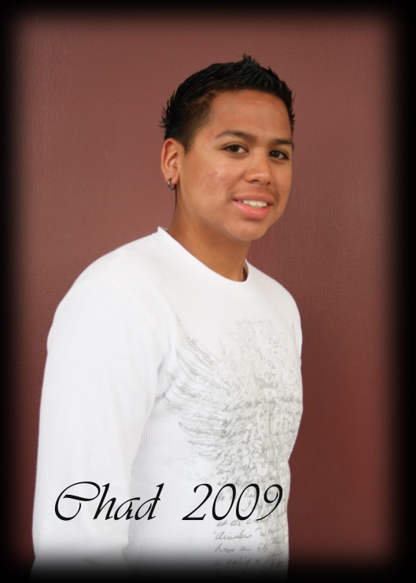
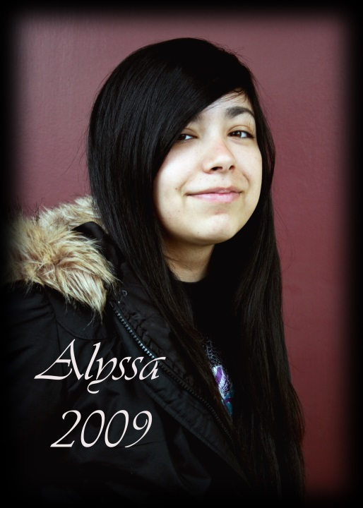
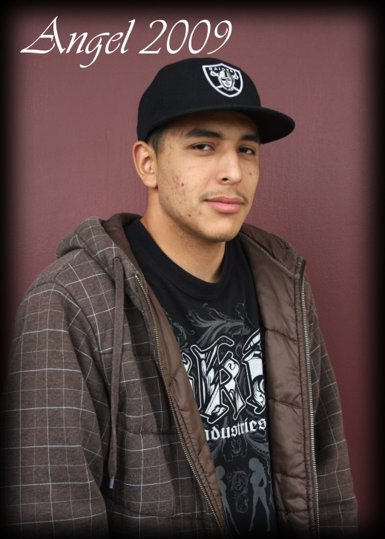
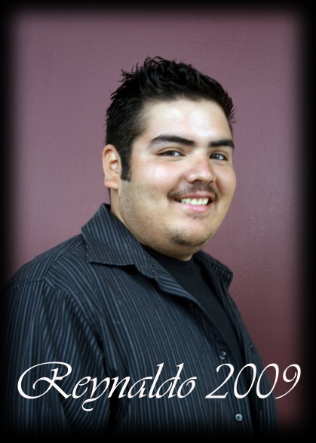
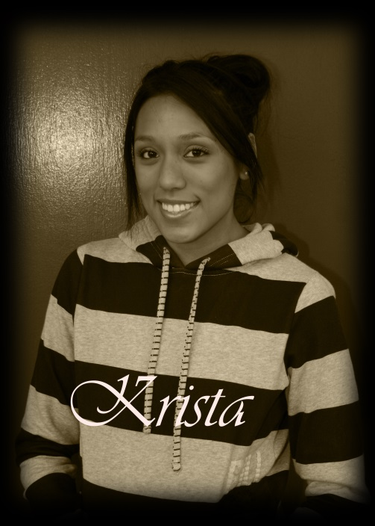
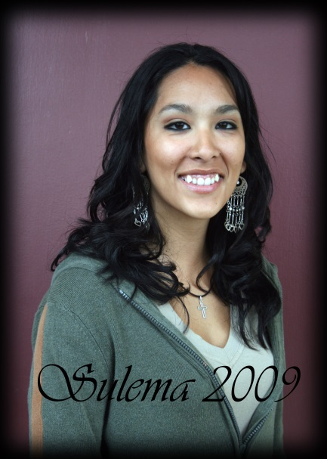
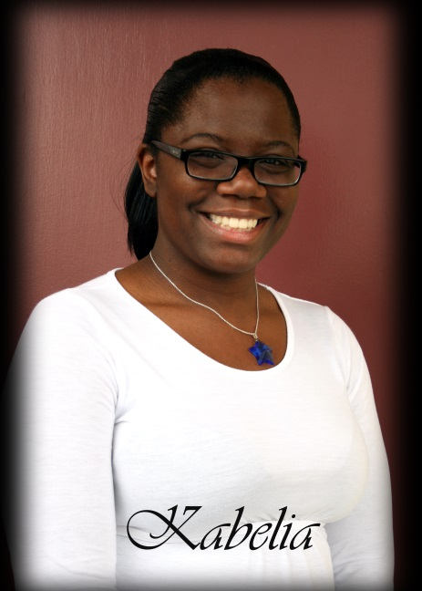
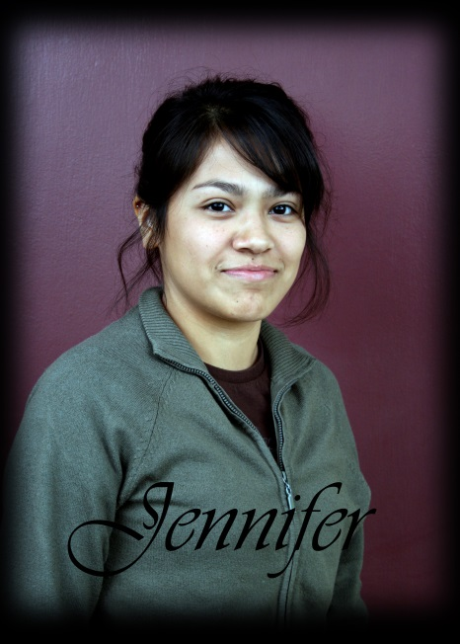

Slide 17
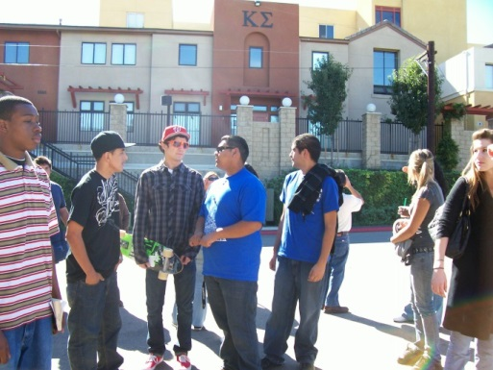
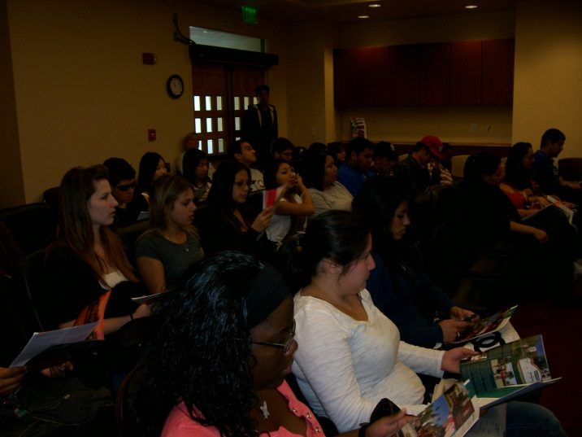
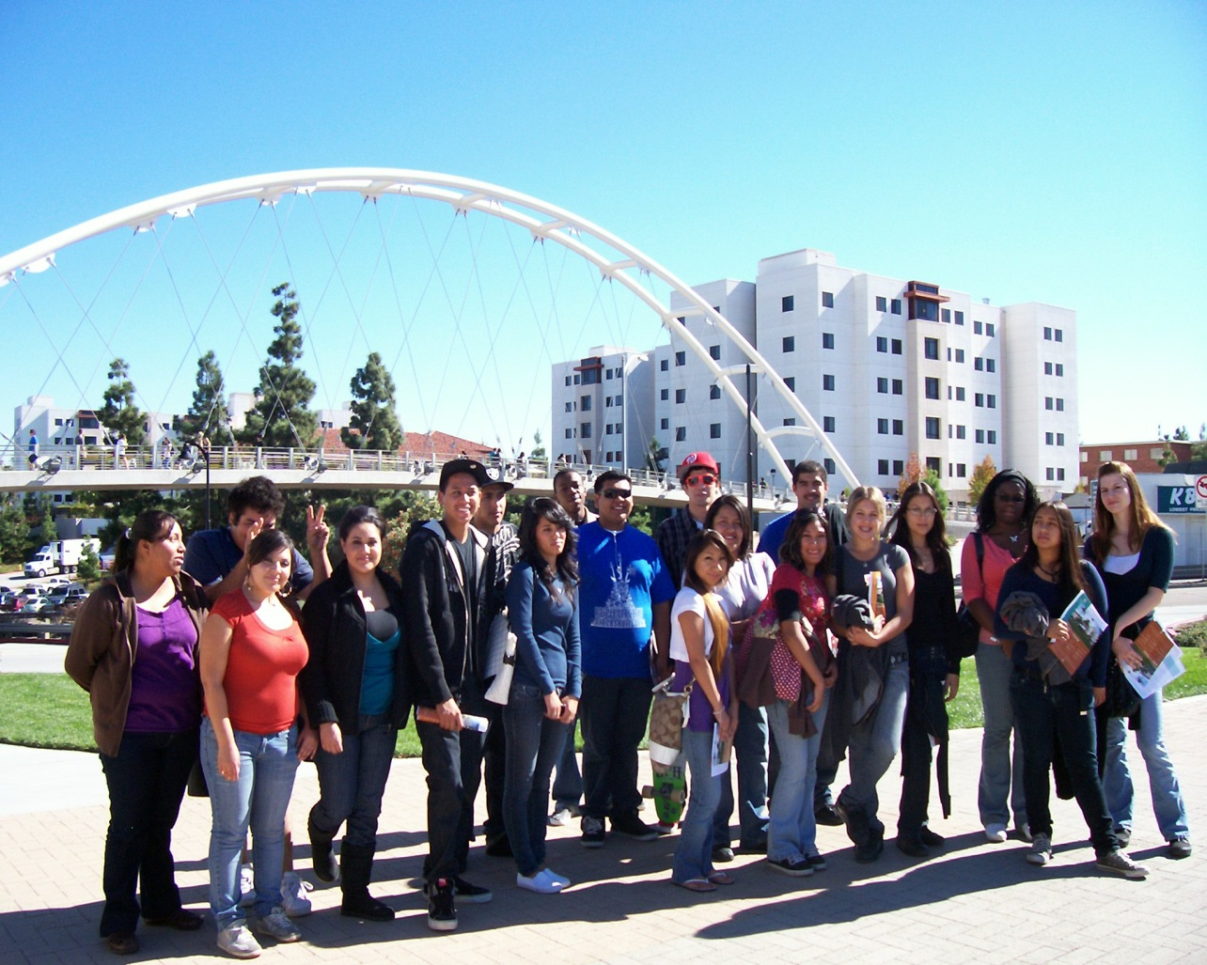
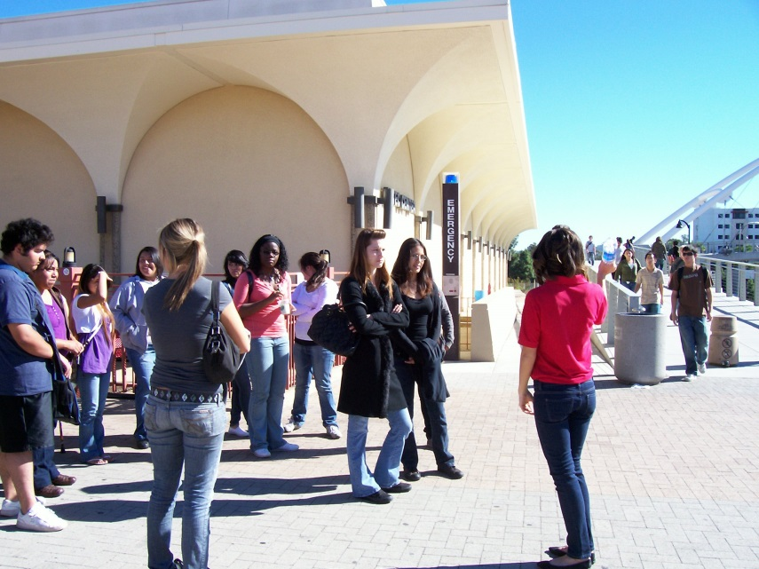
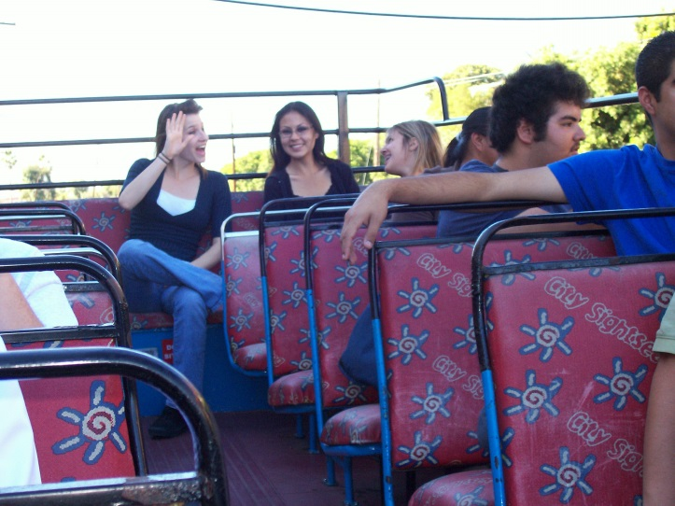
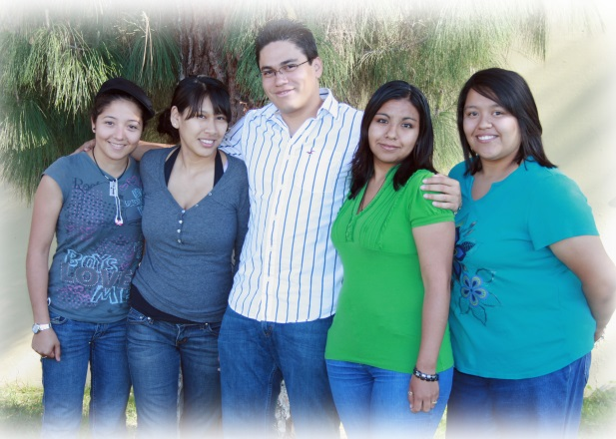
2008-2009

Slide 18
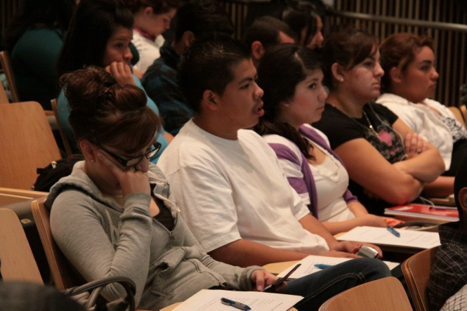
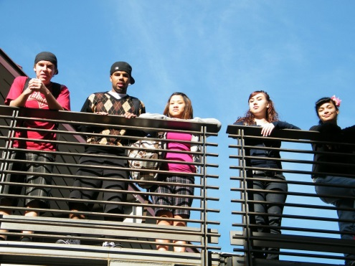
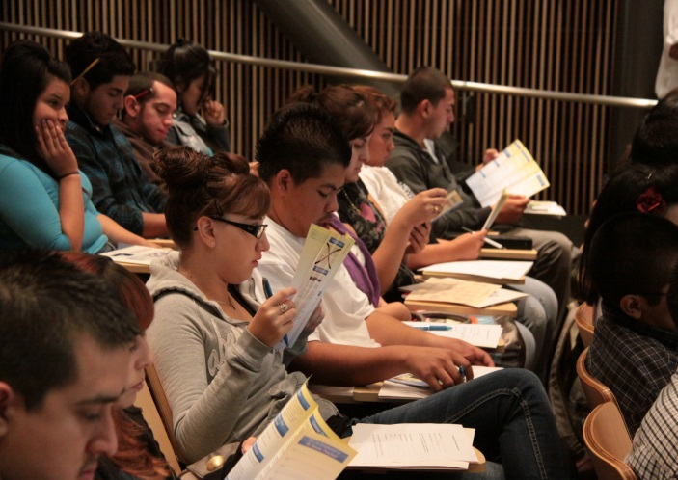
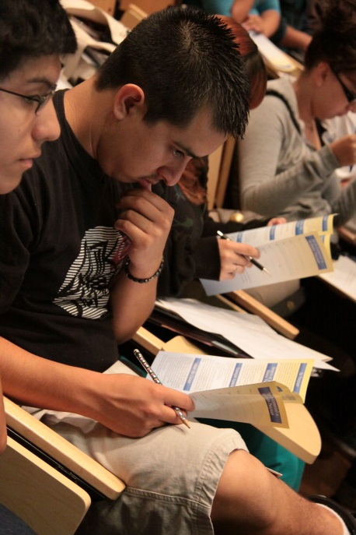
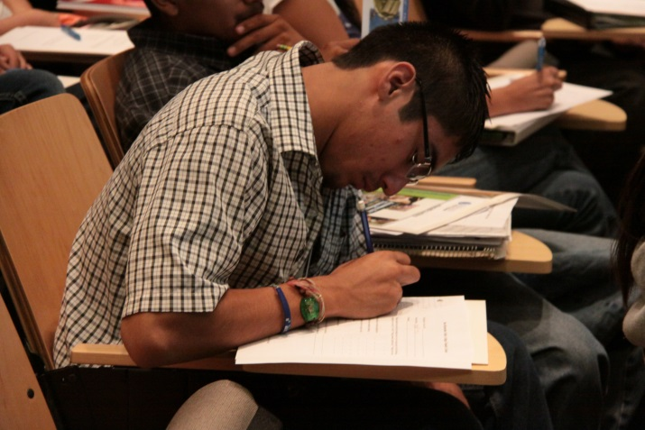
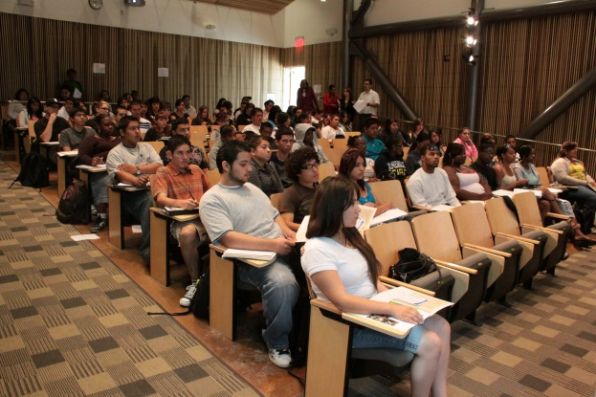
2009-2010

Slide 19
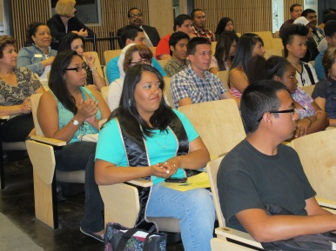
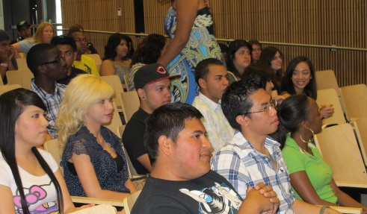
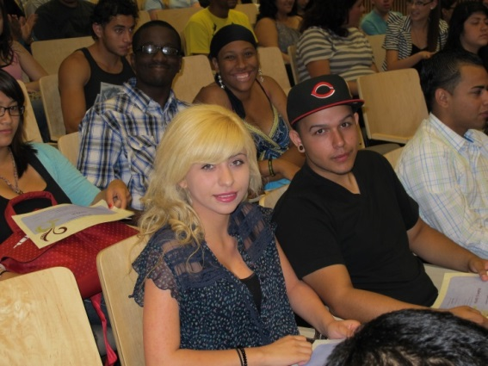
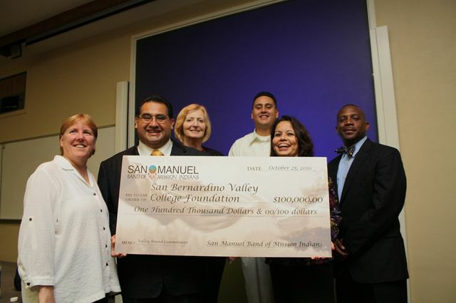
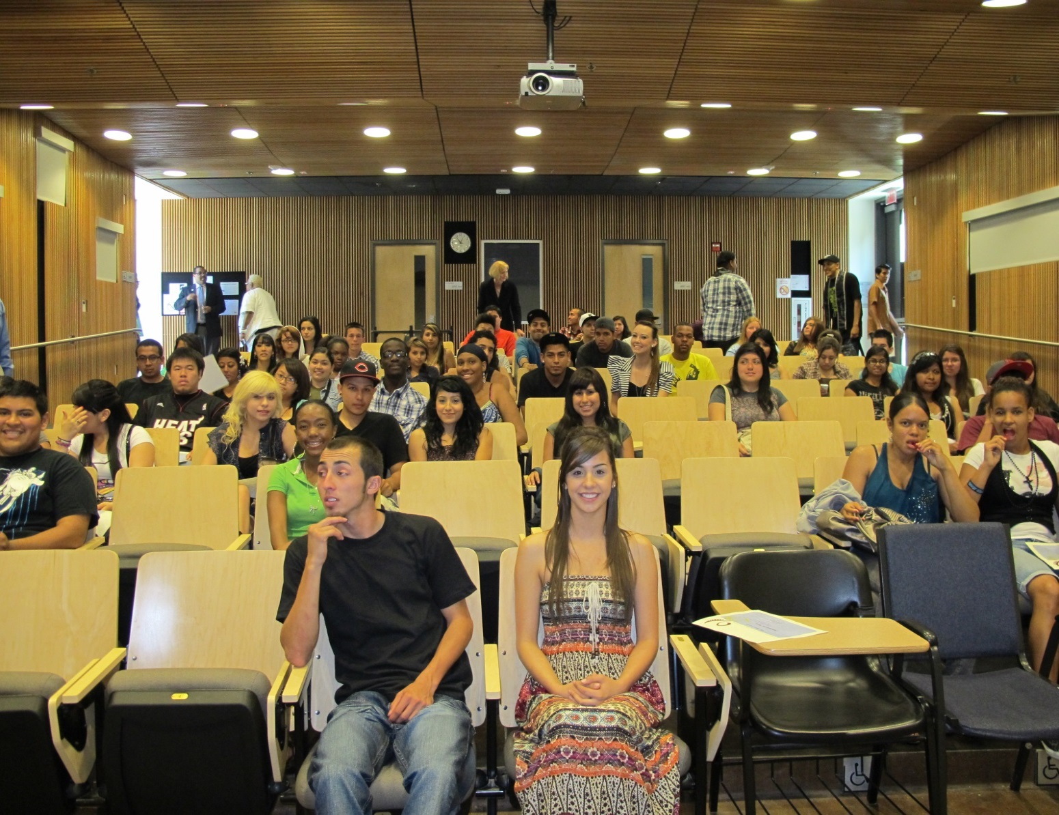
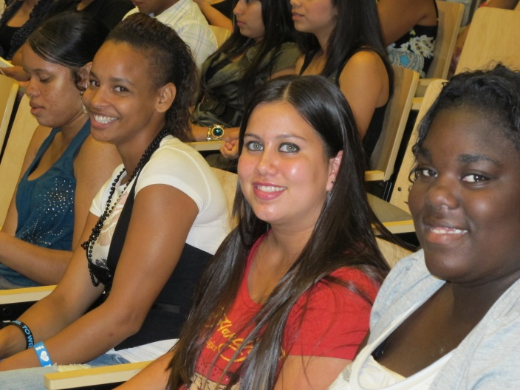
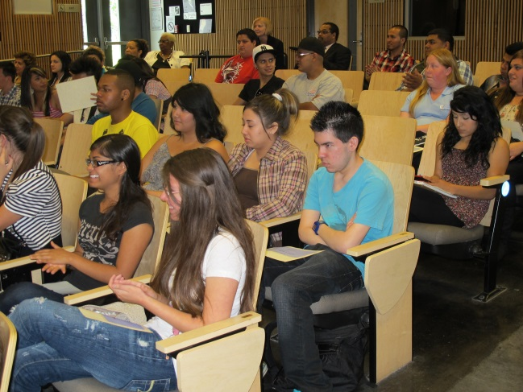
2010-
2011

Slide 20
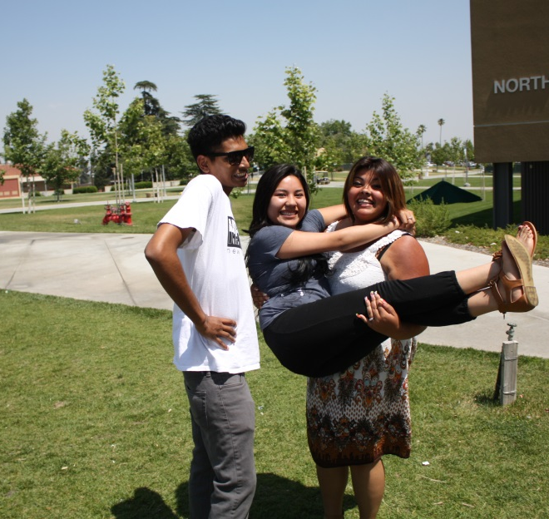
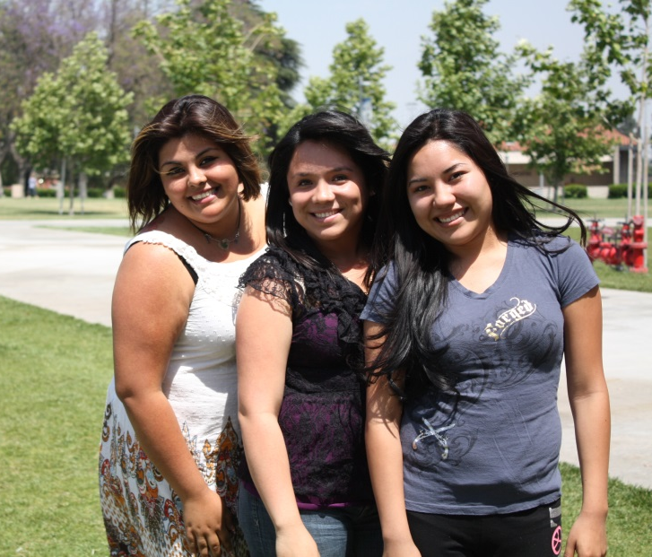
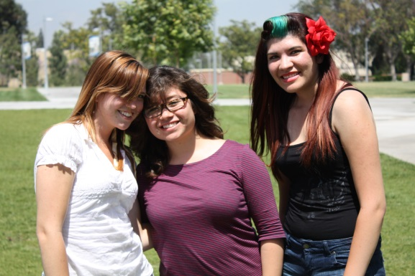
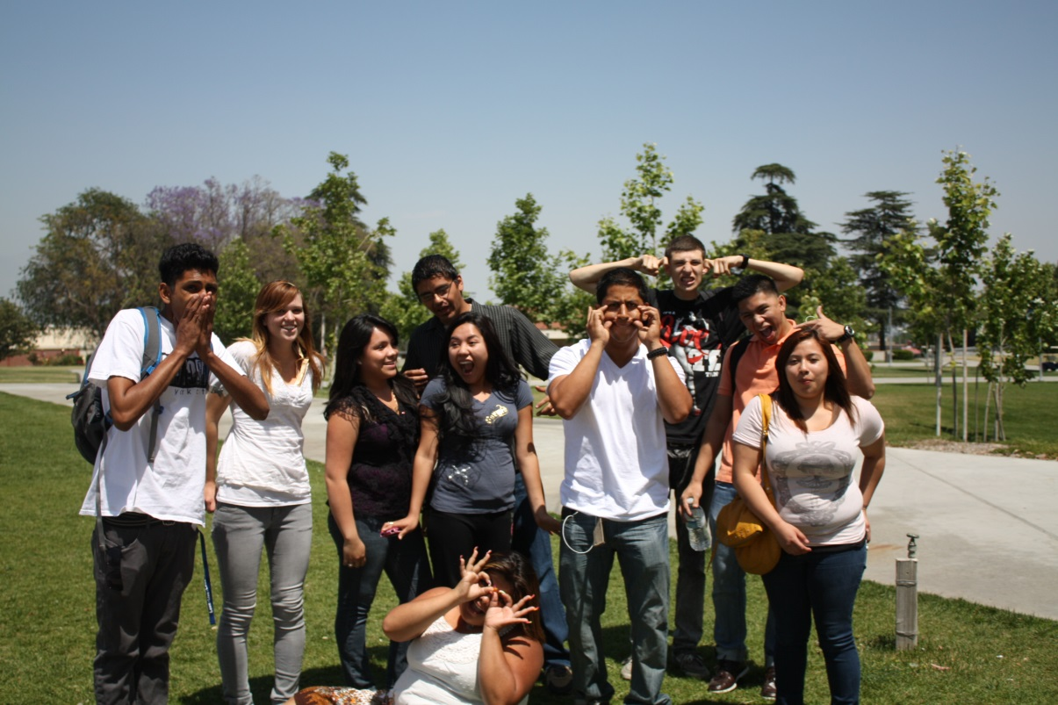
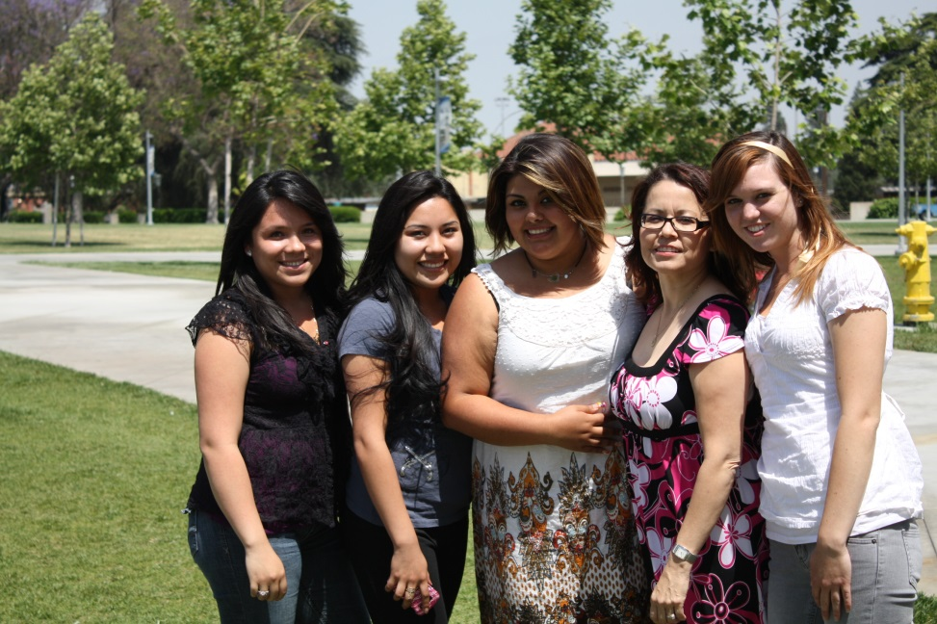
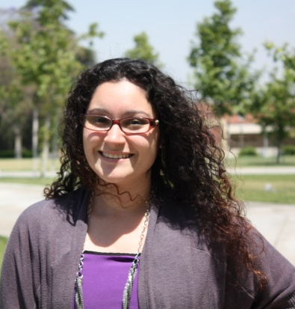
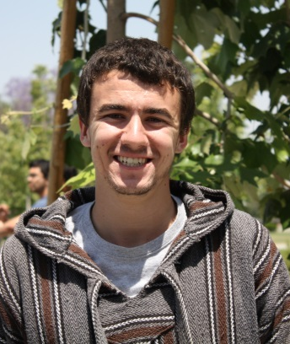
2011-
2012

Slide 21
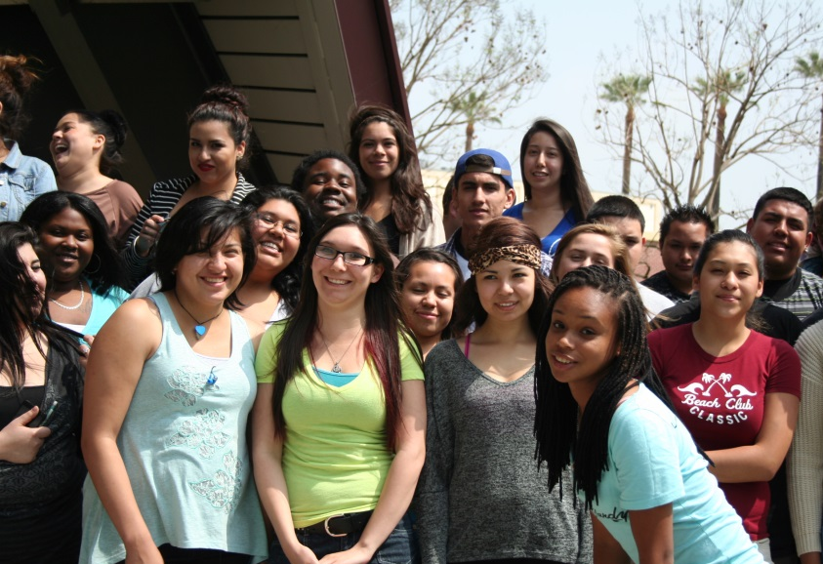
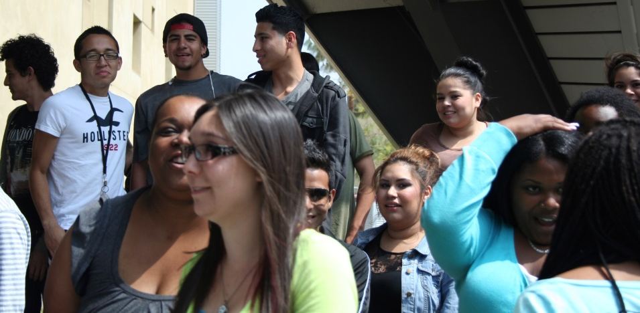
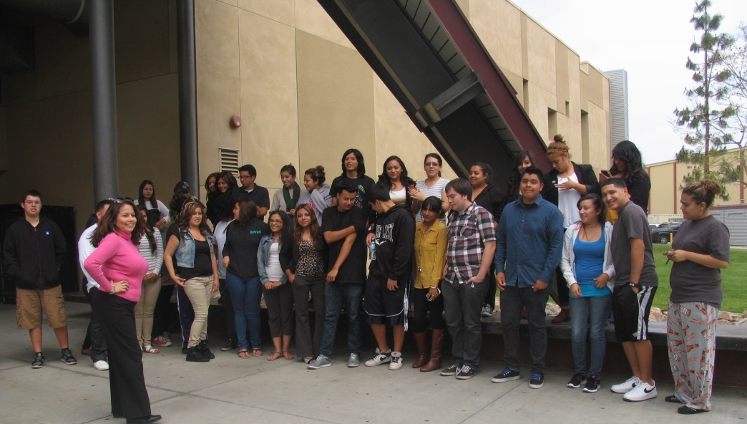
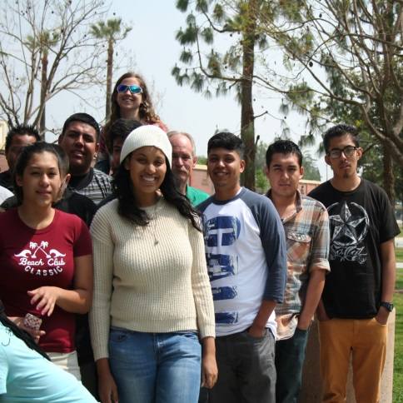
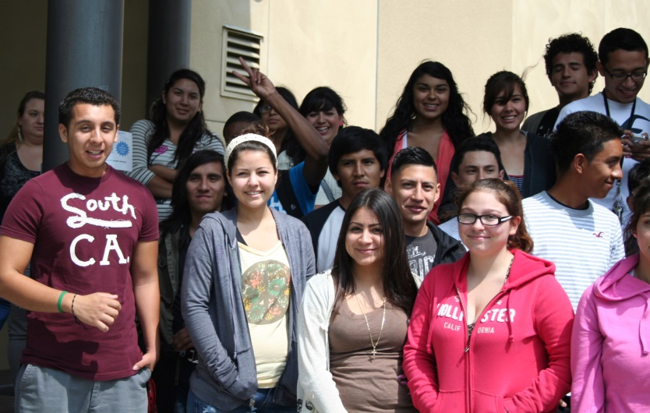
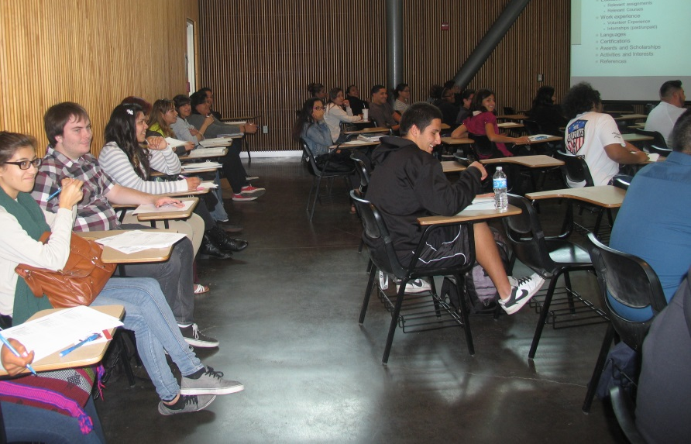
2012-
2013

Slide 22
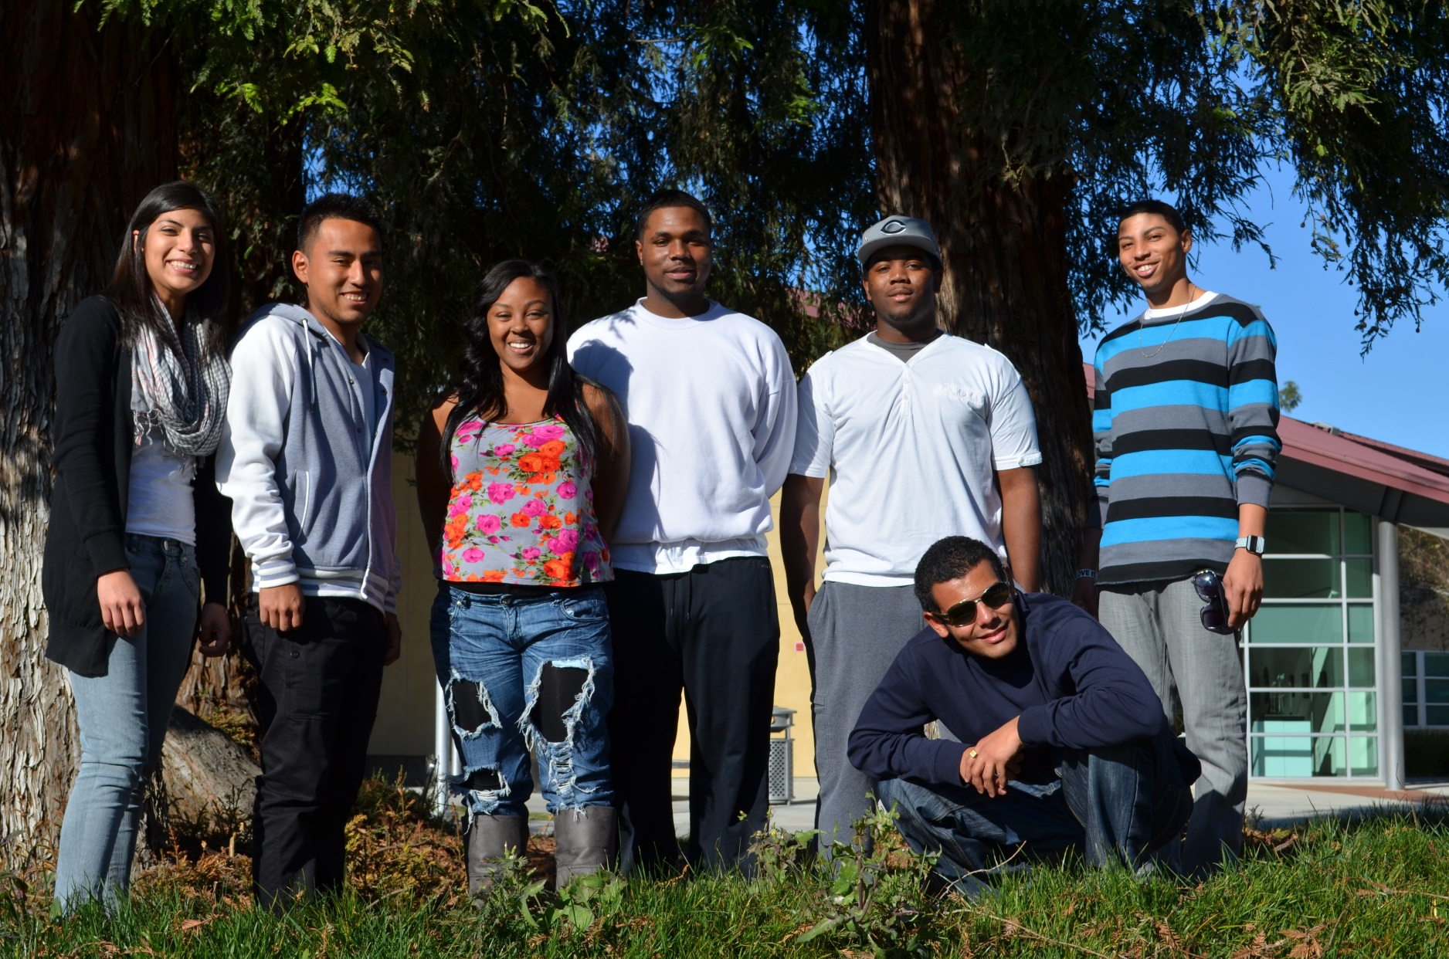

Slide 23
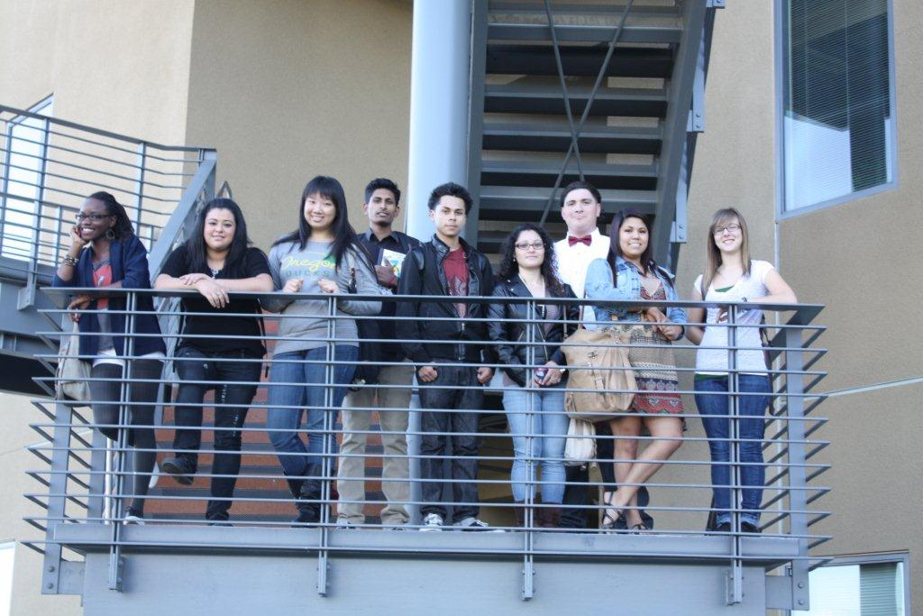

Slide 24
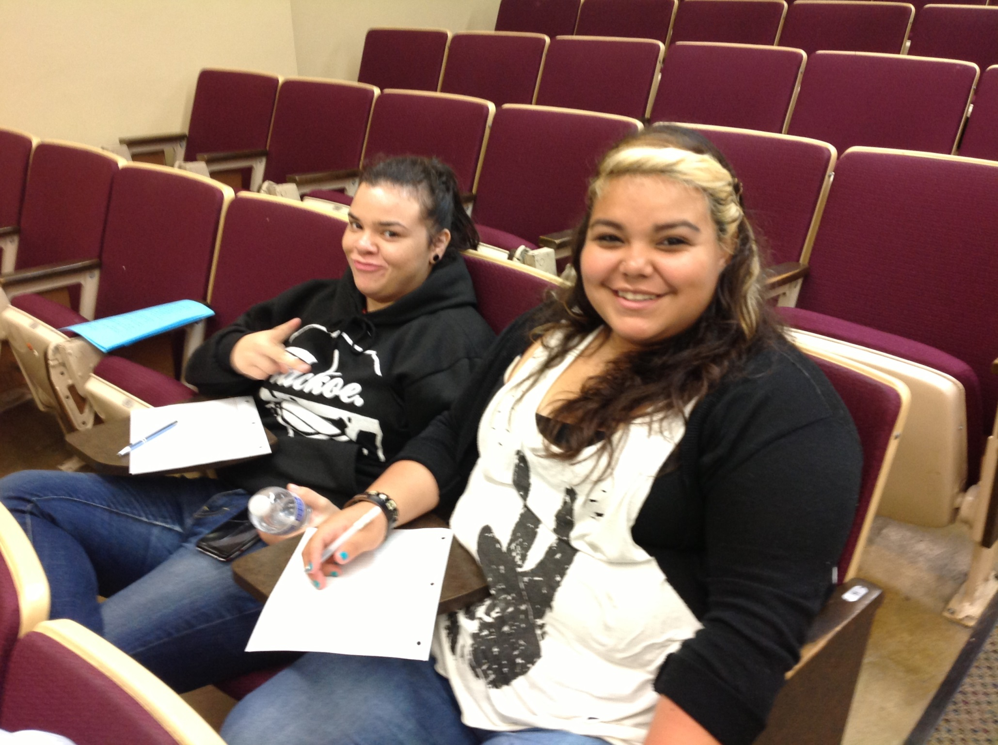

Slide 25
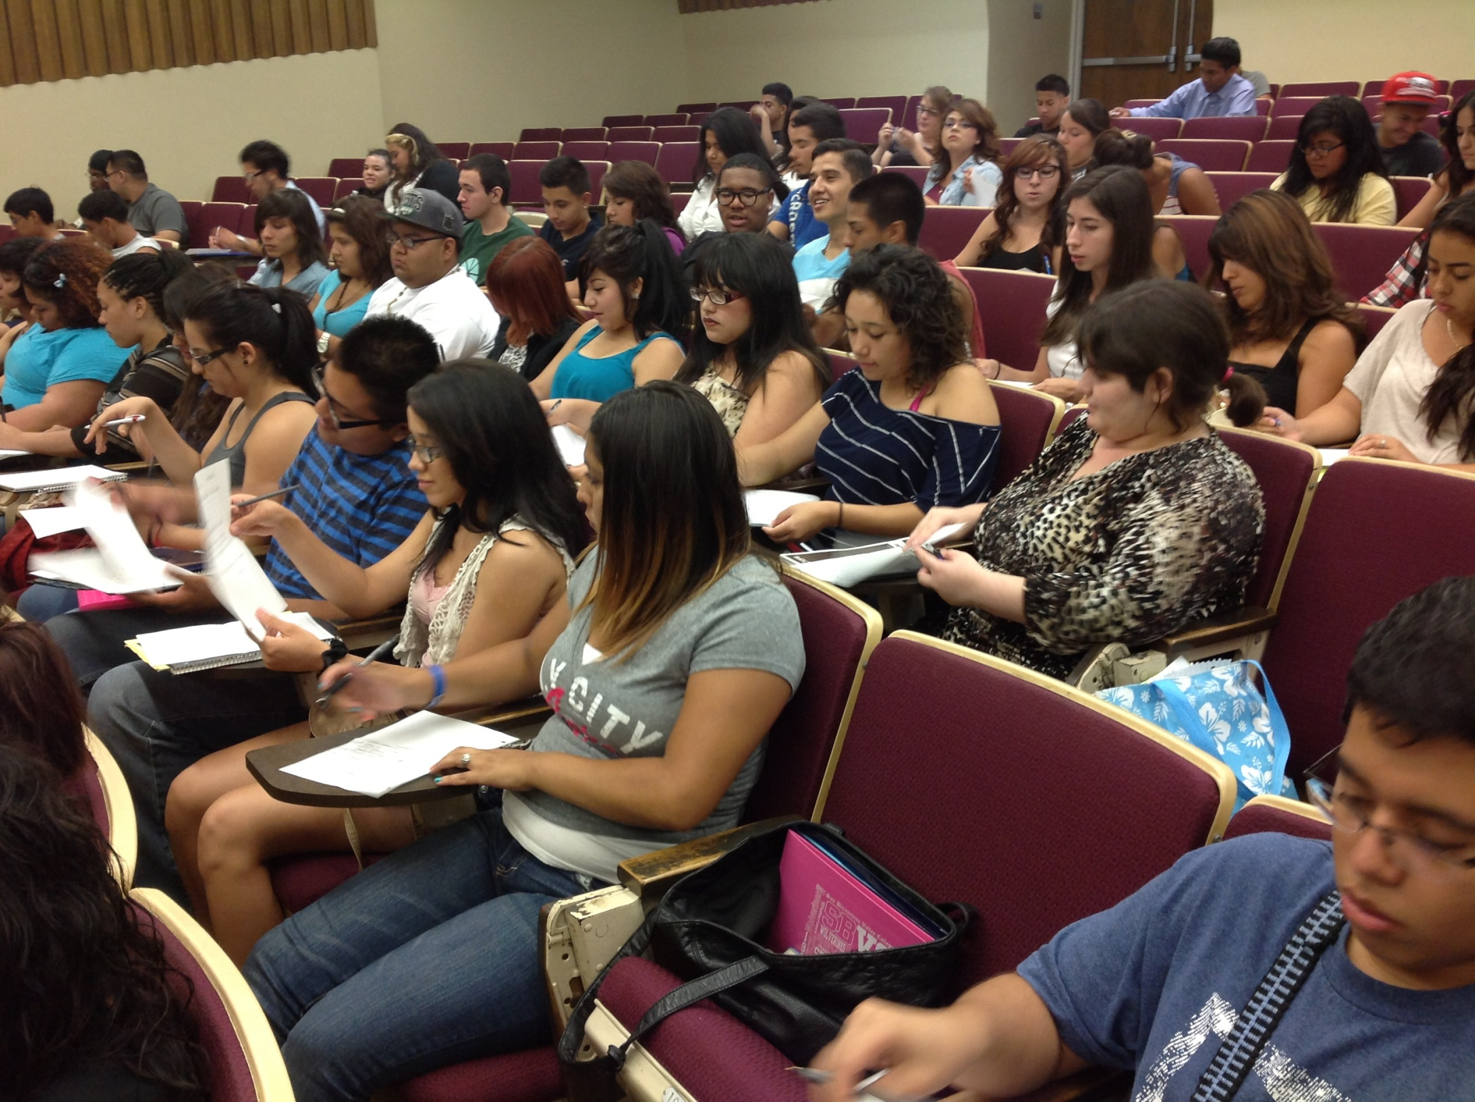

Slide 26
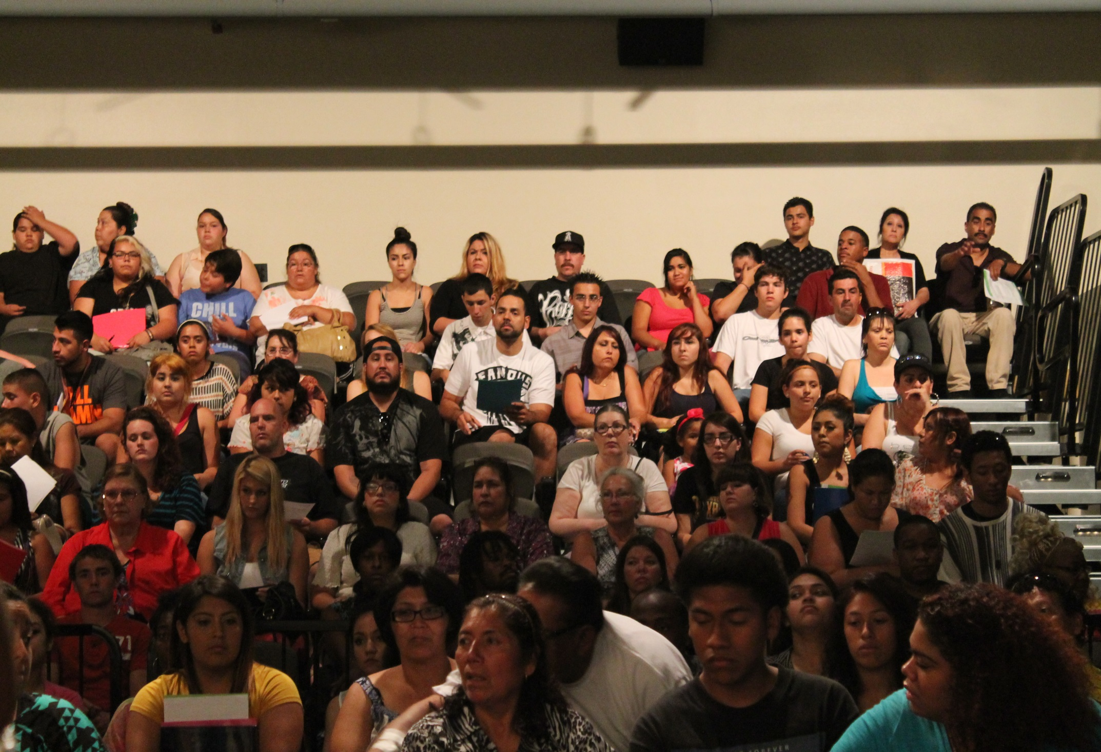

Slide 27
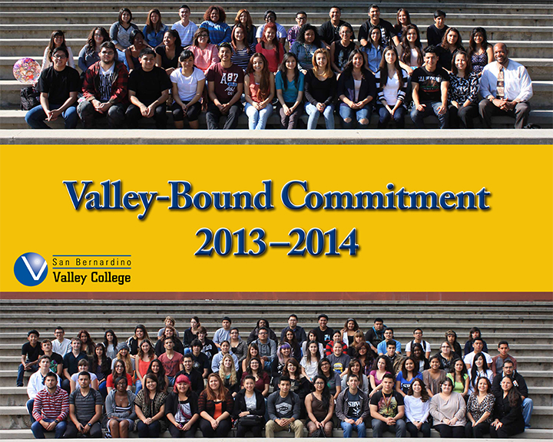

Slide 28
Thank you
SAN MANUEL BAND OF MISSION INDIANS
SAN BERNARDINO VALLEY COLLEGE
2014-2015 applications are being distributed

