Slide 1
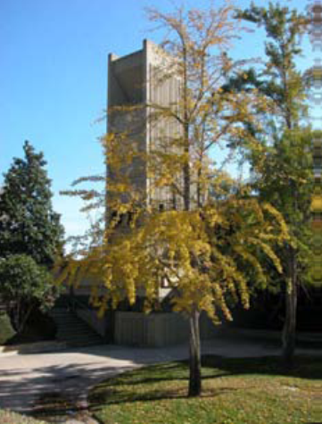
Transfer Center
CRAFTON HILLS COLLEGE
Mariana Moreno,
Transfer Center Coordinator

Slide 2
Crafton Hills College Vision
It takes a college to transfer a student
The vision of Crafton Hills College is to be the premier community college for public safety and health services careers and transfer preparation.

Slide 3
It takes a college to transfer a student
Title V/HSI “Transfer Prep” Grant
Title 5 Regulations, Section 51027, TC minimum program standards
Identify transfer students, specifically underrepresented
Ensure the provision of academic planning
Monitor the progress of students, to the point of transfer
To strengthen transfer resources and thus increase the capacity to transfer more students, specifically Hispanic and low income students.

Slide 4
Established Spring 2012
Located above the Cafeteria

Slide 5
Services
Over 50 workshops
Recruit universities
Educational Planning & Counseling
Classroom Presentations
College Fairs
Events
Transfer Guarantee Agreements
Faculty Transfer Advocate Program
Mobile Transfer Center

Slide 6
Transfer Center Activity Breakdown
2011-2012 | 2012-2013
Utilization of Transfer Center 753 contacts 403 walk-ins 199 workshop appointments 134 individual appointments | Utilization of Transfer Center 1771 contacts 831 walk-ins 440 workshop appointments 500 appointments
Classroom Presentations 24 classroom presentations | Classroom Presentations 19 classroom presentations
Transfer Fairs (Fall & Spring) 1411 student contacts reported | Transfer Fairs (Fall & Spring) 1966 student contacts reported
University visitors 11 dif. universities for tabling and individual appointments | University visitors 16 dif. universities for tabling and individual appointments

Slide 7
Utilization of the TC
It takes a college to transfer a student

Slide 8
Transfer Fairs
It takes a college to transfer a student
39 %
Notes:
1411
1966
Reps report “The best fair all year” or “one of the best fairs” with regards to student participation.

Slide 9
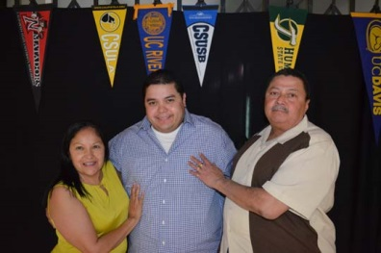
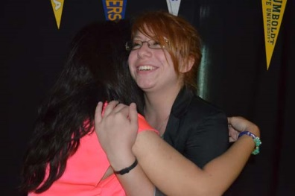
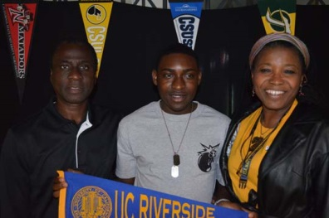
It takes a college to transfer a student

Slide 10
Student Presenters
Leonard Ledbetter, History
Spencer Wells, Business Administration
Anaiza Moreno, Communications & Psychology

