Slide 1
2014 STRATEGIC PLAN DEVELOPMENT

Slide 2
2014 Strategic Plan
STRATEGIC PLANNING IS A TEAM EFFORT
Board of Trustees
Chancellor’s Cabinet
DSPC
Colleges
District Office
Academic Senates
Faculty
Classified Staff
ALL
CONSTITUENCY
GROUPS

Slide 3
2014 Strategic Plan
2013-14 Committee Members: San Bernardino Valley College
Gloria Fisher | Interim President | SBVC
Algie Au | Faculty | SBVC Academic Senate
Greg Zerovnik | Public Information Officer | SBVC
James Smith | Research | SBVC
Jimmie Bradley | Student | SBVC
Laura Gowen | Classified Staff | SBVC
Rania Hamdy | Professional Development | SBVC

Slide 4
2014 Strategic Plan
2013-14 Committee Members: Crafton Hills College
Cheryl Marshall | President | CHC
Chris Robles | Student | CHC
Denise Allen Hoyt | Faculty | CHC Academic Senate
Donna Hoffmann | Public Information Officer | CHC
Keith Wurtz | Research | CHC
Robert Brown | Professional Development | CHC
Tina Gimple | Classified Staff | CHC

Slide 5
2014 Strategic Plan
2013-14 Committee Members: District Office, TESS, EDCT, KVCR
Bruce Baron | Chancellor | District
Tim Oliver | Interim Vice Chancellor FS | District
Amalia Perez | for Vice Chancellor HR | District
Glen Kuck | Assoc. Vice Chancellor | TESS
Deanna Trussell | for Exec Director, EDCT | EDCT
Lillian Vasquez | General Manager Appointee | KVCR
Barbara Nichols | Classified Staff | District Sites (KVCR)
Charlie Ng Strategic Plan Facilitator

Slide 6
2014 Strategic Plan

Slide 7
2014 Strategic Plan
Definition of Environmental Scan
An Environmental Scan is generally defined as a collection of strategic information about the College’s service area or external setting in which it functions.
Study of this external setting includes such factors as its resident population, community college students, businesses, competitive educational institutions, local and regional labor market, and local and regional economic context.

Slide 8
2014 Strategic Plan
Benefits of an Environmental Scan
Ability to better meet the College’s Economic Development Mission
Better informed with regard to the local and regional economies
Being more agile and market responsive in terms of curriculum planning
Identifying the location of current and future job markets
Identifying demand by highest growth and highest paying jobs
Help meet programmatic, grant, and State reporting requirements

Slide 9
2014 Strategic Plan
Benefits of an Environmental Scan
Help meet programmatic, grant, and State reporting requirements
Identifying opportunities for fee-based courses
Better identifying and targeting of potential student markets by population, age, ethnicity, educational attainment, etc.
Better identifying the competition (private and public institutions)
Compiling compelling data useful in competing for Federal Grants and execution of Bond Issue Campaigns
Identifying potential business partners for training programs

Slide 10
2014 Strategic Plan
Benefits of an Environmental Scan
Identifying small businesses (by employees and sales)
Conducting small area analysis at the zip code level
Comparing selected metrics of competitive community colleges
Providing baseline data for Strategic Reports
Providing baseline demographic information for diversity compliance

Slide 11
2014 Strategic Plan
Environmental Scan Components
Study Areas
Demographics
Educational Characteristics
Resident Labor Force
Community Colleges and Students – San Bernardino and Riverside Counties
Private Schools – Possible Competition
Establishments – San Bernardino and Riverside Counties
Jobs Projections by Industry
Jobs Projections by Occupation
Study Area District Fiscal Abstract Data
Success Scorecard
Sample Uses of Environmental Scan Data
Researching an Industry or Sector
Sample Analysis – Comparative Analysis- TOP Code – Health
Analysis by Geography
Appendix

Slide 12
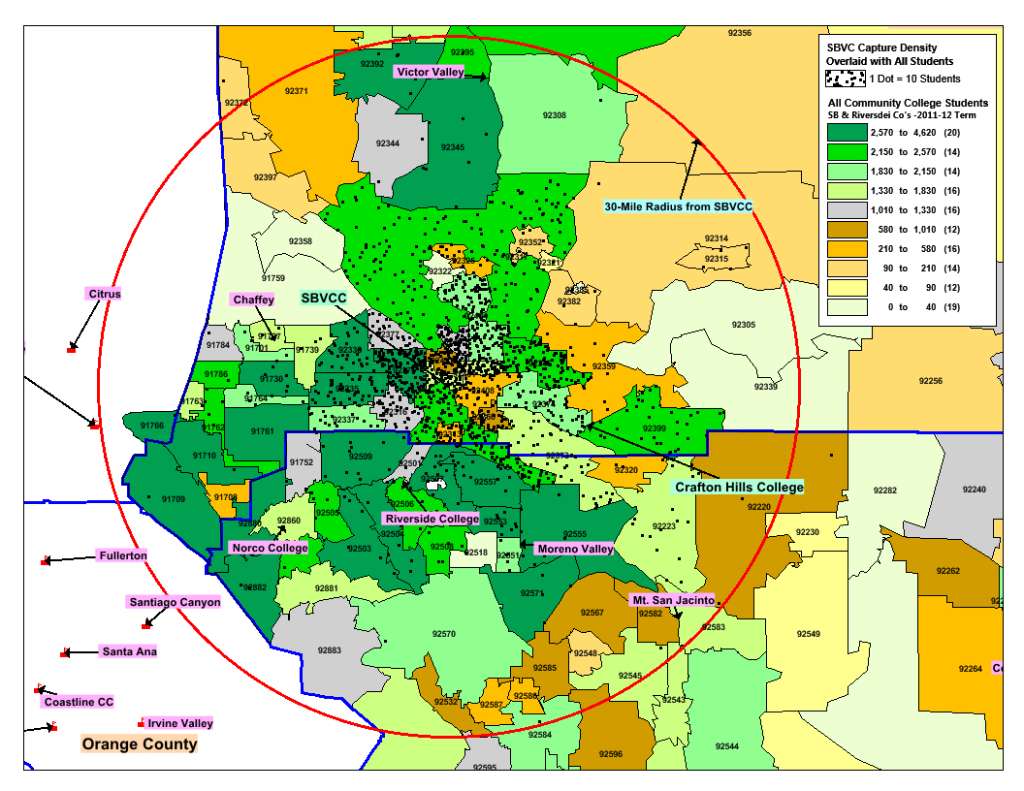
2014 Strategic Plan
Environmental Scan Example: SBVC Capture Rate by ZIP Code

Slide 13
2014 Strategic Plan
STRUCTURE
Mission
Vision
Values
Major Goals
Sub-Goals
Strategies
Addendum
Resources Necessary to Achieve Goals
Ethnic and Cultural Diversity

Slide 14
2014 Strategic Plan
Draft Mission
We transform lives through education of our students for the benefit of our diverse communities.

Slide 15
2014 Strategic Plan
Draft Vision
SBCCD will be most known for student success.
Our educational programs and services will be highly sought after.
Our students will be the most sought after by four-year institutions and employers.
Our transfer students will have the highest graduation rates at four- year institutions.
Our students will have the highest employment rates in our communities.

Slide 16
2014 Strategic Plan
Draft Vision (continued)
Our district will be the gateway to pathways and opportunities for a brighter future.
Our students and alumni will make the largest contribution to the economic prosperity of our communities.
Our employees will want to be here, love working here, and go above and beyond for student success.

Slide 17
2014 Strategic Plan
Draft Values
Service, Integrity, Collaboration,
Innovation, Quality

Slide 18
2014 Strategic Plan
MAJOR GOALS
Goal 1: Student Success
Provide the programs and services necessary to enable all students to achieve their educational and career goals.
Goal 2: Enrollment and Access
Increase access to higher education for growing populations in our region.

Slide 19
2014 Strategic Plan
MAJOR GOALS
Goal 3: Partnerships of Strategic Importance
Invest in strategic relationships and collaborate with partners in higher education, PK-12 education, business and workforce development, government, and other community organizations.
Goal 4: District Operational Systems
Improve the district systems to increase administrative and operational efficiency and effectiveness.

Slide 20
2014 Strategic Plan
Goal 1: Student Success
Provide the programs and services necessary to enable all students to achieve their educational and career goals.
GOAL 1.1
Increase student success while preserving access, enhancing quality, and eradicating attainment gaps associated with income, race, ethnicity, age, and gender.
Key Strategies (Examples)
Strategy 1: Decrease time to complete degree or certificate
Strategy 2: Improve student satisfaction/campus climate survey results
Strategy 3: Increase student engagement

Slide 21
2014 Strategic Plan
GOAL 1.2
Increase the number of students who complete developmental education programs and progress to successful completion of freshman-level courses.
Key Strategies: To be determined

Slide 22
2014 Strategic Plan
Goal 2: Enrollment and Access
Increase access to higher education for growing populations in our region.
GOAL 2.1
Increase our student population to improve the higher education participation rate and supply a well-equipped, educated workforce for our communities.
Key Strategies (Examples)
Strategy 1: Increase international student enrollment.
Strategy 2: Increase marketing and outreach activities

Slide 23
2014 Strategic Plan
GOAL 2.2
Provide transfer, career and technical, and developmental education access to meet student need.
Note: The outcome measures will be the percentage of students who have access to the transfer/CTE/developmental education that students need based on placement information.
Key Strategies (Examples)
Strategy 1: This should be reflective of emerging trends.
Strategy 2: Invest in (a determined) program (or discipline)

Slide 24
2014 Strategic Plan
GOAL 2.3
Enhance the public image of the San Bernardino Community College District.
Key Strategies (Examples)
Strategy 1: Utilize KVCR and EDCT as resources to enhance public image
Strategy 2: Assess public image (polling services), develop and implement plan based on assessment results

Slide 25
2014 Strategic Plan
GOAL 2.4
Increase awareness of San Bernardino Valley College and Crafton Hills College as viable higher education options.
Key Strategies (Examples)
Strategy 1: Easy access.
Strategy 2: Develop community college campaigns to showcase at local high schools

Slide 26
2014 Strategic Plan
GOAL 2.5
Strive to diversify our student and employee populations to be reflective of our communities.
Key Strategies (Examples)
Strategy 1: Market and outreach to student populations that are reflective of emerging trends

Slide 27
2014 Strategic Plan
Goal 3: Partnerships of Strategic Importance
Invest in strategic relationships and collaborate with partners in higher education, PK-12 education, business and workforce development, government, and other community organizations.
GOAL 3.1
Enhance existing and secure new higher education partnerships to improve student transfers rates.
Key Strategies
Strategy 1: Enhance developmental course curriculum.
Strategy 2: Create a consortium of higher education partners to focus on improving student transfer rates.

Slide 28
2014 Strategic Plan
GOAL 3.2
Enhance existing and secure new PK-12 partnerships to improve student pathways, increase awareness of SBVC and CHC as viable options for higher education, and enhance the image of the San Bernardino Community College District.
Key Strategies
Strategy 1: Enhance developmental course curriculum.
Strategy 2: Work with PK-12 partners to develop a communications campaign with the intent on sharing with local high school students and parents

Slide 29
2014 Strategic Plan
GOAL 3.3
Enhance existing and secure new business and workforce development partnerships for student internship opportunities, student pathways, incumbent worker training, and to enhance career and technical education course curriculum.
Key Strategies
Strategy 1: Work with industry partners with a history of utilizing student interns and develop internship opportunities for SBCCD students
Strategy 2: Develop an internship program template that makes it attractive for business partners to enter student interns into their workforce and market the program to local businesses

Slide 30
2014 Strategic Plan
GOAL 3.4
Enhance existing and secure new government and community partnerships to increase funding for improving student success, and increasing student access.
Key Strategies
Strategy 1: Partner with other local community colleges to advocate for community college funding
Strategy 2: Attempt to consistently have a representative from the district serve in state-level leadership roles (CCLC, ACBO, etc.)
Strategy 3: Work with lobby services (CCLC, SSC, etc.) to remain current on funding issues and to provide feedback to local and state government officials in pursuing funding opportunities

Slide 31
2014 Strategic Plan
Goal 4: District Operational Systems
Improve the district systems to increase administrative and operational efficiency and effectiveness.
GOAL 4.1
Improve the district systems to increase administrative and operational efficiency and effectiveness with an emphasis on student records, human resources, facilities, technology, financial systems, and other workflow operational systems.
Key Strategies
Strategy 1: Align policies.
Strategy 2: Conduct a business process analysis.
Strategy 3: Streamline procedures with the district’s strategic plan.
Strategy 4: Improve communications throughout the district.
Strategy 5: Integrate major enterprise resource programs.

Slide 32
2014 Strategic Plan
ADDENDUM
Resources Necessary to Achieve Strategic Goals
Examples:
Funding for Increased Access and Student Success
Increase the number of grants and contributions from foundations. (source: DSPC-opportunities)
Alignment of Budget Priorities with District Strategic Plan Resource Optimization

Slide 33
2014 Strategic Plan
ADDENDUM
Ethnic and Cultural Diversity
Examples:
SBCCD supports the inherent dignity of all individuals and celebrates their diversity.
We support the concepts of inclusiveness and equity for students and employees.
We extend the privileges of academic life to all by promoting the application of fair and ethical practices and policies.

