Slide 1
Accreditation
Snap Shot
An Accreditation Update to the Board of Trustees
4/24/14

Slide 2
Snapshot
Work on self-studies has continued since drafts were submitted to the Board
S.W.O.T Summary Report by Standard
  Campus Strengths
  Campus Weaknesses
  Opportunities: Current and Future
  Threats that could impact Accreditation
Self-Evaluation should be:
  Honest and Evidenced

Slide 3
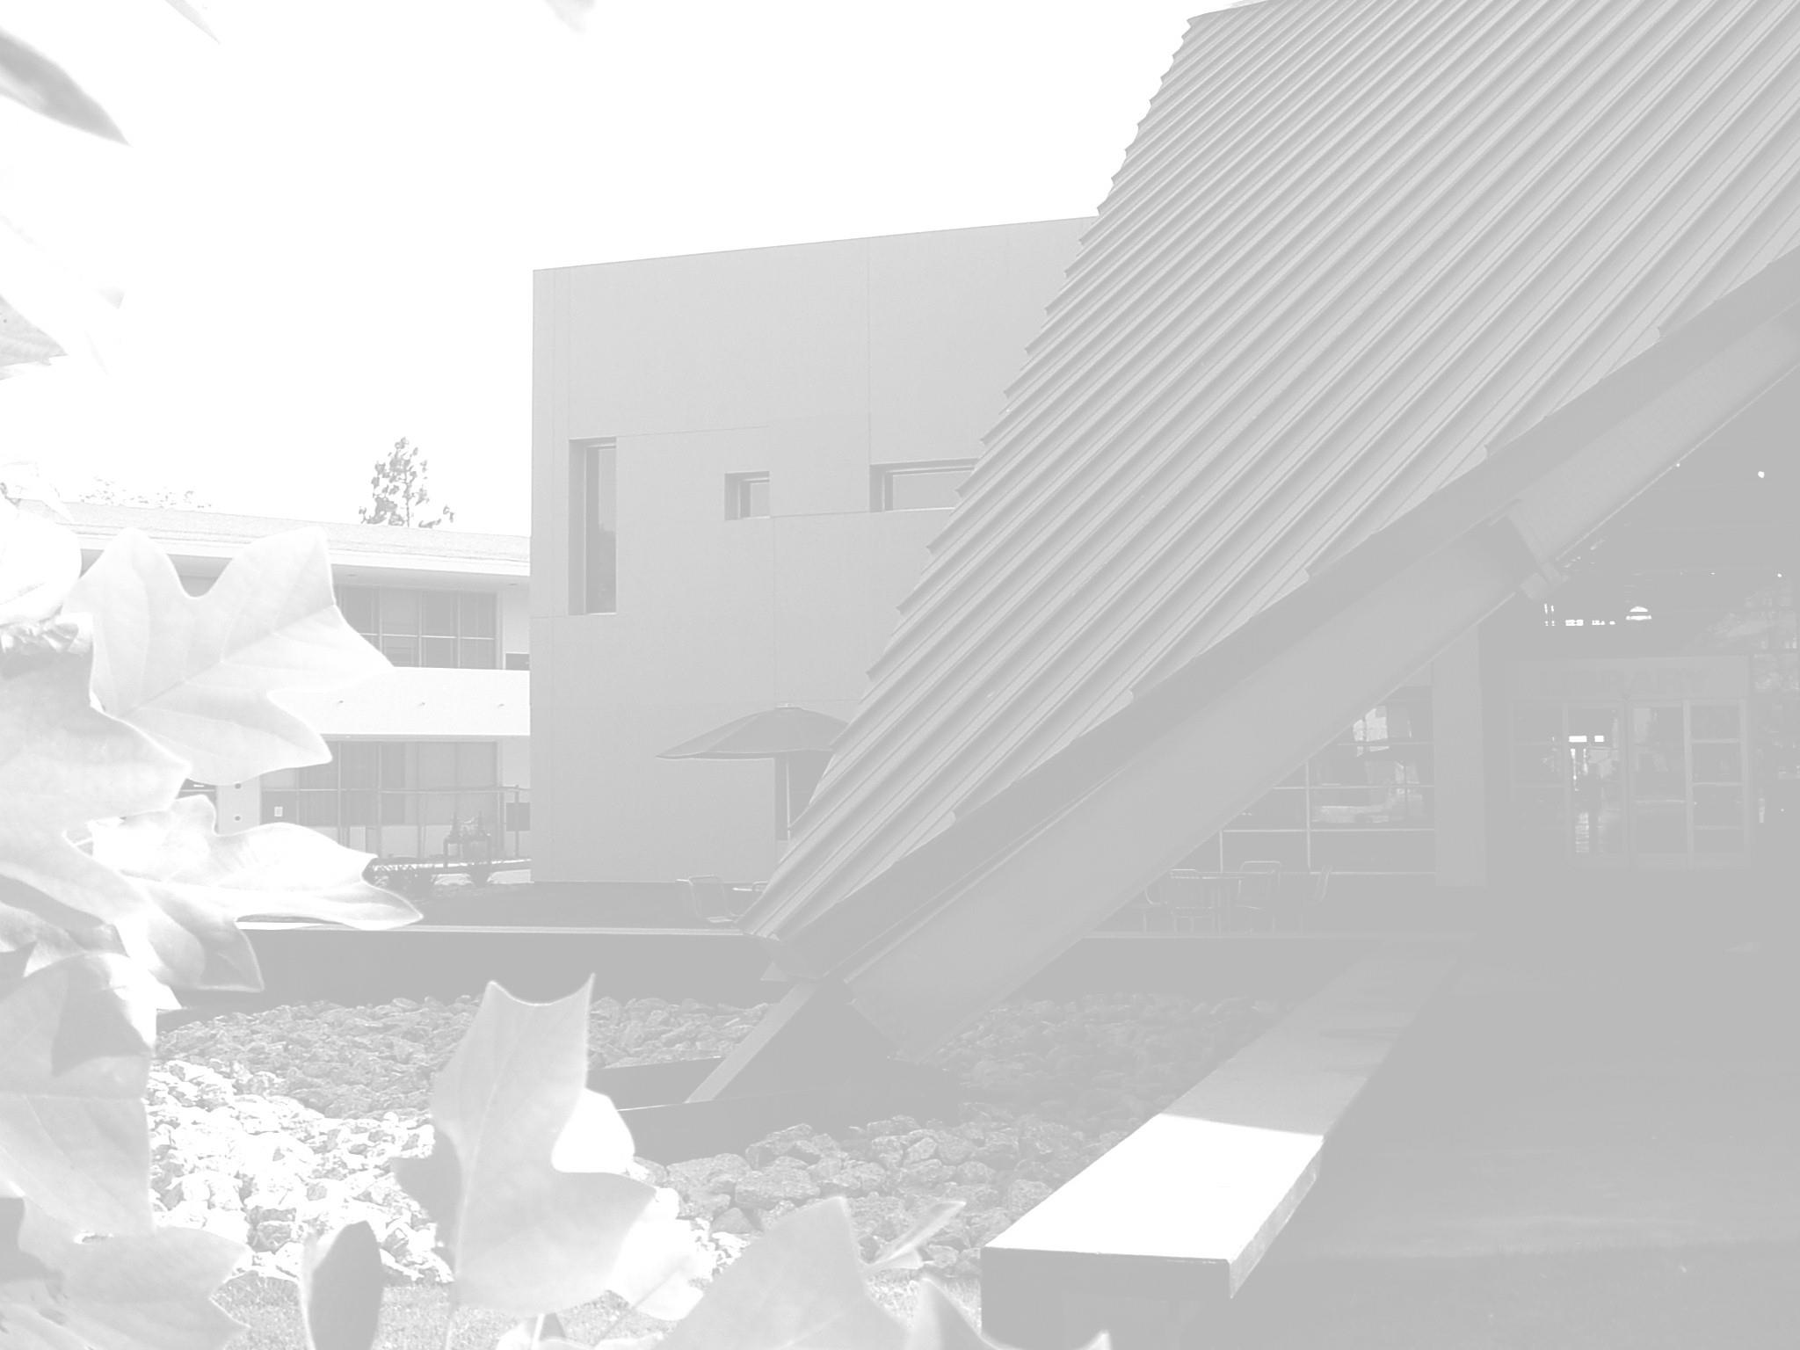
Standard I.A:
Missions
Strengths
  Mission is Board Approved
  Reviewed Annually
  Tied to all key planning processes
  Central to decision making
Weaknesses
  Learning Outcomes
Opportunities
  Included Mission in Budget Charge
Threats

Slide 4
Standard 1.B
Improving Institutional Effectiveness
Strengths
  Dialogue
  Goals
  Planning Cycles
    Budgeting of resources follows planning
  Integrated Planning
  Assessment and Reporting
Weaknesses
  Campus Climate Surveys indicate decreasing familiarity with and participation in campus planning processes and goals
Weaknesses
Threats

Slide 5
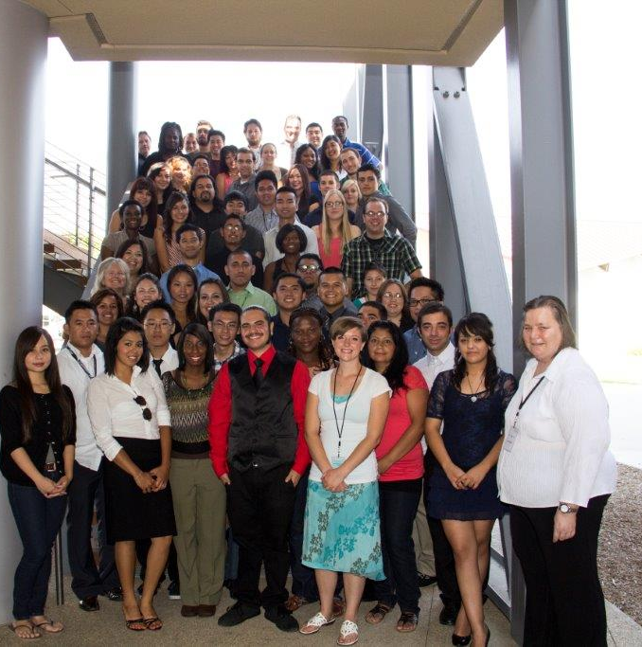
Standard 1.B
Improving Institutional Effectiveness
Strengths
Weaknesses
Opportunities
  SBVC Governance Handbook
  SBVC Communication Flowchart
Threats
  Underlying Cause for decreasing satisfaction and confidence
    High Turnover in Administration
    Disproportionate reduction = increased responsibility
    Fewer responses

Slide 6
2009 Recommendations from ACCJC
Integrated Planning, QEIs, Long-Term Resource Allocation
Data Reliability, Access, Training
Assessment of SLOs
Evaluation of Administrative and Governance Functions
Improving Communication
Participation in Decision-Making and Planning
District-Level Program Review and Planning
Program Review and Distributed Education
Long-Term Fiscal Plans and Financial InformationDistrict
Commission Recommendation: Resource Allocation Process

Slide 7

Standard IA, Mission
Strengths
  Mission is linked with EMP, PPR, DSP, Left Lane, Student Success Plan, Enrollment Management Plan, and many others
  Mission is continuously reviewed
    Currently under revision
    Dialogue and input are ongoing

Slide 8
Standard IB, Institutional Effectiveness
Strengths
  Learning and effectiveness is assessed at all levels
    Course
    Program
    Institution
  Dialogue is robust and ongoing
  Mission and EMP under revision
  Alignment with district plans and imperatives
  Progress toward goals is assessed; results are used for institutional improvement
  The results of assessment are readily accessible
  We improve our planning, evaluation, and resource allocation cycle each year

Slide 9
Standard I A and B: Mission and Institutional Effectiveness
Weaknesses
  None
Opportunities
  Further develop the assessment infrastructure
Threats
  None

Slide 10
Standard II.A
Instruction
Strengths
  The Big Three
    Curriculum
    Program Review
    Learning Outcomes
  Distance Education and Substantive Change
Opportunities
Weaknesses
Threats

Slide 11
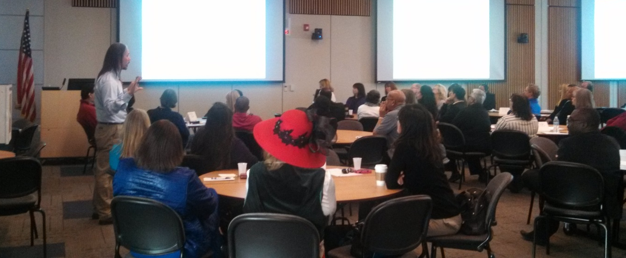
Standard II.A Instruction
Weaknesses
  Learning Outcomes
Opportunities
  Learning Outcomes
Threats
  Learning Outcomes

Slide 12
PROGRESS
Outcomes | Identified | Assessment | ACCJC Expectation | Progress Fall 2013
Courses | 98% | 71% | 75% | 85%
Programs (Degrees & Certificates) | 98% | 2.9% | 85% | 20%
Institutional | 100% | 100% | 75% | Evaluated
FALL 2012 REPORT: LEARNING OUTCOMES IDENTIFIED & ASSESS and
ACCJC EXPECTATIONS

Slide 13
Standard II.B
Strengths
  Student Success & Support Program Committee
  Higher Persistence Rates
  Veterans Resource Center
  Learning Communities
  Comprehensive Array of Services
Weaknesses
Opportunities
Threats

Slide 14
Standard II.B
Strength
Weaknesses
  High ratio of students per counselor
  Number of Vacant Manager and Classified Positions
Opportunities
  Welcome Center
  Learning Compass/ASSETS
  Services Learning
  Student Success & Support Action Plan
  Guardian Scholar/Foster Youth
Threats

Slide 15
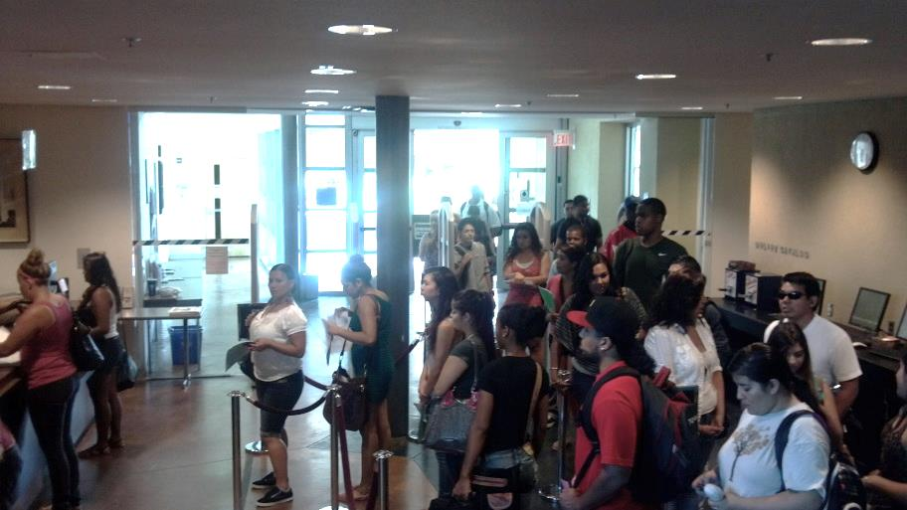
Standard II.C
Library and Learning Support
Strengths
  Wide range of Learning Support Services
  Library Collection supports curriculum
  Supportive of DE
  Supplemental Instruction
  Committed Faculty and Staff
Weaknesses
  Access
    Fewer Hours
    Understaffed
    Underfunded
    Library Operates on Overtime
Opportunities
Threats

Slide 16
Standard II.C
Library and Learning Support
Strengths
Weaknesses
Opportunities
  SAO Assessment
  Basic Skills Partnership
Threats
  Loss of Dean of Library & Learning Support & Director of D.S.P.&S.
    Administrative Contracts not renewed
    No Collegial Consultation Reorganization
      Positions Downgraded
      Division Dissolved

Slide 17
Standard IIA, Instruction
Strengths
  Planning
  Increasing Faculty Input/Engagement
Weaknesses
  Distance Education plan is out of date
  Assessment in specified courses/programs
Opportunities
  Evaluate Distance Education Courses
  Ensure services support DE students
  Reach 85% of assessed courses by Fall 2014
Threats
  None

Slide 18
Standard IIB, Student Support Services
Strengths
  Information and services in a variety of formats
  Assessment of effectiveness and continuous improvement
  Alignment between unit, institution plans
Weaknesses
  Degree audit and student education planning in progress
  Online counseling not developed
Opportunities
  Implement critical web tools
  Develop online counseling services
Threats
  None
Notes:
Online orientation
Online and print catalog
Financial aid online
Social media
Parking online
Transcript requests

Slide 19
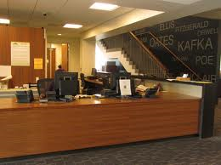
Standard IIC, Library, Learning Resources
Strengths
  Broad range of books and materials
  Information is accessible
  Effectiveness is assessed in Tutoring and Library
  Tutoring services meet student needs
Weaknesses
  Staffing, Library
Opportunities
    Increase access to library service (IIC1.c)
Threats
  None

Slide 20
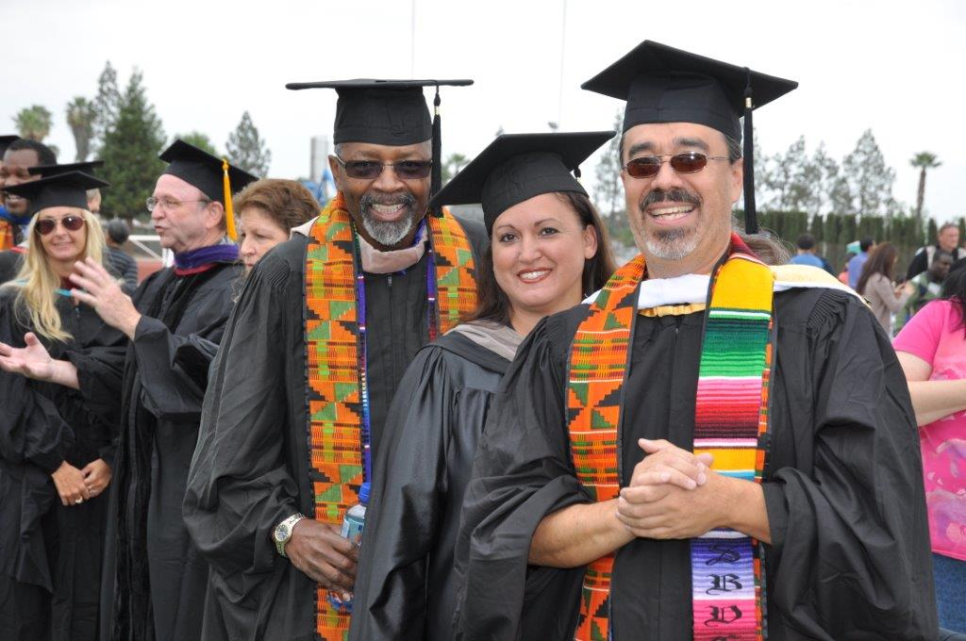
Standard III.A: Human Resources
Strengths
  Quality of Staff and Faculty
  Professional Development
  Needs Assessment
  MOU for SLOs
  Ethics Statements
  Equity & Diversity
Weaknesses
Opportunities
Threats

Slide 21
Standard III.A
Strengths
Weaknesses
  No Approved HR Handbook
  Long Range Human Resources Plan
  Past Practice vs. Administrative Procedure
  Board Policy vs. Administrative Procedure
  Website or Forms often out of date
Opportunities
Threats
  Evaluation of Administrators & Managers
  Disproportional Reduction of Staff, Faculty & Managers
  High number of interims
  Spring 2013 Student Services Terminations
  Fair Hiring Practices
There is Evidence
Honest Evaluation

Slide 22
Standard III.A
Strengths
Weaknesses
Opportunities
  Take Action on Hayes Report
  Fill Vacancies
  BP/AP Are Open Address:
    Evaluation of Interim Managers
    Institutionalize Past Practices
    Clear up contradictions between BP & AP
  Approve HR Handbook
  Complete Long Range Hiring Plan
Threats

Slide 23
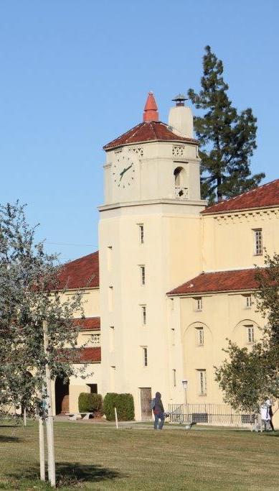
Standard III.B
Strengths
  Campus has Long-Range Plan
  and Budget for Facilities
  Maintenance and Equipment
  Replacement
  Facilities and Safety Committee
  Facilities Needs Incorporated
  into Program Review
Weaknesses
  Inability to Sell More Bonds
  has Slowed or Delayed
  Needed Construction
Opportunities
Threats

Slide 24
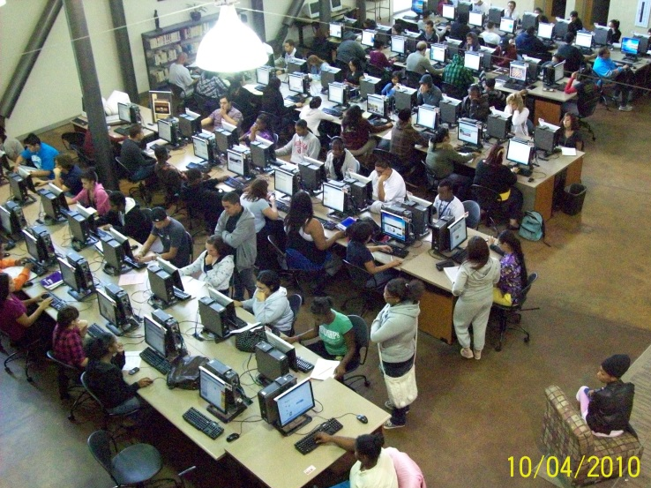
Standard III.C
Strengths
  Established Campus Technology Services
  Technology Plan Integrated with Campus and District Planning
  Budgeted Technology Replacement Rotation
Weaknesses
Opportunities
  Better Utilization of Campus Labs
Threats

Slide 25
Standard III.D
Strengths
  Revitalization of the Budget Committee as a Shared Governance Committees
  College Brain Trust Report
  Needs Assessment Process
Weaknesses
  No Funding for Growth Positions
  Floating Split replacing 70/30 Split
Opportunities
  Fund Balance for One-Time Funding
  FTEs Growth
Threats
  Economy

Slide 26
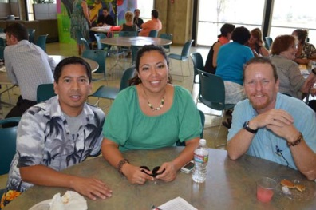
Standard IIIA, Human Resources
Strengths
  Policies and procedures
  HR treats applicants fairly
  Sensitive information is kept confidential
  Faculty participate in the selection of faculty
  Personnel are evaluated timely
  Reflection about assessment included in faculty evaluation (SLO MOU)
  Codes of ethics—managers, staff, faculty, board

Slide 27
Standard IIIA, Human Resources
Weaknesses
  Outdated Long Range Hiring Plan
  Evaluation tools not updated (SLO MOU)
Opportunities
  Analyze organizational problems and address
  Hay Group, Inc. study; feasibility determination
Threats
  Adequacy of funding to support salary increase

Slide 28
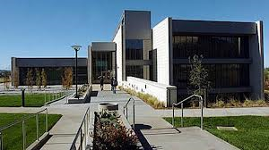
Standard IIIB, Physical Resources
Strengths
  Facilities Master Plan
    building, infrastructure, & site improvements
  Safety training
  Compliance with applicable laws and regulations
  Energy management
  Construction and Construction standards
  Facility assessment
Weaknesses
  Funding for all construction/renovation needs
  Operational funding to support facilities
  Improved utilization and coordination of space

Slide 29
Standard IIIB, Physical Resources
Opportunities
  Expansion of facilities to accommodate growth
  Continued implementation of sustainability and energy management initiatives
  Integration of total cost of ownership projections into financial planning
  Implementation of Colleague (Resource 25)
Threats
  Funding limitations
  Aging buildings and systems

Slide 30
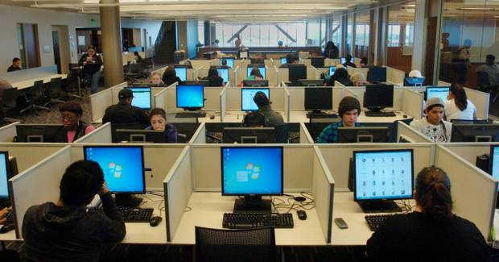
Standard IIIC, Technology Resources
Strengths
  Strong district/college infrastructure
  Technology supports teaching, learning, service
  Training at site and district levels
  Replacement and maintenance plans
  Alignment of plans
Weaknesses
  DE plan out of date
Opportunities
  Update DE plan, align with EMP
Threats
  None

Slide 31
Standard IIID, Fiscal Resources
Strengths
  Resource allocation is integrated with planning
  FMP is aligned with the EMP
  Five-year budget projections
  Healthy District reserve
  Grant funding supports comprehensive college
  Compliance with federal and state requirements
  Allocation model includes liabilities and future obligations
  Rigorous dialogue and opportunities for input

Slide 32
Standard IIID, Fiscal Resources
Weaknesses
  History of deficit spending
  High fixed costs (as a small college)
  Increasing capacity without a firm growth model in place
  OPEB obligations (District)
  Weak position control (District)
  Integrated facilities planning and resource allocation
  DSP does not always inform campus directions

Slide 33
Standard IIID, Fiscal Services
Opportunities
  Address inefficiencies
  Develop a district strategy for growth
  Continued support for comprehensive college components
  Strengthening and development of partnerships
  Align resource allocation to the growth strategy
  Multi-year fiscal planning
Threats
  State budget volatility

Slide 34
Standard IV.A
Strengths
  Collegial Governance
  Integrated Plans & Processes
  Institutional Evaluation and Review
Weaknesses
  Campus Climate Surveys indicated decreasing familiarity and confidence in campus planning
Opportunities
  Raise moral
  Increase Transparency
Threats

Slide 35
Standard IVA, Leadership
Strengths
  Leadership is promoted at all levels of the institution
  Written policy for participation in decision-making
  Defined roles in governance
  Appropriate bodies make recommendations about learning programs
  Responsiveness to Commission recommendations
  Honesty and integrity

Slide 36
Standard IV.B.1: Board and Administrative Organization
Strengths
  Policies and Procedures
  Goals and Imperatives
  Institution-Set Standards
  Board Self-Review
  Clearly Defined Roles
Weaknesses
  BP and AP updates
  Consistency: Deviation for 2045
  Decision Making Without Consultation: AB955
Opportunities
  Hays Group Salary Report
  College Brain Trust Study
  CCLC Consultant Developing Review Cycle
Threats
  Chancellor’s Evaluation

Slide 37
IV.B.2.: Board and Administrative Organization
Strengths
  Long-term interim with long history @ SBVC
  College Council
  Campus has strong Academic and Classified Senates
  Core Plans & Processes are stable and functioning
Weaknesses
  Unable to hire and retain a permanent President.
  32 months, 2 Failed Searches & 3 Interims since last permanent President
Opportunities
  Hays Group Salary Report could lead to a pay scale increase
Threats
  Number of Interims have limited long-term campus planning and decision making

Slide 38
Standard IVB.2., Board and Administrative Organization
Strengths
  President has responsibility for the college
    Guides improvement, evaluation, resource planning and distribution, and evaluates systems
    Communicates effectively
    Delegates appropriately
    Consults collegially
Weaknesses
  None
Opportunities
  None
Threats
  None

Slide 39
IV.B.3. Board and Administrative Organization
Strengths
  District Strategic Plan
    Linked to Board Imperatives
  District Program Review
  AP 2225
  District Assembly
  AP 2045: Process Chart
Weaknesses
  Resource Allocation Model
  Multi-Year Budget Planning
  Financial 2000
  District Assessment
Opportunities
  College Brian Trust Report
Threats

Slide 40
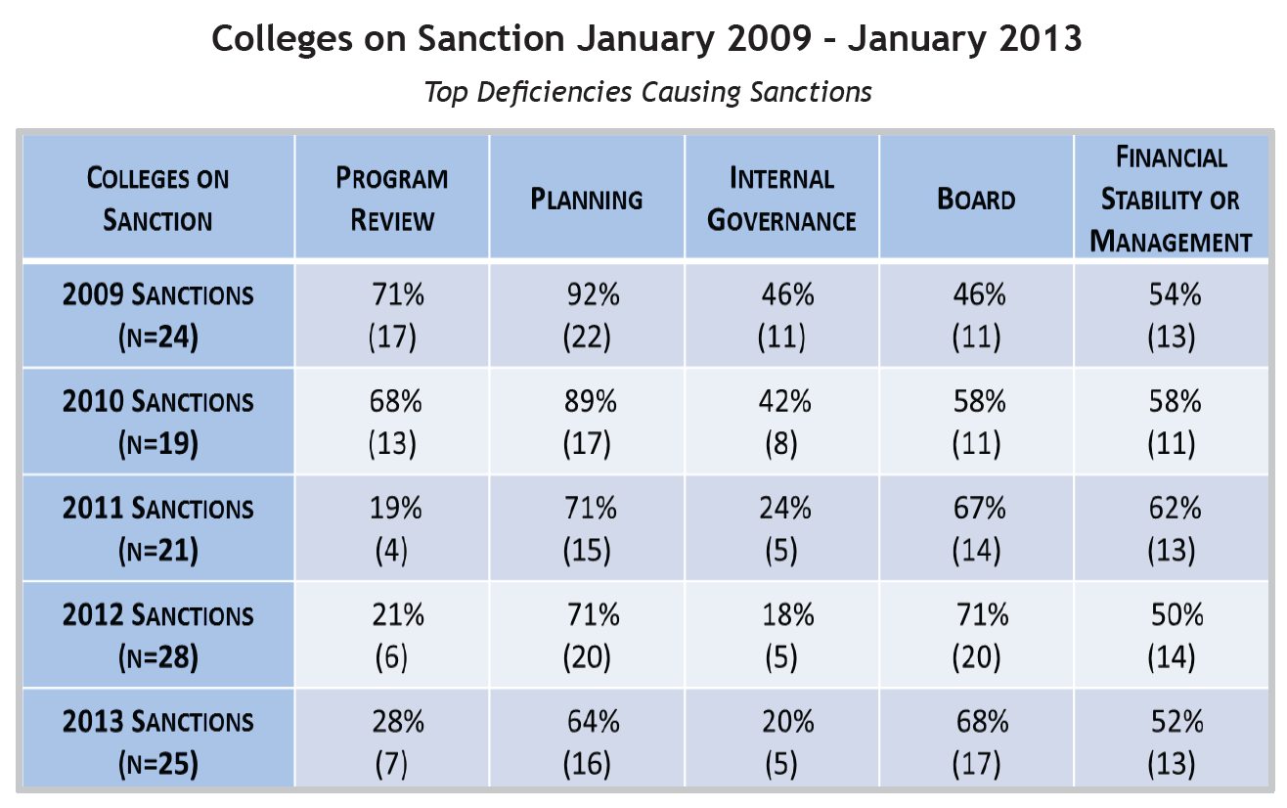
Red Flags
ACCJC Sanctions

Slide 41
Internal Governance
Two failed presidential searches and the number of interim managers, VPs & Presidents over the last several years will be a red flag. The District has also experienced high turnover of classified staff and has a number of interim management positions.
The lack of a process to evaluate Interim Managers needs to be addressed. AP 7251 is currently being reviewed and an evaluation process should be included.
2013 non-renewal of 4 permanent managers contracts in Student Services further destabilized leadership at a time when the President and all VPs were interim.
  Managers positions were down graded and division/departments reorganized without observing collegial processes.

Slide 42
BOARD
ACCJC will need evidence that the Chancellor evaluations are current and conducted according to AP.

Slide 43
Financial Stability
While the District is financially stable the college still have financial needs.
College Brain Trust Report helps to document budgeting processes.
Hay Group, Inc. Report: The commitment to a more equitable pay scale can be leveraged to demonstrate District commitment to hiring and retaining quality administrators, faculty and staff.

Slide 44
Crucial Issues
Irregularities in HR hiring and evaluation processes
College Brain Trust Report: Position Control Numbers
High number of vacancies across campus
Caution
Human Resources Standard Operation Procedures Manual – 2011 is not yet approved
Long Range Staffing Plan not updated, currently being completed College Brain Trust
Institution Set-Standards
Program SLO Assessment

Slide 45
Commission Actions
Reaffirm Accreditation
Reaffirm Accreditation and Request Two-Year Follow-Up Report
Reaffirm Accreditation and Request a Follow Report with a Visit
Defer reaffirmation of Accreditation
Issue Warning
Impose Probation
Order Show Cause
Terminate Accreditation

