Slide 1
Resource Development and Grants
August 14, 2014
Karen Childers
Director, Resource Development and Grants
Crafton Hills College
kchilder@craftonhills.edu
(909) 389-3392

Slide 2
Background
2005: Title V Coop grant with SBVC established Resource Development Office
2011: Title V Individual grant established Grants Office
Resource Development and Grants merged in 2012
Staffing:
Director, Resource Development and Grants
Assistant Director, Resource Development
Administrative Secretary
Account Clerk (0.48 FTE)

Slide 3
Background, continued
Grants Office goal from Title V-HSI proposal
“Goal 3. Fiscal Stability. By Fall 2015, double the external support of the college through grants, partnerships, and gifts over the 2009-2010 baseline.”
Baseline $842,904
Fall 2015 goal $1,685,808
Awarded so far for 2014-15: $1,792,416

Slide 5
San Manuel ISEEK grant
Dear San Manuel,
Thank you so much for your generous donation to Crafton Hills College, specifically to student workers. My job funds my education and without it, I could not afford to be a full-time student. My words are insufficient to fully express my gratitude. I’m honored to be a tutor and a part of so many students’ educational success.
Thank you for your thoughtful donation. Your generosity is paying for my first job and allowing me to save up for medical school.
2014-2015
Student employment
Scholarships

Slide 6
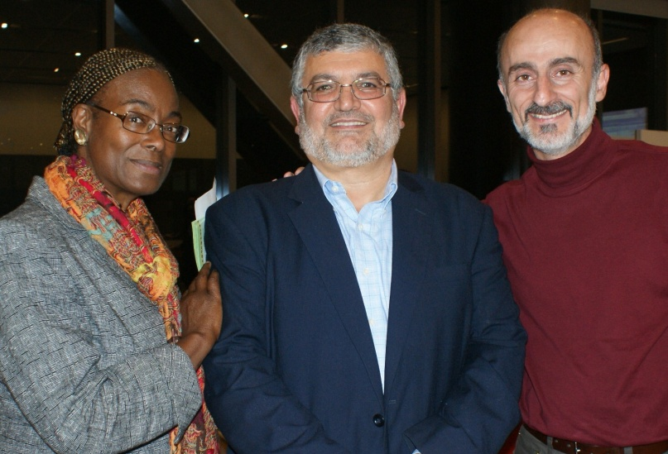
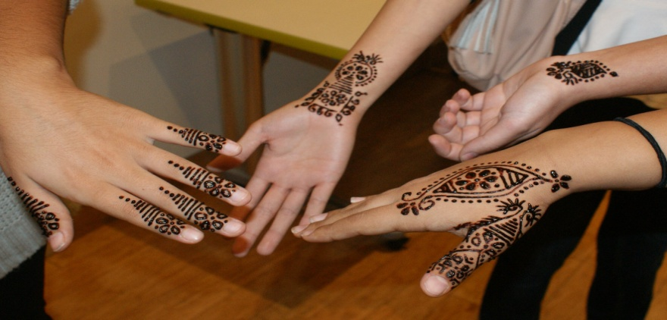
NEH Challenge Grant for Two-Year Colleges
National Endowment for the Humanities
A.A. in Arabic Studies is one of two in the state
Good transfer path for CSUSB
2:1 match requirement

Slide 7
California Career Pathways Trust
RAMP UP
Pipeline to College & Career
Fiscal agent is Victor Valley College
One immersive conferencing classroom
Health pathways: Respiratory Therapist, EMT, Paramedic
SBVC also a partner
Fiscal agent is Public Safety Academy
Fire Technology
Fire Academy
SBVC also a partner (Police Science)

Slide 8
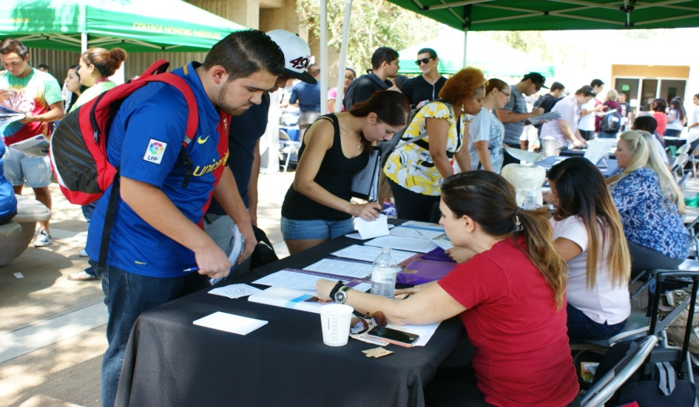
Future of Grants at Crafton Hills College
Grants
2014-15
Raise match for Arabic
Continue to pursue and increase number of grants
Infrastructure
Grants database
Title V
TRIO
GEAR UP
FIPSE
State grants
Partnerships
Foundation grants

Slide 9
CHC Foundation Activities
Presidential Inauguration
Career Fair

Slide 10
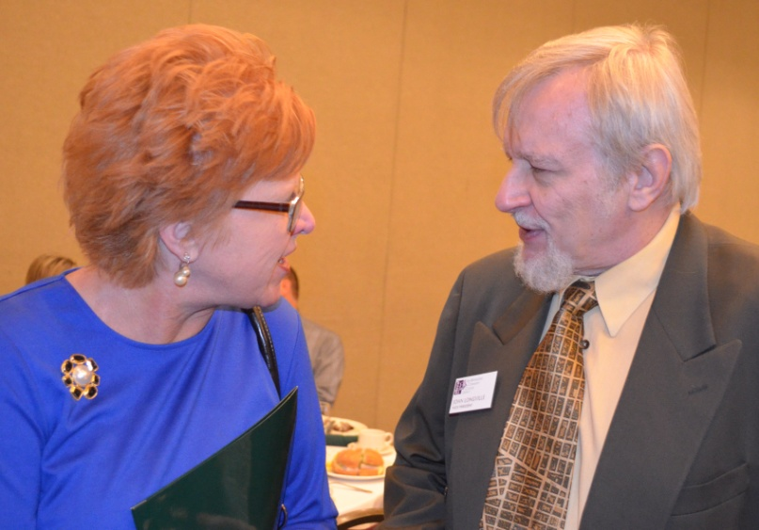
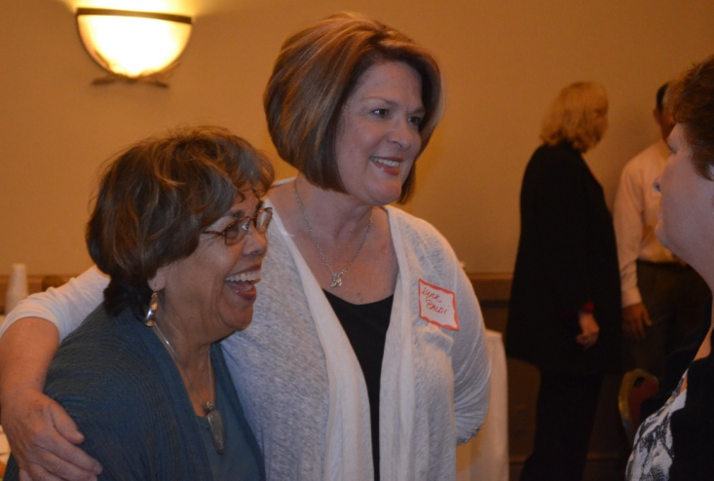
CHC Foundation Activities
Friends of CHC Luncheon

Slide 11
Use of Foundation Funds
Scholarships
Student Support and Engagement
Emergency textbook loans
Student conferences and competitions
Honors
Campus events
Alumni engagement
Infusion funds
To support CHC programs
Campus Needs
Endowment
Endowment for Arabic Studies
Facility and equipment needs

Slide 12
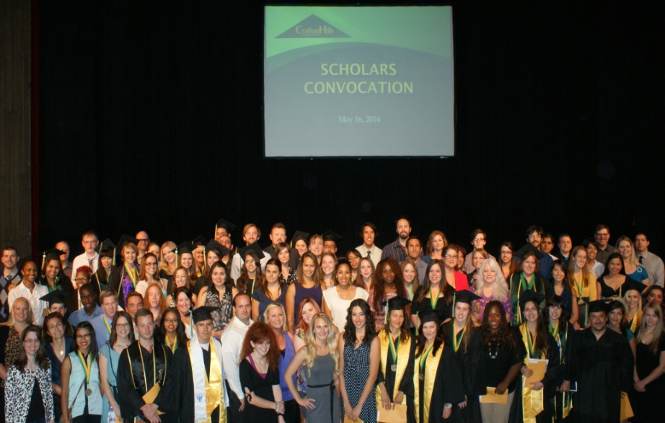
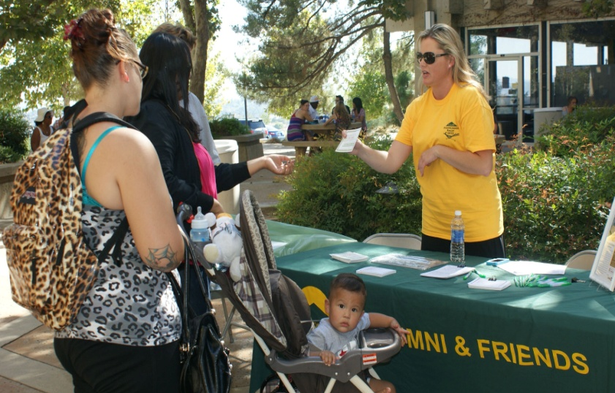
Use of Foundation Funds
Scholarships
Program Support
$75,100 awarded at Scholars Convocation on May 16, 2014
Infusion funds
Student engagement
Campus needs
Alumni engagement

Slide 13
CHC Foundation Activities
CDC Trike a Thon

Slide 14
Future of Resource Development and Grants at CHC
Infrastructure
Relationships
Grants
Marketing & Communication
Manage Donor Information Effectively
Manage Financial Information Effectively
Cultivation
Foundation Board
Moves Management
Fundraising
Alumni
Stewardship
Raise match for Arabic
Continue to pursue and increase number of grants

Slide 15
Campus Happenings
Campus Tours
Buy-a-Brick Campaign

