Slide 1
SBVC SPANISH CLUB
Logo created by: Nathaniel Washington
(2014-15 Treasure)
PowerPoint Created by: Samuel Bojórquez
2013-14 Public Relations

Slide 2
2013-2014 ADVISORS and OFFICERS
Advisor
Dr. José Recinos
Co-Advisor
Dr. Nori Sogomonian
President
Paula Venegas
Vice President
Cinthia Alcaraz
Inter-Club Council Representative
Vicente Rodriguez / Anggie Sarti
Treasurer
Rosalinda Sosa Sanchez
Public Relations
Samuel Bojórquez

Slide 3
Fall 2013

Slide 4
Spring 2014

Slide 5
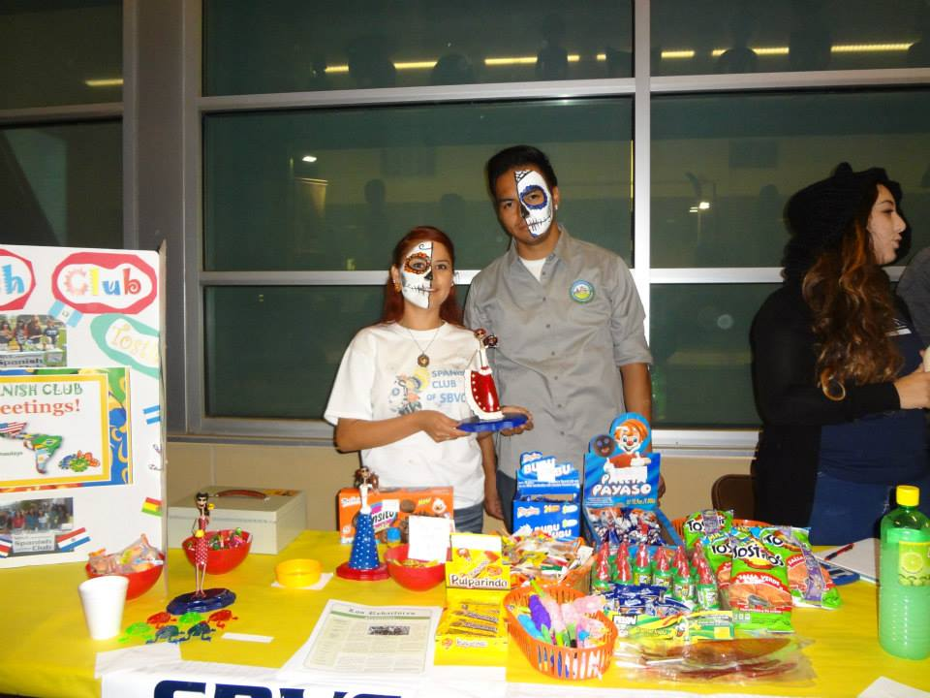
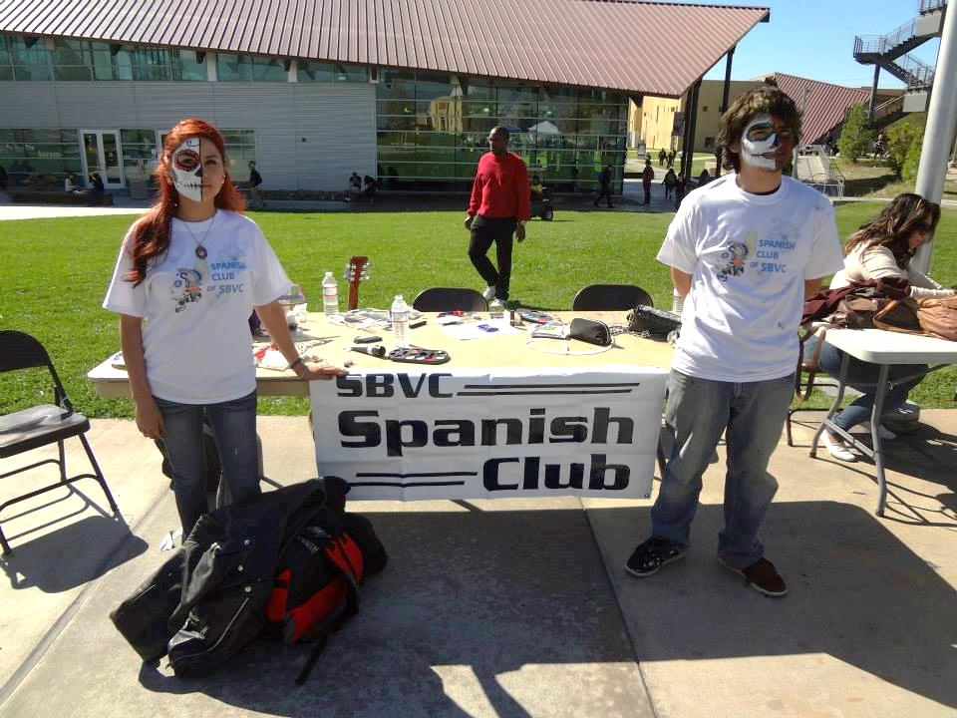
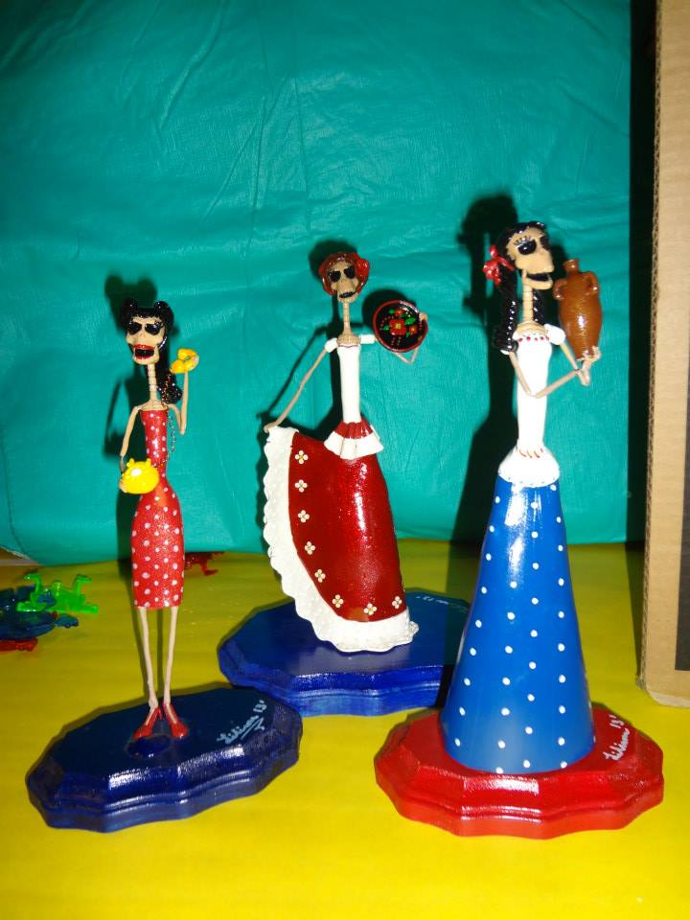
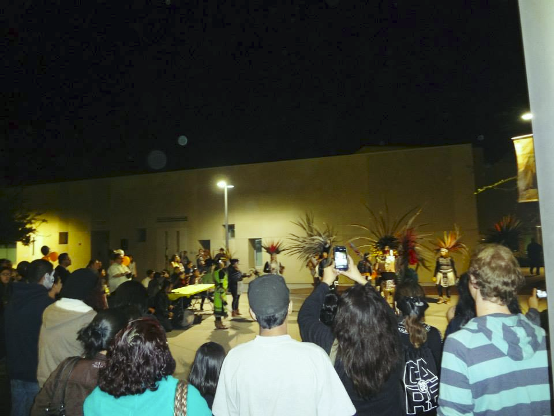
Día de los Muertos

Slide 6
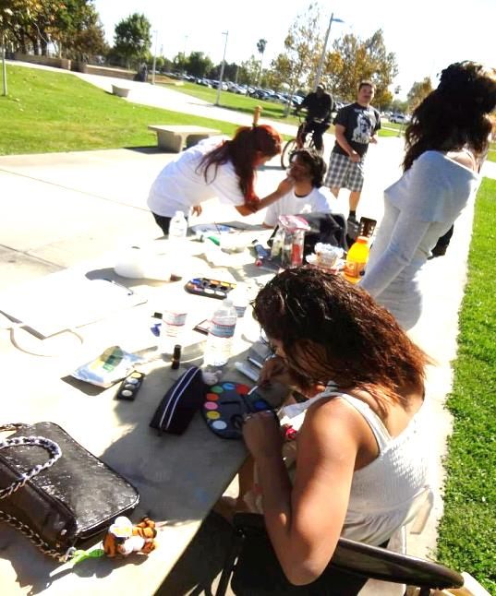
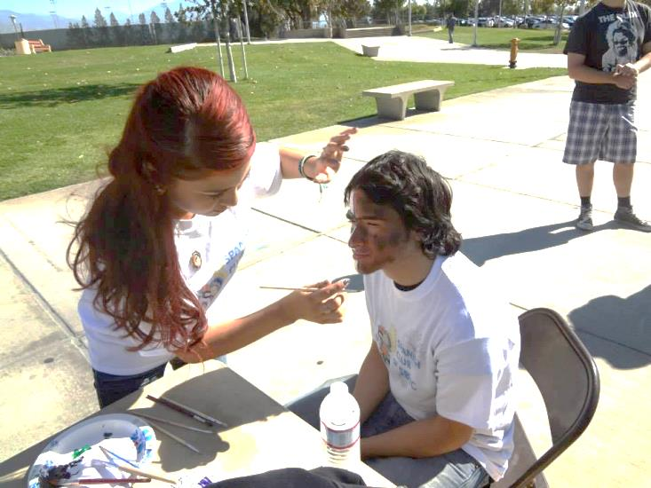
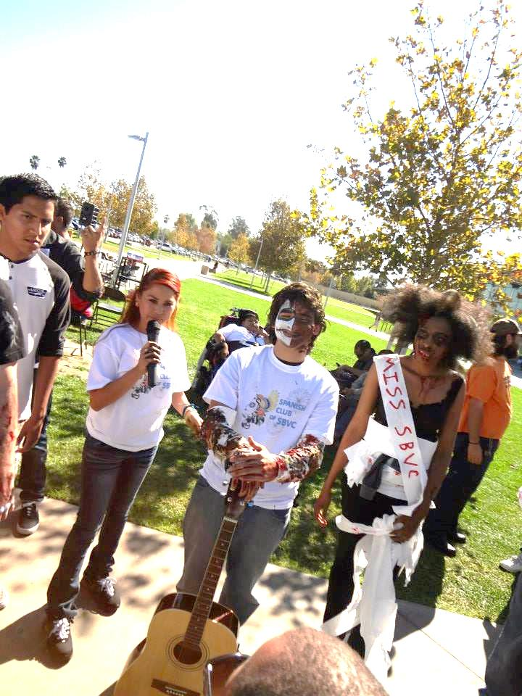
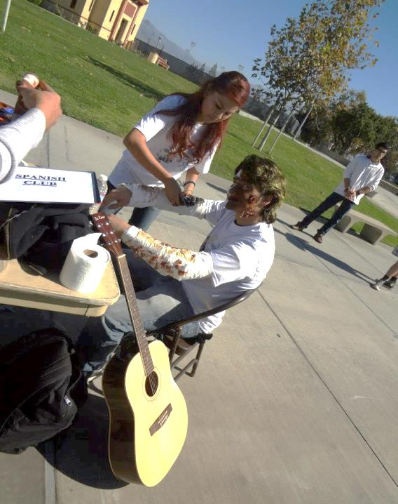
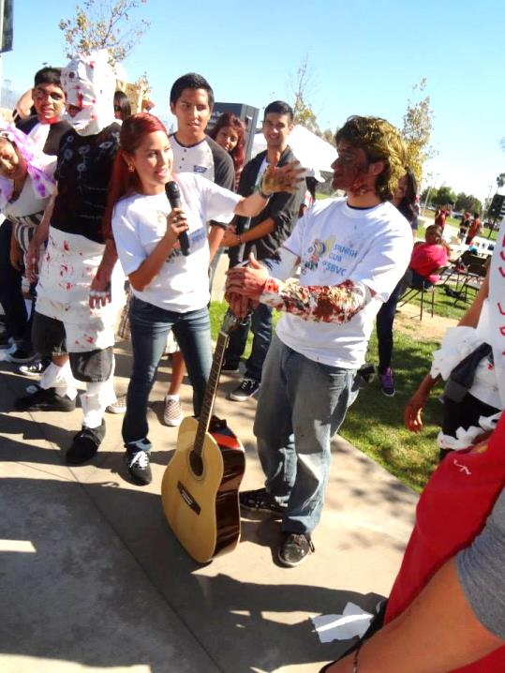
Clash of the Clubs

Slide 7
Tostilocos Sale

Slide 8
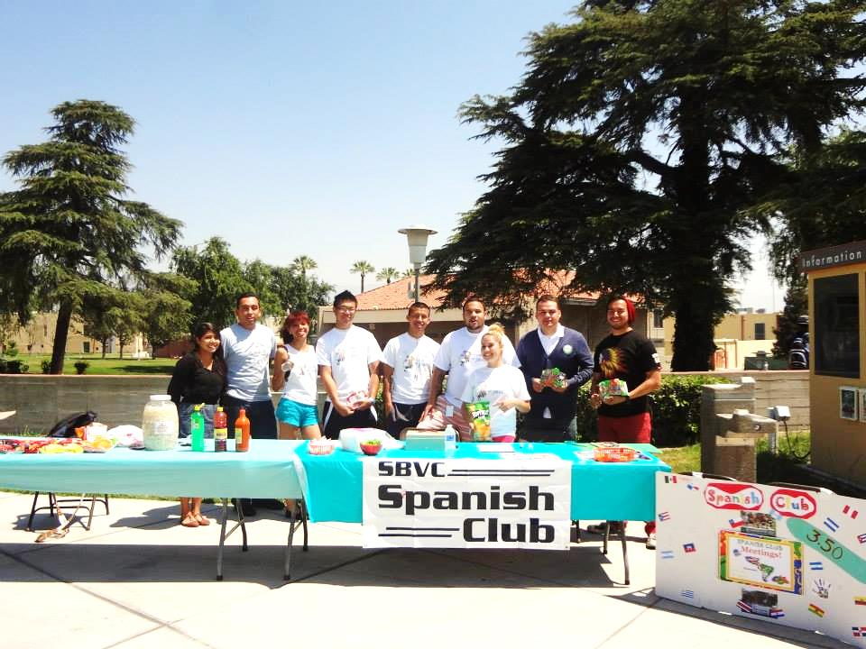
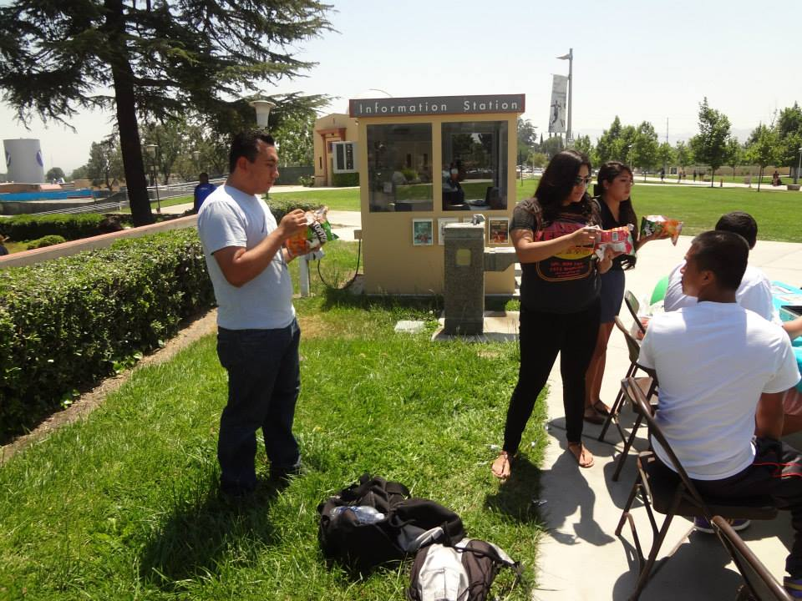
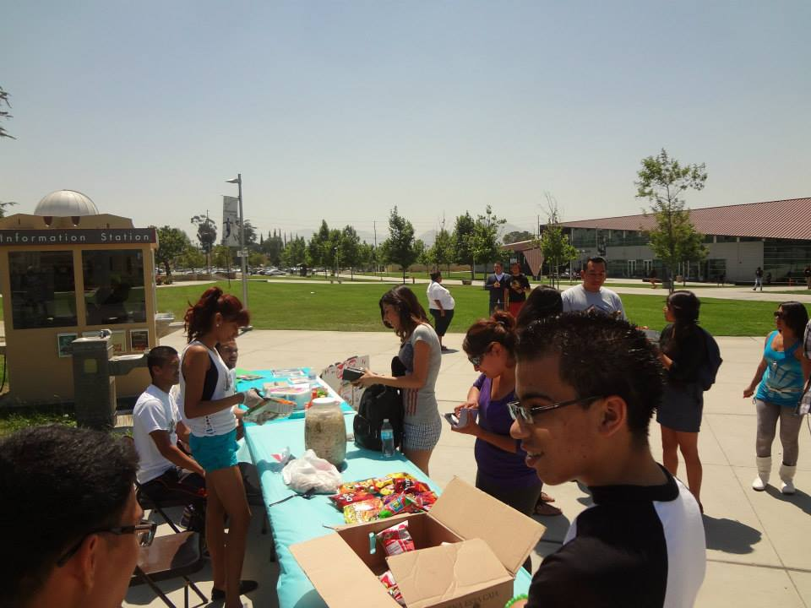

Slide 9
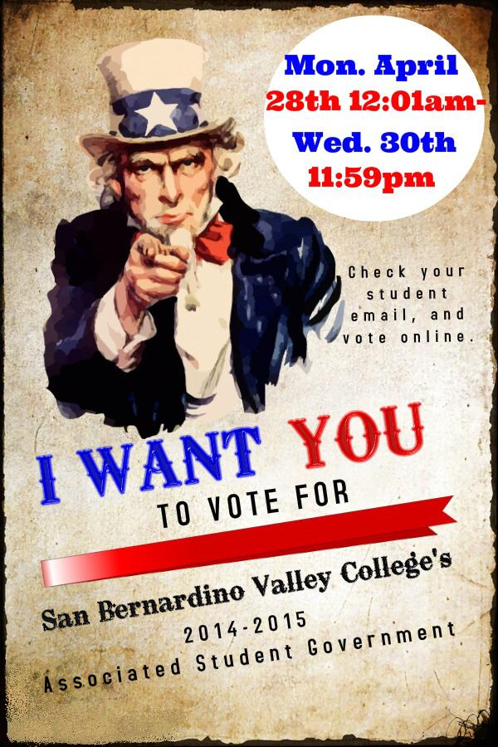
ASG Elections

Slide 11
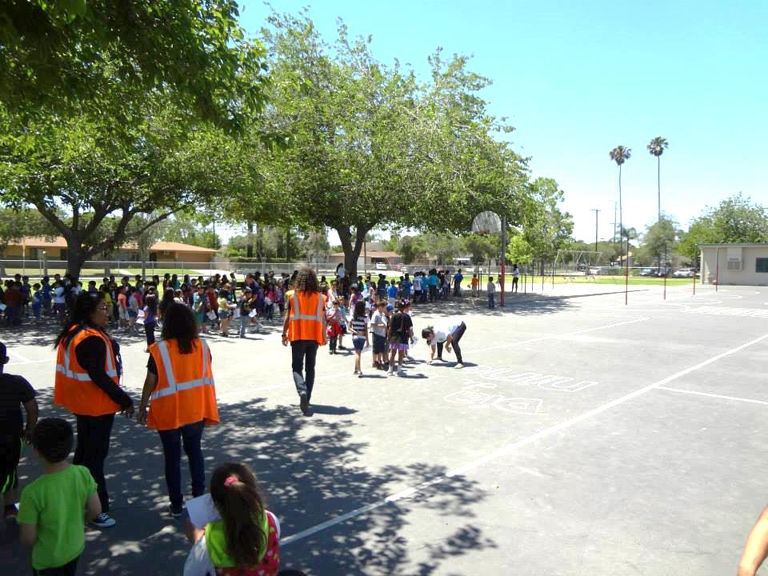
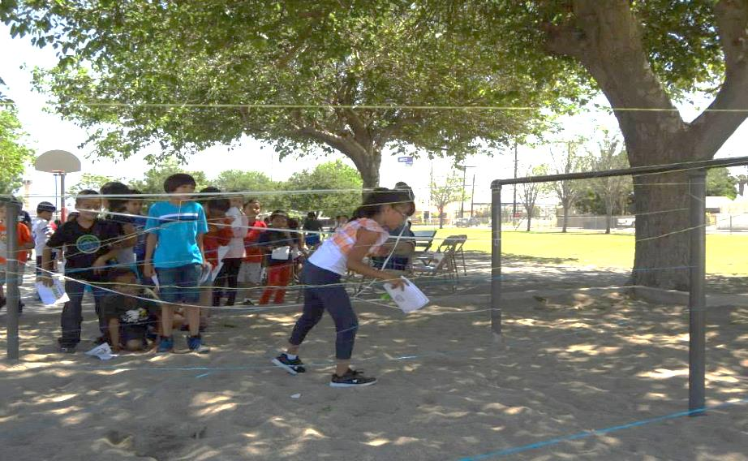
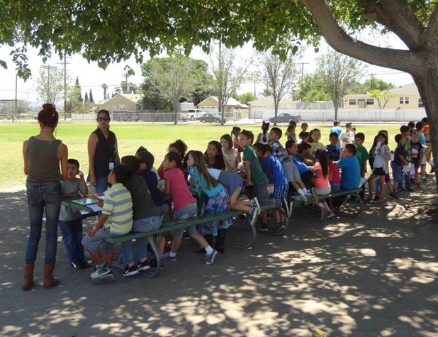
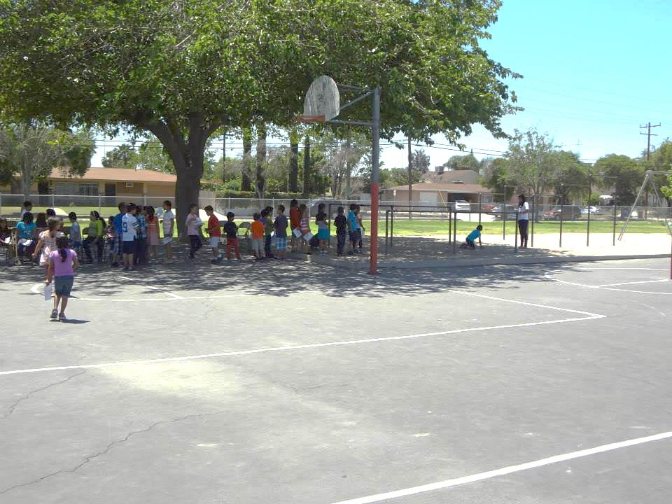
Día de los Niños @ Urbita Elementary School

Slide 12
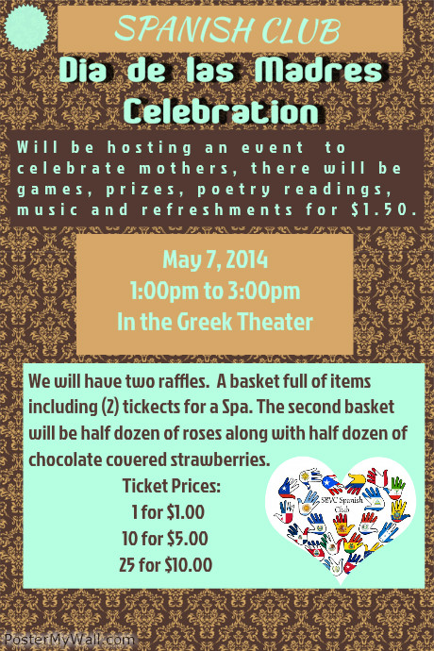
Día de las Madres

Slide 13
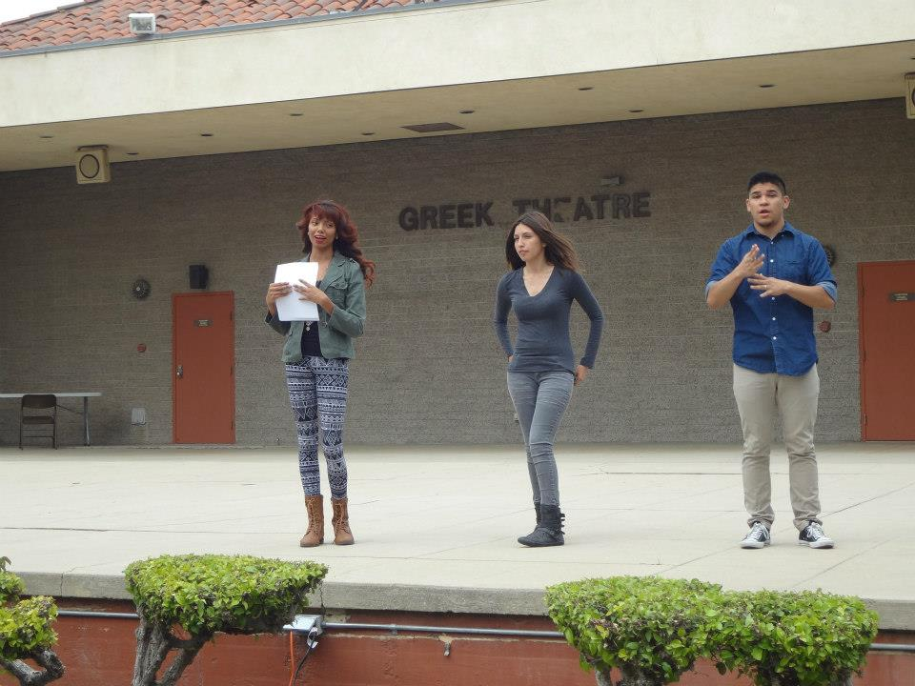
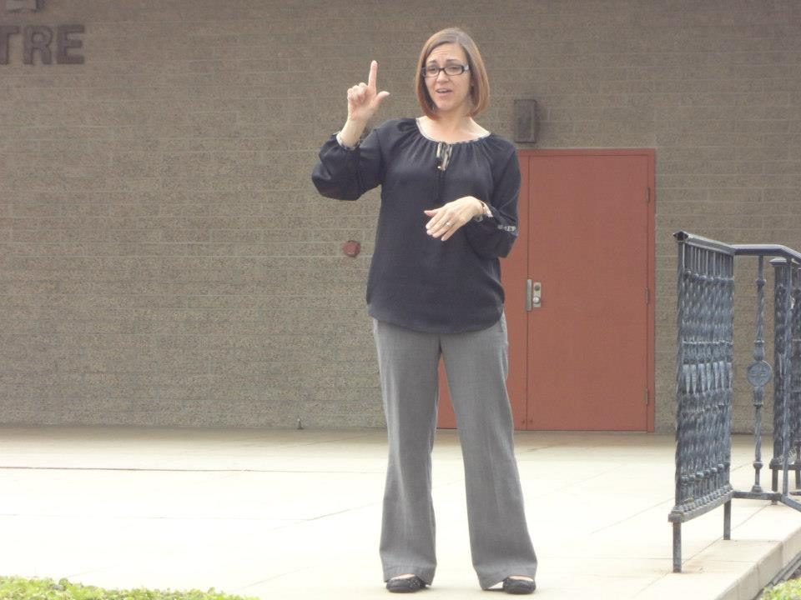
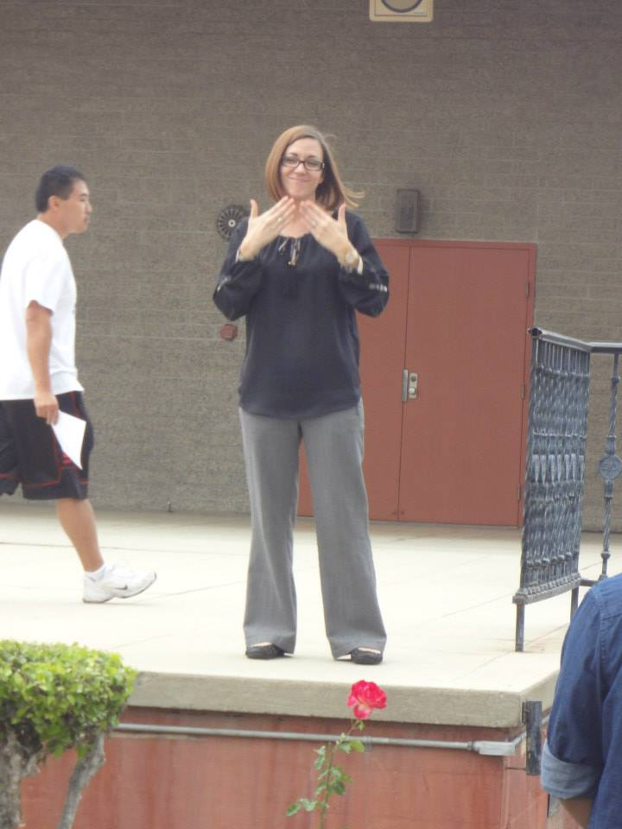
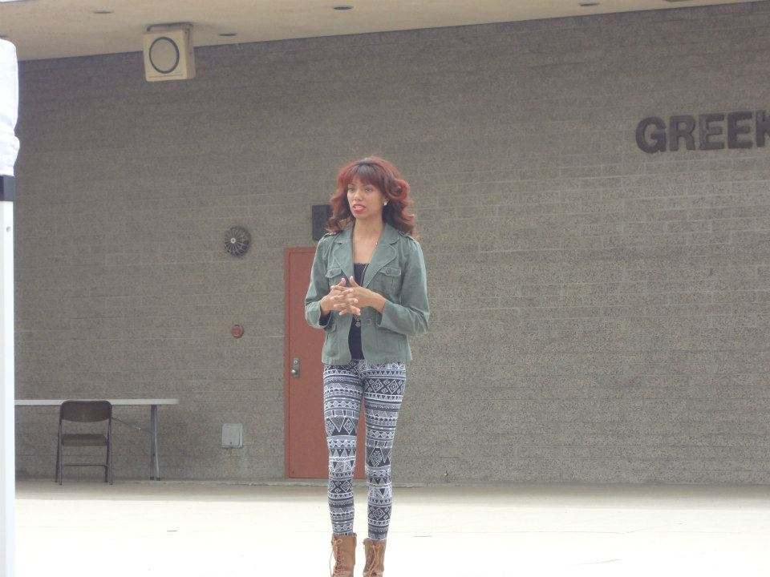

Slide 14
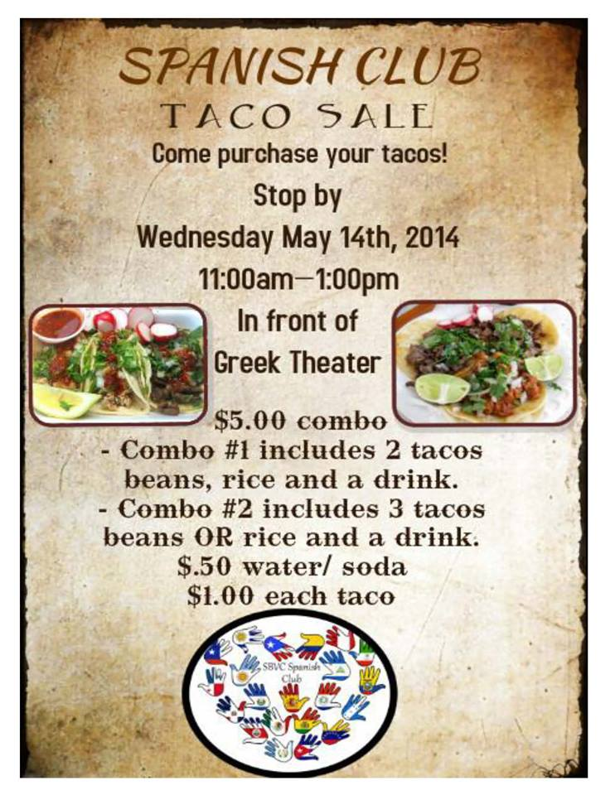
Taco Sale

Slide 15
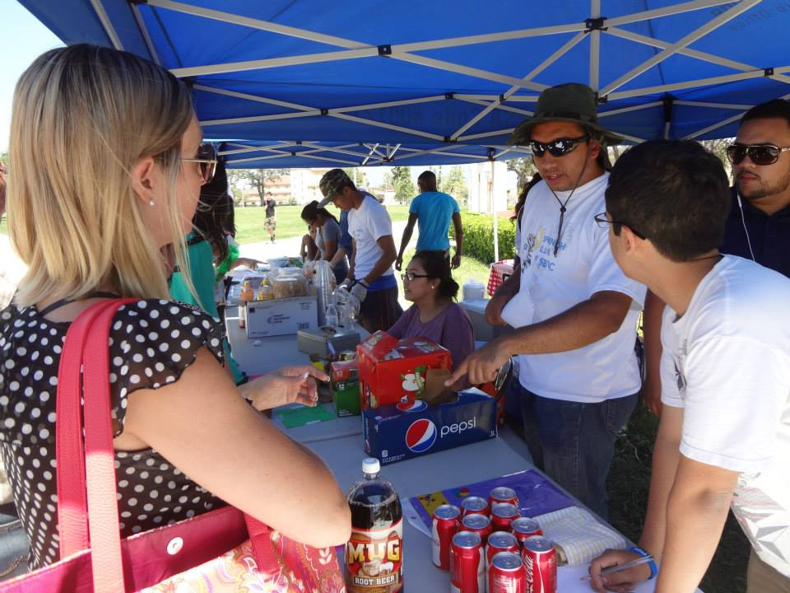
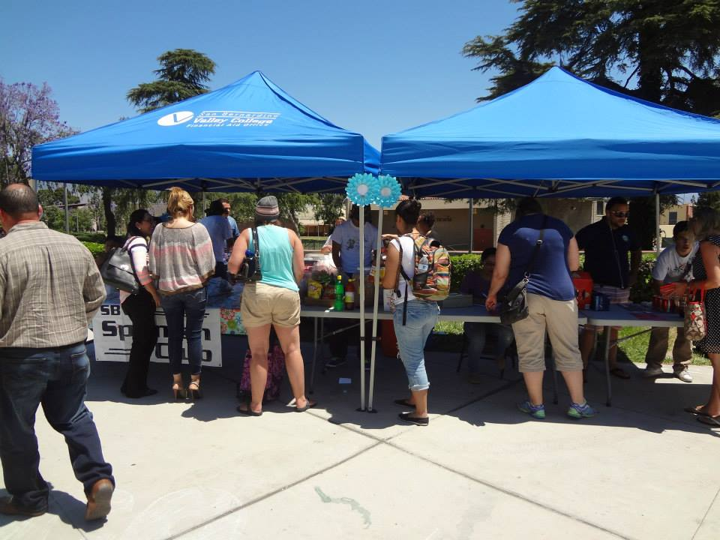
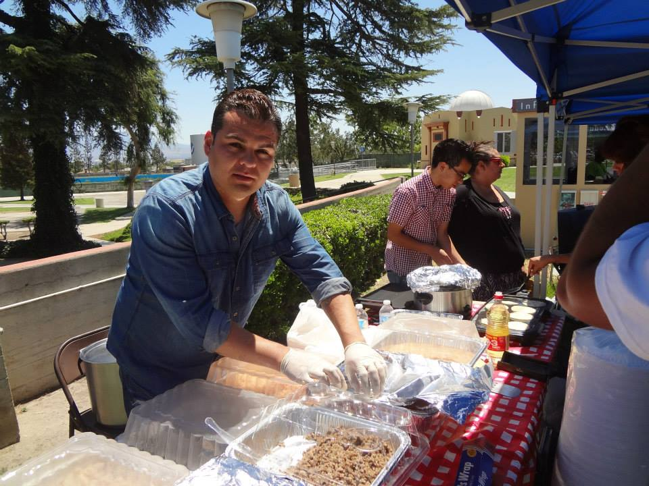
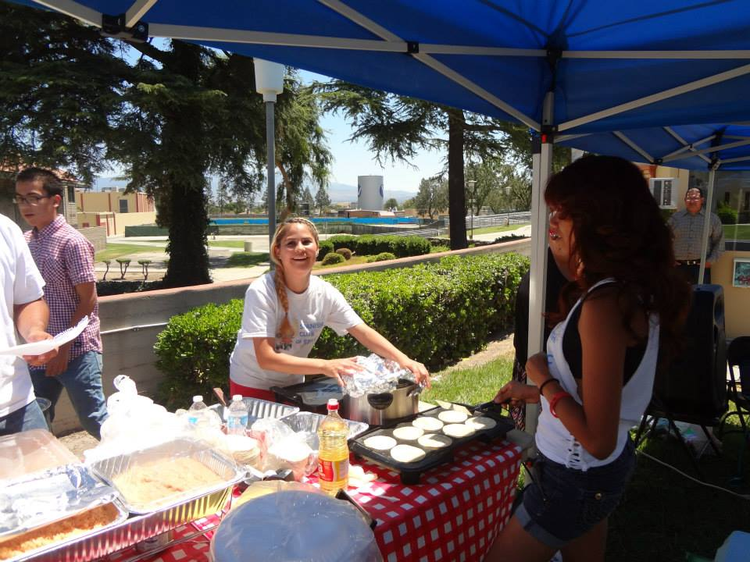

Slide 16
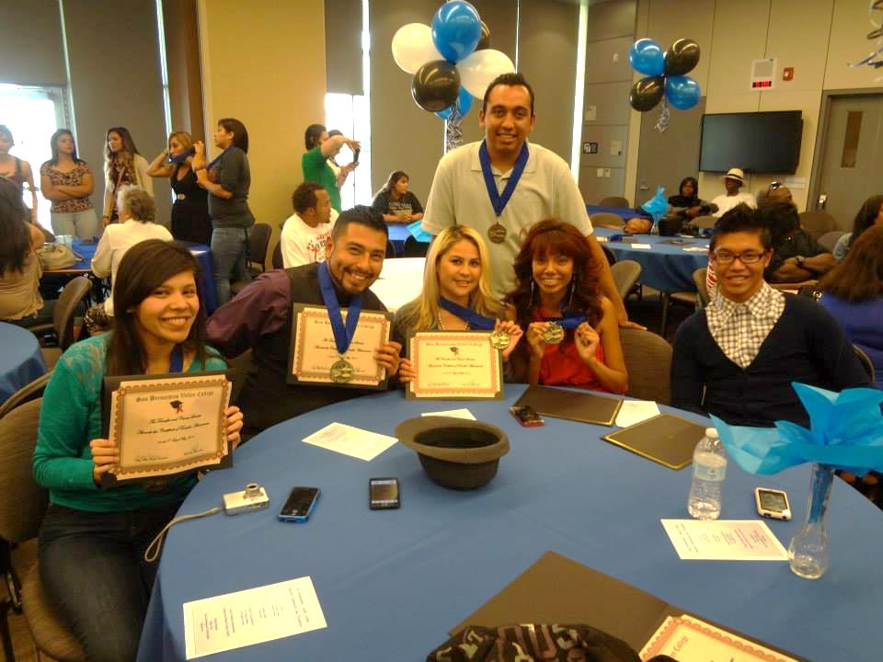
Transfer Celebración 9 de mayo de 2014
Officers/Members transferring:
(2)CSUSB, (2)UCR, CSULA, CSULB

Slide 17
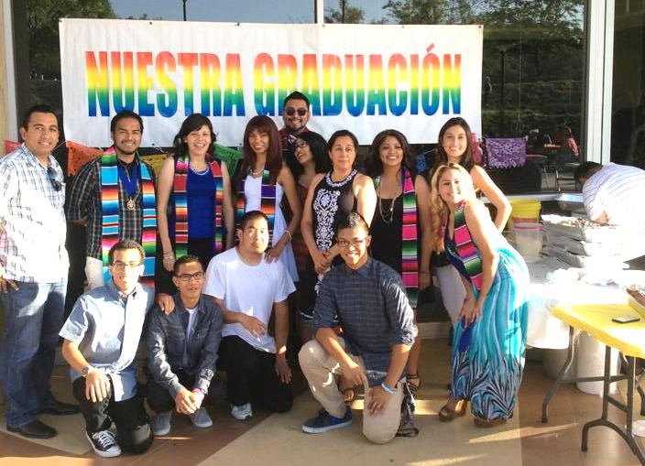
Nuestra Graduación 18 de mayo de 2014

Slide 18
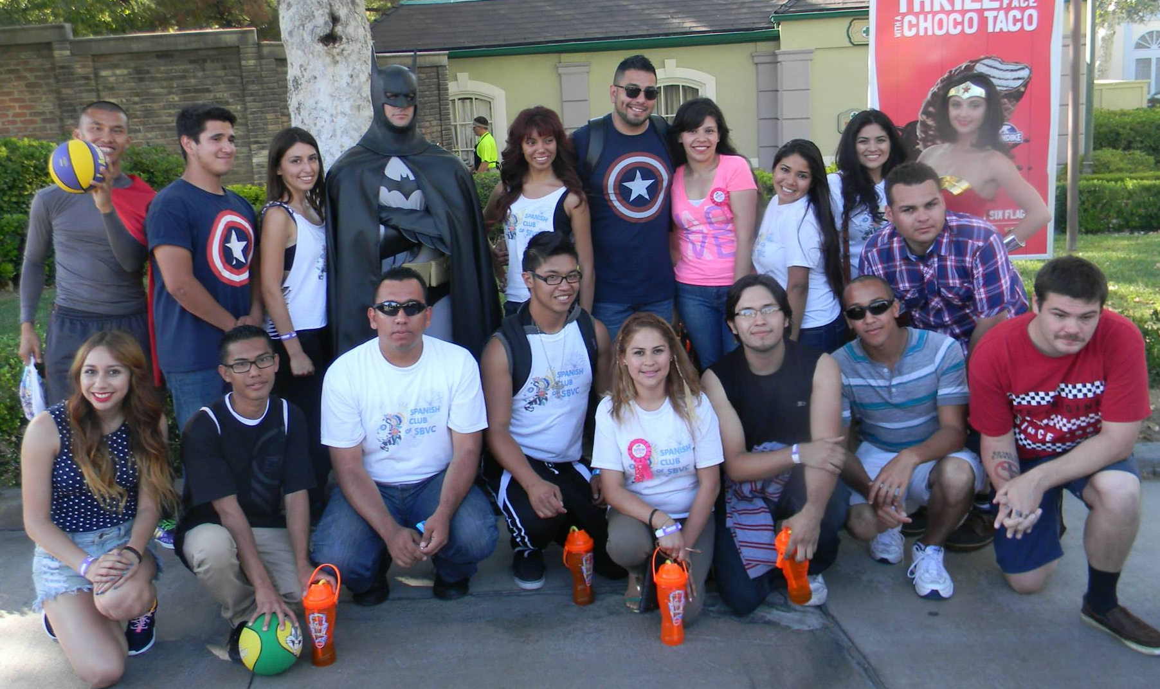
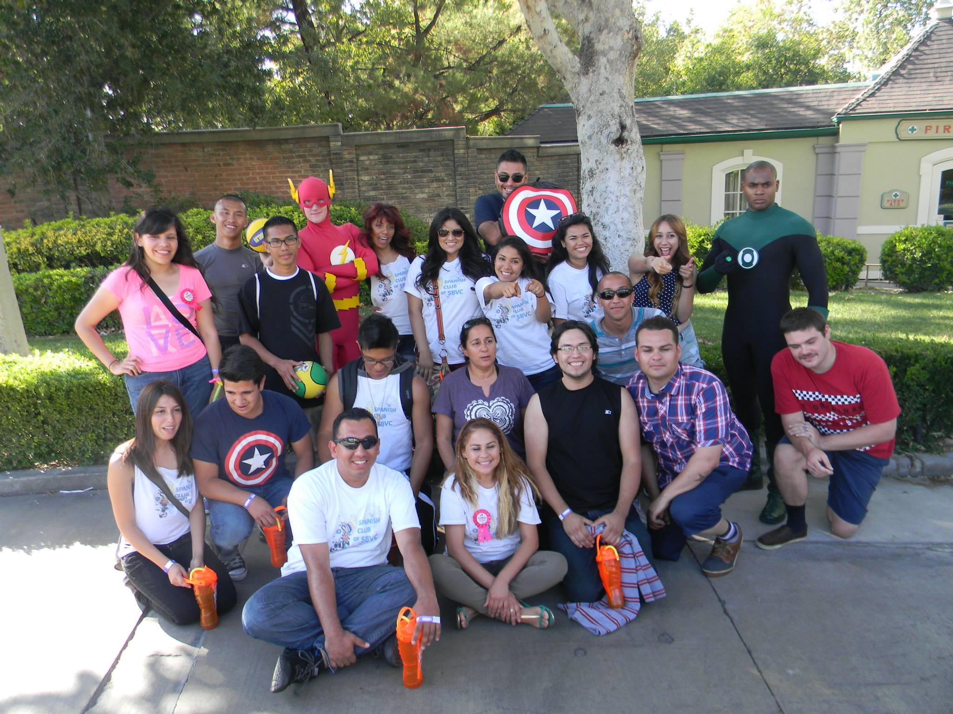
End of the year event
Coming Soon

Slide 19
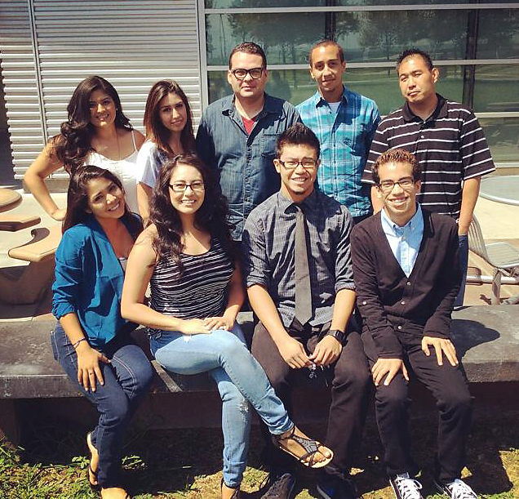
2014-2015 Officers
President: Omar Castro
Vice President: Estefania Alvarez
Executive Assistant: Deborah Goiz
Secretary: Cynthia Calvillo
Finance/ Relations Director: Nathaniel Washington
Historian: Jessie Martinez
ICC: April Keller
Alternate-ICC: Carlo Gutierrez
Sergeant of Arms: Mark Han

Slide 20
Thank You

