Slide 1
Left Lane Program
Crafton Hills College
Left Lane Students,
Jonathan Townsend, &
Luis Mondragon

Slide 2
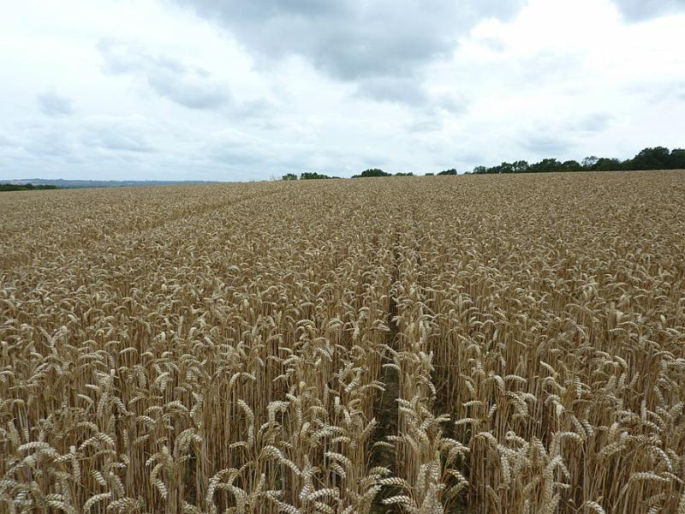
The Need

Slide 3
The Purpose of Left Lane
Leverage existing services strategically
Threefold Model:
Course availability
Counseling support
Tutorial support

Slide 4
Program Components
Attend registration orientation
Attend Summer Bridge
Complete full SEP (Student Education Plan)
Be in the Tutoring Center 2 hours/week
Attend 2 check-in meetings per semester for accountability
Pass classes

Slide 5
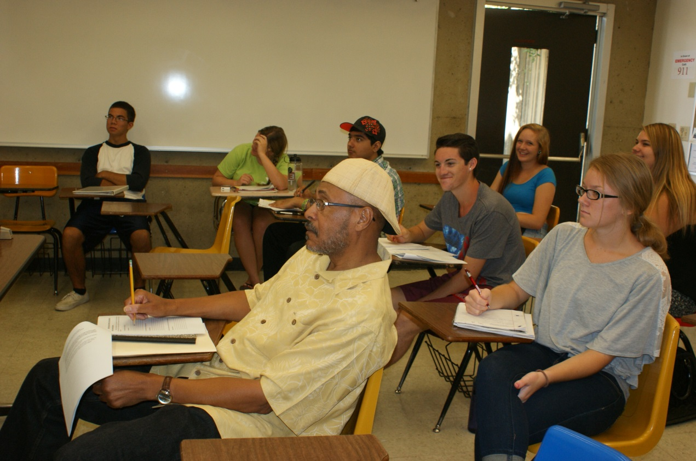
Summer Bridge 2014

Slide 6
Current Left Lane Students

Slide 7
Previous Left Lane Students

Slide 8
Questions

