Slide 1
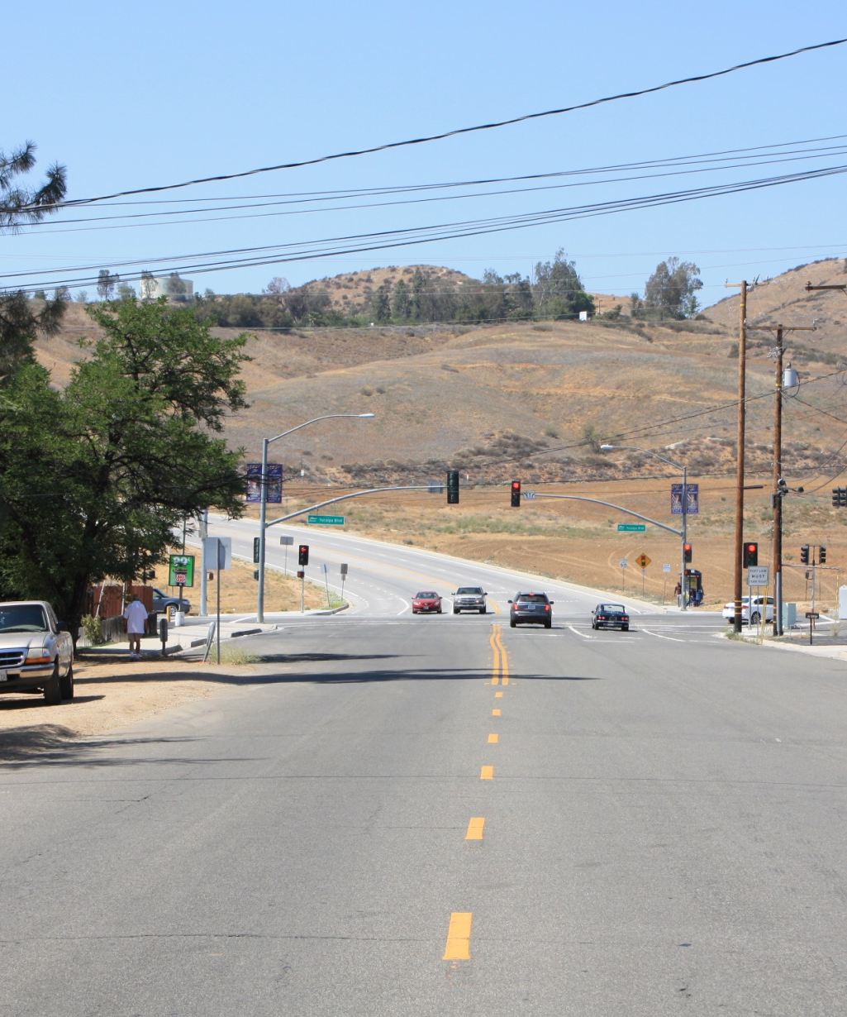
PROJECT BACKGROUND
Awarded Southern California Association of Governments (SCAG) Grant for integrated land use and transportation planning efforts (2013-2014)
Consultant hired to create an Overlay Zone specific to the Crafton Hills College campus and the Dunlap Corridor
Complements ongoing General Plan Update and feeds into GPU technical studies

Slide 2
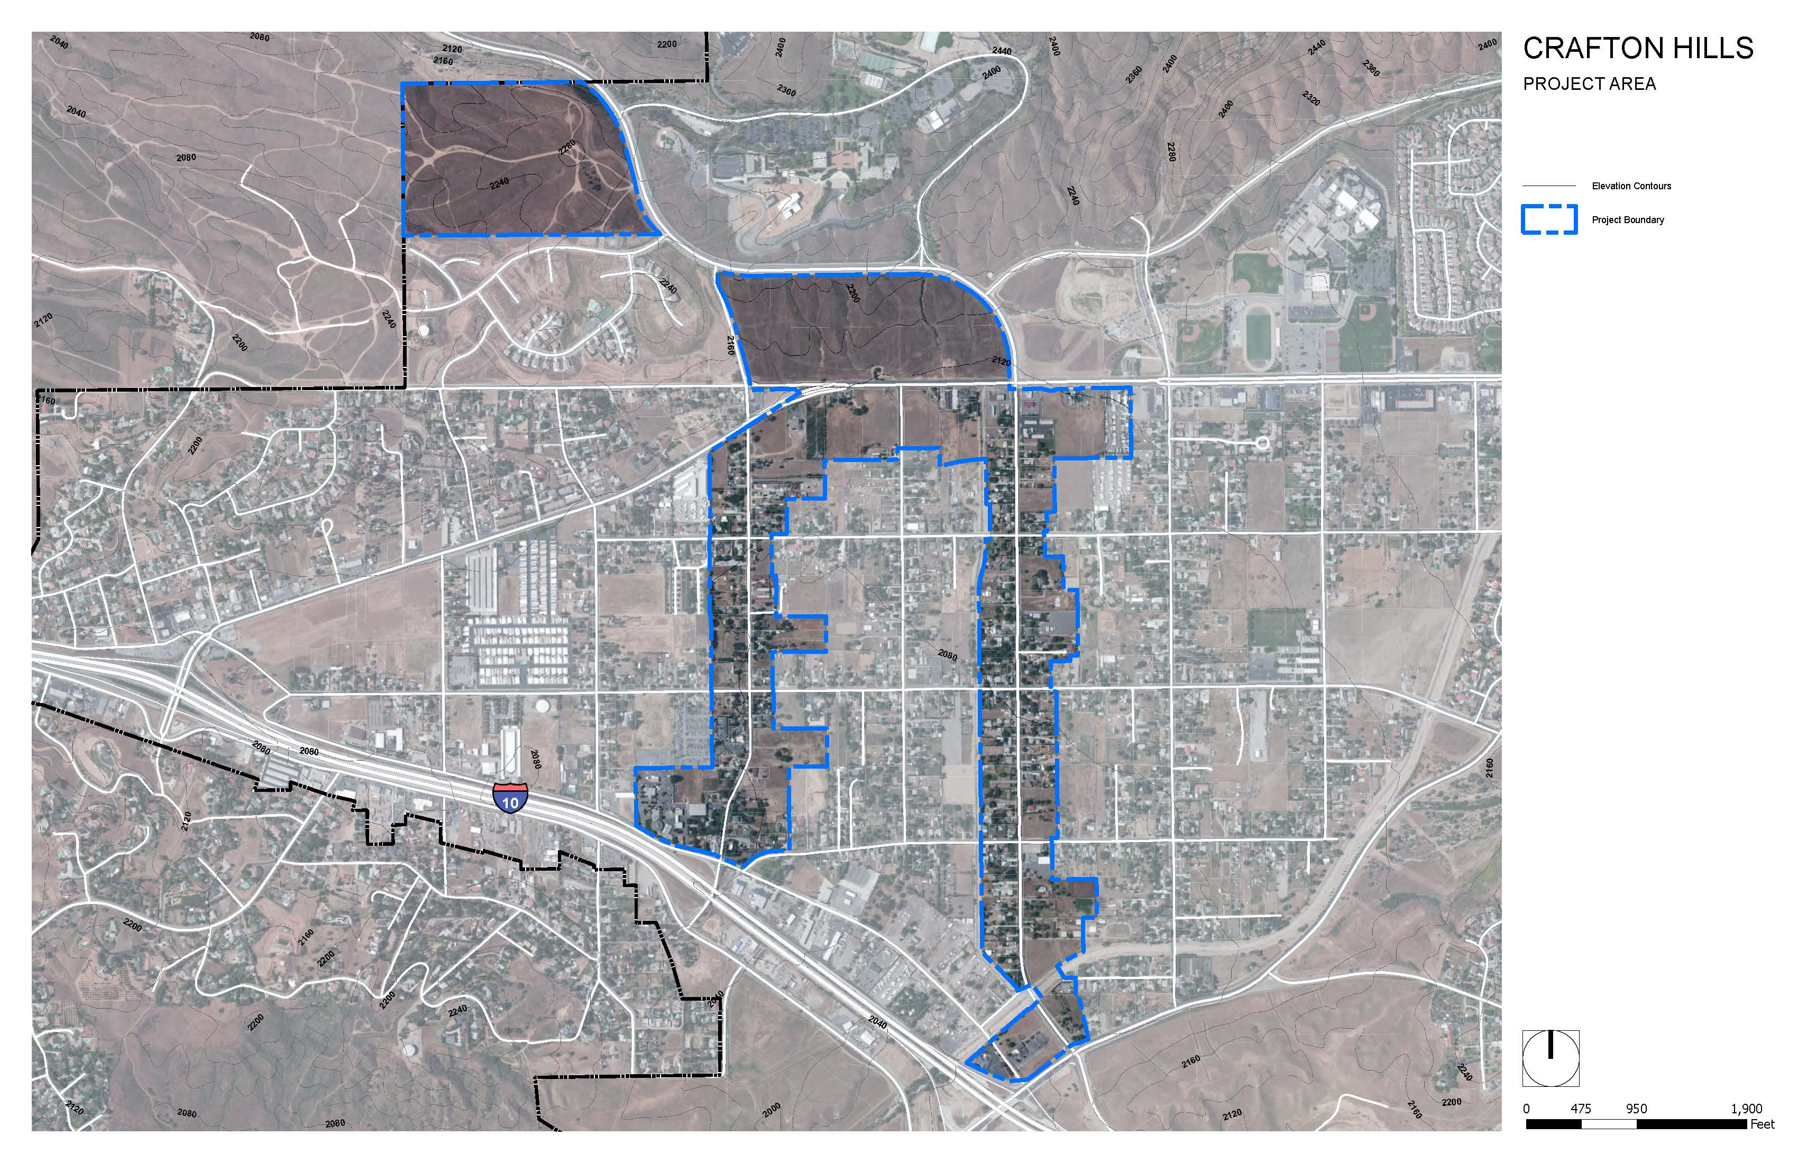
PROJECT AREA

Slide 3
PROJECT OBJECTIVES
Integrate land use and transportation planning to promote a sustainable land use mix, including new housing;
Develop a complementary land use mix to serve the City as a whole, the College, and the region
Ensure adequate roadway capacity to reduce vehicular congestion;
Provide pedestrian and bicycle amenities, including improved sidewalks, benches, pedestrian lighting, theme paving, and new bike lanes;
Capitalize on existing trails infrastructure and institutional and open space uses (CHC trails, YHS, ball fields, BMX)
Be sensitive to site topography and improve aesthetics of the area

Slide 4
OUTREACH TO DATE
Public Outreach Meetings
One meeting held at Dunlap Elementary on October 30, 2013
Two meetings held at Crafton Hills College -
January 22, 2014
July 31, 2014
Staff Meetings with Crafton Hills College

Slide 5
OUTREACH TO DATE
GPAC Recommendation
Include Multiple family housing/student/faculty housing
Include Adequate daytime uses (i.e. retail/commercial) to support and serve the community and the College area
Develop a sense of place utilizing proper architectural designs and site planning
Controls on density, utilizing an incentive based system for housing density such as a Development Opportunity Reserve, in which exceptional projects could be granted increased density by the City Council if deemed appropriate.
Policies to properly regulate number of students/unit, conduct, and landowner responsibilities
Planning Commission
Recommended that the City Council consider the proposed Crafton Hills College Village Plan as recommended by GPAC, including mixed-use (housing)

Slide 6
WHY PLAN FOR A COMMUNITY COLLEGE VILLAGE?
Mission of Community Colleges is Changing
New 21st –Century Initiative tied to the Innovation Economy
Refocus programs to meet local high-tech employment needs
Collaborate with other institutions
Partner with private businesses and industries
Community College Demographics are Changing
Nearly a quarter of US Community Colleges provide on-campus or adjacent campus housing.
College Village provides a unique opportunity for a new district where campus and community life converge, innovative businesses are created, and interaction is encouraged

Slide 7
STUDENT HOUSING
How many Fall 2013 Crafton students who live in a primarily Crafton service area city live on their own?
1,136 (23%) CHC students live on their own.
How many Fall 2013 Crafton students who live in Yucaipa live on their own?
316 (24%) Fall 2013 CHC Yucaipa students live on their own.
How many Fall 2013 Crafton Students who live in Yucaipa and Redlands live on their own?
613 (24%) Fall 2013 CHC Yucaipa and Redlands students live on their own.
Notes:
We’ve heard from staff that you have asked for more information on examples and the need for student information around Crafton Hills. Since that time we’ve learned some interesting statistics related to the current student population.
Conclusion: built-in demand today

Slide 8
STUDENT HOUSING
Summary of Findings
How many Fall 2013 Crafton students who live in a primarily Crafton service area city live on their own?
1,136 (23%) CHC students live on their own.
How many Fall 2013 Crafton students who live in Yucaipa live on their own?
316 (24%) Fall 2013 CHC Yucaipa students live on their own.
How many Fall 2013 Crafton Students who live in Yucaipa and Redlands live on their own?
613 (24%) Fall 2013 CHC Yucaipa and Redlands students live on their own.
Notes:
We’ve heard from staff that you have asked for more information on examples and the need for student information around Crafton Hills. Since that time we’ve learned some interesting statistics related to the current student population.
Conclusion: built-in demand today

Slide 9
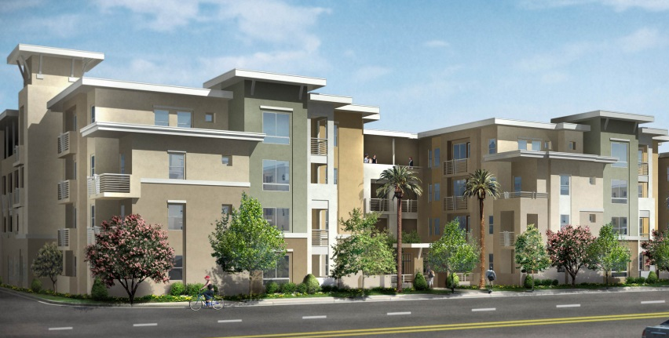
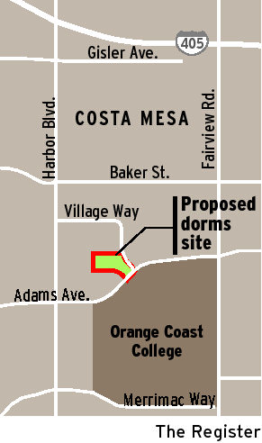
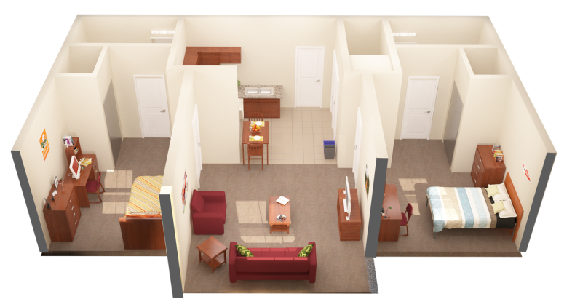
STUDENT HOUSING
Notes:
Upper left: University House. Lower Left: The Quad at San Marcos. Middle: OCC housing site. Upper right: U of Miami 2/2 unit. Lower right: distribution of community colleges with on-campus housing.

Slide 10
STUDENT HOUSING
Utilize existing city codes to properly regulate:
Minimum dwelling sizes, parking, amenities/open space, architectural design requirements, landscaping, ongoing maintenance
Conditions of approval related to safety and security
Section 88.01301-88.01350 of the Development Code address standards for High Density Residential Developments. Most stringent housing regulations in the County.
“Room Rental Permit” Agreement examples
Recorded CC&R’s that run with the land to regulate all aspects of the housing
Partnerships with Crafton Hills College and property owners
If housing is designated as student housing, CHC PD will take the lead on law enforcement.

Slide 11
ECONOMIC OVERVIEW
Spending by current students and faculty probably support more than 20,000 square feet of retail in Yucaipa
With the college expansion as envisioned, Yucaipa would likely capture close to $10 million in retail spending
To the degree that the expansion attracts an increased percentage of the student body to live in Yucaipa, the City’s capture of retail spending would also increase
Spending by employees in the project area would likely generate an additional $500,000 in retail sales

Slide 12
TRAFFIC ANALYSIS
Although the mixed-use alternatives have more building square footage overall, the traffic analysis demonstrates that land use Alt. 1 (all commercial) results in the greatest amount of overall vehicle trips and external trips.

Slide 13
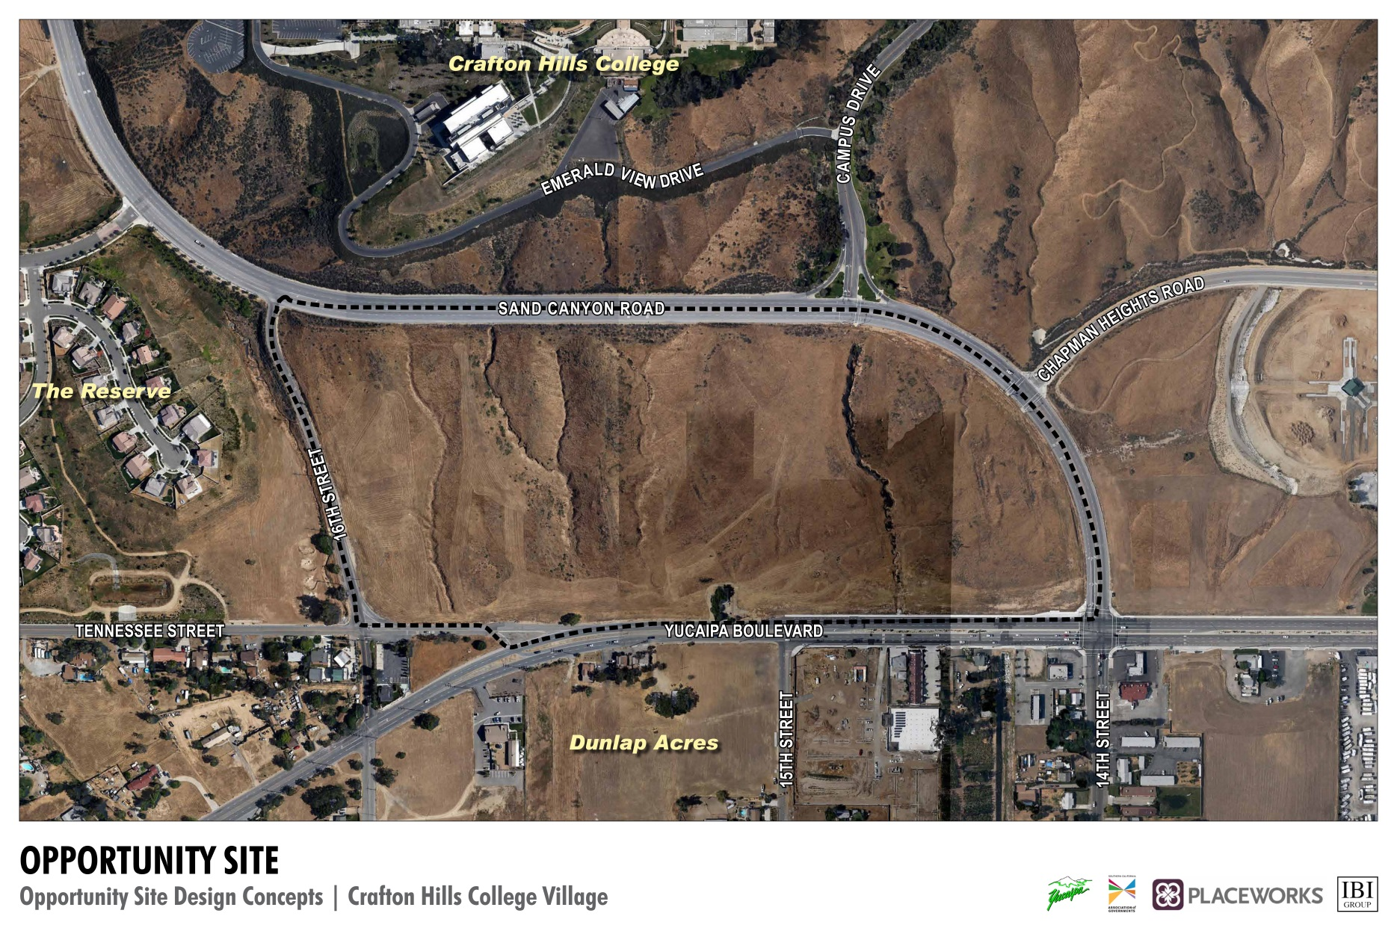
OPPORTUNITY SITE – CRAFTON HILLS COLLEGE VILLAGE

Slide 14
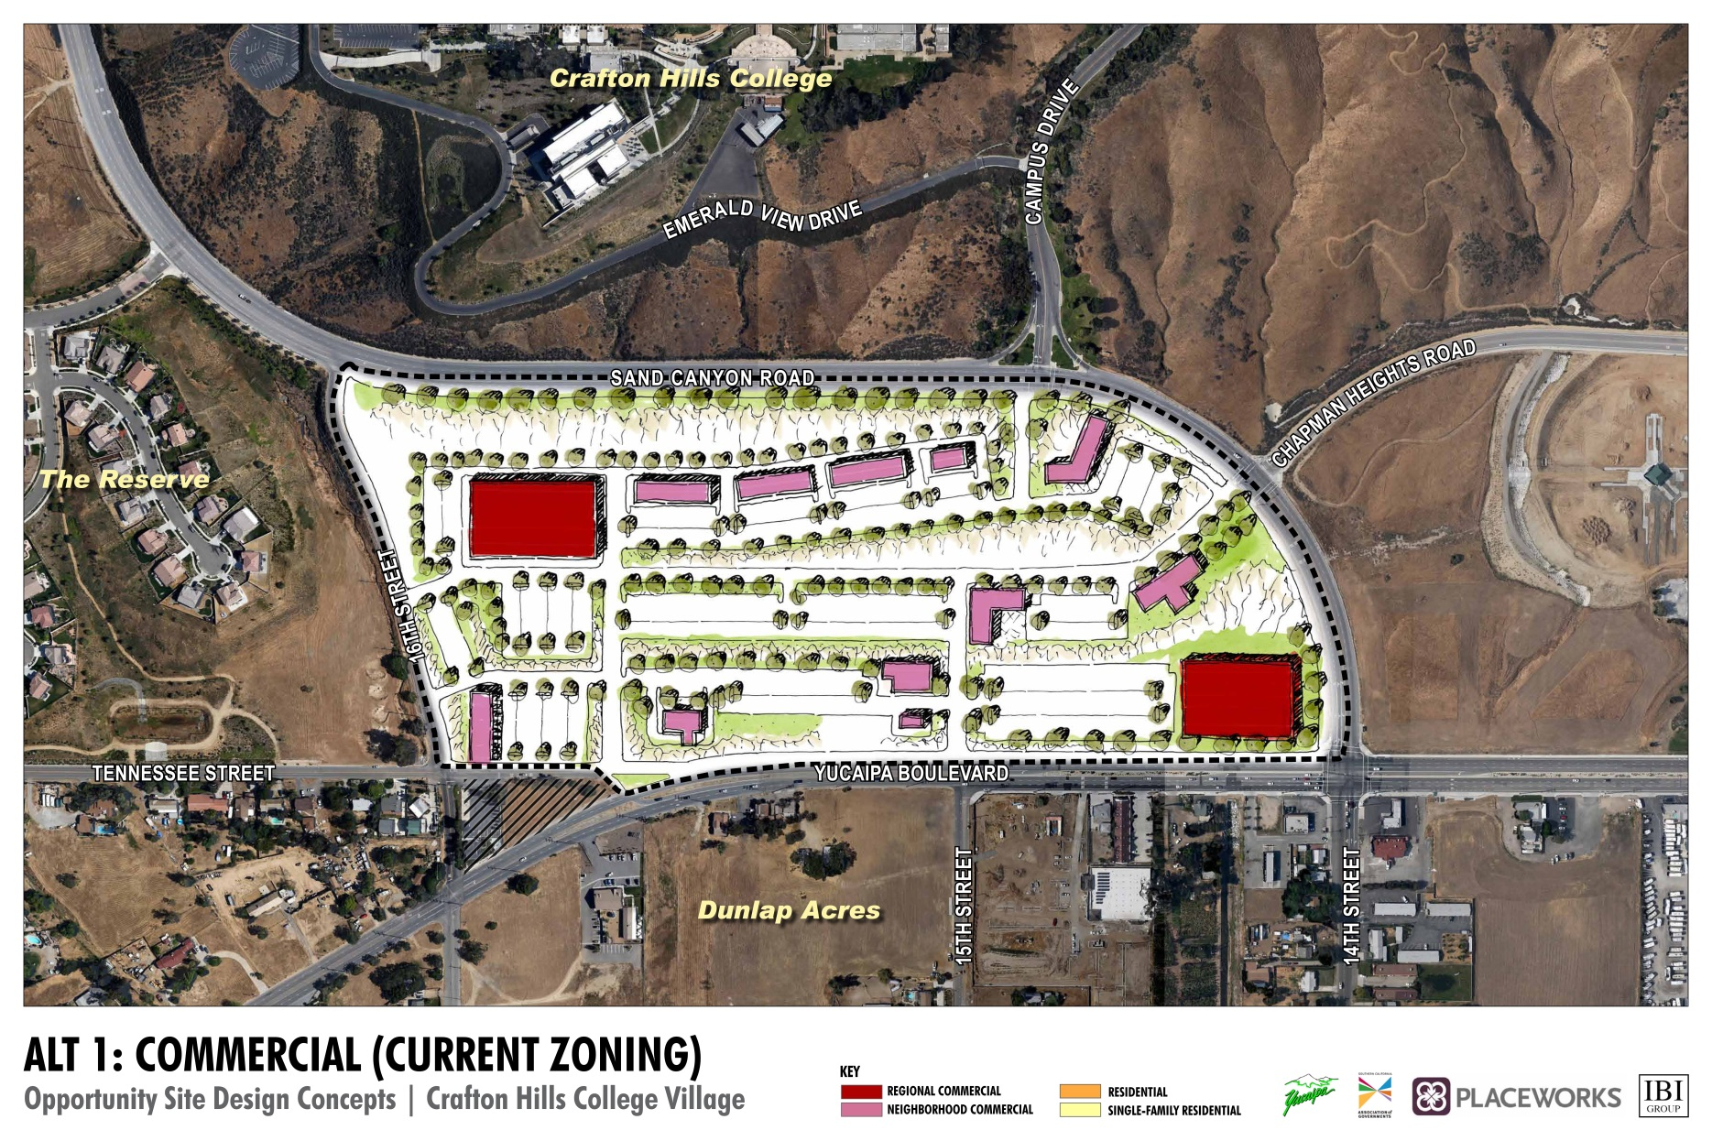
ALTERNATIVE 1: All Commercial

Slide 15
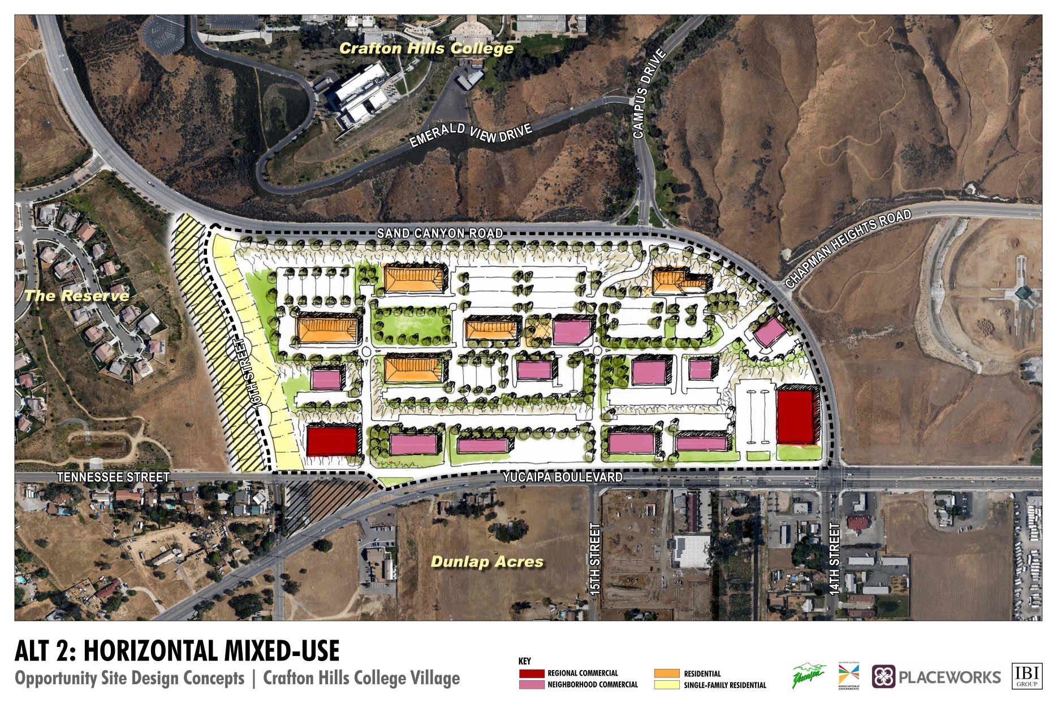
ALTERNATIVE 2: Horizontal Mixed Use

Slide 16
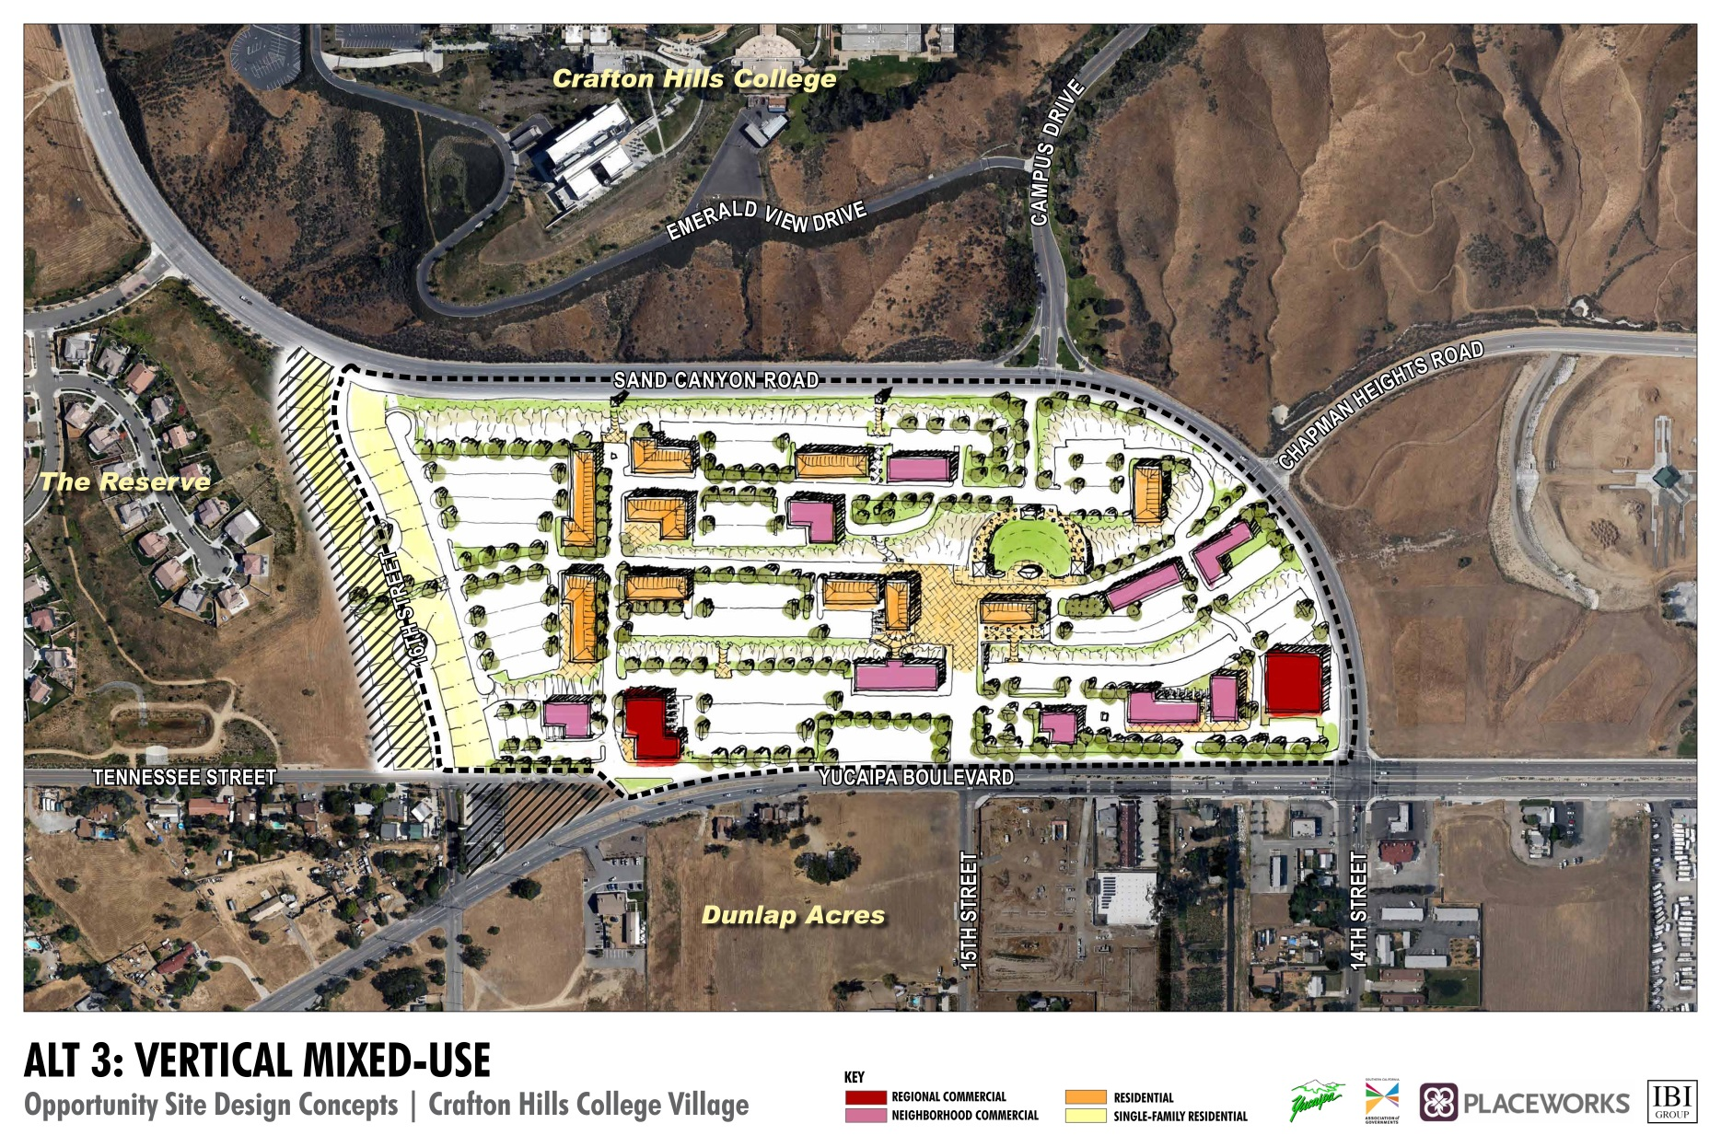
ALTERNATIVE 3: Vertical Mixed Use

Slide 17
LAND USE ALTERNATIVES
 | Alt 1: All Commercial | Alt 2: Horizontal Mixed Use | Alt 3: Vertical Mixed Use
Regional Commercial: Retail | 133,500 | 68,500 | 47,700
Neighborhood Commercial: Retail | 141,100 | 94,500 | 126,140
Neighborhood Commercial: Office | - | 40,500 | 54,060
Residential | 0 | 392 | 393
Single-Family Housing | 0 | 43 | 43
Nonresidential Parking (4/1,000 for Alt 1, 3.3/1,000 for Alts 2 and 3) | 1102 | 672 | 755
Student Parking at 1.75/unit | - | 686 | 688
Total Nonresidential SF | 274,600 | 203,500 | 227,900
Total Residential Units and Beds | - | 392 | 393
Total Single-Family Housing (with 2-car garages) | - | 43 | 43
Total Parking Spaces (excluding SFD) | 1,102 | 1,358 | 1,443
For Alternatives 2 and 3, the Neighborhood Commercial is split 70% Retail, 30% Office

Slide 18
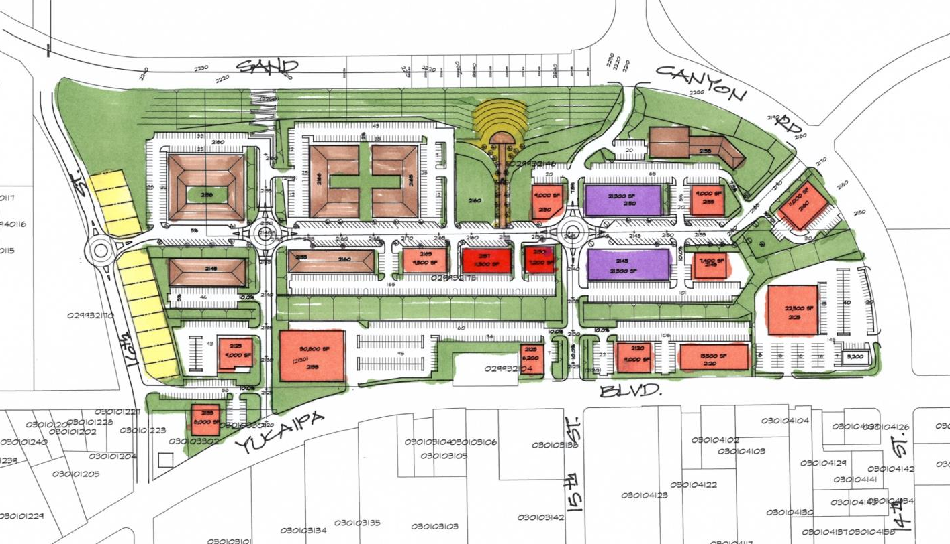
DRAFT Preferred Alternative: Mixed Use

Slide 19
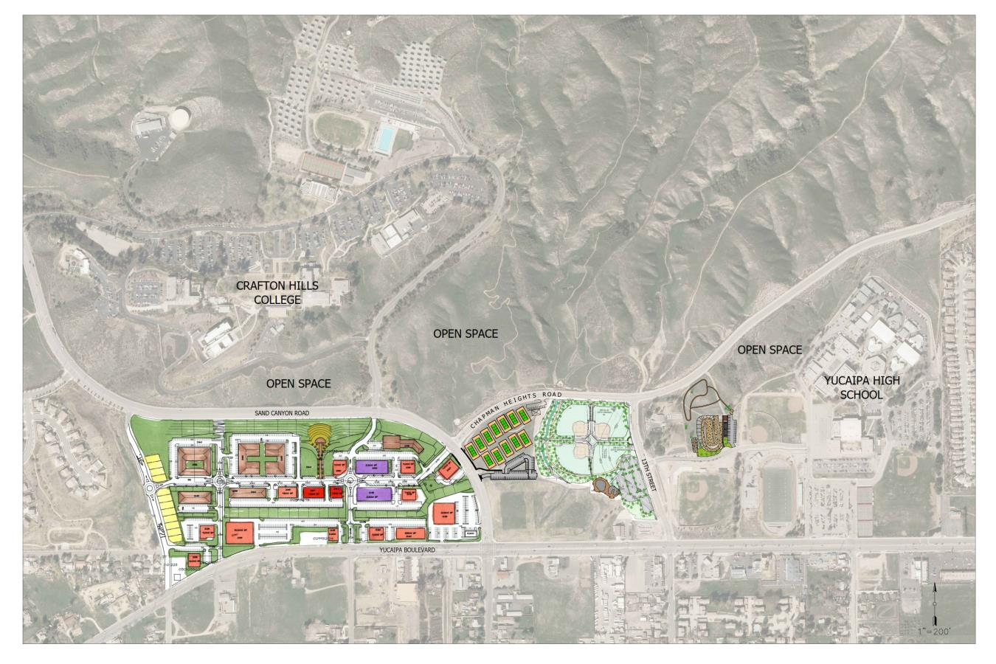
Integration Ideas and Issues

Slide 20
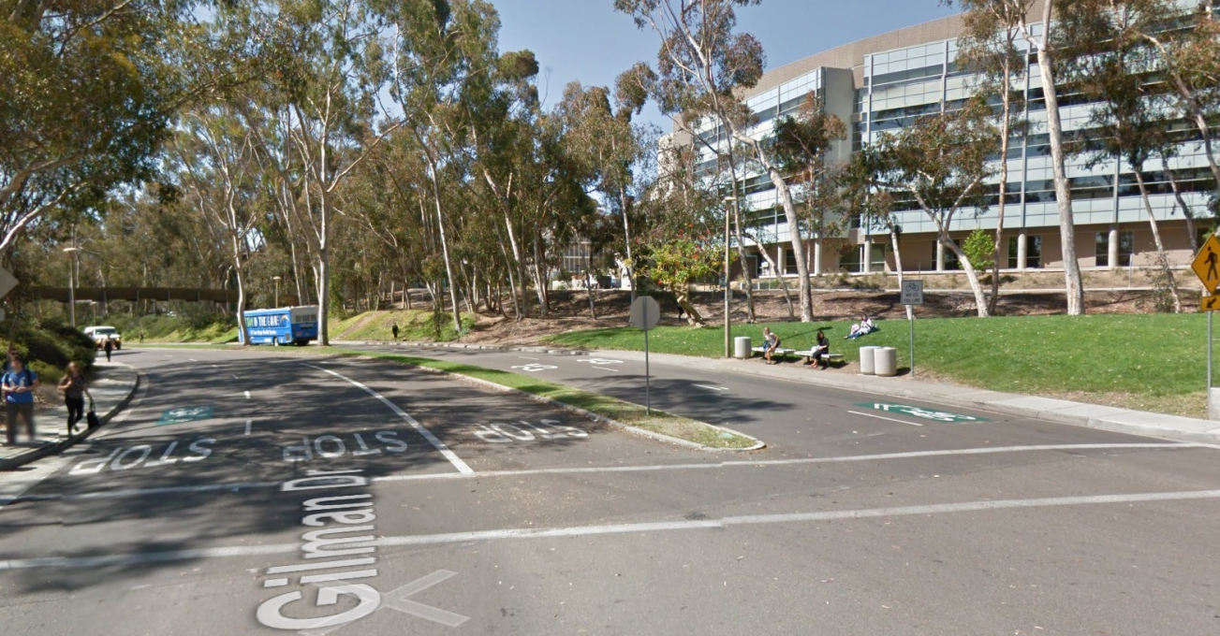
COMPLETE STREETS
The California Complete Streets Act (AB 1358) requires Circulation Elements of General Plans to address multimodal transportation
All modes of transportation: walking, biking, car travel, and transit
Multiple users including children, adults, seniors and the disabled
Different modes of travel prioritizes for different roadways
Transit
Bicycle
Auto
Pedestrian

