Slide 1
Student Success Scorecard Data from ARCC 2.0 2014 Year Ending in 2012-2013
Prepared and Presented by:
Dr. James Smith, Dean, Institutional Effectiveness, Research & Planning
Keith Wurtz, Dean, Institutional Effectiveness, Research & Planning
Notes:
ARCC – Accountability Reporting for the Community Colleges

Slide 2
Purpose of ARCC 2.0
To facilitate the improvement of student progress and success
ARCC 2.0 is part of the Statewide Student Success Initiative and the Student Success Act and was a recommendation of the Student Success Task Force

Slide 3
ARCC 2.0 Momentum Point Outcomes
Remedial (English and Math) – Percentage of credit students tracked for six years from 2007-08 to 2012-13 who started below transfer level in English, mathematics, and/or ESL and completed a college-level course in the same discipline.
Persistence – Percentage of first-time degree and/or transfer-seeking students tracked for six years from 2007-08 to 2012-13 who enrolled in the first three consecutive terms. This metric is considered a milestone or momentum point. Research shows that students with sustained enrollment are more likely to succeed.
30 Units – Percentage of first-time degree and/or transfer seeking students tracked for six years from 2007-08 to 2012-13 who achieved at least 30 units. Credit accumulation, 30 units specifically, tends to be positively correlated with completion and wage gain.
Notes:
Leinbach and Jenkins (2008, pp. 1) define momentum points as “measurable educational attainments, such as completing a college-level math course, that are empirically correlated with the completion of a milestone.” The CCCCO Student Success Task Force (SSTF, 2011) refers to momentum points as progression metrics.
Persistence – The percentage of first-time students with minimum of 6 units earned who attempted any Math or English in the first three years and achieved the following measure of progress (or momentum point) within six years of entry:
• Enroll in first three consecutive primary semester terms (or four quarter terms) anywhere in the CCC system.
30 Units – The percentage of first-time students with minimum of 6 units earned who attempted any Math or English in the first three years and achieved the following measure of progress (or milestone) within six years of entry:
• Earned at least 30 units in the CCC system.
Remedial (English and Math) – The percentage of credit students who attempted a course designated at “levels below transfer” in:
• Math and successfully completed a college-level course in Math within six years.
• English and successfully completed a college-level course in English within six years.
• ESL and successfully completed the ESL sequence or a college-level English course within six years.
The cohort is defined as the year the student attempts a course at “levels below transfer” in Math, English and/or ESL at that college.

Slide 4
ARCC 2.0 Completion Outcomes
Completion (SPAR) – percentage of first-time degree and/or transfer-seeking students tracked for six years from 2007-08 to 2012-13 who completed a degree, certificate or transfer related outcomes.
Career Technical Education (CTE) – Percentage of students tracked for six years from 2007-08 to 2012-13 who completed several courses classified as career technical education (or vocational) in a single discipline and completed a degree, certificate or transfer related outcome.
Notes:
Completion (SPAR) – The percentage of first-time students with minimum of 6 units earned who attempted any Math or English in the first three years and achieved any of the following outcomes within six years of entry:
• Earned AA/AS or credit Certificate (Chancellor’s Office approved)
• Transfer to four-year institution (students shown to have enrolled at any four-year institution of higher education after enrolling at a CCC)
• Achieved “Transfer Prepared” (student successfully completed 60 UC/CSU transferable units with a GPA >= 2.0)
Career Technical Education (CTE) – The percentage of students who completed a CTE course for the first-time and completed more than 8 units in the subsequent three years in a single discipline (2-digit vocational TOP code where at least one of the courses is occupational SAM B or C) and who achieved any of the following outcomes within six years of entry:
• Earned any AA/AS or credit Certificate (Chancellor’s Office approved)
• Transfer to four-year institution (students shown to have enrolled at any four-year institution of higher education after enrolling at a CCC)
• Achieved “Transfer Prepared” (student successfully completed 60 UC/CSU transferable units with a GPA >= 2.0)

Slide 5
ARCC 2.0 Comparison Groups
Remedial Progress Rate (Unprepared for College) - The percentage of credit students who start out at any levels below transfer in English, Mathematics, and/or ESL
College Prepared Rate – First attempted math or English was transfer level.

Slide 6
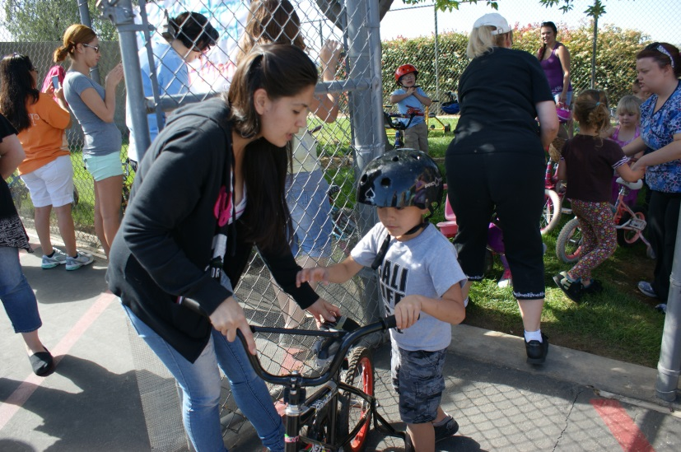
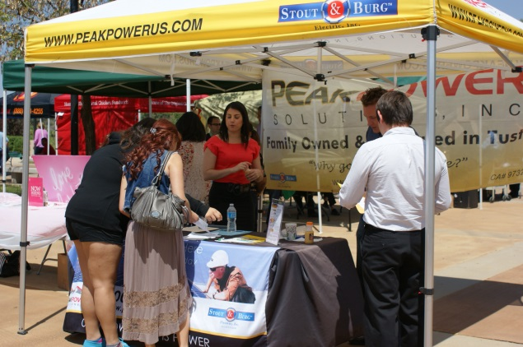
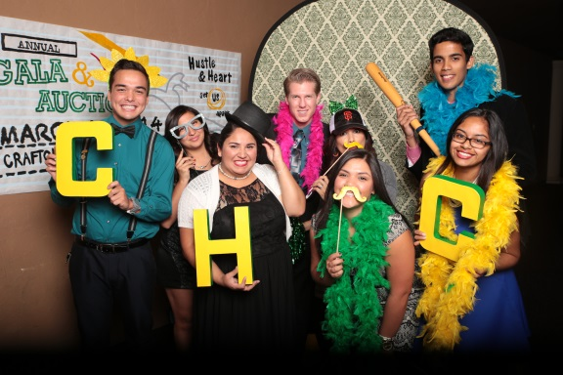
Crafton Hills College

Slide 7
Crafton ARCC 2.0 Momentum-Point Rates
Notes:
Comment that the strategies we implemented will not be impactful for two more years.

Slide 8
CHC Momentum-Point Rates by Gender
Gender | Math | English | Persistence | 30 Units
Overall | 32.6 | 41.8 | 70.4 | 62.6
Female | 36.4 | 45.7 | 74.3 | 63.5
Male | 28.6 | 37.8 | 65.9 | 62.0
The percentages reflect the percent of students in the six year cohort who completed each momentum point
Males appear to struggle slightly more with improving in math than females.
The other differences are not substantially different from each other.
Notes:
If use the 80% rule and divide Male Math improvement rate of 28.6 by Female math improvement rate of 36.4% the result is 79.0% which is slightly lower than 80%. Suggesting that males male struggle more at math improvement than females.
Using the 80% rule, even though males struggle more with English improvement rates, does not meet the 80% rule criterion: 37.8/45.7 = 82.7.

Slide 9
CHC Momentum-Point Rates by Ethnicity
Ethnicity | Math | English | Persistence | 30 Units
Overall | 32.6 | 41.8 | 70.4 | 52.2
African American | 26.5 | 35.1 | 65.2 | 66.7
Native American | 25.0 | 50.0 | 75.0 | 66.7
Asian | 52.6 | 64.3 | 69.0 | 72.4
Filipino | 40.0 | 50.0 | 47.8 | 65.2
Hispanic | 27.9 | 38.3 | 69.0 | 61.3
Pacific Islander | NA | 42.9 | 66.7 | 66.7
White | 35.9 | 44.4 | 72.8 | 64.1
Notes:
Higher Rates
-African American and Native American students are more likely to earn 30 units
-Native American students are more likely to improve in English and persist than overall and Caucasian students
Lower Rates
-Using the 80% rule, African American (.265/.359 = .696), Native American (.250/.359 = .696: however, n is low), and Hispanic (.279/.359 = ..777) students have lower math improvement rates than Caucasian students
-Using the 80% rule, African American students had lower English (.351/.444 = ..791) improvement rates than Caucasian students
-Only 23 students in Filipino cohort

Slide 10
Crafton ARCC 2.0 Completion Rates
Notes:
The CTE programs contain three strategies that research has shown to work extremely well and may be reason for increase: clear goals, connected to faculty, and cohorts.
The CTE Completion rate is a new measure and one we will be exploring in the future.

Slide 11
CHC Completion Rates by Gender
Gender | CTE | Completion
Overall | 49.1 | 39.8
Female | 55.0 | 43.2
Male | 46.3 | 36.2
Males appear to struggle more with CTE improvement rates than females.
Notes:
-Again used the 80% rule, and differences were not substantially different. Males had lower rates in both.

Slide 12
CHC Completion Rates by Ethnicity
Ethnicity | CTE | Completion
Overall | 49.1 | 39.8
African American | 31.6 | 34.8
Native American | N/A | 41.7
Asian | 70.8 | 58.6
Filipino | 53.8 | 43.5
Hispanic | 53.5 | 33.1
Pacific Islander | N/A | 33.3
White | 46.8 | 42.6
Notes:
-Using 80% rule African American students have a lower CTE Completion (.316/.468=.675) than Caucasian students
-Using 80% rule Hispanic students have a lower Completion (.331/.426=.776) than Caucasian students .

Slide 13
Crafton Completion Rates Over Prior Year
ARCC Outcome | 06-07 to 11-12 | 07-08 to 12-13 | Improvement over Prior Year
Persistence | 69.5% | 70.4% | Yes
30 Unit Completion Rate | 64.6% | 62.6% | No
Completion Rate (SPAR) | 43.5% | 39.8% | No
Remedial Rate English | 43.7% | 41.8% | No
Remedial Rate Math | 32.6% | 32.6% | Same
CTE Rate | 44.2% | 49.1% | Yes
Notes:
Will see growth based on interventions in two years and we will need more sections to meet the demand.

Slide 14
Crafton Completion Rates Compared to State
ARCC Outcome | 2007-08 to 2012-13 |  | CHC Rate Higher than State
 | State | Crafton
Persistence | 70.5 | 70.4 | Same
30 Unit Completion Rate | 66.5 | 62.6 | No
Completion Rate (SPAR) | 48.1 | 39.8 | No
Remedial Rate English | 43.7 | 41.8 | No
Remedial Rate Math | 30.6 | 32.6 | Yes
CTE Rate | 53.9 | 49.1 | No
Notes:
Will see growth based on interventions in two years and we will need more sections to meet the demand.

Slide 15
Completion Rates Examined Further
Completion | 2003-04 | 2004-05 | 2005-06 | 2006-07 | 2007-08
Overall | 999 | 947 | 989 | 1,033 | 1,075
 | 44.2% | 41.2% | 42.2% | 41.8% | 39.8%
College Prepared | 194 | 178 | 221 | 257 | 259
 | 66.0% | 62.4% | 62.4% | 58.8% | 61.0%
Unprepared | 805 | 769 | 768 | 776 | 816
 | 39.0% | 36.3% | 36.3% | 36.2% | 33.1%
Crafton extensively researched the Completion rate and learned that the largest predictor of the Completion Rate is to successfully complete transfer level math
Information is being used to inform writing of grants, and for the Left Lane proposal
Notes:
Both the college prepared and unprepared rates have decreased consistently over last five years. The college prepared rate has decreased from 66% to 61%, a 5% decline or an 8% rate decrease. The unprepared rate has decreased from 39% to 33%, a 6% decline or a 15% rate decrease. Basically these are the same. However, in order to move this rate focus needs to be on where most of the students are. In this case, by far, more students are coming to us unprepared: 75% in the 2006-2007 cohort.

Slide 16
Crafton Student Learning and Success
Integration of Instruction/Student Services | First Year Implemented | First Year See Impact in Scorecard | Scorecard Outcome
 |  |  | Math | English | Persist | 30 Unit | Completion | CTE
Fast Track Math | 2013-2014 | 2019-2020 | X |  | X | X | X
Left Lane | 2012-2013 | 2018-2019 | X | X | X | X | X
Santos Manuel | 2010-2011 | 2016-2017 | X |  | X
Learning Communities | 2007-2008 | 2013-2014 |  |  | X
Tutoring (SI, SLA) | 2011-2012 | 2017-2018 | X | X | X
Note: The First-Year See Impact in Scorecard was estimated by calculating six years starting in the year the cohort would be identified and adding one year since the year the information is reported in the Scorecard one after the six-year cohort has ended.
Notes:
Need to give example, For example, Fast Track is where students can take two math courses in the same semester. The first semester we did this was in Spring 2014, and three-year math throughput rate almost doubled.
In addition, with LCs will see impact in 2013-2014, which we will have data for next year.
*Many of the Title V Transfer Prep strategies were not implemented until a year after the grant had started in 2010-2011.
** Many of the Title V STEM strategies were not implemented until a year after the grant had started in 2011-2012.
Persistence did improve by ONE PERCENTAGE POINT, which is a pretty good start.
Need to spend time here and discuss. Research conducted at Crafton shows that each of these are related to student success.
Integration of Instruction and Support Services – Crafton has implemented these programs in the last two years and we should see increases in the Completion rate, 30 unit completion rate, persistence, and in the math and English improvement rates.
Left Lane Program -
Santos Manuel -
Learning Communities – Counselors are attached to classes
Tutoring (SI, SLA) -
Counselors Attending Classes -
Enhanced Transfer Programs and Services – These programs will help with the Crafton persistence, 30 unit rate, and completion rate.
Title V Transfer Prep Grant -
STEM and Trek Academy
Honors
Transfer Center
Transfer Advocates
Curricular changes
Reducing time to complete basic skills – Focus here is on moving towards acceleration.
Alignment and Partnership with K-12 – These strategies will also help to address the English and math improvement rates.
Common Core
SOAR
EAP

Slide 17
Crafton Student Learning and Success
Strategy | First Year Implemented | First Year See Impact in Scorecard | Scorecard Outcome
 |  |  | Math | English | Persist | 30 Unit | Completion | CTE
Enhanced Transfer Programs & Services
Title V Transfer Prep | 2011-2012* | 2017-2018 |  |  | X | X | X
STEM and Trek Academy | 2012-2013** | 2018-2019 |  |  | X | X | X
Honors Program | 2012-2013 | 2018-2019 |  |  | X | X | X
Transfer Center | 2012-2013 | 2018-2019
Transfer Advocates | 2012-2013 | 2018-2019 |  |  |  |  | X
Alignment and Partnership with K-12
SOAR | 2009-2010 | 2015-2016 | X | X | X | X | X
Early Assessment Program (EAP) | 2012-2013 | 2018-2019 | X | X | X | X | X
Common Core | 2014-2015 | 2020-2021 | X | X | X | X | X
Note: The First-Year See Impact in Scorecard was estimated by calculating six years starting in the year the cohort would be identified and adding one year since the year the information is reported in the Scorecard one after the six-year cohort has ended.
Notes:
*Many of the Title V Transfer Prep strategies were not implemented until a year after the grant had started in 2010-2011.
** Many of the Title V STEM strategies were not implemented until a year after the grant had started in 2011-2012.
Persistence did improve by ONE PERCENTAGE POINT, which is a pretty good start.
Need to spend time here and discuss. Research conducted at Crafton shows that each of these are related to student success.
Integration of Instruction and Support Services – Crafton has implemented these programs in the last two years and we should see increases in the Completion rate, 30 unit completion rate, persistence, and in the math and English improvement rates.
Left Lane Program -
Santos Manuel -
Learning Communities – Counselors are attached to classes
Tutoring (SI, SLA) -
Counselors Attending Classes -
Enhanced Transfer Programs and Services – These programs will help with the Crafton persistence, 30 unit rate, and completion rate.
Title V Transfer Prep Grant -
STEM and Trek Academy
Honors
Transfer Center
Transfer Advocates
Curricular changes
Reducing time to complete basic skills – Focus here is on moving towards acceleration.
Alignment and Partnership with K-12 – These strategies will also help to address the English and math improvement rates.
Common Core
SOAR
EAP

Slide 18
Crafton Student Learning and Success Funding Sources
Strategy | Funding Source
Integration of Instruction/Student Services
Fast Track Math | General Fund (Cost of Offering Sections)
Left Lane | SBCCD
Santos Manuel | Santos Manuel Indian Tribe
Learning Communities | Title V Transfer Prep and STEM Trek Grants
Tutoring (SI, SLA) | Title V Transfer Prep and STEM Trek Grants
Enhanced Transfer Programs & Services
Honors Program | Title V Transfer Prep Grant
Transfer Center | Title V Transfer Prep Grant
Transfer Advocates | Title V Transfer Prep Grant
Alignment and Partnership with K-12
SOAR | Student Success , Left Lane, Santos Manuel
Early Assessment Program (EAP)
Common Core

Slide 19
Current support programs are helping.
Program | Success Rate
 | Program | Campus
Left Lane | 78.7% | 73.4%
Supplemental Instruction: STEM | 78.7% | 73.4%
Supplemental Instruction: Title V | 80.2% | 73.4%
SOAR | 81.2% | 73.4%
STEM Counseling | 83.9% | 73.4%
Occupational Programs | 79.3% | 73.4%
Compressed Courses | 74.8% | 73.4%
Tutoring Center San Manuel Students | 76.6% | 73.4%
These programs need regular review and assessment, data for the same cohort year as this report (2012 – 13) shows higher success rates for all support programs.
Notes:
Left Lane success rate is from the Fall 2012 cohort and includes the all discipline success rate (see Table 3 from 2014 report).
Supplemental Instruction if from RRN 606, Fall 2012 brief.
SOAR Success rates are a summary from Fall 2009 to Fall 2012: RRN 380.
Compressed courses is from the study conducted by Ben that looks at success from 1011 to 1213: RRN 688.
Tutoring Center San Manuel Students are San Manuel students who attended tutoring center: RRN 492. It was 2011-2012 though.

Slide 20
Crafton Student Learning and Success
Assess, Measure, and Continuous Improvement
Revision of QEIs to measure progress annually
Updating and revising EMP
Notes:
Assess, Measure, and Continuous Improvement – These are being addressed this year.
Revision of QEIs – QEIs will be aligned at each level of institution and programs will be able to see how they are contributing to each QEI. In addition, in process of developing annual measures that will inform the cohort tracking measures.
Updating EMP

Slide 21
Successful Strategies Supported by Crafton Research
Strategy | Approach
Successfully complete transfer level math and English | Left Lane, SOA³R, New Innovation in Higher Education and Title V Pathways Grant, Fast Track Math, SI, Student Equity Plan
Enroll full-time | Left Lane
Collaboration between Instruction and Student Services | Left Lane, SOA³R, Transfer Prep and STEM grants
Student Education Plan (SEP) | Student Success, Left Lane, SOA³R
Notes:
Best predictor of transferring to a four-year institution is to complete transfer level math
Students are more likely to transfer if they enroll full-time

Slide 22
Student Success Annual Effectiveness Indicators
Course Success
Course Completion (i.e. retention)
Degree/Certificate Completion Rate (Developing Methodology for annual measure)
Transfer Rate (Developing Methodology for annual measure)
Transfer Readiness Rate (Developing Methodology for annual measure)
Notes:
In order to be able to determine what kind of impact that Crafton is having we are in the process of developing annual indicators.

Slide 23
How can you help Crafton?
Ellucian’s (i.e. Datatel’s) electronic Student Education Plan (SEP, Course Planning Interface has been implemented
Continue to support the implementation of Degree Audit systems
All students need to have an SEP
Help Crafton to meet the requirements of the Student Success Act by supporting the addition of more sections to meet demand
Crafton will be able to plan courses based on SEPs
Crafton will be able to track student progress on meeting their educational goals and identify improvement areas
Notes:
This request has gone through TESS and has been prioritized.
Support the implementation of the priority registration process that requires students to continuously enroll in math and English until they have completed the math and English required in their SEP
Successfully completing transfer level math is the best predictor of achieving any ARCC milestone
Students are statistically significantly more likely to complete any ARCC milestone if they complete transfer level English within their first year

Slide 24
How can you help Crafton?
Support funding the Student Success Initiatives and the additional sections needed to support initiative
Need to continue to balance incentives for growth with incentives for success
Notes:
Support the increase in math and English sections to meet student need
Crafton students need an additional 37 math sections and 47 English sections or 345 FTES
Or
First-time Crafton students need an additional 15 math sections and 23 English sections or 156 FTES

Slide 25
San Bernardino Valley College

Slide 26
San Bernardino Valley College
Student Success Scorecard data supports goal setting in several campus planning documents:
Strategic Plan
Educational Master Plan
Student Equity Plan
Basic Skills Plan
Student Success Plan
The scorecard provides a basis to focus on specific content areas and the needs of specific student sub-groups.

Slide 27
SBVC ARCC 2.0 Momentum-Point Rates
Notes:
English rates have improved.
Math improvement rates show almost no meaningful change--equal to the state average and significantly higher than peer campuses.
Persistence and 30 units completion rates have declined.

Slide 28
SBVC Momentum-Point Rates by Gender
Gender | Persistence | 30 Units | English | Math
Overall | 64.0% | 57.5% | 32.1% | 30.4%
Female | 64.3% | 57.8% | 33.8% | 31.5%
Male | 63.5% | 56.8% | 29.4% | 28.6%
No significant achievement gaps exists between men and women. Women do slightly better in both math and English.

Slide 29
SBVC Momentum-Point Rates by Ethnicity
Ethnicity | Persistence | 30 Units | English | Math
Overall | 64.0% | 57.5% | 32.1% | 30.4%
African American | 64.6% | 51.6% | 23.1% | 20.5%
Native American* | 60.0% | 30.0% | 8.3% | N/A
Asian | 67.7% | 64.6% | 51.1% | 40.0%
Filipino* | 57.6% | 63.6% | 32.1% | 31.1%
Hispanic | 66.2% | 58.6% | 30.5% | 32.4%
Pacific Islander* | 55.6% | 72.2% | 36.8% | 18.8%
White | 57.9% | 56.8% | 44.2% | 36.1%
Notes:
Red circles identify disproportionate impact levels (less than 80% of the highest preforming group.)

Slide 30
SBVC Completion Rates
Completion rates have experienced a two year decline; CTE completion rates have only declined slightly (1.3%) after a large increase in 2011-12.

Slide 31
Completion Rates by Gender
Gender | CTE | Completion
Overall | 52.0% | 33.5%
Female | 57.4% | 33.6%
Male | 47.7% | 33.3%
Women are completing Career Technical Education (CTE) programs at a higher rate than men. This is largely due to the high completion rates in nursing and child development programs where women are highly represented.
Notes:
Course Retention Rates 2012-13
Aeronautics 95.59%
Automotive Technology 89.91%
Child Development 89.98%
Electricity & Electronics 91.62%
Inspection Technology 99.46%
Library Technology 87.03%
Machinist Technology 91.82%
Nursing 97.80%
Psychiatric Technician 97.50%
Refrigeration & AC 94.32%
Water Supply Technology 95.27%
Welding Technology 95.80%

Slide 32
SBVC Completion Rates by Ethnicity
Ethnicity | Completions | CTE
Overall | 33.5% | 52.0%
African American | 32.3% | 52.0%
Native American* | 10.0% | 18.2%
Asian | 41.4% | 60.9%
Filipino* | 57.6% | 64.7%
Hispanic | 31.0% | 54.8%
Pacific Islander* | 44.4% | 63.6%
White | 36.3% | 45.3%
(*) Asterisk identifies groups with very small populations
Notes:
Disproportionate impact

Slide 33
SBVC Improvement Rates Over Prior Year
ARCC Outcome | 06 - 07 to 11-12 | 07- 08 to 12-13 | Improvement over Prior Year
Persistence | 63.4% | 64.0% | +0.6%
30 Unit Completion Rate | 58.5% | 57.5% | -1.0%
Completion Rate | 35.6% | 33.5% | -2.1%
Remedial Rate English | 25.2% | 32.1% | +6.9%
Remedial Rate Math | 31.5% | 30.4% | -1.1%
CTE Rate | 53.3% | 52.0% | -1.3%
Red circle identifies the measures with the largest change between cohort years—Increase in English and decline in Completion
Notes:
Completions declined to by a meaningful amount, English increased by a meaningful amount. Other changes were not statistically meaningful.

Slide 34
SBVC Rates Compared to State
ARCC Outcome | 2007- 08 to 2012 -13 |  | SBVC rates compared to the State
 | State | SBVC
Completion | 48.1% | 33.5% | No
Persistence | 70.5% | 64.0% | No
30 Unit Completion Rate | 66.5% | 57.5% | No
Completion Rate Math | 30.6% | 30.4% | *same
Remedial Rate English | 43.6% | 32.1% | No
Remedial Rate ESL | 27.1% | 15.9% | No
CTE Rate | 53.9% | 52.0% | No
* No statistical difference
Notes:
We are closest to the state in the remedial math completion (effectively equal), but have greatest disparity in overall completion.

Slide 35
SBVC Completion Rate Examined Further
Completion | 2003-04 | 2004-05 | 2005-06 | 2006-07 | 2007-08
Overall | 1,400 | 1,477 | 1,470 | 1,534 | 1,718
 | 35.8% | 36.0% | 37.3% | 35.2% | 33.5%
College Prepared | 122 | 128 | 143 | 155 | 143
 | 55.7% | 60.9% | 58.7% | 54.2% | 58.7%
Unprepared (Remedial) | 1,278 | 1,349 | 1,327 | 1,379 | 1,575
 | 33.9% | 33.7% | 35.0% | 33.1% | 31.2%
Completion rates have declined for unprepared students. Success rates have increased for prepared students. However, prepared students represent a very small percentage of the total count and have a small effect on the overall rate.
Notes:
The greatest loss in the most recent cohort was among unprepared students.

Slide 36
Success in Math and English by Ethnicity
Notes:
Remedial

Slide 37
Success Differences Between Prepared and Unprepared Students by Ethnicity
Notes:
These ethnicities comprise the majority of the students (African American = 13.8%, Hispanic = 59.5%, White = 17.1%).

Slide 38
What are we doing to address Student Learning and Success
Student Success Center continues to show success —we have plans to expand and add more centers
A First-Year experience program is being planned
Reviving campus satellites to offer courses off-campus
Instituted courses on-demand
Partnerships with K-12
Partnership with CSUSB (STEM Pass Go Program)
Offering greater access to counselors for SEP
All current student success programs will continue
Notes:
AB86

Slide 39
Current support programs are helping.
Program Name | Program Success rate | Campus Success rate | Program Retention rate | Campus Retention rate
CARE | 77% | 69% | 91% | 89%
EOP&S | 77% | 69% | 93% | 89%
Puente | 81% | 69% | 94% | 89%
STAR | 75% | 69% | 89% | 89%
Student Success Center | 75% | 69% | 92% | 89%
Tumaini | 74% | 69% | 95% | 89%
Valley Bound | 72% | 69% | 94% | 89%
MCHS | 88% | 69% | 98% | 89%
These programs need regular review and assessment; data for the same cohort year as this report (2012–13) show higher success rates for all support programs.

Slide 40
Successful Strategies Supported by SBVC Research
Strategy | Program /Service | Outcome
Increase full-time enrollment | -First-year experience programs -Improved F/A service -Outreach to HS students to come directly to SBVC | Increase persistence Increased 30 unit rate Increased completions
Improve success in developmental and basic skills courses | -Writing lab -Reading lab -Student success center -Non-credit ESL courses | Higher success rates in English and math
Increase participation in learning communities | -HSI STEM Pass Go project -MSEIP | Higher transfer rates
Notes:
Best predictor of transferring to a four-year institution is to complete transfer level math
Minority Science and Engineering Improvement Project (MSIEP)
Student Success Centers (Dreamer’s Center; Athletes; students with children)

Slide 41
Strategies currently monitored by SBVC Research
Strategy | Program /Service | Outcome
Student Education Plan (SEP) | -Counselor in the quad -New Student Welcome Day | Increase SEP rate and completion rates
Increase success rates in basic skills English and reading | -Supplemental Instruction -Linked courses -Contextual learning | Greater success in upper-division courses
Increase success in developmental courses | -Pre-assessment workshops -Early alert notices from faculty (new SARS system) | Higher success rates
Notes:
Best predictor of transferring to a four-year institution is to complete transfer level math
Minority Science and Engineering Improvement Project (MSIEP)
Student Success Centers (Dreamer’s Center; Athletes; students with children)

Slide 42
How can you help SBVC?
Continue to Support Grant Development
Support innovative activities and programs on our campus
Support exploring the development of alternative modalities:
Online courses
Courses offered at satellite locations
Non-credit ESL
Continue to support our diverse set of student support programs
Support other innovative programs and partnerships:
Accelerated course model for basic skills
Supplemental Instruction
Tutoring
Professional development for faculty (SI, Online, SLOs, Technology )
Partnerships with K-12 and 4-year colleges

Slide 43
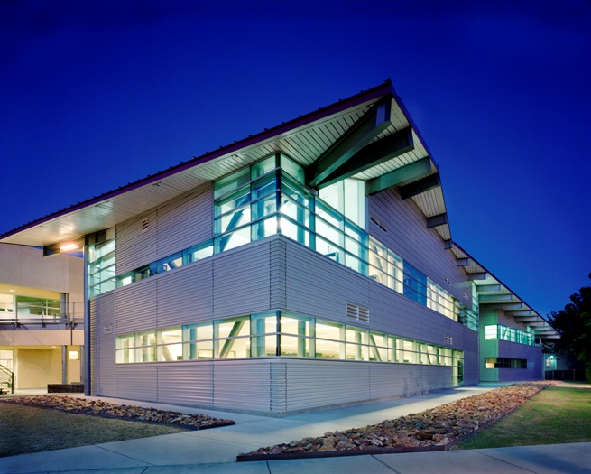
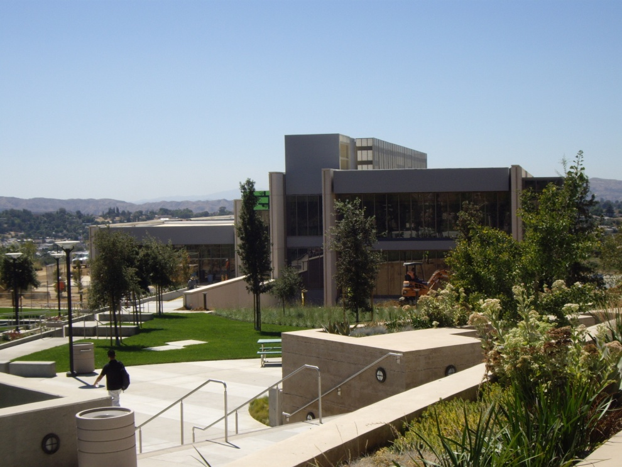
Questions?
.

