Slide 1
Master Student Program

Slide 2
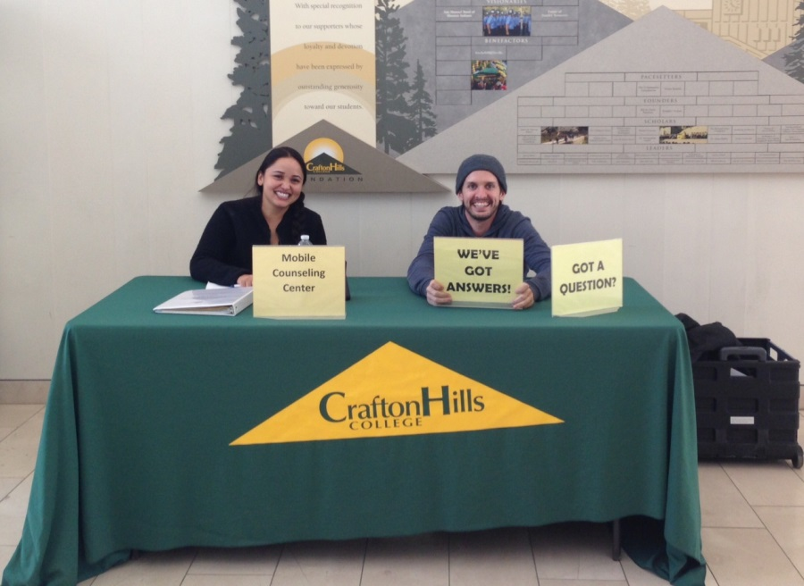
Creation of the Master Student
Need for a universal worker
Meet the evolving needs of the college
Mentors
Student Perspective

Slide 3
Who can be a Master Student
Student Currently enrolled at Crafton Hills College
Have completed at least 2 semesters
Minimum 3.0 GPA

Slide 4
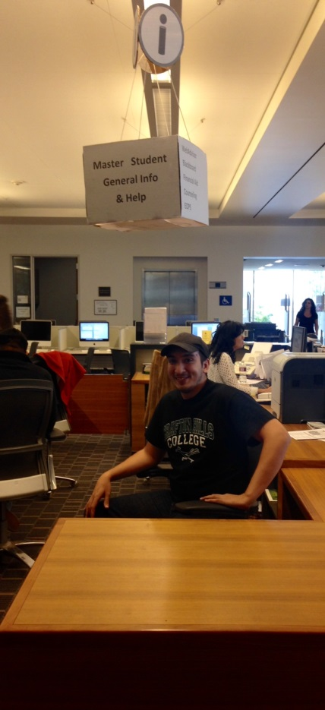
What does a Master Student do?
Main Role: Assist prospective and current students in navigating the ins and outs of being a SUCESSFUL student at Crafton.
We fulfill this role by assisting in…
Answer Centers
Left Lane / Summer Bridge
New Student Advising
Road Runner Rally
Senior Day
SEP Workshops
SOAR
Campus Programs

Slide 5
The Master Student Impact
Help bridge the gap between faculty and students.
Connect with other students by providing a student prospective.

Slide 6
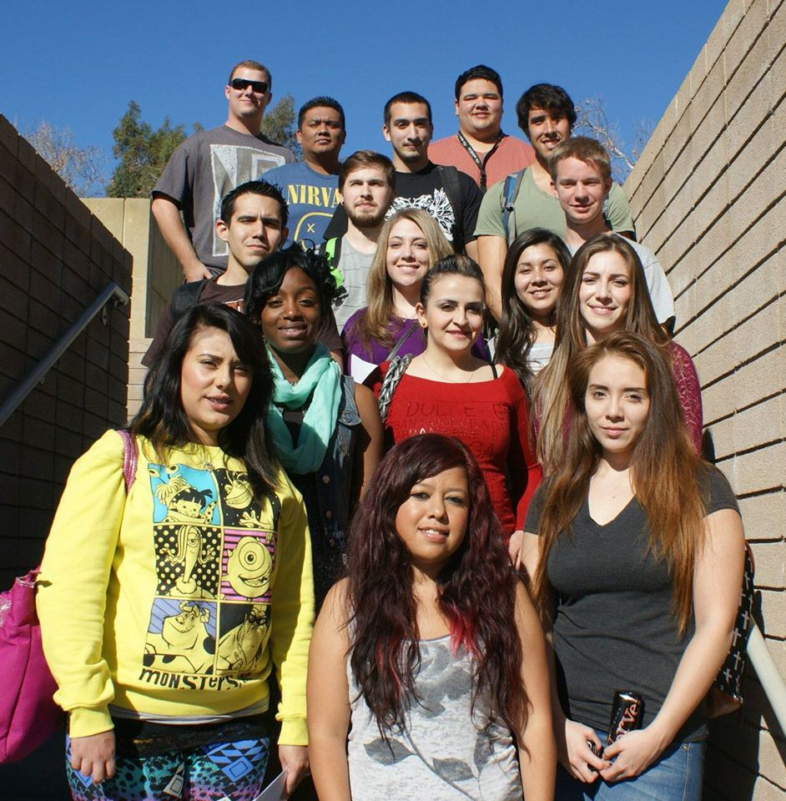
Thank You!

