Slide 1
Sabbatical 2014
Julie McKee, Sociology, CHC

Slide 2
What I did…
A.K. Smiley Library
Alpine Zoo
All Breed Dog Rescue
Banning District Library
Bear Paw Sanctuary
Blessing Center
Blossom Grove
Carol’s Kitchen
Cornerstone Hospice
Deseret Industries
Edward Dean Museum
Living Free
Loma Linda VA Hospital
Mentone Senior Center and Library
Millennium Housing/Spark Program
Norton Younglove Senior Center
Redlands Salvation Army
Redlands Bicycle Classic
Riverside County Library, Calimesa Branch and Yucaipa Branch
Rose Garden
“Point in Time Count” County of San Bernardino
San Bernardino County Museum
San Bernardino County Library, Loma Linda Branch and Highland Branch
YAPS
Youthhope

Slide 3
For Students

Slide 4
For Faculty

Slide 5
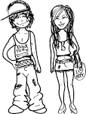
What I Learned

Slide 7
What’s Next?

Slide 8
For Crafton:
Technology
Courses
Program
Professional Development
Data

Slide 9
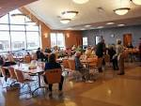
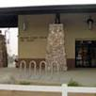
For the Community:

Slide 10
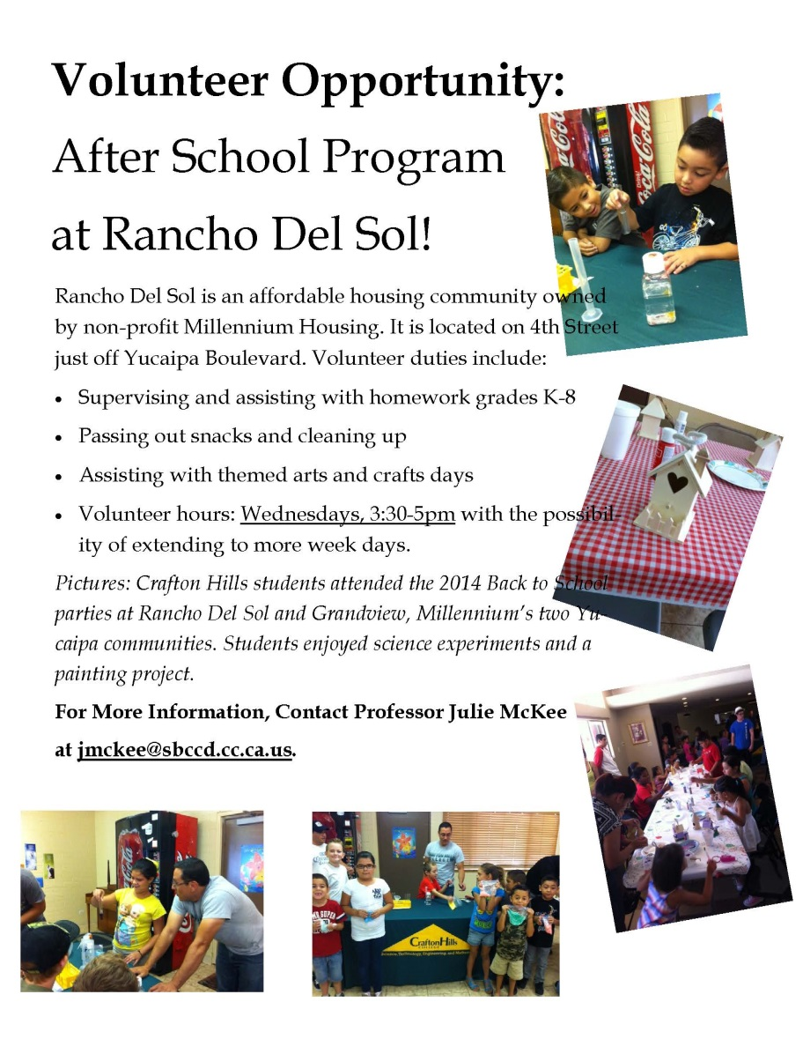
For Sociology Students:
Kick Off and Valentines for Vets 2/11 Pizza Party
Afterschool tutoring Wednesdays 3:30-5pm with snacks and supplies
“Second Saturdays”:
3/14 March to the Music
4/11 Celebrate Earth Day
5/9 Mothers Day Crafts Day
Sponsored by a President’s Circle Innovation Mini Grant

