Slide 1
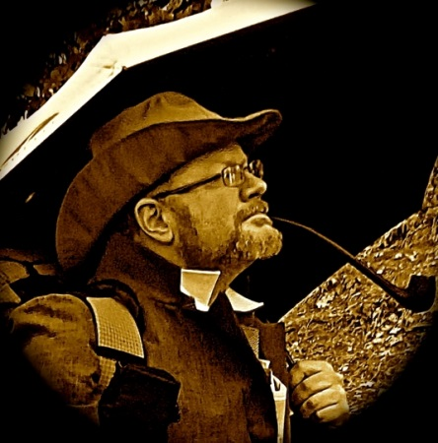
A Season of Pilgrimage
Michael “Professor Errant”Slusser
Sabbatical Journey
Fall 2014

Slide 2
“The human story finds its structure in geology and geography, in biology and chemistry—both natural and constructed—and in the complex and rapidly-changing cultural and natural landscape. With more people sharing our planet’s finite space, and with our planet and its systems imperiled, an educated attention to place in the broadest sense of the term is vital.”
(Iowa State University Program for Writing and the Environment)

Slide 3
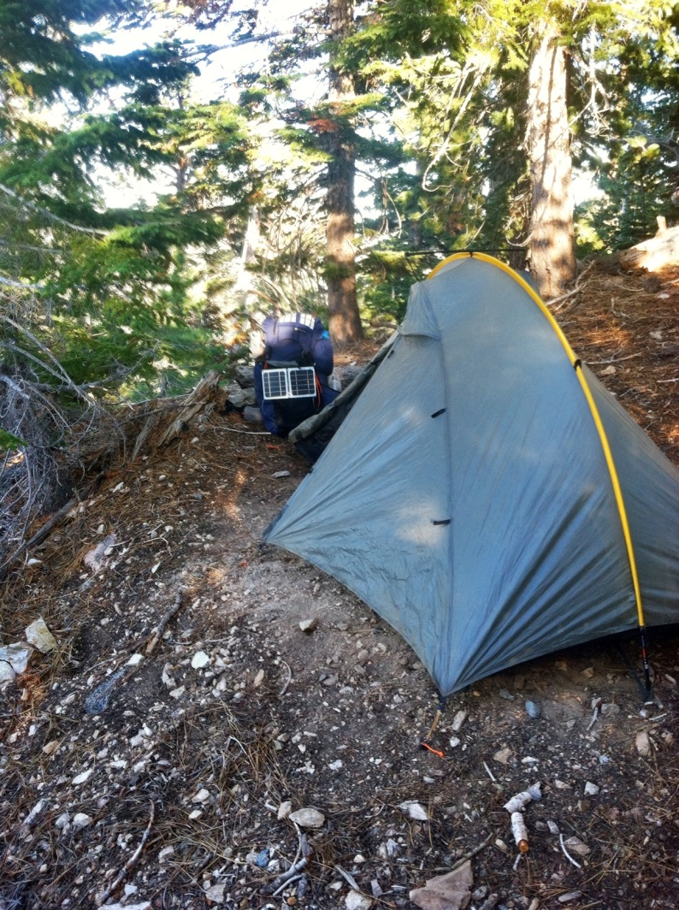
Rationale
— How do our experiences affect how we see the world? How does this, in turn, affect how we express ourselves?
— If students’ physical, economic, and cultural situations profoundly shape how they understand the world and how they choose to express themselves, how do these factors, in turn, build their perception of who they are and what they can be?
“The balance of evidence indicates conclusively that knowing and experiencing nature makes us generally happier, healthier people. More fully characterizing our intangible connections with nature will help shape decisions that benefit people and the ecosystems on which we depend.”
(“Humans and Nature: How Knowing and Experiencing Nature Affect Well-Being.”)

Slide 4
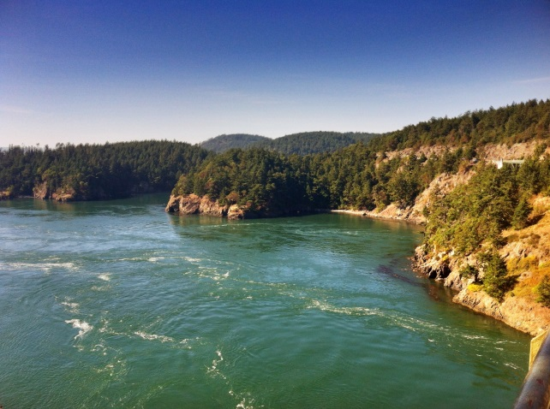
Areas Traversed:
Running Springs to near Agua Dulce
Oregon border at Ashland to Crater Lake
Port Townsend, Washington to Victoria, BC
Red’s Meadow near Mammoth Lakes to Bishop, CA
Big Bear Lake

Slide 5
“As I wrote to the committee when I finally decided to let go my attempt at hiking the entire trail, what I learned was a good deal more difficult, but I think more valuable, than I had intended: that endeavoring to achieve our hopes is always worthwhile; that learning about ourselves through that process is the most useful knowledge we can attain; and that life will never be what we predicted, but joy can be had from finding and pursuing our dreams, even if we do not reach those dreams for which we strove.”
(Manuscript of A Season of Pilgrimage—work in progress)

Slide 6
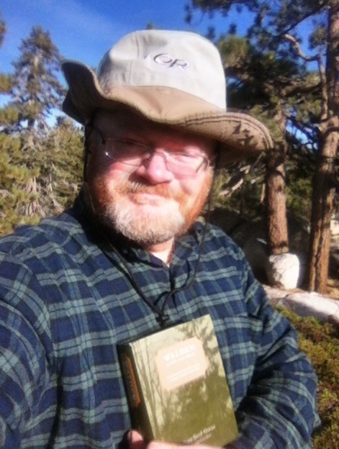
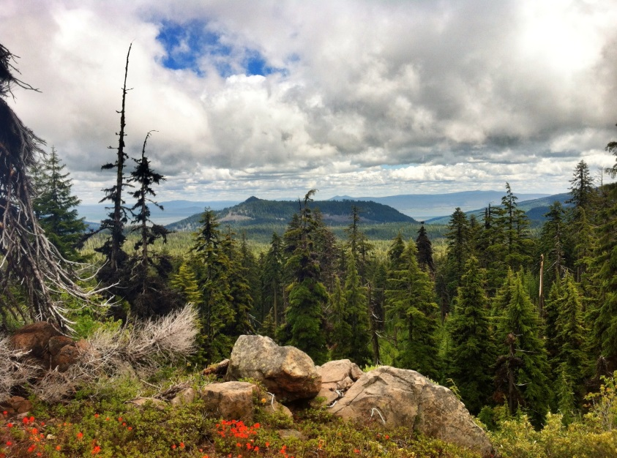
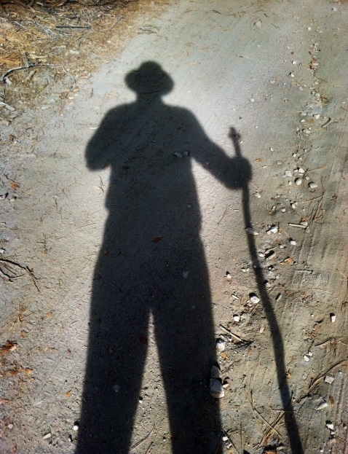
Narrative: A Season of Pilgrimage
— Focus is on personal growth through grappling with setbacks, changes in plan, and unlooked-for providence
— “I have been profoundly changed… I often find myself wondering ‘what if’ I had experienced this in my 20s? Of course, I always answer that I wasn't ready then. But I wonder if a caring, mentoring college professor could have sparked that readiness in me and changed my life? I think the trail has taught me that I can (and must) rely on myself—and at the same time that I can and must rely on the environment, and other people.”
(River Malcom)

Slide 7
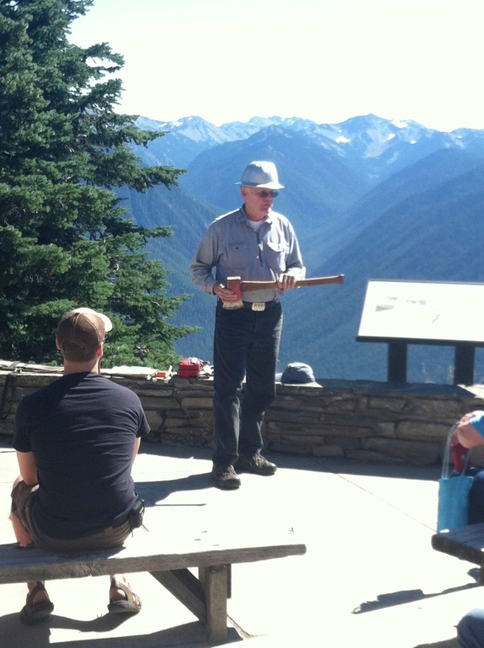
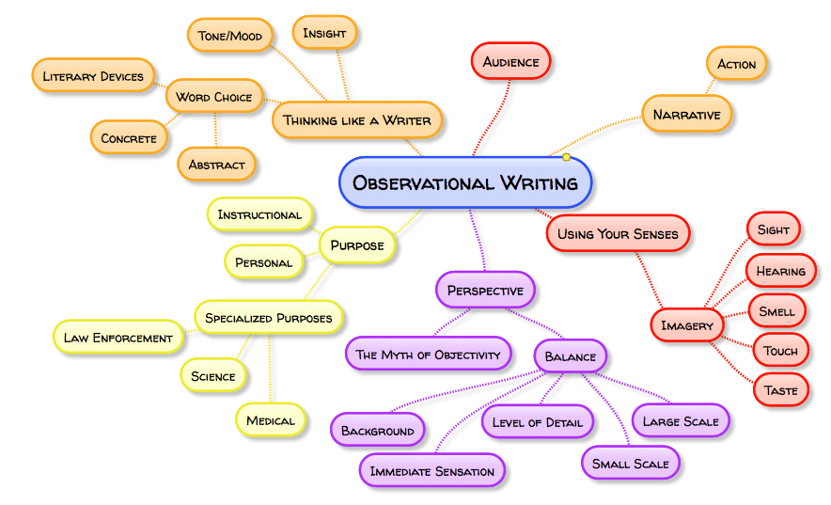
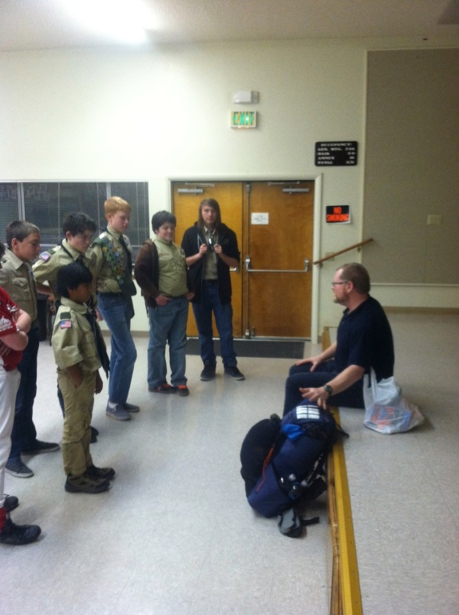
Observational Writing Text
— Focus is writing and the environment, both natural and cultural, and writing for a variety of purposes and audiences
— Includes sections on writing for specific disciplines, including law enforcement, medicine, and the sciences

Slide 8
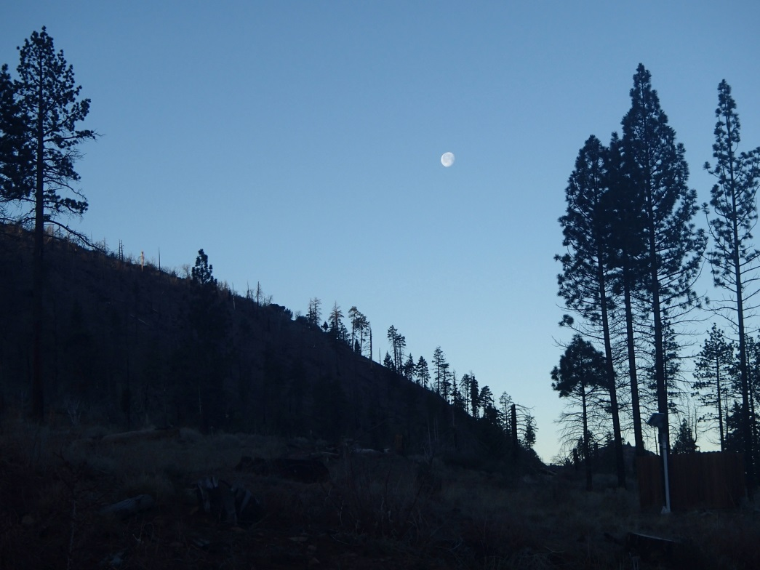
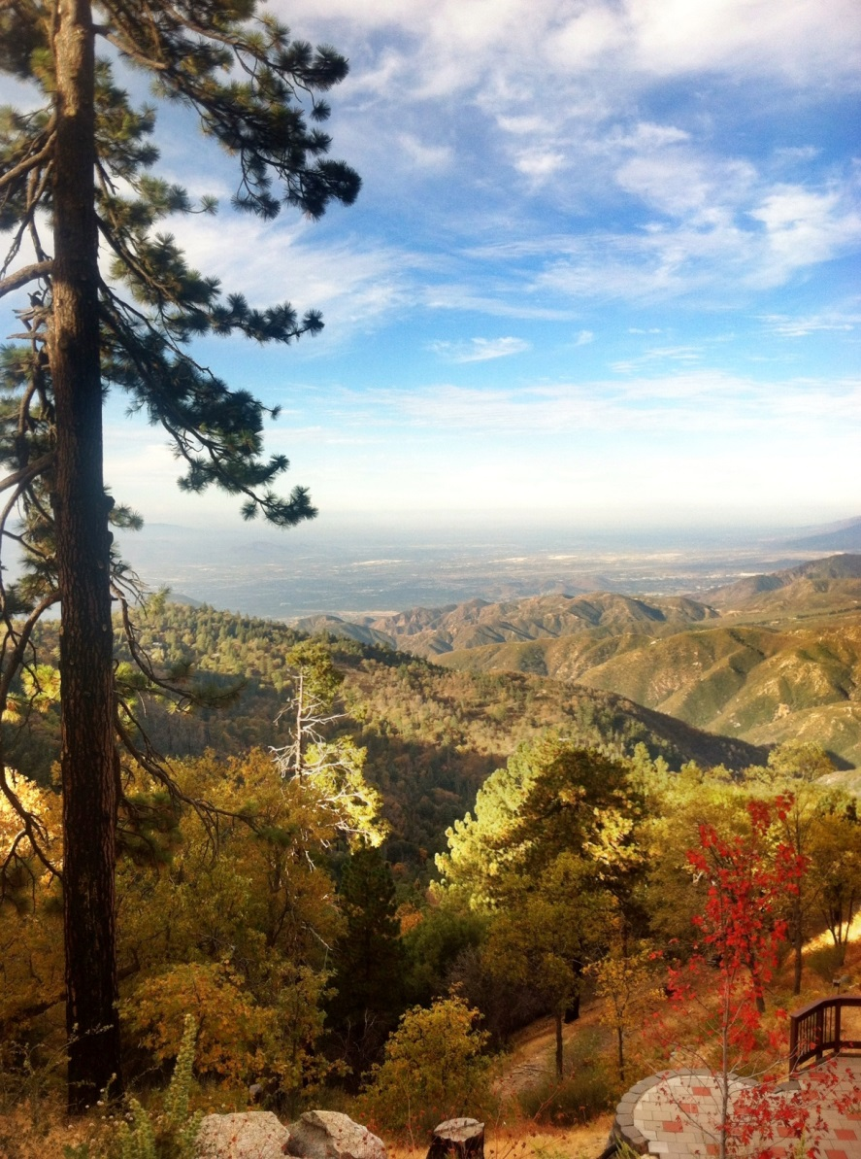
Observational Writing Course
— Focus is writing and wilderness, though overall observation is stressed
— Ideally could include one or two off-campus trips to local wild spaces (Joshua Tree National Park, San Bernardino National Forest, etc.)

Slide 10
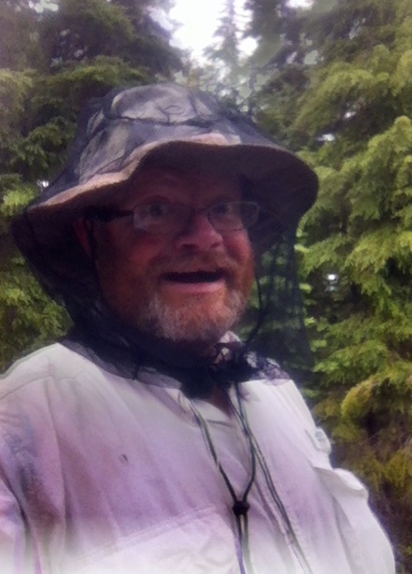
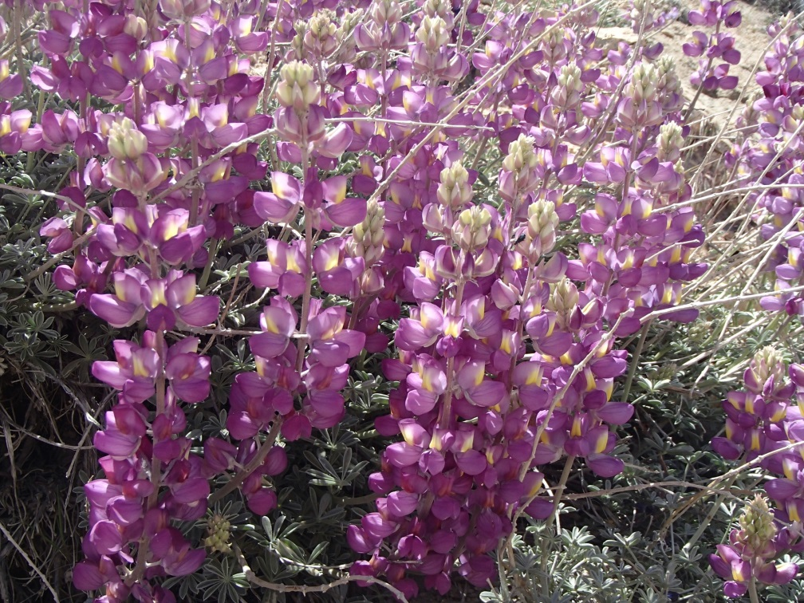
Citations
— English Department. Iowa State University, n.d. Web. 28 Jan. 2013.
— Russell, Roly, et al. “Humans and Nature: How Knowing and Experiencing Nature Affect Well-Being.” Annual Review of Environment and Resources 38 (Aug. 2013): 473-502. Web. 18 Oct. 2013.

