Slide 1
Student Equity
Transforming Lives:
Strengthening Community
Dr. Ricky Shabazz
Dr. Bryan Reece

Slide 2
Agenda
Process
Research and Measures
Findings: Disproportionately Impacted Groups
Goals
Interventions
Budget

Slide 3
Student Equity Process
SEP Funding for SBCCD $889,081 (Categorical)
  Allocation released in October 2014
    $227,081-Crafton Hills College
    $612,000-San Bernardino Valley College
    Governor's 2015/16 Preliminary Budget increases SEP $100,000,000 next year
Campus Steering Committees
  CHC: the Student Success, Equity, and Enrollment Management Committee
  SBVC: VPSS, VPI, Instructional and Student Services Deans, Administrators, Faculty, Staff, and Students
SEP Timeline
  SEP Template and Guidelines Released in May 2014
  Allocations released in October 2014
  Presentations and approvals by planning committee, Academic Senate, Classified Senate, and College Council
  President’s Review and signature required
  Due to State Chancellor on January 1st, 2015

Slide 4

SBVC Student Equity Plan

Slide 5
SBVCs Target Populations
Group | Count
African-American | 1,541
Hispanic | 7,608
Male | 5,390
First Year Students | 1,630
Foster Youth | 86
AB540 Students | 444
*Duplicated Head Counts

Slide 6
Disproportionate Impact:
Gender and Ethnicity
Disproportionate Impact | Access | Course Success | Basic Skills Progress |  | Transfer | Completions
 |  |  | Math | English
Gender
Female
Male
Ethnicity
Asian
African American |  | X | X | X
Hispanic |  |  | X | X |  | X
Native American |  | X | X | X | X | X
White | X
Multi-ethnicity

Slide 7
Age, Disability, Economic Disadvantage, Foster Youth and Veteran Status
Disproportionate Impact | Access | Course Success | Basic Skills Progress |  | Transfer | Completions
 |  |  | Math | English
Age
19 or younger |  |  |  | X | NA
20-24 |  |  |  |  | X | X
25-29 |  |  |  |  |  | X
30-34 |  |  |  |  |  | X
35-39 |  |  | X |  |  | X
40-49 |  |  | X
50 or older |  |  | X |  |  | X
Disabled
Economically Disadvantaged
Foster Youth | X |  |  |  | X | X
Veterans | X

Slide 8
Student Equity Goals
Linked to SBVC’s Strategic Plan Goals and Objectives
Student Equity Goals | Strategic Initiative/ Objective Address by Student Equity Goal
Increase by 5% the number of students from SBVC feeder high schools. | Access: Objective 1.6.3
Increase by 5% the number of students who earn a degree or certificate compared to the previous academic year. | Student Success: Objective 2.5.1.1
Increase by 5% the number of students who transfer to four-year colleges/universities. | Student Success: Objective 2.5.1.2
Increase student retention by 2%. | Student Success: Objective 2.5.2
Increase success rate by 2%. | Student Success: Objective 2.5.1.1
Increase by 2% the number of continuing students who enroll in sequential semester/term. | Student Success: Objective 2.5.2
Increase by 2% the number of continuing students who register on time. | Student Success: Objective 2.8.4
Increase by 5% the number of students who complete Financial Aid applications by the March 2nd deadline. | Access: Objective 1.5.2

Slide 9
Improving Pathways to Student Success
Student Development Courses at Feeder High Schools
Student Services Advising Centers on Campus
First Year Experience Program w/2 cohorts: Males and Foster Youth
Student Equity Conferences: Dreamers; Guardian Scholars; Male Conference; and Student Leadership
Summer Bridge Programs focus on Math and English
Supplemental Instruction and Support for Puente, Tumaini and Arts/Humanities
Student Ambassadors Program

Slide 10
Student Services Advising Centers
A Welcome Center (ADSS/102) for New Students
Financial Aid Computer Lab
A Dreamers Resource Center (LA/102) for advising and support for AB540 students
Guardian Scholars Program for Foster Youth (CC/202)
First Year Experience program focusing on counseling and advising for Valley Bound and FYE

Slide 11
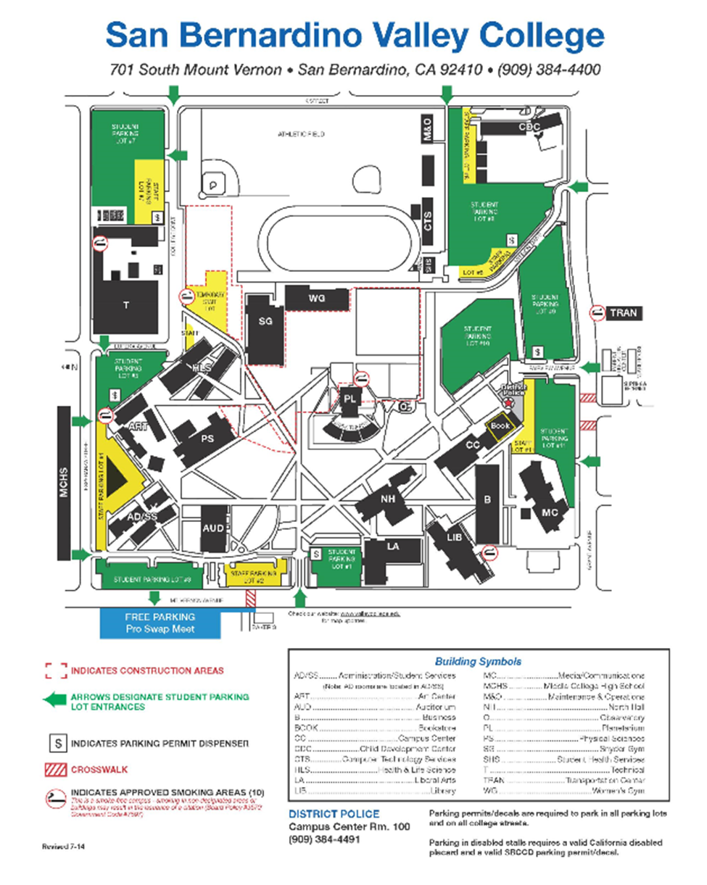
Student Services Advising Centers on Campus
Guardian Scholars
Welcome Center
Dreamers Center
Financial Aid Lab
FYE

Slide 12
Student Equity Conferences
Student Leadership Conference March 13th
(Transfer and Success)
  Target Current SBVC Students
  Workshops on Leadership, Service Learning and Transfer
  Strengths Approach Assessment by Gallup
Dreamers Conference April 17th (Access)
  Target 13 feeder High Schools (Parents and Students)
  Showcase Services for Dreamers
  Market our Academic and CTE programs to the community
Male Conference April 24th (Access)
  Target 13 Feeder High Schools
  Market FYE Cohort for Males
  Market our Academic and CTE Programs to the community
  Hands-On Career Day
Guardian Scholars Conference May 14th (Access)
  Target Practitioners who work with Foster Youth
  Showcase Services for Foster Youth
  Market FYE Cohort for Foster Youth
  Market our Academic and CTE Programs to the community

Slide 13
SBVC Equity Staffing
Staffing | Equity Funds | SSSP Funds | Goal | Objective(s)
Director of First Year Experience |  | X | A | A1; A2; A3; A4
Financial Aid Specialist II | X |  | B | B7
Student Equity Counselor | X |  | A, B, C & D | A3.2; B2; B3; B4; B5; B6; C2; C3; D1; D2
Guardian Scholars Counselor for Foster Youth |  | X | A, B, C & D | A3.2; B2; B3; B4; B5; B6; C2; C3; D1; D2
Secretary II for Student Equity & SSSP | X | X | A | A1; A2; A3; A4
Matriculation Coordinator |  | X | A, B, C & D | A3.2; B2; B3; B4; B5; B6; C2; C3; D1; D2
Student Success Coordinator | X |  | A, B, C & D | A3.2; B2; B3; B4; B5; B6; C2; C3; D1; D2
Sr. Student Services Technician |  | X | A, B, C & D | A3.2; B2; B3; B4; B5; B6; C2; C3; D1; D2
Guardian Scholars & Dreamers Liaison |  | X | A, B, C & D | A3.2; B2; B3; B4; B5; B6; C2; C3; D1; D2
Adjunct Counselors | X | X | A, B, C & D | A3.2; B2; B3; B4; B5; B6; C2; C3; D1; D2
Student Ambassadors | X | X | A | A1; A2; A3; A4

Slide 15
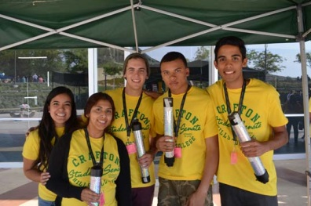
CHC Student Equity Plan

Slide 16
CHC’s Target Populations *
Group Membership | Count (CHC) | Percentage of the CHC Population
Male | 3,590 | 47.7%
African American | 343 | 4.6%
Hispanic | 3,209 | 42.7%
Native American | 18 | .2%
Age 20-24 | 2,727 | 36.3%
Age 25-29 | 949 | 12.6%
Age 30-34 | 458 | 6.1%
Age 35-39 | 245 | 3.3%
Disability | 335 | 4.5%
Economic Disadvantage | 4,121 | 54.8%
Foster Youth | 54 | .7%
Veteran | 250 | 3.3%
*Duplicated Headcounts

Slide 17
Disproportionate Impact:
Gender and Ethnicity
Group Membership | Access | Course Success | Throughput Rate |  | Degree/Cert Completion Rate | Transfer Rate
 |  |  | Math | English
Gender
Female
Male |  |  |  |  | X
Ethnicity
Asian
African American |  |  | X | X | X | X
Hispanic |  |  |  | X | X | X
Native American | X |  |  |  | X
Caucasian | X
Two or More Races
Missing

Slide 18
Disproportionate Impact: Age, Disability, Foster Youth, Veteran Status
Group Membership | Access | Course Success | Throughput Rate |  | Degree/Cert Completion Rate | Transfer Rate
 |  |  | Math | English
Age
19 or younger
20-24 |  |  |  |  | X | X
25-29 |  |  |  |  | X | X
30-34 | X |  | X |  | X | X
35-39 | X |  |  |  |  | X
40-49 | X |  |  |  |  | X
50 or older | X |  |  |  | X | X
Disability | X |  |  |  |  | X
Economically Disadvantaged |  |  | X
Foster Youth |  | X
Veteran | X

Slide 19
CHC Equity Goals

Slide 20
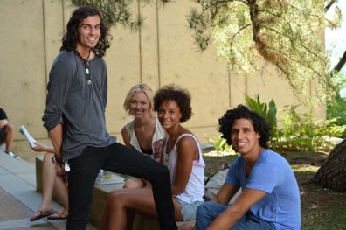
Implement Research-Based
Best Practices
Educational Planning
Embedded Tutoring
Intrusive Advisement
Universal Design

Slide 21
Increase Student Support
Targeted outreach
Availability of courses and materials in alternate formats
Tutoring for Basic Skills Math Students
Tutoring for Basic Skills English Students
Educational Planning, Follow-up and Early Intervention

Slide 22
Enhance Professional Development
Cultural Competency
  Courageous Dialogues about
    Race
    Disability
    Foster Youth, Veteran Status
    Poverty and Privilege
Universal Design
  Accessible Course Design; Online/Evening/Weekend Formats; Broad Adoption of Read and Write Gold

Slide 23
CHC Equity Resources and Staffing
Resource | Description | Equity Funds | SSSP Funds | Goal and Objective
.25 Research Assistant | Salary and benefits for ongoing equity research and the disaggregation of institutional data | X | X | A.1.1, 1.2, 1.3, D.1.5, 1.6, 1.7
.50 Professional Development Coordinator | Salary and benefits for the coordination of professional development to better prepare faculty and staff to support, teach, and guide disproportionately impacted students | X |  | A.1.4, B.1.1, C.1.1, 1.2; C.1.3, 1.4; B.1.1, 1.2
1.0 Benefits, Foster Youth Counselor | Benefits for an EOPS counselor whose responsibility will include programming for Foster Youth | X |  | B.1.1
Professional Development | Speakers, training, workshops, and conference attendance for professional development that addresses CHC’s disproportionately impacted populations | X |  | A.1.4; B.1.1, C.1.1, 1.2; C.1.3, 1.4; E.1.1, 1.2
Tutoring/Instructional Support | Supplemental instruction, group tutoring, zero-unit labs, summer bridge | X |  | A.1.1,1.2; B.1.1; C.1.3,1.4; D.1.5, 1.6, 1.7; E.1.1,1.2
Student Success Advisor | Intrusive advisement, follow-up, direct student contact and referral | X | X | C.1.3,1.4; D.1.5,1.5,1.7; E.1.1,1.2
.25 Re-Entry Counselor | Salary and benefits for .25 counselor to provide services and programming for re-entry students | X | X | A.1.1,1.2
Distance Education Coordinator | Backfill, 100% faculty release to develop DE, weekend, and evening programs and support services | X |  | A.1.1,1.2,1.3,1.4; C.1.1, 1.2, 1.3, 1.4; D.1.5, 1.6, 1.7; E.1.1, 1.2, 1.3

Slide 24
CHC Equity Budget
Expenditure | FTEF | 2014-15 Cost | Annual Cost | Alignment with Equity Plan Objectives
Research Assistant | .25 | 11,000 | 20,048 | A.1.1, 1.2, 1.3, D.1.5, 1.6, 1.7
Professional Development Coordinator | .50 | 25,000 | 50,000 | A.1.4, B.1.1, C.1.1, 1.2; C.1.3, 1.4; B.1.1, 1.2
Benefits, Foster Youth Counselor | 1.00 | 11,000 | 22,000 | B.1.1
Professional Development |  | 25,000 | 10,700 | A.1.4; B.1.1, C.1.1, 1.2; C.1.3, 1.4; E.1.1, 1.2
Tutoring |  | $150,748 | $100,000 | A.1.1,1.2; B.1.1; C.1.3,1.4; D.1.5, 1.6, 1.7; E.1.1,1.2
Student Success Advisor | .50 | $17,500 | $35,000 | C.1.3,1.4; D.1.5,1.5,1.7; E.1.1,1.2
Re-Entry Counselor | .25 | $12,500 | $25,000 | A.1.1,1.2
Distance Education and Alternative Learning Coordinator | .50 | $25,000 | $50,000 | A.1.1,1.2,1.3,1.4; C.1.1, 1.2, 1.3, 1.4; D.1.5, 1.6, 1.7; E.1.1, 1.2, 1.3
Total Annual |  | $277,748 | $277,748

Slide 25
All of us in the academy and in the culture as a whole are called to renew our minds if we are to transform educational institutions--and society--so that the way we live, teach, and work can reflect our joy in cultural diversity, our passion for justice, and our love of freedom.
                -bell hooks

