Slide 1
KVCR FM/TV/FNX
Community Service
and Sustainability

Slide 2
Sustainability thru Increased Revenue
Membership Growth
Explore Additional Gifts
Partnerships
Increase Studio Rental & Production Revenue
Development and KVCR Foundation

Slide 3
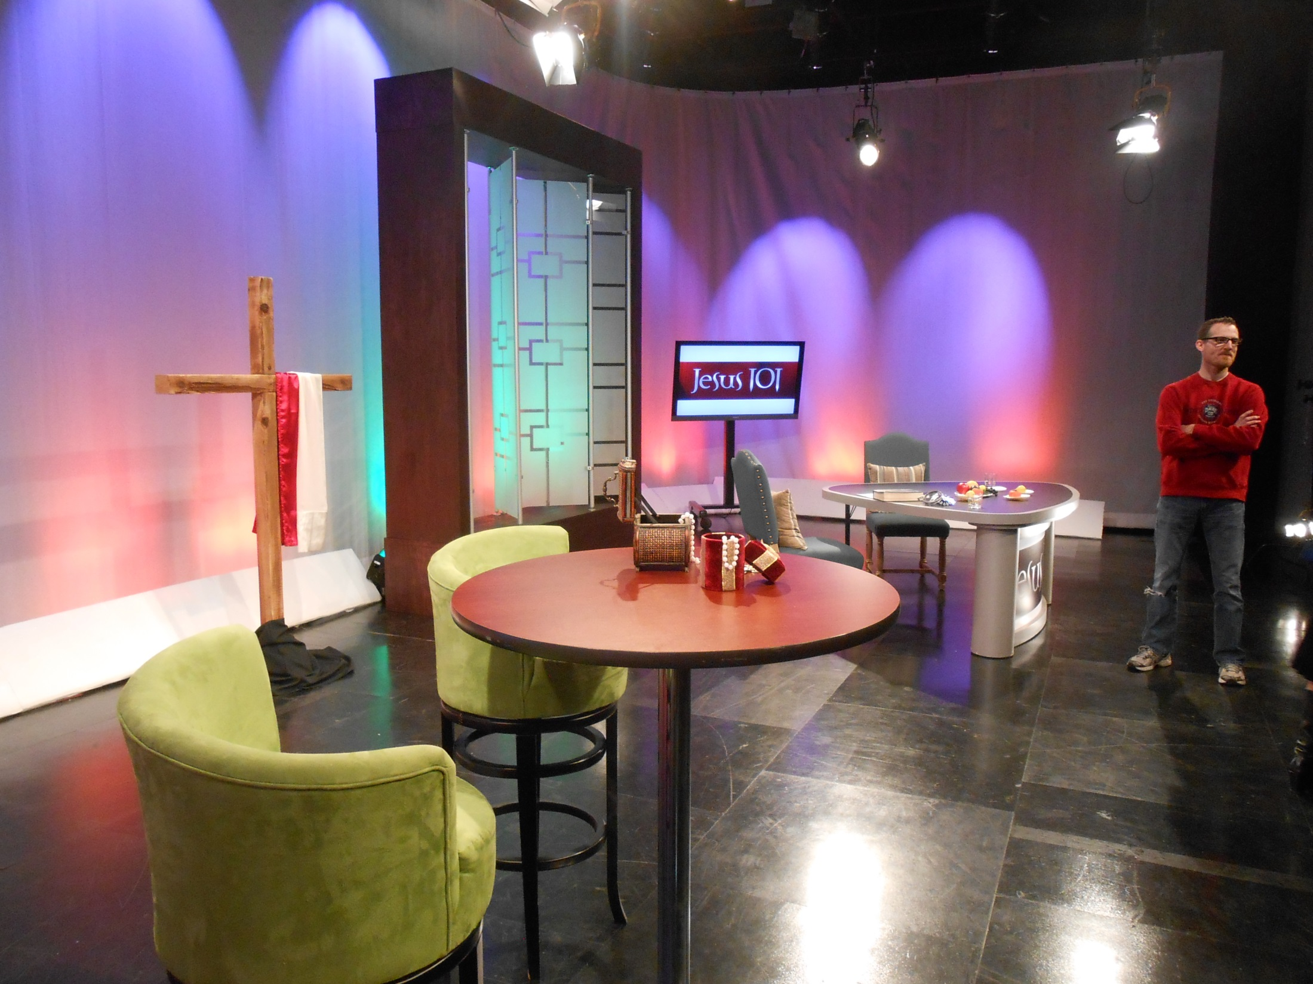
Studio Rental for outside production

Slide 4
CCS Accomplishments
Created and established development plan and accountability procedures.
Comprehensive multi-year fundraising plan
Recognition and stewardship plan
Researched Peer to Peer Benchmarking
Staffing and Organizational structure recommendations

Slide 5
CCS cont’d
Developed recommendations for KVCR Foundation Board policies and procedures
Currently working on operating plan for next FY with metrics to help with accountability
Identifying and cultivating major gift prospects
Developing UW program for FNX

Slide 6
Fundraising
Major and mid-level membership giving
Donor Cultivation and Stewardship
Grants

Slide 8
Membership & Audience

Slide 9
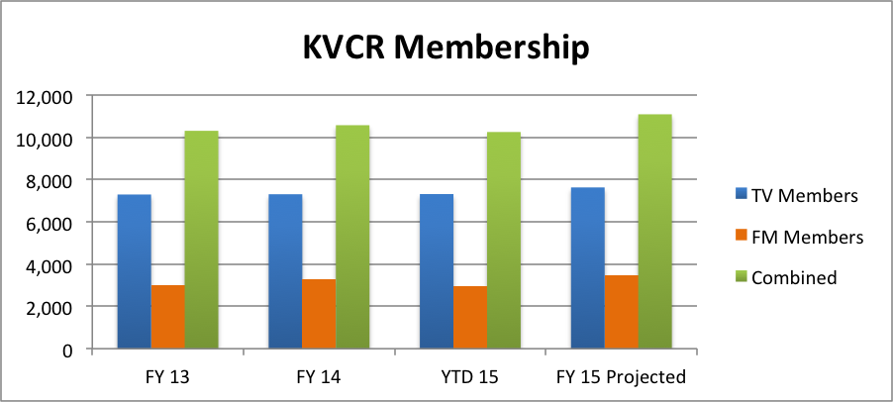
Membership Growth in FY15
Goal = 5% Growth from FY14

Slide 10
TV Audience

Slide 11
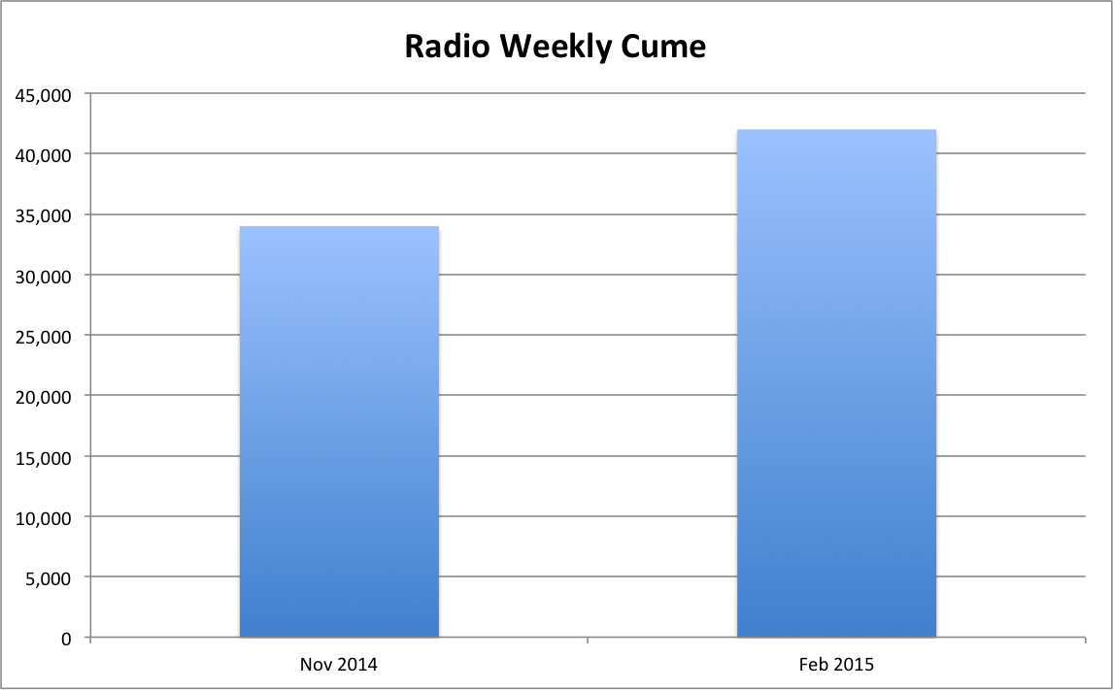
Radio Audience

Slide 12
News Team – added 2 reporters and more than doubled local newscasts from 9 to 20 per day
Programming – KVC_aRts is now weekly
Outreach – Feeding America, local forest and pet causes

Slide 13
Organizational Structure
Staff Structure and Fiscal Optimization
Director of Foundation and Development
KVCR Foundation Board

Slide 14
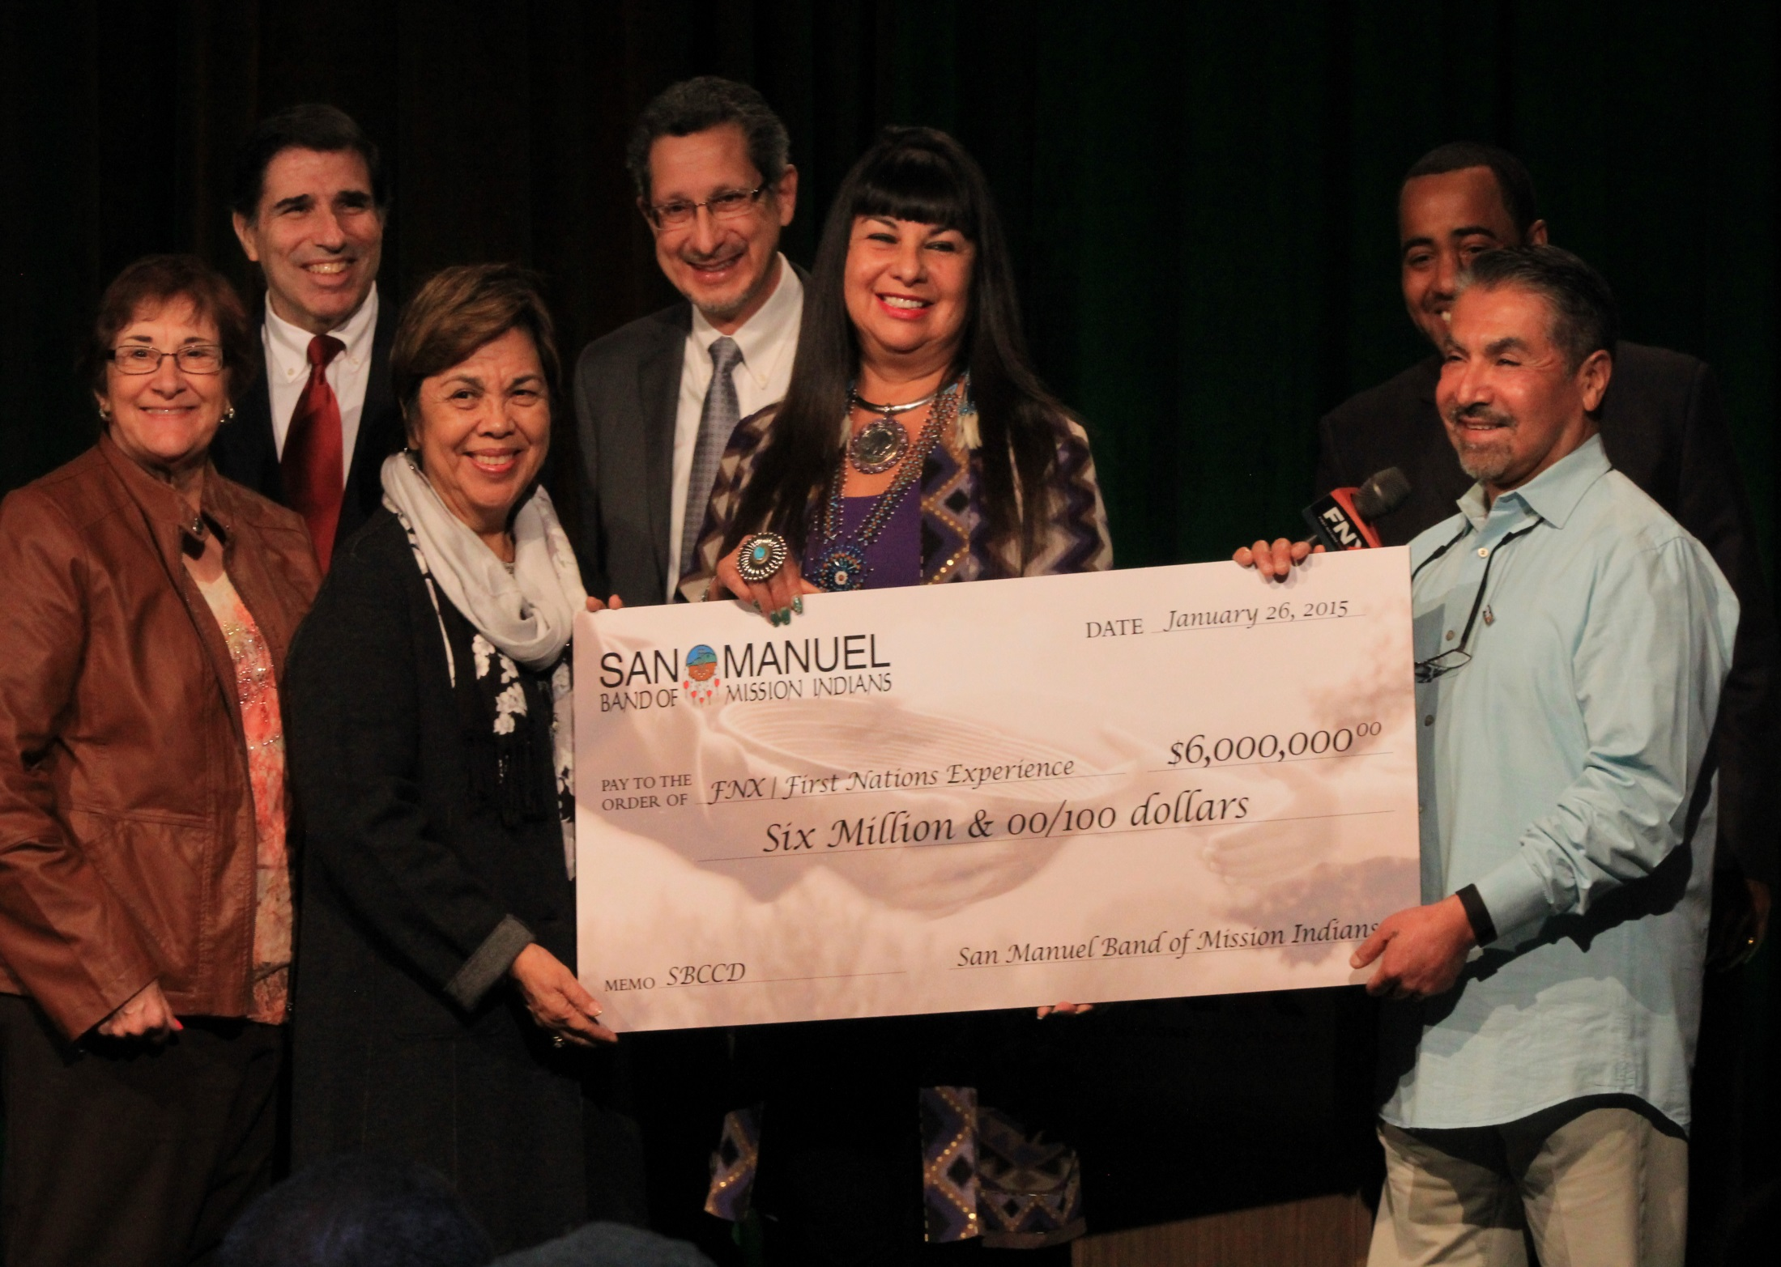
San Manuel Gift Presentation

Slide 15
FNX Update
FNX Operating Committee launched
Exploring Funding Options
Increase Local and Affiliate Productions
Establish FNX as a National Network

Slide 17
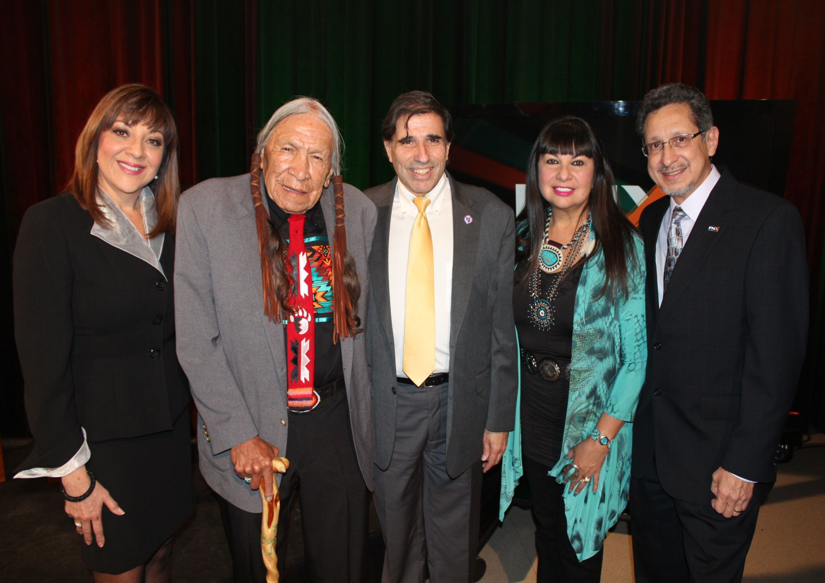
FNX National Live Broadcast

Slide 18
adn

Slide 19
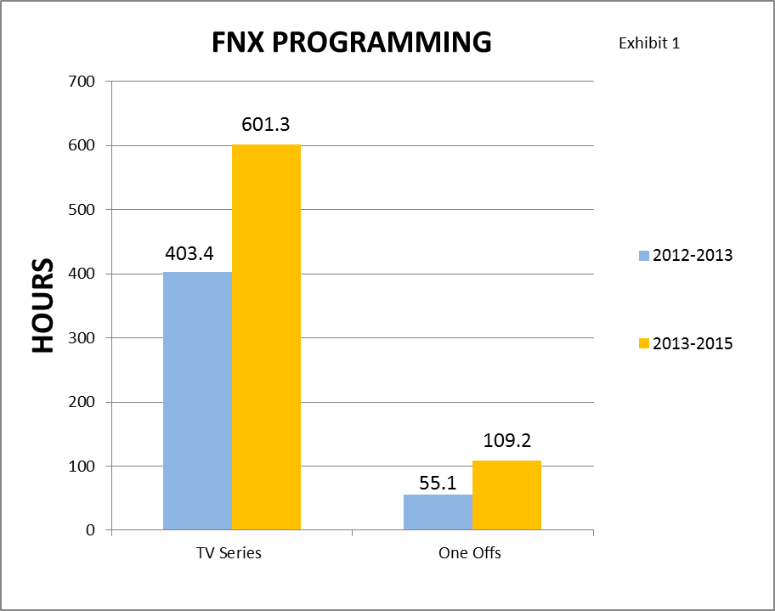
FNX Content Growth

Slide 21
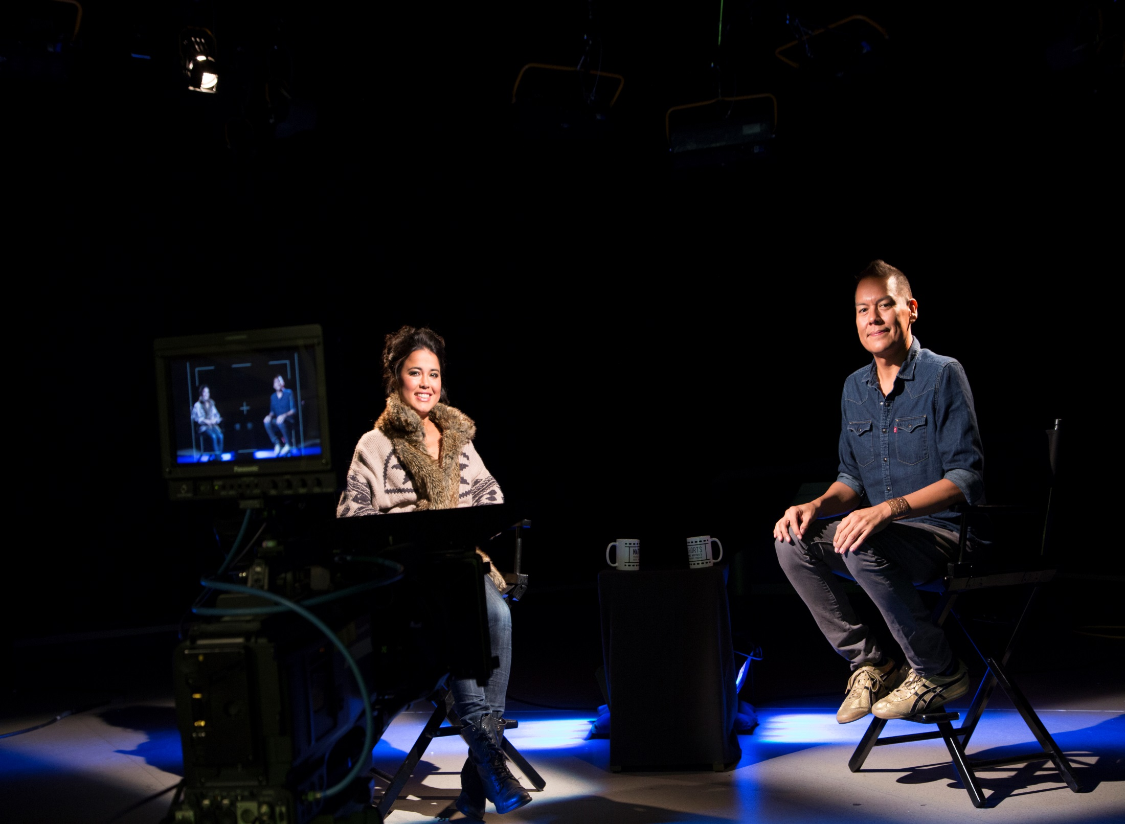
Native Shorts 2014 Set

Slide 22
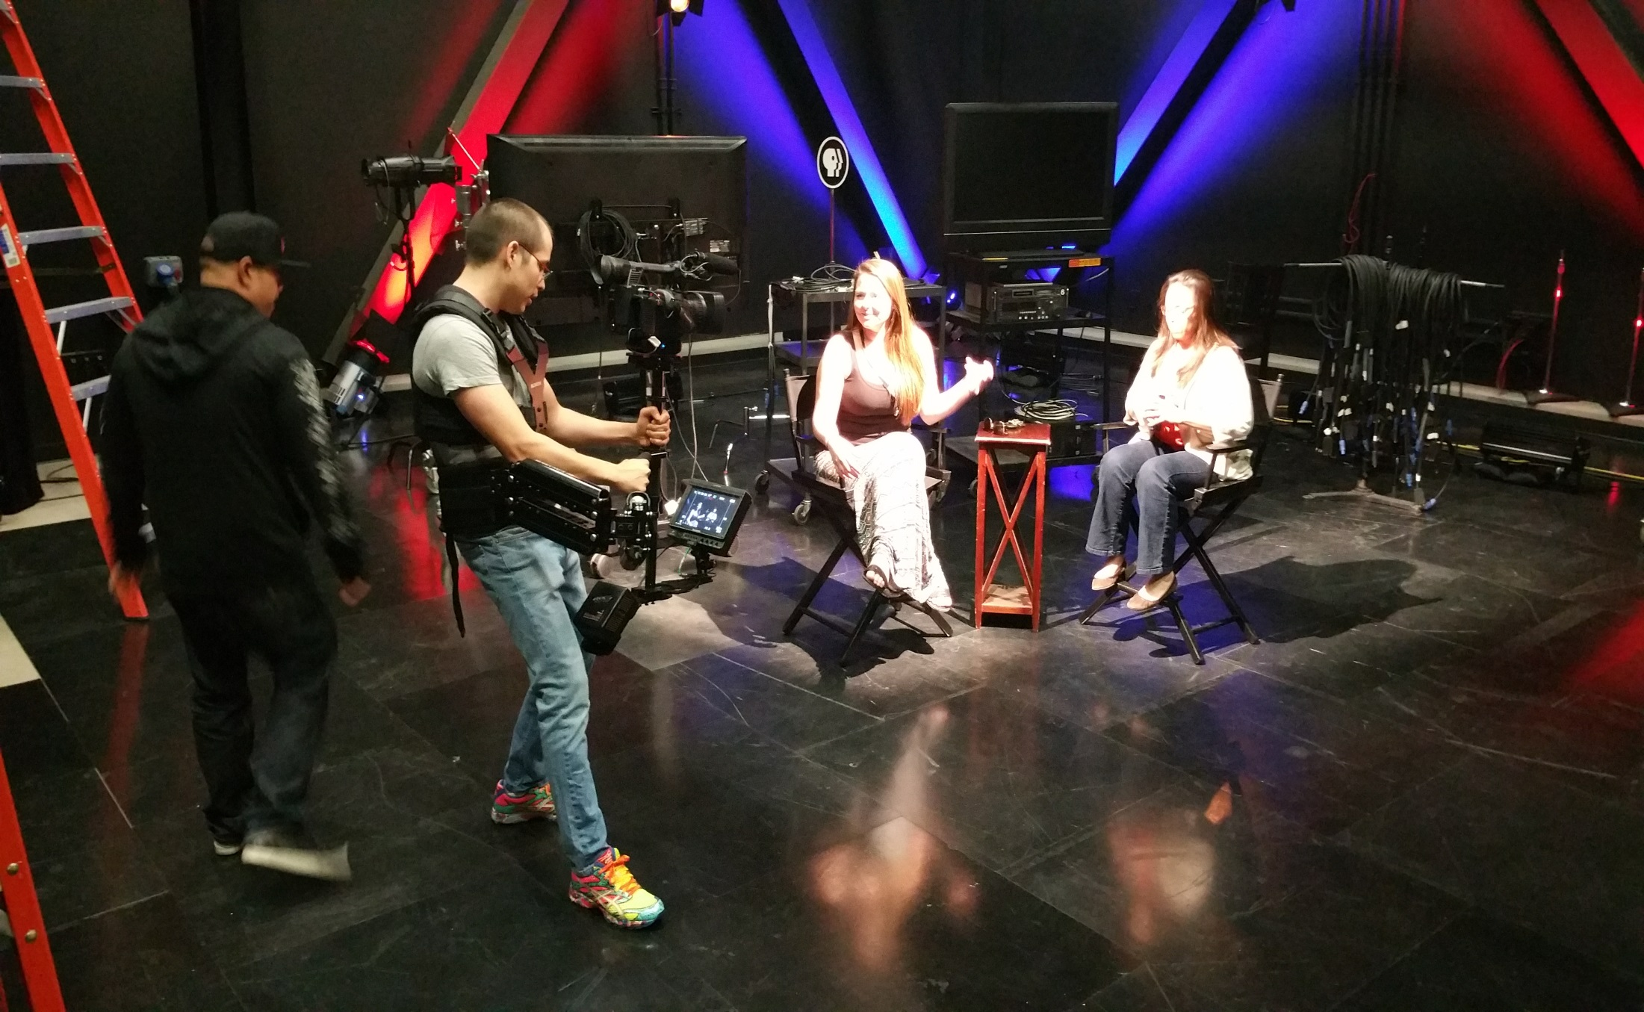
Native Shorts 2015 Set

Slide 23
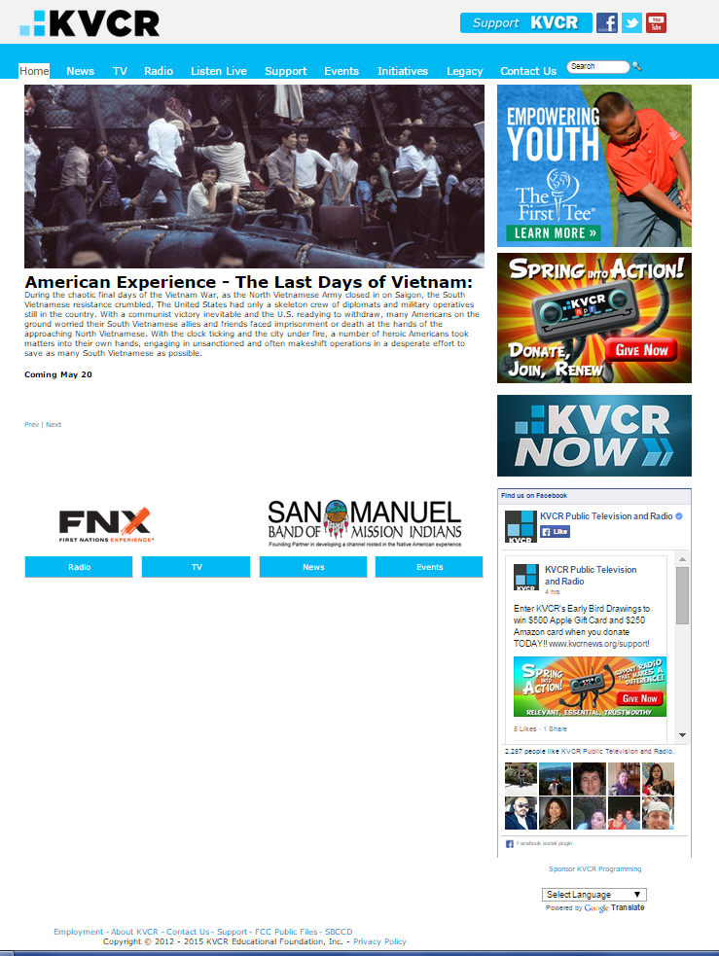
Web Updates

Slide 24
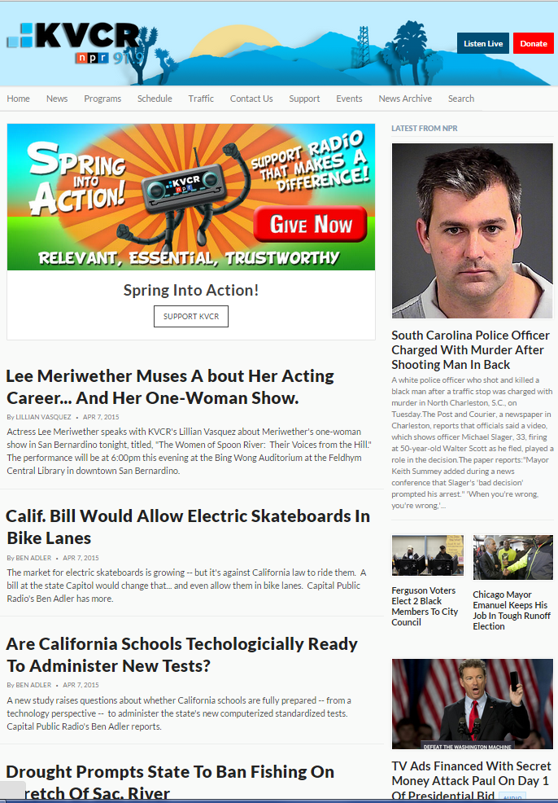

Slide 25
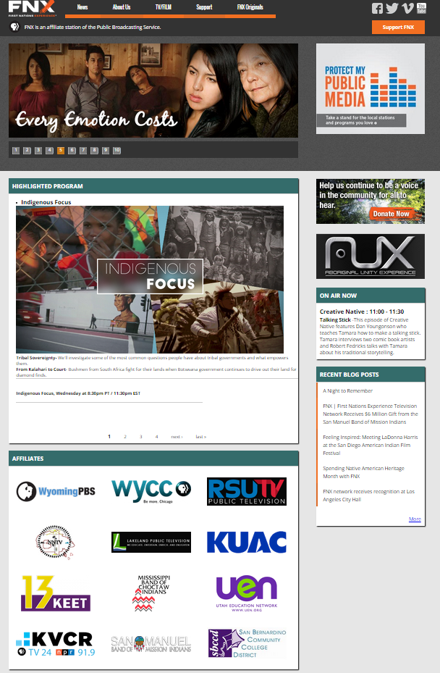

Slide 26
Student Programs, Interns & Volunteers
Working closer with SBVC RTVF Dept.
Offering Hands-on Professional Experience
On-Air Promotion, Production and News Reporting
Closed Captioning and Web Development
Motion and 3-D Animation

Slide 27
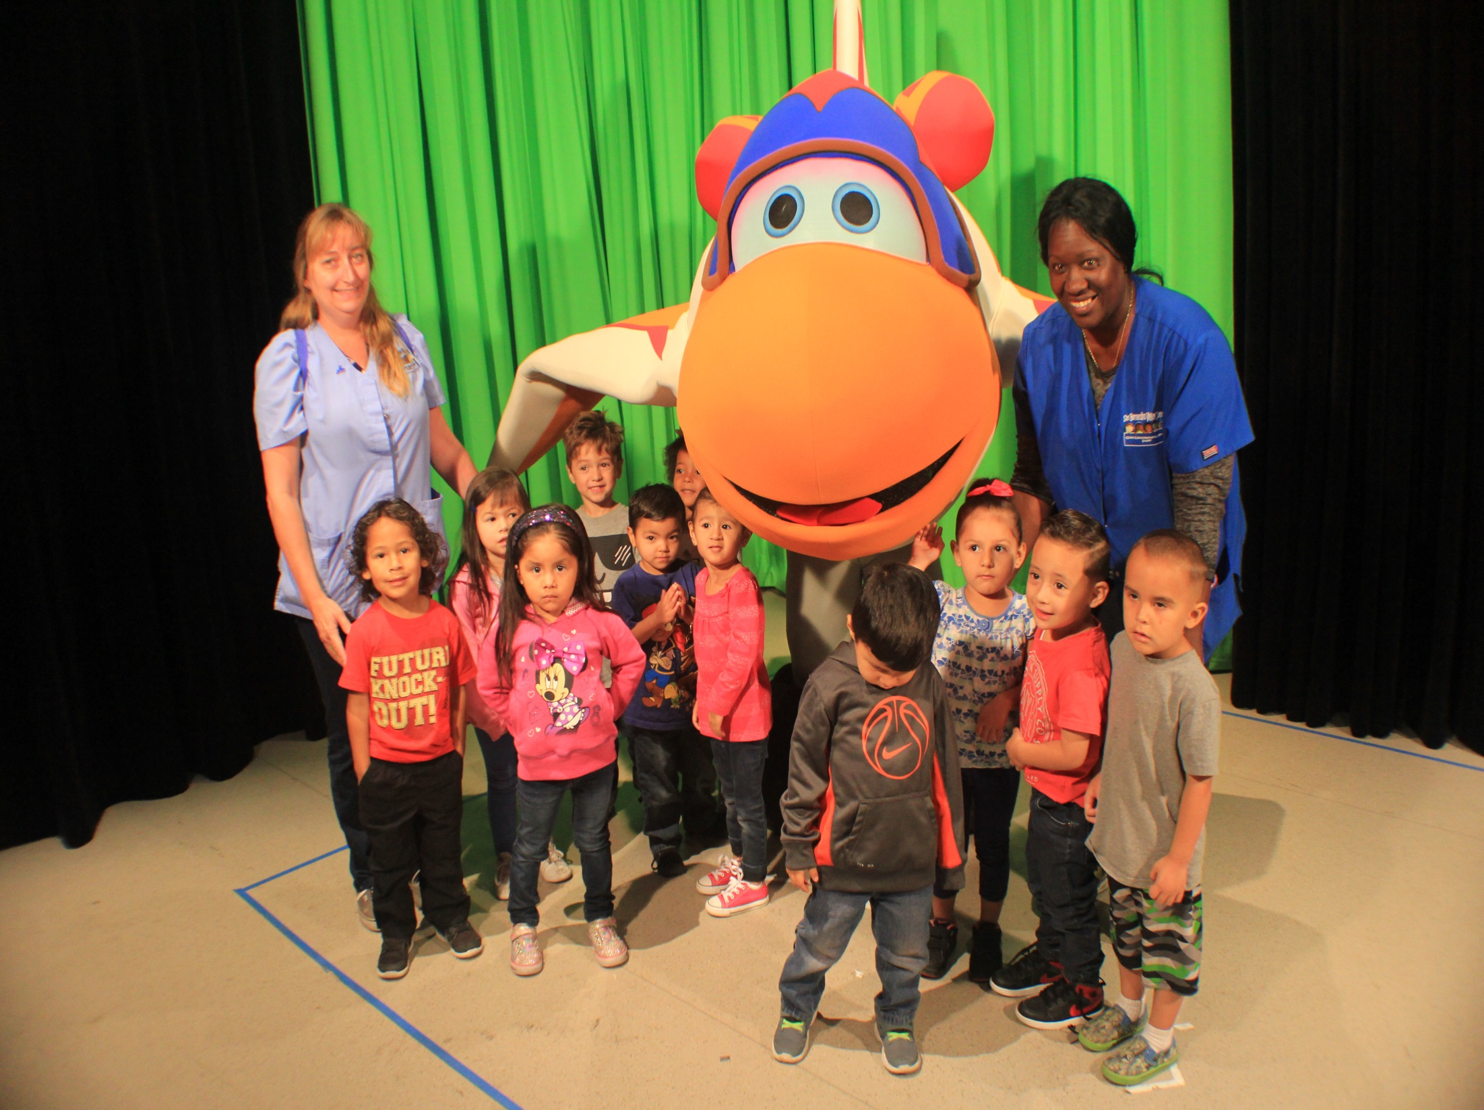
Space Racers event for SBVC CDC

Slide 28
Community Partners
SBVC, CHC, EDCT, other local colleges and county schools
Internship Opportunities – TM, VisionMaker Media, The Art Institute, and other schools
IEEP, Smithsonian’s National Museum of the American Indian, PBS, NPR, Agua Caliente Cultural Center, The VA Hospital, The Community Foundation, The Autism Society, and local law enforcement agencies…

Slide 29
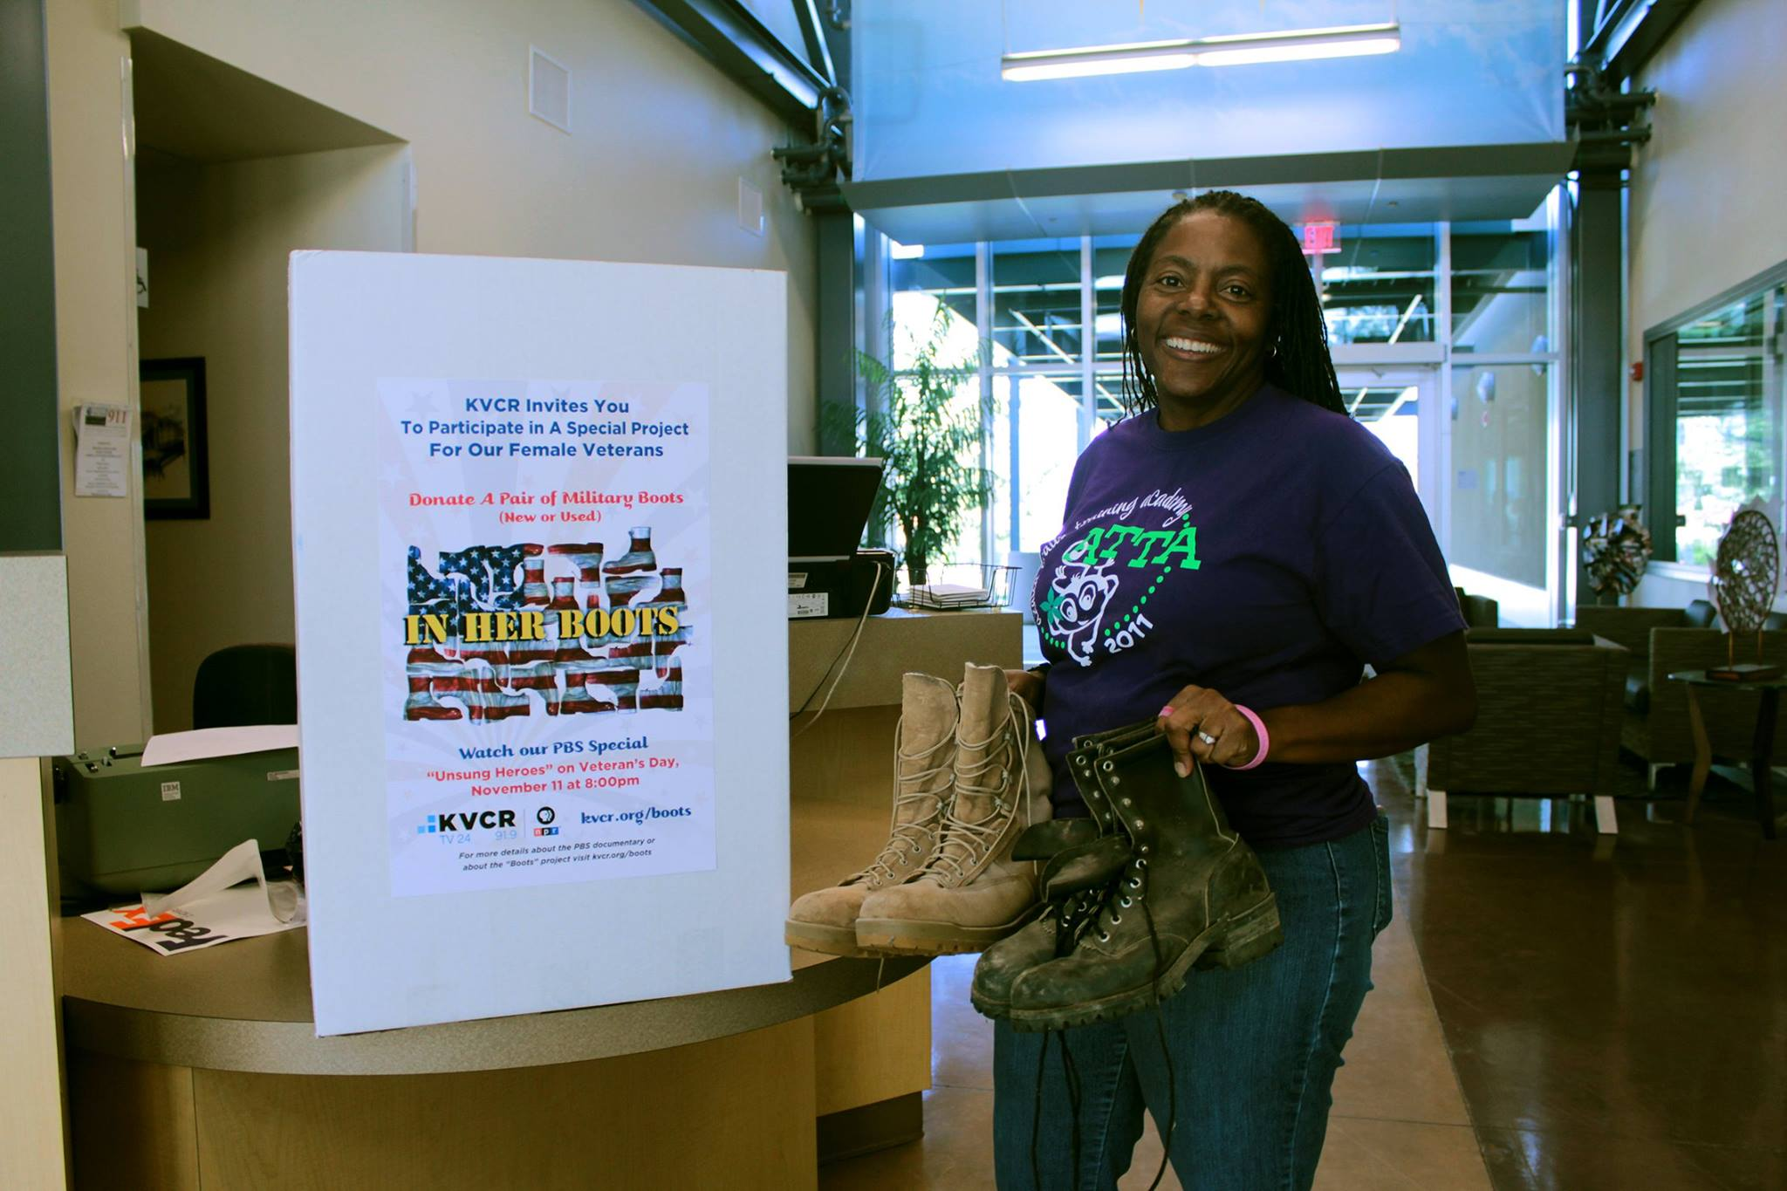
In Her Boots – Veterans Event

Slide 30
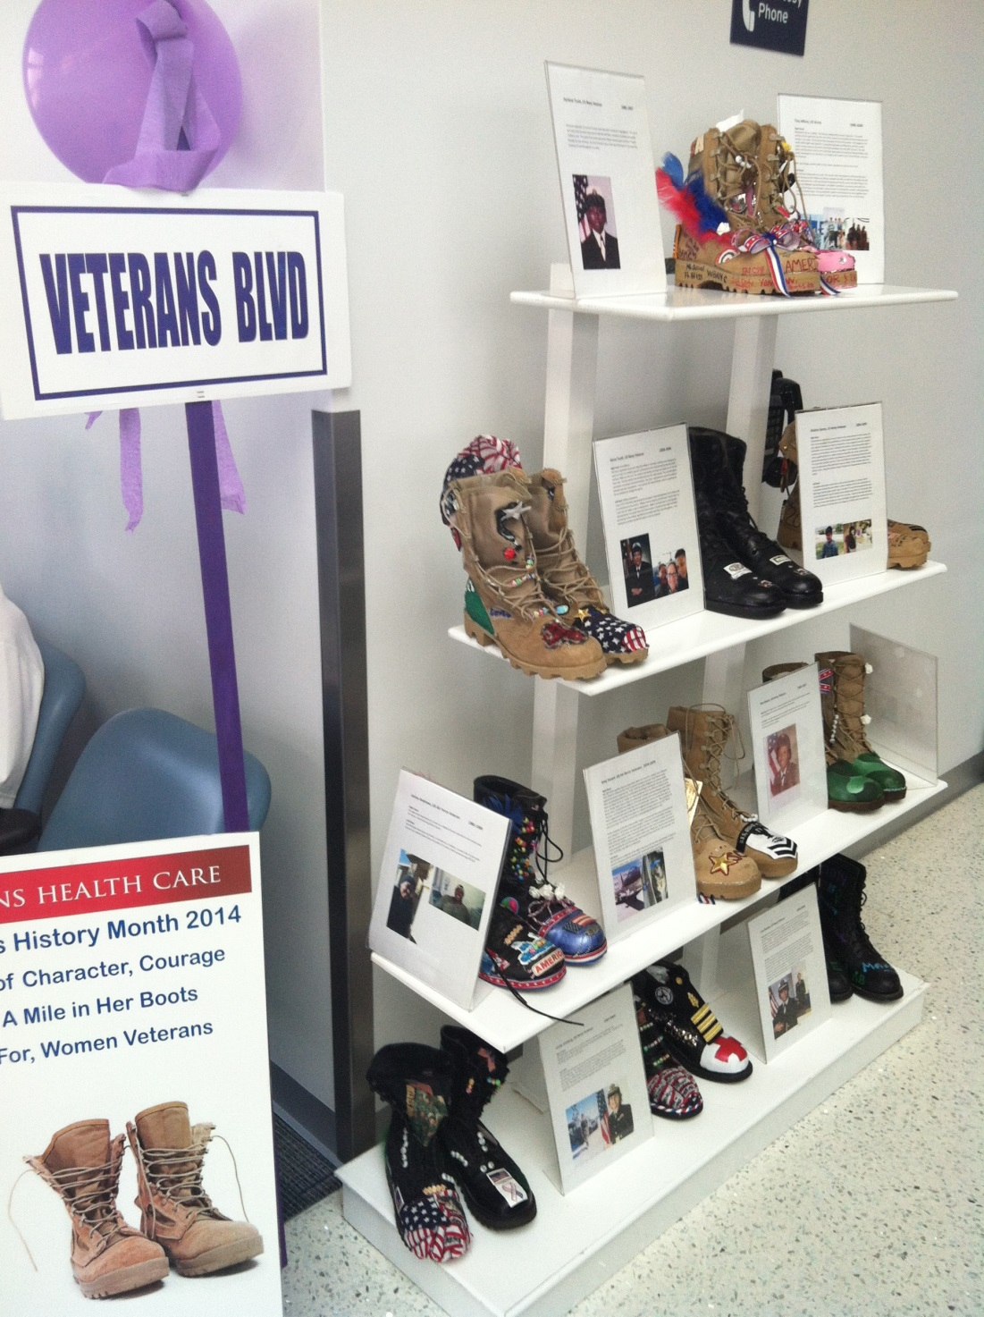

Slide 31
In Review
Ethical and transparent fiscal management
Strengthening KVCR FM/TV/FNX brands thru cross-promotion & programming
Solid local and national profile
Increasing membership and revenue opportunities
Financial and staff planning for growth & sustainability

