Slide 1
Executive Training SEMS/NIMS & ICS
San Bernardino Community College District Board Of Trustees

Slide 2
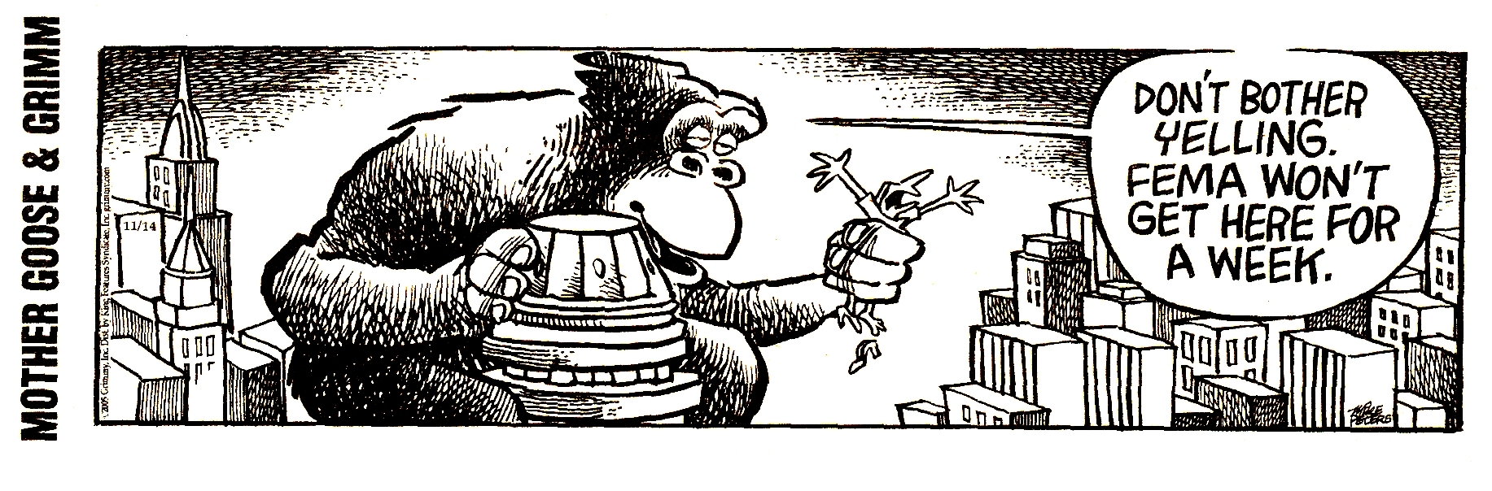
Elected Official
SEMS/NIMS/ICS Awareness Course and Tabletop Exercise
Notes:
Welcome
Thanks to host campus
Introduction of Instructors
Housekeeping

Slide 3
Objectives
Provide an overview and comparison of the:
  Standardized Emergency Management System (SEMS)
  National Incident Management System (NIMS)
  Incident Command System (ICS)
How do SEMS/NIMS/ICS apply to community colleges
What is your role as an Elected Official during a disaster?
Notes:
Review the objectives from the slide.
The principles of all three systems are very inter-related so in our discussion we will let you know if it applies to only one or two of the three.

Slide 4


Why Are You Here?
SB 166 – California Community Colleges
State law CA Govt. Code 8607 (1993)
CA Govt. Code 3100-3109 – Disaster Service Worker
NIMS requirement
  January 2009
HSPD 8 & 9 -Homeland Security
Presidential Directives
Notes:
SEMS requires it
NIMS requires its
It is a component of Best management Practices

Slide 5
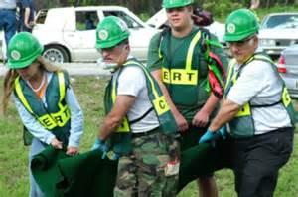
What are SEMS & NIMS Really?
A system of management and best
practices that standardizes
incident management processes,
protocols, and procedures for use by
all responders through:
Coordination
Communication
Resources

Slide 6
Under SEMS
State Law Says…
STATE AGENCIES
MUST USE SEMS!
LOCAL GOVERNMENTS
ARE STRONGLY ENCOURAGED TO USE SEMS…...
$
… To be eligible for State funding of RESPONSE RELATED PERSONNEL COSTS!
SEMS
Notes:
Who has to use SEMS?
MOUSE CLICK - By law, state agencies MUST use SEMS when responding to emergencies involving multiple jurisdictions or multiple agencies.
MOUSE CLICK - Under the law, local governments do not have to use SEMS, but are encouraged to do so.
MOUSE CLICK - Jurisdictions who do not use SEMS will not be eligible to collect state funding of response related personnel costs. Also, following a disaster, the press and the public will be aware of what is happening and will be asking questions. Non-compliance with the emergency management system being used statewide may be used against you by the press—but compliance can be a positive image for your jurisdiction.
Compliance with SEMS needs to be documented and includes:
Emergency plans and procedures.
SEMS training provided to its emergency response personnel.
The use of SEMS during exercises.
The use of SEMS during emergency activation/response.

Slide 7
SEMS Organizational Levels
State (SOC)
State Operations Center
Regional (REOC)
Regional Emergency Operations Center
Operational Area (EOC)
County of San Bernardino
Local Gov’t - (EOC) Cites & Special Districts
San Bernardino Community College District
Campus Field (ICP)
Incident Command Post
Notes:
Crafton
San Bernardino Valley
Economic Development & Corporate Training Center
KVCR Broadcasting

Slide 8

SEMS Coordination
Flow of Information
ICP
Coordination & Control

Slide 9

Operational Area
Geographical area – San Bernardino County
Includes political sub-divisions such as cities and special districts
Establishes and maintains Op Area EOC
Coordinates information between County and its cities and special districts
Prioritizes resource requests
Requests resources from Regional EOC
Notes:
Under SEMS, the Operational Area is the geographical boundaries of the County and includes Orange County, all cities (88), unincorporated areas and special districts (277+).
Our Op Area and County EOC is located on Eastern Ave. in East LA. It is activated jointly by Office of Emergency Management and Sheriff. The Sheriff is the lead during disasters.
The Op Area EOC coordinates information flow between county depts., cities and school districts. These agencies send status reports and request resources to the Op Area via the Emergency Management Information System (EMIS) which is an internet based system which ties these agencies together. Back-ups for EMIS includes a satellite dish and computer, amateur radios, and making contact with the contact Sheriff’s station.
Resource requests are made to the Op Area. If the Op Area can’t fill the requests, it will send requests to the Regional EOC (REOC) of the OES.
The Op Area is the intermediate level of the state emergency services organization. The cities go to the state through the Op Area.
The Op Area EOC must activate for support when requested by a jurisdiction – may be a low-level activation to monitor the situation.

Slide 10
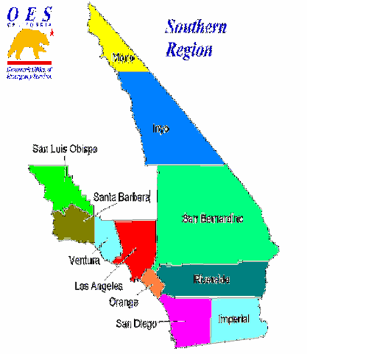
Region Level (OES)
Coordination between op areas and state level
  3 Administrative Regions
  6 Mutual Aid regions
Operates REOC
Implements state emergency plan
Coordinates resources between Operational Areas within the region
Southern Region:
Mutual Aid 1 & 6
Notes:
Because of its size and geography, the state has been divided into six Mutual Aid Regions in order to coordinate mutual aid and other emergency related activities. The Office of Emergency Services (OES) also has three Administrative Regional Offices.
The cities of Orange County falls within Mutual Aid Region I and the Southern Administrative Region. The Southern Region EOC and administrative offices are located at the Armed Forces Reserve Center in Los Alamitos.
In SEMS, the regional level manages and coordinates information and resources among operational areas within the mutual aid region and also between the operational areas and the state level.
The regional level also coordinates overall state agency support for emergency response activities within the region.
The Southern Region will also coordinate with FEMA on behalf of the cities and operational areas.
The regional level EOC shall be activated and SEMS used when any operational area EOC within the mutual aid region is activated.

Slide 11
State Level (OES)
Coordinates resources between regions
Federal response coordination
Communicates with governor and legislature
Implements media policy
Notes:
The state level of SEMS manages state resources in response to the emergency needs of the other levels and coordinates mutual aid among the mutual aid regions and between the regional level and state level. The state level also serves as the coordination and communication link between the state and the federal disaster response system. The State level will activate its EOC and use SEMS when:
A regional level EOC is activated.
The governor proclaims a state of emergency.
The governor proclaims an earthquake or volcanic prediction.

Slide 12
SEMS/NIMS ICS Functions
Command Structure
Command/
Management
Operations
Section
Planning
Section
Logistics
Section
Finance /
Administration
Section
Notes:
ICS is a modular organization and can be as large or small as needed to fit the incident. It can be modified at any time during the incident.
You activate only the positions you need
The Incident Commander or EOC Director handles all responsibilities until they are delegated to another person by activating a position or section.

Slide 13
Mutual Aid Agreements
Local mutual aid agreements are used when local resources are exhausted to provide:
  Services
  Resources
  Facilities
Interstate mutual aid agreements cover:
  Interstate Civil Defense Compact
  Emergency Management Assistance Compact
Notes:
Mutual Aid is defined as a “voluntary and reciprocal agreement” meaning you come help me today and I will come help you when you need it!
The use of mutual aid is a basic emergency management concept we have been using in California since 1950 through the CA Master Mutual Aid Agreement. Discipline specific mutual aid plans include: Fire and Rescue, Law Enforcement, Coroners, and Emergency Managers. These are provided without expectation of reimbursement.
When local resources are not enough to handle the incident, mutual aid can be requested through the LA County Op Area or through other normal mutual aid channels. Mutual aid includes: personnel services, equipment, supplies and facilities. Agreements between states include the Civil Defense Compact which has been in existence for many years (California, Arizona, Nevada and Oregon are partners in mutual aid) in various forms and the new EMAC of which California is now a part.
EMAC allows California the ability to send or receive assistance from other states during a disaster and augments resources that would be needed during a disaster. EMAC was used by California for the first time during Hurricane Katrina.

Slide 14

National Incident Management
System
NIMS resulted from 9-11-2001
Homeland Security Presidential
Directive #5
NIMS is applicable at all jurisdictional levels and across disciplines
NIMS ─ A comprehensive, national approach to incident management developed to improve the coordination of federal, state and local emergency response nationwide
Notes:
We will now be discussing the National Incident Management System (NIMS).
Complex 21st century threats and the horrific events of Sept. 11 demand that ALL Americans share responsibility for homeland security—to prevent, protect against, respond to and recover from a wide range of major events that exceed the capabilities on any single agency.
There is a need for a unified and coordinated national approach to planning and to incident management. All responders need to be able to work together, communicate with each other and depend on each other.
HSPD 5 identifies steps for improved coordination in response to incidents and requires a National Response Plan and a National Incident Management System (NIMS)
There are federal requirements for NIMS implementation by Sept. 30, 2006 in training, planning, resource identification and adoption of NIMS.
NIMS provides a consistent framework for incident management at all jurisdictional levels regardless of the cause, size or complexity of the incident. Building upon the ICS, NIMS provides the Nation’s first responders and authorities with the same foundation for incident management for terrorist attacks, natural disasters and other emergencies.
When we look at past disasters, the most common cause of response failure is poor management. Confusion about who’s in charge of what and when, together with unclear lines of authority, have been the greatest contributors to poor response.
Whether from different departments within the same jurisdiction, from mutual aid partners, or from State and Federal agencies, responders need to be able to work together, communicate with each other and depend on each other.
NIMS provides for national standards to address these issues.

Slide 15
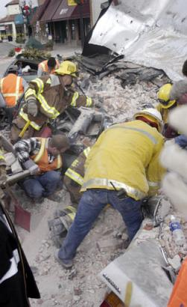
NIMS Organizational Structure
NIMS incorporates standard emergency management practices & processes, such as:
Incident Command
System (ICS)
Multi-agency
Coordination
Resource Coordination
Public Information
Systems
Notes:
NIMS requires that responses to all incidents utilize a common management structure.
ICS: ICS allows for an integrated organizational structure that matches the needs of single or multiple incidents and for all hazards.
Multi-agency Coordination Systems: These are a combination of facilities, equipment, personnel, procedures, and communications integrated into a common framework for coordinating and supporting incident management.
Public Information Systems: Because public information is critical to incident management, it is imperative to establish Public Information Systems and protocols for communicating timely and accurate information to the public during emergency situations.

Slide 16
NIMS Components
NIMS incorporates standard emergency
management practices and processes, such
as:
Command & Management
Preparedness
Resource Management
Communications & Information Management
Supporting Technologies
Ongoing Management & Maintenance
Notes:
Command and Management is based on 3 key organizational systems: the Incident Command System (ICS), Multi-agency Coordination Systems and Public Information Systems.
We will be discussing the other components in more detail

Slide 17
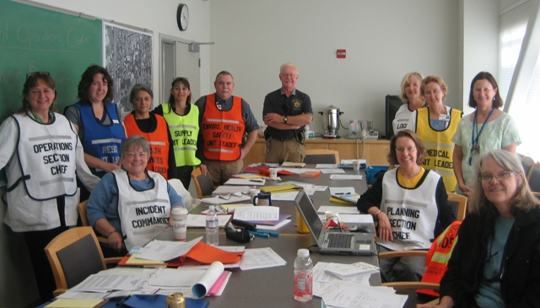
Incident Command System
ICS is a management system which includes:
Standardization
On scene control
All hazard approach
Adaptability
Common management structure
Notes:
We will now be discussing the Incident Command System
NIMS requires that responses to all incidents use a common management structure—ICS. ICS is a proven system that is used widely for incident management by firefighters, rescuers, emergency medical teams, and hazardous materials teams.
ICS has been tested for more than 30 years and is used for planned events, fires, hazardous materials spills and multi-casualty incidents; multi-jurisdictional and multi-agency disasters, such as earthquakes, hurricanes, and winter storms; search and rescue missions; biological outbreaks and disease containment; and acts of terrorism.
CLICK MOUSE - In addition to responding to incidents, ICS can be used to plan parades, celebrations, concerts – the Rose Parade is a good example.
CLICK MOUSE – ICS can be used for everything from single traffic accidents to a major transportation incident.
The private sector also uses the ICS.
We will be discussing these features throughout the class.
ICS Purpose
Utilizes best practices to ensure:
Safety of responders and other
The achievement of tactical objectives
The efficient use of resources
Benefits:
Meet the needs of incident of any kind
Allows personnel from a variety of agencies to meld
Rapidly into a common management structure
Provides logistical and administrative support to operational staff
Is cost effective by avoiding duplication of efforts.

Slide 18
Incident Command System
Concepts:
Field Operations
Emergency Operations Center
Chain and Unity of Command
Management by Objectives
Multi-Agency Coordination
Features:
Common Terminology
Modular Organization
Incident Action Plan
Manageable Span of Control
Resource Management
Unified Command
Unity of Command
Notes:
Chain of command:
Is an orderly line of authority within the rank of the incident management organization
1.Unity of command means that every individual has a designated supervisor to whom he or she reports at the scene of the incident.
2.Use of the ICS helps all responders communicate and get needed resources quickly. ICS also provides a safe, efficient, and cost-effect response and recovery strategy.
3. Manages by Measurable Objectives within a time frame or Operational Period
We will be discussing these features throughout the class.
READ SLIDE BULLETS

Slide 19
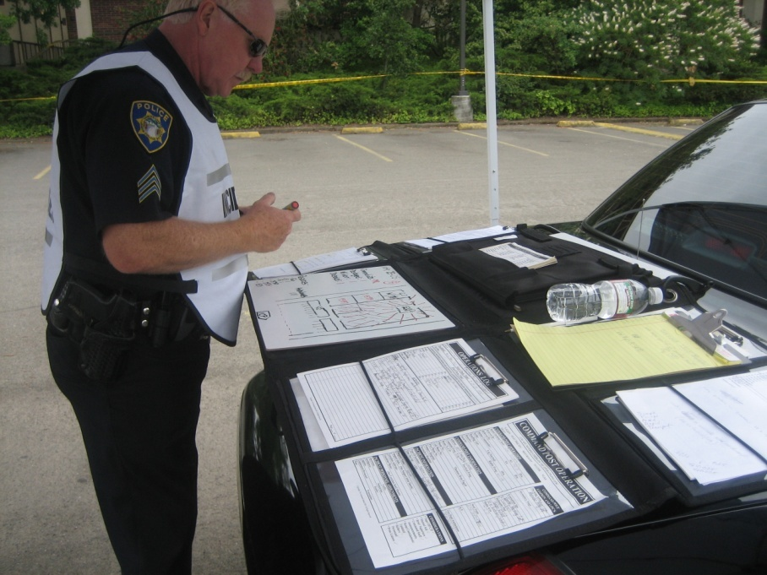
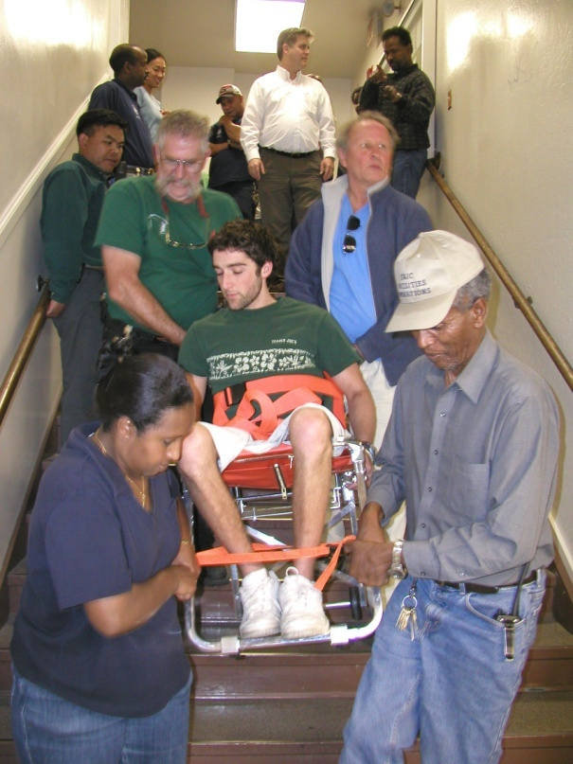
How ICS is Used
Manage:
Fires, hazmat, earthquakes, acts of terrorism, sporting events, demonstrations and multi-casualty incidents
Works well for:
Campus events & incidents
Campus Evacuations
Wide-area coordinated emergency responses
Notes:
Chain of command:
Is an orderly line of authority within the rank of the incident management organization
1.Unity of command means that every individual has a designated supervisor to whom he or she reports at the scene of the incident.
2.Use of the ICS helps all responders communicate and get needed resources quickly. ICS also provides a safe, efficient, and cost-effect response and recovery strategy.
3. Manages by Measurable Objectives within a time frame or Operational Period
ICS is a modular organization and can be as large or small as needed to fit the incident. It can be modified at any time during the incident.
You activate only the positions you need
The Incident Commander or EOC Director handles all responsibilities until they are delegated to another person by activating a position or section.
Go over the general responsibilities: Doers/Planners/ Getters/ Payers/
To manage all types of incidents
Fires, hazmat, earthquakes, acts of terrorism and multi-casualty incidents
Parades, celebrations and concerts
(a viable application for ICS)
Private sector emergency programs
Works well for:
Small, large and complex incidents
Single or multiple agency or jurisdiction incidents
Wide-area search and rescue

Slide 20

Command: Overall responsibility for the incident – sets objectives
Incident Commander
Operations
Planning / Intel
Logistics
Finance / Admin
Develops the tactical organization and directs resources to carry out Incident Action Plan
Develops the Incident Action Plan to meet objectives
Provides resources and all services needed
Monitors costs and documents the incident

Slide 21





BOT Responsibilities During a Disaster

Slide 22
Understanding of Emergency Declarations
Local Emergency
State of Emergency
Fire Management Assistance Declaration
Presidential Declaration of Emergency
Presidential Declaration Major Disaster
US SBA Designation
USDA Disaster Declaration
Proclaimed by the governing body of a local government, a local emergency occurs when conditions become or are anticipated to exceed the resources of a local jurisdiction
Proclaimed by the Governor when conditions exceed the control of local government and require the combined forces of mutual aid regions
Declared by FEMA based on a state request, not requiring a local or state proclamation, or a Presidential declaration.
Declared by the President following the Governor’s provision of information that state and local resources have been tasked and that specific federal aid is required.
Declared by the President at the request of the Governor or Acting Governor. California’s $48 million fiscal threshold must be met barring a “catastrophe of unusual severity and magnitude”.
Designated by the Small Business Association based on a state request.
Designated by the USDA Secretary based on a state request.
Notes:
There are several types of emergency declarations that can be instituted by various state and federal agencies. Based on factors including location, severity, property and population affected, many types of state, local and federal assistance programs are available.

Slide 23

Emergency Responsibilities
Policy - Direction and support
Planning - Through District
interoperability and
multi-agency
coordination
Training - Needs based
upon Emergency Role
Exercise - Support and
participate in required
activations
Response - Ensure effectiveness
through established objectives
and policy administration

Slide 24
BOT Roles and Duties
Policies
SUPPORT
Personal Preparedness at home and office
Board Policies to support Levels of Emergency Delegation of Authority
Establish Emergency Campus & District Proclamation Guidelines
Policies for Increasing Disaster Expenditure without Board approval process
Ensure MOUs & Emergency POs are in place and follow FEMA guideline
Ensure that all plans, training, exercises, are procedures are standardized
Ensure District EOP and Campus Activation Plans are current and updated
Ensure that a District-wide Recovery Plan and COOP-ED is developed and manage
Ensure annual Cal OES and FEMA training & exercise requirements and met
Allocate funding for emergency response supplies and equipment
Prepare for the worst and hope for the best
Notes:
Clear schedule of Authority in event Disaster Does the Board need to convene to make a decision to act
Does your Bi-laws allow for teleconference to hold quorum?

Slide 25
Communication During the Disaster
Establish chain of communication among Trustees with Campus Presidents or designees
Ensure communications protocols and system redundancy with critical District personnel
Be available for on-going briefings with campuses and public responders
All media crises communication are the direct responsibility of the President
If asked for interview refer to President and state your support for the response efforts
If public presentation is required, coordinate and craft message with President to ensure correct information is provided
Notes:
Do you have Emergency Policies in place to cover critical issues and needs.

Slide 26

Emergency Operations Centers (EOC) or Department Operations Centers (DOC)
Joint Field Office (JFO)
Reception Center or Shelter
Local Assistance Centers (LAC)
Disaster Recovery Centers (DRC)
Point of Dispensing, Point of Distribution (PODs)
Notes:
Next, we’ll discuss some other types of facilities that are established during a disaster.
Highlighted and italics are the most common emergency facility use seen across the U.S. during disastsers

Slide 27
An EOC is a location from which centralized emergency management can be performed
The EOC may support multi-agency coordination and joint information activities
An EOC is the central point for:
  Coordination of all the jurisdiction's emergency operations.
  Information gathering and dissemination.
  Coordination with other local governments and the Operational Area.
EOC Staffing will vary depending on the type of emergency
Notes:
The size, location and staffing of EOCs vary from agency to agency but the function remains the same: centralized emergency management activities.
An EOC is part of a multi-agency coordination system.
The EOC is a location which coordinates and supports all operational activities in response to an incident.
The EOC is also the primary contact point for county, state and federal resources as they become available.
In some agencies, a departmental operations center (DOC) is sometimes used to better coordinate critical resources and is a link between the field and the EOC. The DOC is discipline specific—law, public works, fire, etc.

Slide 28

Joint Field Office
The JFO is a multi-agency coordination center established at local level
It provides a central location for coordination of federal, state, local, non-governmental, and private-sector organizations
The JFO enables coordination of federal incident-related actions
The JFO does not manage on-scene operations but provides operational support
Notes:
As more and more county, state and federal resources arrive in your campus, a J Field Office can be established to better coordinate and share information on the incident and resource status.
The Joint Field Office is NOT a mini-EOC but a coordination point for all outside agencies.
The Joint Field Office does NOT have tactical control of any incident but is there in a support role for all tactical activities.

Slide 29

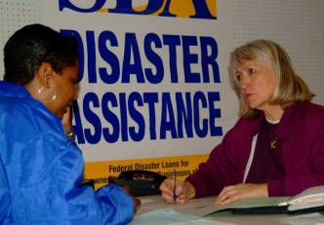
LACs are:
  Managed by local government
  Staffed by Private/Non-Profits (PNPs), local, state and federal government agencies
  A centralized location for information, services, resources and program referrals for disaster victims
  LACs are very useful for recovery efforts in a community
State funding may
be available for eligible
LAC operations
Notes:
A Local Assistance Center is established as a place where citizens can come to for assistance from various local, county, state and federal agencies and programs.
It is a “one stop shopping” for disaster victims!
If you open a Local Assistance Center in your campus, some of the costs of creating and then maintaining the Center might be reimbursable.
Establishing an Local Assistance Center immediately after a disaster can do much to move people from the “victim” stage to a “survivor” stage.

Slide 30

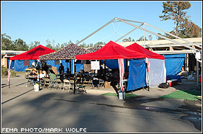
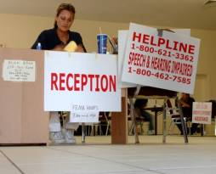
Activated by federal
agencies to provide
information to victims and
private non-profit
organizations about FEMA
and SBA programs.
Fixed site or mobile
Managed by the federal government and staffed by FEMA, OES, SBA and other federal, state and local agencies
Often co-located with LACs
Notes:
REVIEW SLIDE
Although Disaster Recovery Centers are established to let citizens know about the federal programs that are available, they are often collocated with a Local Assistance Centers since the organizational structure is also the same.

Slide 31

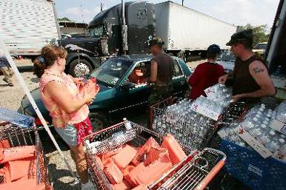
POD (Point of Dispensing)
for public health emergencies
POD (Point of Distribution)
for disaster recovery
Location where medications
are given to the public
LoLoLocation where general supplies such as food and water are given to the public
On the fly” terminology:
Be prepared for names of places
and facilities to be created or changed with each disaster
Notes:
PODs can refer to:
Point of Dispensing – where medicines are distributed to citizens during a public health emergency.
Point of Distribution – where food, water, etc. is made available to the general public
Names of facilities can often be changed or created to fit a particular need or that is easily recognized by the community so be prepared to be flexible!

Slide 32

SBCCD
Board of Trustees Tabletop and Discussion-based Exercise.

Slide 33
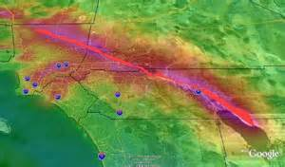
San Andreas Fault

Slide 34
USGS Shake map
http://earthquake.usgs.gov/regional/nca/simulations/animation.php?mov=ShakeOut_PalmSprings_hd&set=shakeout

Slide 35
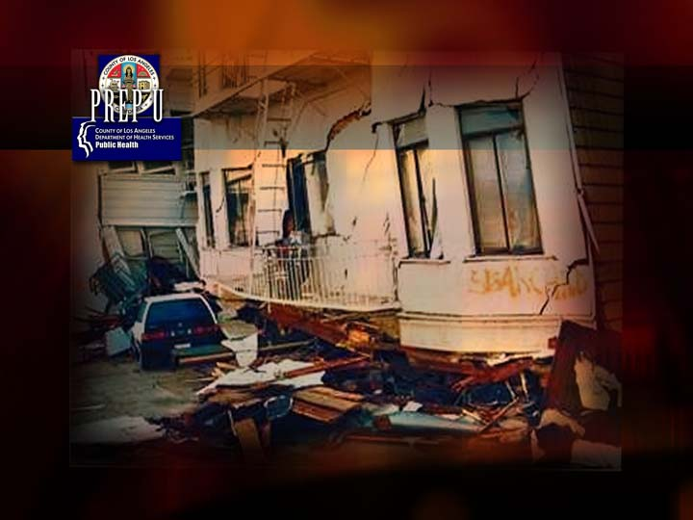
Earthquake Scenario
Notes:
We are now going to be discussing some features that will be called into play when the incident gets bigger and more complex

Slide 36
Critical Issues
  Utility and power services, and water delivery has been heavily compromised throughout greater Riverside and San Bernardino County
  Freeways sustain catastrophic destruction with 215, 10, 60 and 210 freeways closed through out the region. Traffic gridlocked throughout the region.
  Structural debris throughout San Bernardino County impacting roads and highways making transport impossible. Traffic light systems are off grid with critical County Operations sites working on back-up power only
  Death toll in San Bernardino presently 57 with hundreds unaccounted for.
  Conflagration of fires throughout California due to broken fuel line and limited water sources to fight fire.
  Ongoing aftershocks of a magnitude of 7.2 and less continue to impact emergency response activities through County and the District.
  Educational Impact
  Colleges and Universities through Southern California heavily impacted with all education functions down.
  All SBCCD campuses sustain the highest impact damage ( MMI value X) with significant or full structural failure.
  Unable to contact State Chancellor Office
  Total impact to SBCCD still unknown.
Notes:
Fwy way closures: 215, 10, 60, 210 throughout San Bernardino & Riverside County.

Slide 37

7.8 Earthquake – How bad “is” it?
500 times larger than the 6.7 magnitude Northridge earthquake.
Shaking lasted from 1 ½ - 2 minutes.
Statewide there were over 2,000 deaths and 50,000 injuries.
Estimated $200 billion in damages.
Major damage to transportation routes, water, and utilities.
Fire conflagrations (urban and wildfires).
Modified Mercalli Intensity (MMI) Scale: Not related to the Richter scale; it is based on subjective descriptions of damage.
  V: Light shaking/pictures move
  VI: Mod shaking/objects fall
  VII: Strong shaking/non- structural damage
  VIII: Very strong shaking moderate damage
  IX: Violent shaking/heavy damage
  X: Very violent/extreme damage

Slide 38
Crafton Hills College Damage
  Limited communication with CHC due to communication systems down.
  Complete structural collapse of Math/Science Annex , Gymnasium, Learning Resource Center. Four (4) Reported, but unconfirmed deaths. Make shift triage area established to treat wounded.
  Chemistry/Health Science building burning. Unable to account for students and faculty in building. Minimal support from local Fire Agency due to inability to access campus and lack of water support.
  Nurse’s Station attempting to cope with walking wounded.
  M&O teams attempting to access buildings and search for injured and dead. On-going after shocks making damage assessment nearly impossible.
  Surrounding parking lots are full of damaged vehicles, debris, broken asphalt, and concrete. Many students and employees are unable to evacuate campus and are now sheltering minimally damaged buildings.
  Campus Police are requesting any and all support possible from local agencies and District EOC.
Notes:
SBVC though retrofitted has significant structural property damage; The Liberal Arts, Gym are presently under Bond support retrofitting but have collapsed. The T building South ( South of Grant) street, the Parent Education Center, Warehouse/Shipping & Receiving all have not been retro _ need disasters impact
Crafton Hills College has taken the significant impact.
All buildings has sustain significant damage and are still being assessed by campus M&O teams.

Slide 39
SB Valley College Damage
  Neighboring Community has sustained heavy structural damage with neighbors sheltering in parking lots 8, 9, 10 and the Athletic field.
  Children Development Center is sheltering unclaimed children and those who families cant leave campus. Requesting aid from County Child Services.
  Make shift morgue established in Health Life Science – eight (8) confirmed dead, five (5) unidentified.
  Campus shelter established in Snyder & Woman’s gym
  Middle School High Schools students and staff have sheltered with campus. Many children’s families are unaccounted for.
  Campus has no water supply and intermittent power. Food is being salvaged from Campus Center and Vending machines.
  Incident Command is located in Police station, which is still structurally sound. Request for medical assistance and evacuation has gone to County Emergency Operation Center Post (ICP), no confirmation for assistance.
  ICP is asking if District EOC has activated and need financial support to purchase food water and emergency supplies.
Notes:
Additional notes:
SBVC has sustain significant structural damage but most buildings still partially habitable.
Science building and Computer Center sustain most damage- all rooms filled with equipment and structural debris, making the rooms unusable.
Hazardous chemicals within Chemistry prep lab has building evacuated and cordon off
Student Health Center has become critical triage center. Athletic trainers are dealing with walking wounded and community at large.

Slide 40
SBCCD Operational State
SBCC District Office– Has sustained moderate structural damage but can still functional. Boardroom has been cleared of debris and a partial EOC has been established. Only 30% of Emergency Operation staff are in place but with power down al records and accounts are inaccessible. San Bernardino International Airport has been converted in a State Regional Operation Center with the Joint Field Office to receive Federal assistance from FEMA and the National Guard. Access to District Office is restricted and main road will be closed only to federal and military support agencies. EOC may need to be relocated.
KVRC– Has regained much of system capability. Building Infrastructure sustained moderate damage but much of the damaged was not to weight baring walls and building was deemed “safe for occupancy”. Broadcasting services has been intermittent with primary functions to broadcast EAS ( Emergency Alert System) messages with regional updates.
EDCT– The Economic Development & Corporate Training Center sustained heavy damage. Minimal staff were during initial quake and all evacuated area. Present building and staff condition unknown.

Slide 41
Response/Recovery Exercise:
Objectives
Objectives:
  Assess the financial impact and Continuity of Education (COED) the earthquake had on the college(s) and discuss critical policies and procedures that must be enacted to support the District-wide response and short-term needs.
  Prioritizing critical functions and address the emergency funding needs for the college’s response and recovery
  Identify process for Allocating long term recovery funds for resources, facilities, and personnel, if necessary, to achieve continuity of education/business and resume normal operations.
Notes:
Objectives for BOT include:
Assessing the impact the earthquake had on the college(s) and address critical policies and procedures that must be enacted to support the campus response needs for life & Safety.
Prioritizing critical functions and address the emergency funding needs for the college’s response and recovery
Allocate long term recovery funds for resources, facilities, and personnel, if necessary, to achieve continuity of education/business and resume normal operations

Slide 42
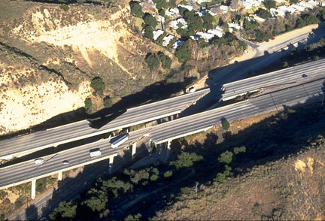
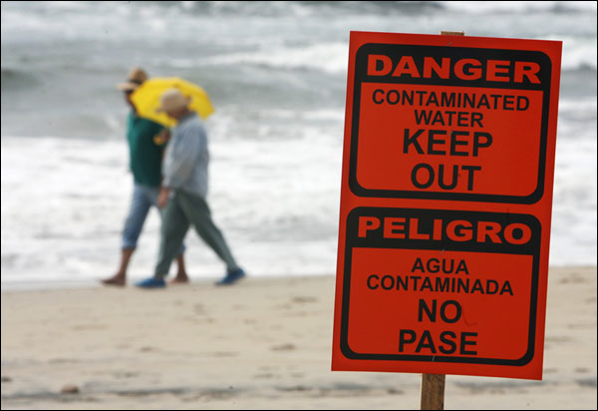
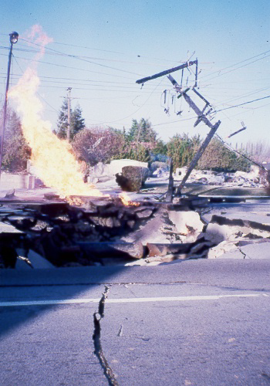


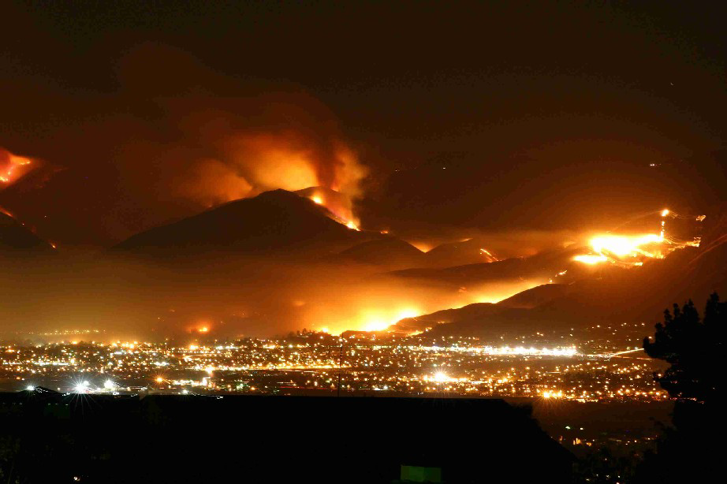
Open Discussion

