Slide 1
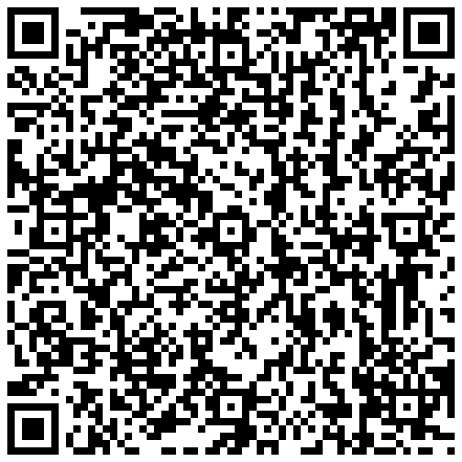
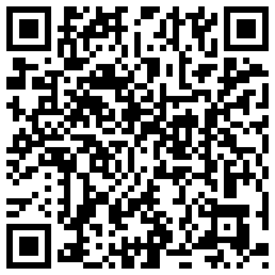
https://market.android.com/details?id=com.blackboard.android
http://itunes.apple.com/us/app/blackboard-mobile-learn-for/id376413870?mt=8

Slide 2
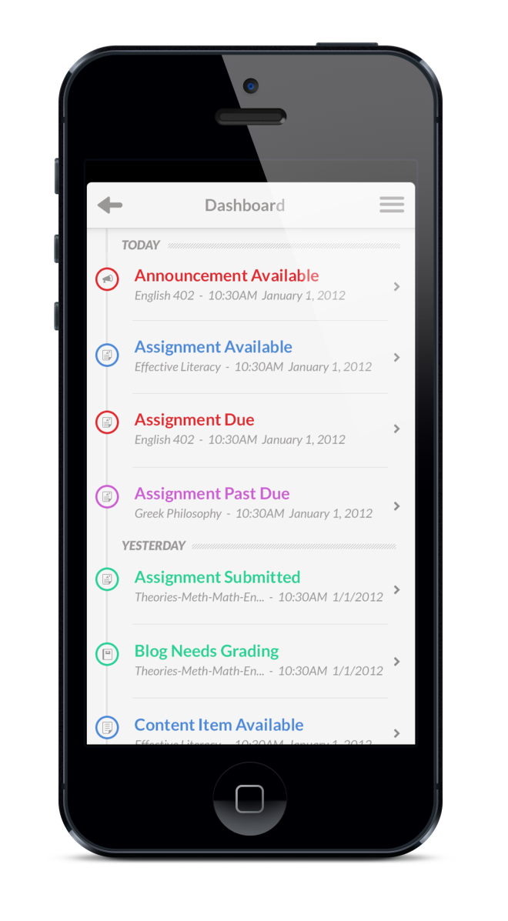
Accessing Blackboard Mobile Learn
Search for “Blackboard Mobile Learn” in your App Store or click the links below:
Apple App Store.
Google Play
BlackBerry App World.
Palm App Catalog
Once Blackboard Mobile Learn is installed, search for SAN BERNARDINO COMMUNITY COLLEGE DISTRICT using the search bar that automatically appears when you open the app
Log in using the same username and password you normally use to access Blackboard

Slide 3
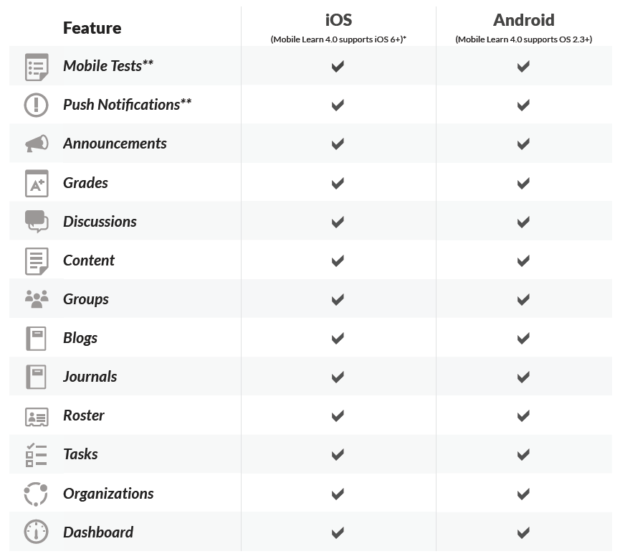

Slide 4
Blackboard Mobile Learn Analytics - When We Launched the Free App
As of 4/9/2015

Slide 5
Blackboard Mobile Learn Analytics
As of 5/4/2015

Slide 6
Blackboard Mobile Learn Analytics
As of 5/4/2015

