Slide 1
SBVC and CHC Mobile Apps
Presentation to the Board of Trustees

Slide 2
Some quick stats (as of 5/4/15)
Launched April 1st, 2015
SBVC app downloaded 551 times (iOS) and 563 times (Android)
CHC app downloaded 93 times (iOS) and 57 times (Android)
Student comments include:
“It's pretty helpful. I like it so far”
“This app is amazing it still might need a few upgrades but it does the job that all I have to say”
“It has a lot of potential. If you guys keep updating it with great features, like Apple Pay and Schedule appointments and more. I believe it will be a awesome app”

Slide 3
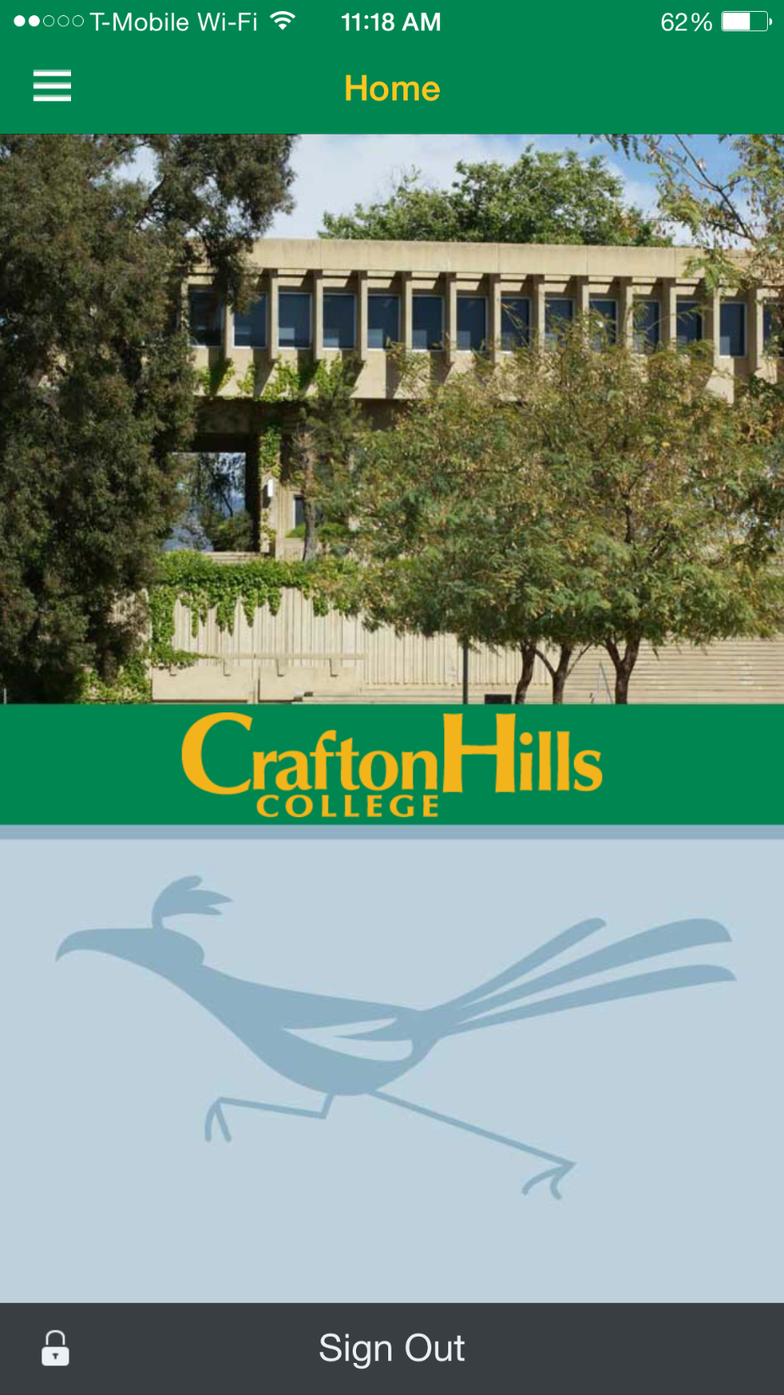
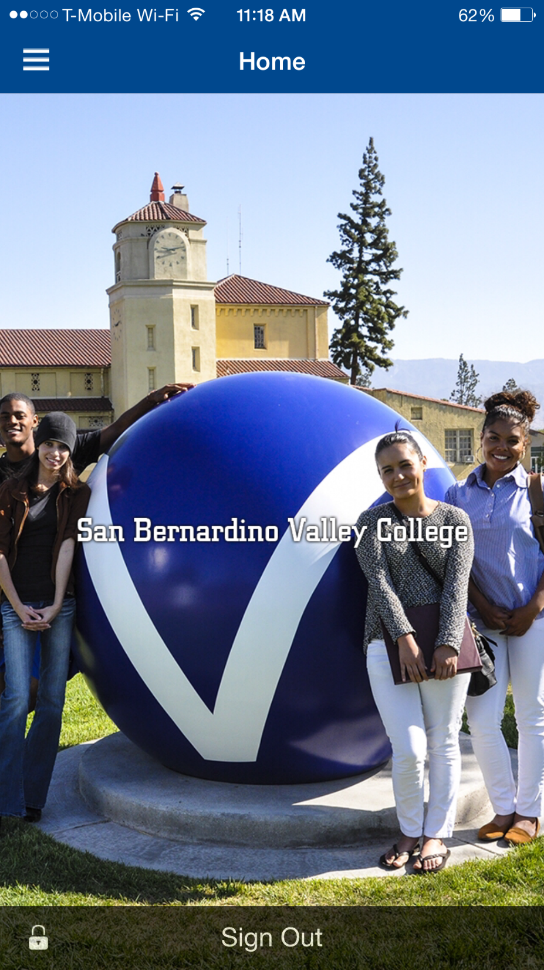

Slide 4
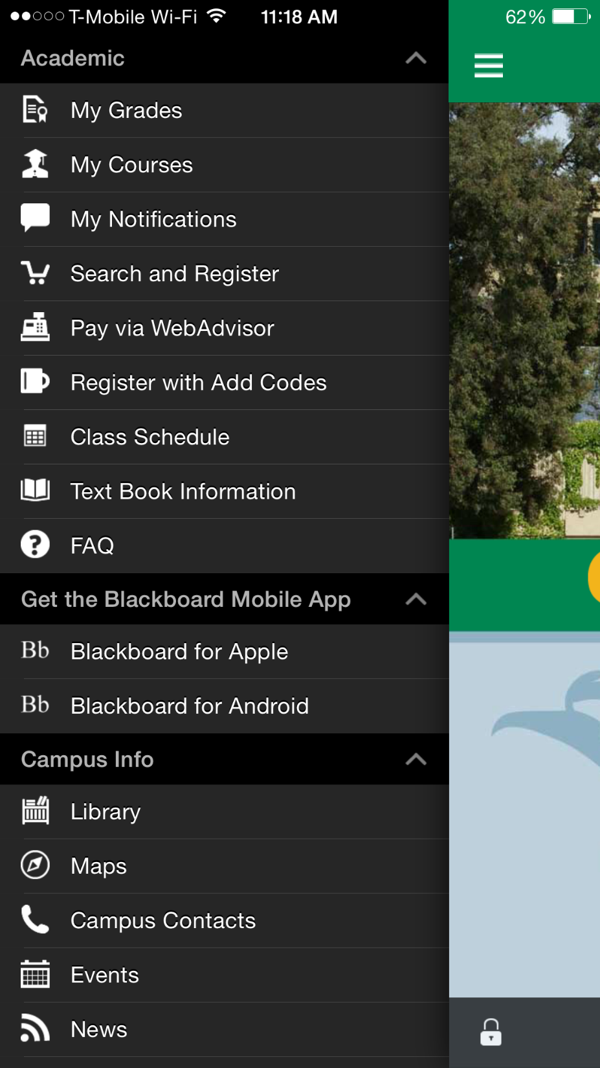

Slide 5
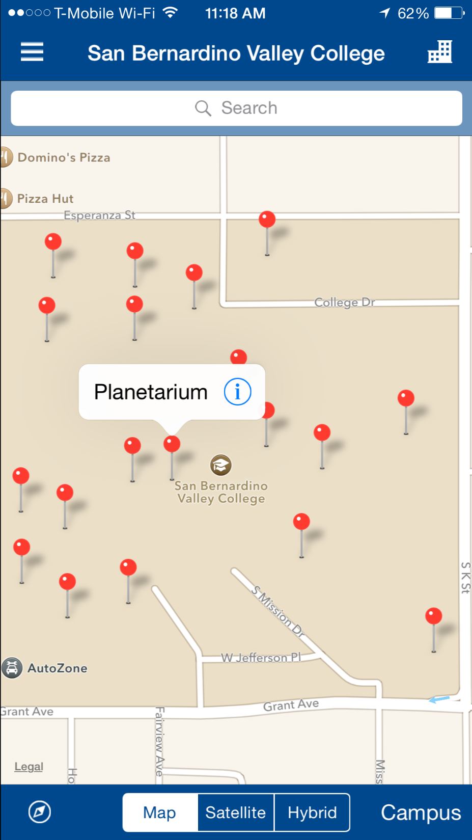

Slide 6
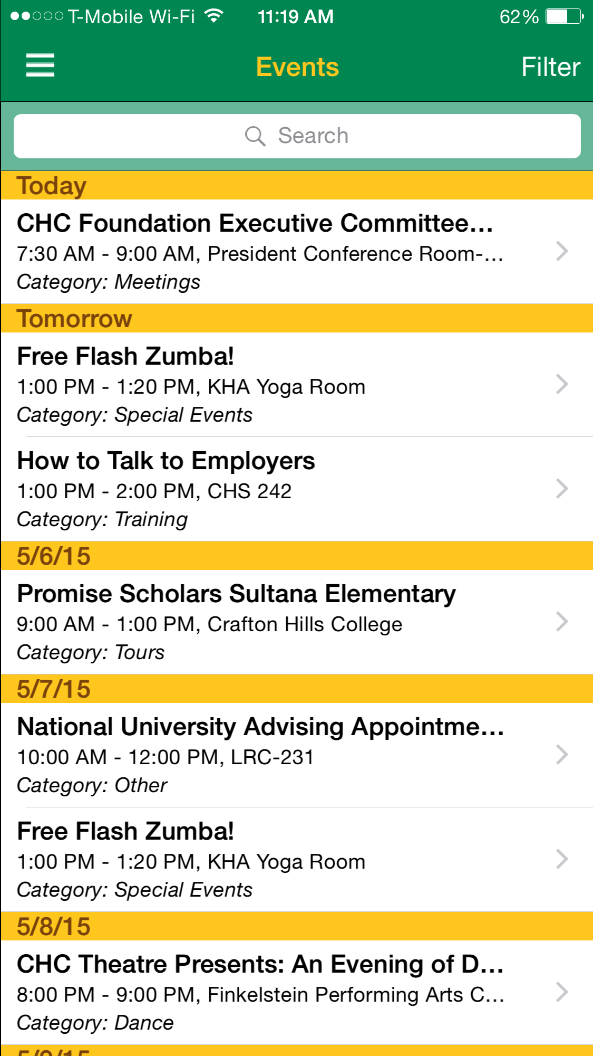
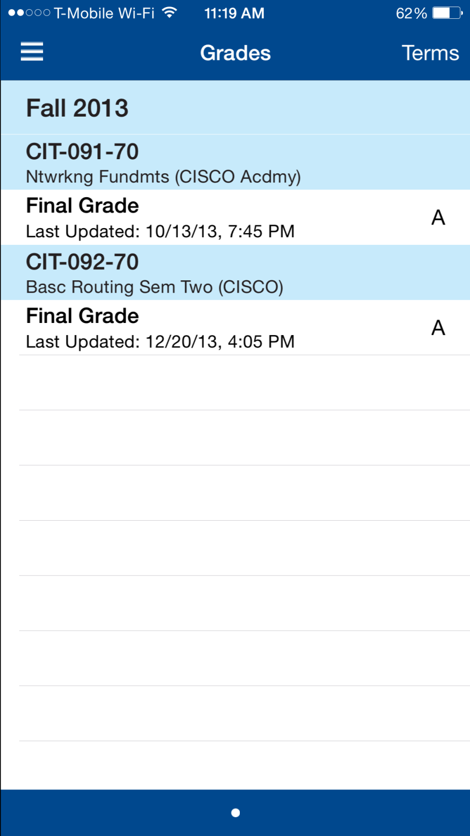

Slide 7
Future?
Monitor student and staff feedback
Provide updates as vendor makes them available

