Slide 1
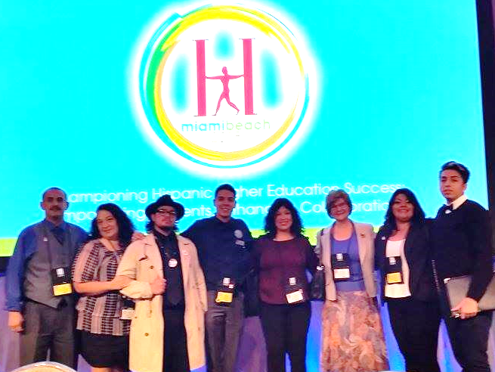
Hacu 2015
Miami, Florida

Slide 2
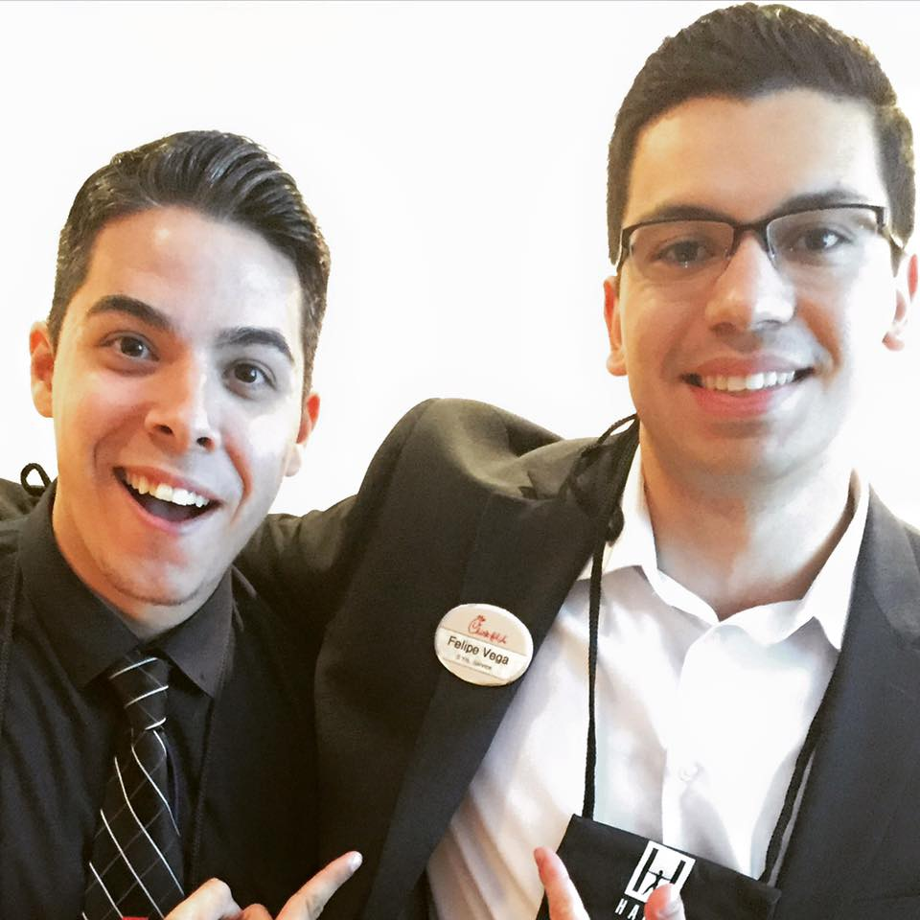
Thomas Robles, Student Trustee

Slide 3
The Fontainebleau

Slide 4
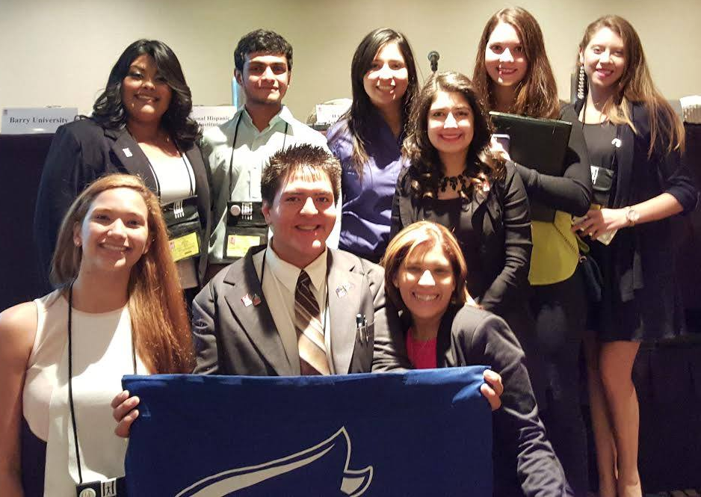
Gracie Fuentes, asl & mecha

Slide 5
Miami weather

Slide 6
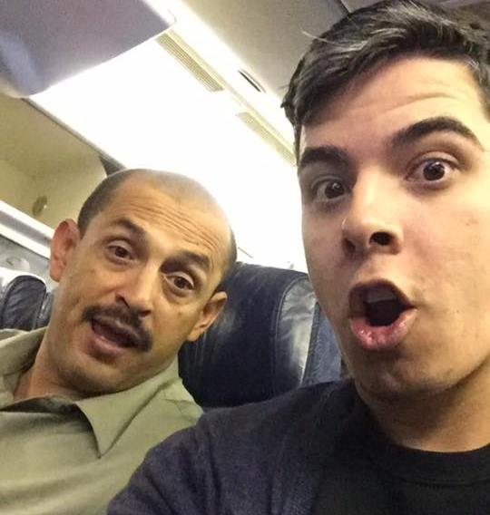
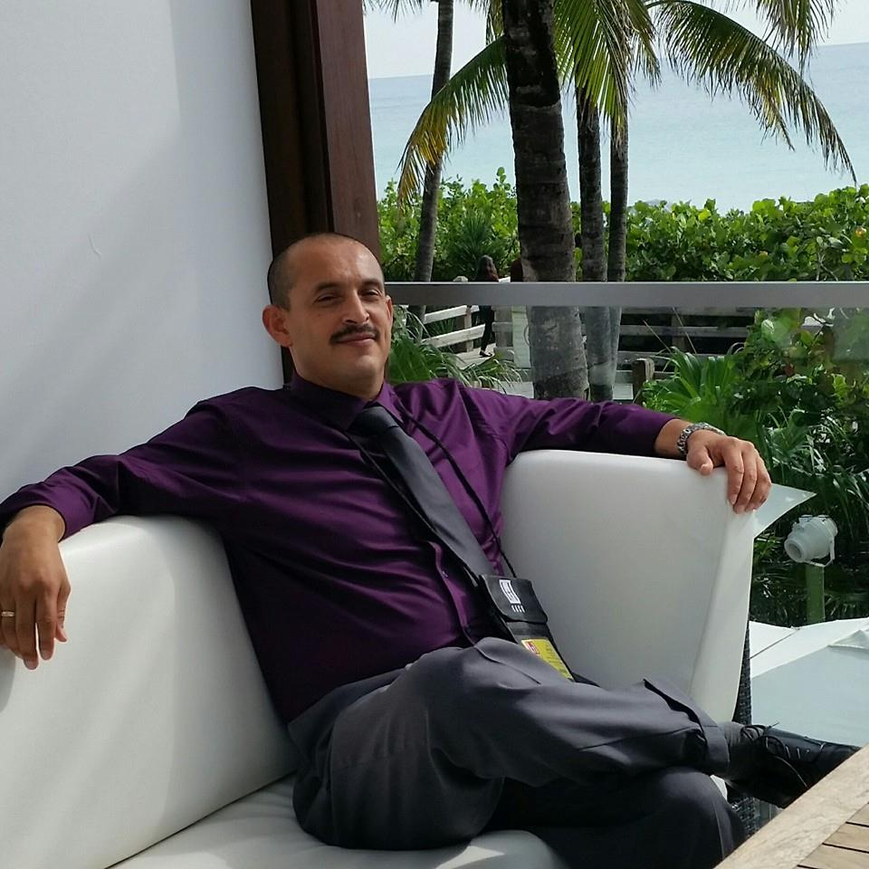
Sergio Alvarez, Puente & stem

Slide 7
sunsets in Miami

Slide 8
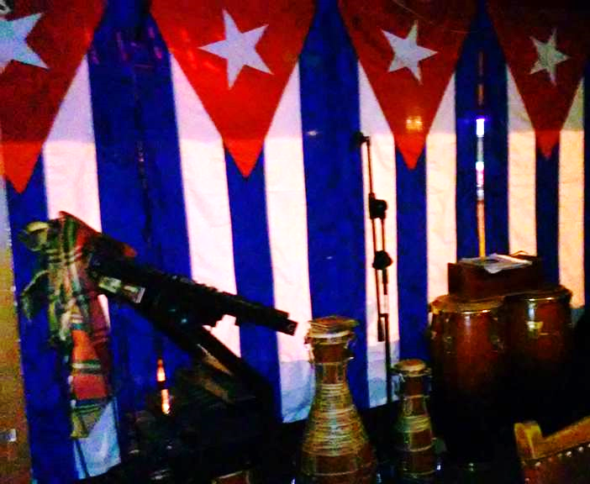
Jason martinez, mecha & aim

Slide 9
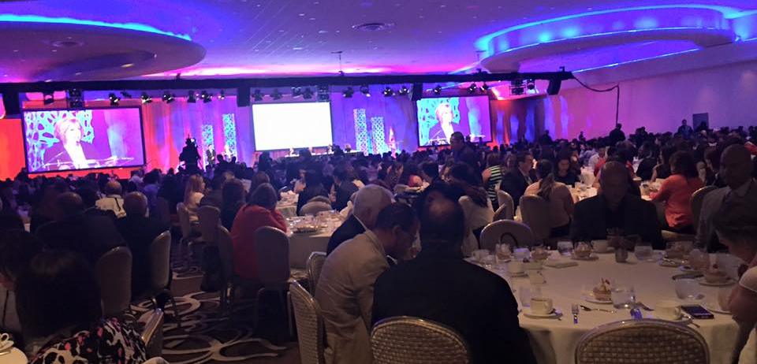
Miami nights

Slide 10
Jesse Ramirez, valley bound

Slide 11
Championing Hispanic Higher Education Success, Empowering Students, Enhancing Collaboration

Slide 12
HACU National Internship Program
Empowering Hispanic Students through the Open-Access Teaching Method – STEMP
HACU Government Relations Update
Success Through K-12 Collaboration
Enhancing Hispanic Student Learning by Growing the Hispanic Professoriate
Game Changers: Corequisite Remediation Initiative for HSI
LIFE = Learning. Improvement. Fun. Empowerment. Near-peer Mentoring Programs
Collaborative Linking: Academic Advising and Career Center Services
Advocacy and How it Benefits You
The Sophomore Year Initiative: Removing Barriers to Empower Students
Growing the Pool of Diverse Faculty Candidates: Development of Students and Faculty Panel

Slide 13
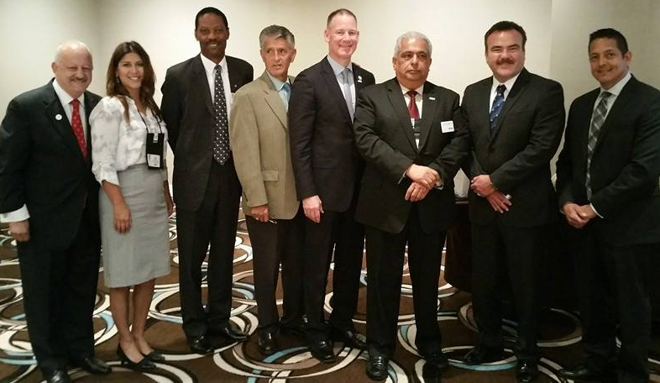
Pre-K-12 & higher education collaboration symposium

Slide 14
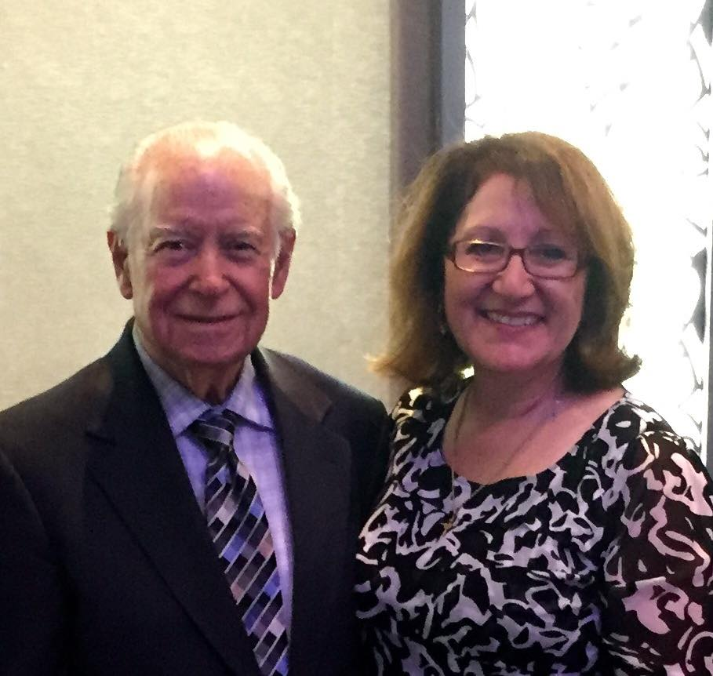
Friends & community

Slide 15
Hacu 2016
San Antonio, Texas

Slide 17
2017 Hacu costa rica

