Slide 1
KVCR FM/TV/FNX
District and Community Stakeholder Value:
Customer Loyalty
Economic Growth, and
Societal Well-Being

Slide 2
The Future: Cost Controls, Increased Revenue and Commitment to Quality Cost Control
Membership Growth
Major Gifts and Planned Giving
Stakeholder Value: SBCCD and Our Community
KVCR Foundation and Development
An engaged, invested Community and District

Slide 3
Development Strategies
Established Development Plan and Accountability Procedures
Comprehensive Multi-Year Fundraising Plan
Staffing & Organizational Cost Efficiencies
Revised KVCR Foundation Board Policies and Procedures

Slide 4
Focusing on Success:
Established Operating Plan for next 3 FYs with measures for accountability
Expanded Community Engagement and Investment, Programming, Value and Loyalty Building
A Commitment to Quality and Continuity of Operations
Visionary Leadership
Ethical, Transparent Operations

Slide 5
Fundraising and Revenue
Major gifts ($150K value for FY 15/16)
Donor Cultivation and Stewardship: Membership Growth
Grant Development: Governmental & Foundations
Planned Giving
Corporate Sponsorship
Board Commitments
Station Production and Studio Rental Income
Continued Institutional Support

Slide 7
KVCR Revenue (non-SBCCD) support

Slide 9
KVCR Foundation Board
Revised Bylaws approved- October, 2015
Strategic Plan approved- October, 2015
Master Agreement with District approved- January, 2016
Board Financial Commitment - formalized giving agreement
Articulation of Director Duties, Responsibilities and Expectations
Succession Plan for Recruitment of New Directors
Nominating Committee established

Slide 10
KVCR Foundation board of directors: annual giving

Slide 12
Cost Controls - Fiscal Accountability
Restructure of Financial System
Accurate Budget and Accounting System
Robust Fiscal Controls in place – Daily Balance Report
Ethical and Judicious Expenditures
Elimination of Non-Essential Expenses; Cost Containment for Current FY of $388K (Personnel, Station Supplies, Outside Services, Operating Expenditures)

Slide 13
Grant Development
Goal: $458K FY15/16
Total Requests Goal: $1M Annually
Requests Year to Date, FY 15/16 – $791K
Governmental = $150K
Foundations – $641K
Goal for Q4, FY 15/16: $250K
End of year projection: $1,000,041

Slide 14
Director of development and foundation
Overall management and administration of the KVCR Educational Foundation
Management of KVCR-FNX Development Department
Develop and implement comprehensive fundraising program
Support KVCR mission, member services, and external relations with underwriters, sponsors and community stakeholders/ partners
Oversee all philanthropic activities: major gifts, annual fund, events and development operations
Implement creative strategies to promote long-term sustainable growth

Slide 15
Immediate Need:
Necessity for $800K per year in district support for the current (FY16) and next two fiscal years (FY17 & FY18)
Immediate need for additional $500K for current FY from the district (District support was $300k at start of FY16)
Currently operating at a $373K deficit for FY16
Down from a projected $1.1M deficit for FY16

Slide 17
Fnx update: san Manuel financial support
Skillful stewardship and ethical management practices yielded expansion and renewed support of the San Manuel Gift
$2 Million annually, presently in the second of three year gift
Collaborative and supportive partnership and community engagement
Over 20 Million U.S. households now have access to FNX
100% Affiliate Growth - last year 10, currently 17 stations carrying FNX with 3 additional finalizing contracts

Slide 18
FNX national presentations

Slide 19
FNX affiliates graphic

Slide 20
fnx Special invited guests at festival Internacionál de cine y video Indígena, Puebla, Mexico March, 2016

Slide 21
CPB Partners

Slide 22
KVCR/FNX Recognition
KVCR and FNX have been nominated for and won numerous awards for TV/radio productions, including:
National IMAGEN Award
Two NAJA Awards (1st and 2nd Place) for FNX
Indigenous Music Awards (International)
Inland Empire Media Awards (Radio & TV)
IEEP Non-Profit of the Year Award

Slide 23
Inland Empire Media Award

Slide 24
Inland Empire Media Award
2014 – 2015
Locally Produced Radio or
Television Show of the Year
Presented to
KVCR Now
KVCR-TV
For Outstanding Service to the Industry
and the Community

Slide 25
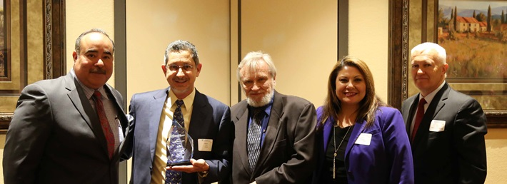
Ieep Non Profit of the Year
KVCR named 2015 Non-Profit of the Year by the Inland Empire Economic Partnership
For “exemplary leadership in furthering the cause of economic development and a better quality of life for all of the Inland Empire.”

Slide 26
Pbs executive leadership program

Slide 27
programming: Kvcr-TV
PBS shows ……… ……………………… = 54.98%
APT Shows …….................................... = 5.44%
NETA Shows …………………………….. = 11.55%
Other Shows
(Huell Howser, Cargo Live, etc.)…= 12.45%
KVCR Now, fillers & local interstitials…= 10.0 %
Local shows (KVCR, Raven, FNX) ….. = 5.58%

Slide 28
KVCR-91.9 FM
KVCR News Department grew in quantity and quality of local coverage
Aired more than 2,920 daily local news casts
Added another reporter to news team
KVCR was the biggest local source for keeping community informed of the Dec. 2nd tragedy in San Bernardino
KVCR was the voice of the IE on dozens of NPR stories and reports, post 12/02
SBCCD IDs mentioned over 13,000 times
More than 900 SBVC & CHC support spots
104 KVC_aRts episodes

Slide 29
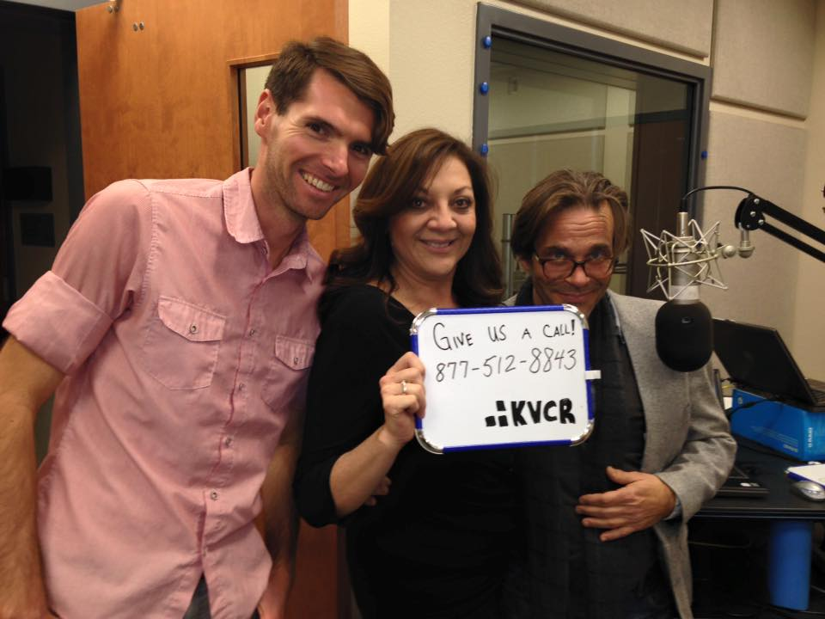
Kvcr radio pledge: the PM pitching team

Slide 30
Student Programs, Interns & Volunteers
Working closer with SBVC, CHC and other regional colleges and schools to provide internships and develop content
Interns and volunteers = $10,000-$20,000+ annual value
KVCR Offers Hands-on Professional Experience
Journalism/news reporting, audio/TV production, marketing, et al.
Closed Captioning and Web Development, Engineering
Motion and 3-D Animation

Slide 31
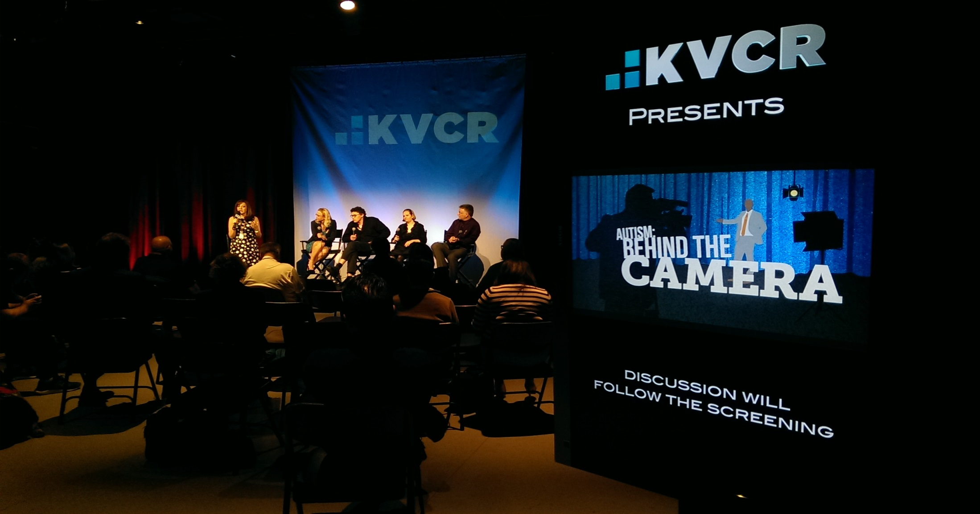
KVCR Community Engagement

Slide 32
KVCR: Community Matters

Slide 33
Sb strong: Kvcr

Slide 34
Kvcr community champions event: café sevilla

Slide 35
SB Chamber, station tour

Slide 36
Kvcr-TV: in her boots, 2015

Slide 37
Palm springs outreach

Slide 38
Chancellor’s Chat

Slide 39
Community Partners
SBVC and CHC – President’s Cabinets
District academic/faculty & staff groups, and units
CSUSB, UCR, Redlands Univ., UCR Extension, and more
IEEP, Smithsonian National Museum of the American Indian, PBS, NPR, Agua Caliente Cultural Center, The VA Hospital, The Community Foundation, The Autism Society, Local Law Enforcement Agencies, The Autry Museum, FICVI, Vision Maker Media, Loma Linda Medical Ctr., Ballard Rehab, A&R Tarpaulins, Brickley Environmental, and others

Slide 40
KVCR Strategic Context: Constituent Relationships & Audience

Slide 41
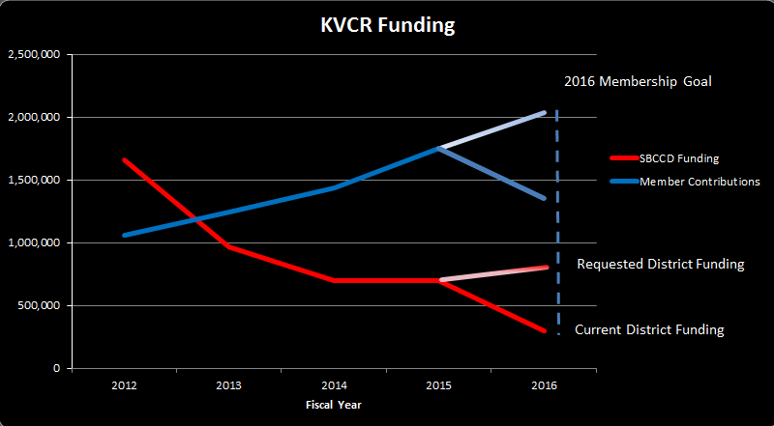

Slide 42
Community Events
Immediate needs:
$500K Additional Funding for FY16
$800K Continued District Funding Commitment for FY17 and FY18
Reassessment in FY19

Slide 43
In Review
Ethical and transparent management & fiscal practices
Development stability and revenue growth
Continue reduction of non-essential expenses
Financial and staff optimization for sustainability & growth
Trust and continued community engagement and building the KVCR Radio/TV & FNX brands
Innovative programming strategy, cross-promotion and multi-platform delivery

