Slide 1
San Bernardino Community College District Enrollment Management: College Reports 2016-2017 Diana Rodriguez, President, San Bernardino Valley College Dr. Wei Zhou, President, Crafton Hills College

Slide 2
SBCCD Enrollment Management Plan
The purpose of the Enrollment Management plan is to create a responsive, flexible, educationally sound, research based approach to enrollment management.
The end result was the creation of an Enrollment Management Plan that is intended to ensure the following:
The achievement of enrollment targets in order to obtain maximum resources available to SBCCD.
Maintain student access and pathways consistent with educational quality.
Offer a well-balanced and varied schedule responsive to the needs of our students and community.
Maintain a comprehensive educational program that is responsive to the needs of our students and community.

Slide 3
SBVC Enrollment Goals
SBVC has and will continue to focus on enrollment growth while the State is funding FTES growth and the growth incentives are available.
To grow, SBVC will continue to maintain its strong general education, transfer and occupational program offerings, while simultaneously enhancing educational opportunities utilizing the following strategies:
Online Degree / Certificate
Evening / Weekend College Program
Non-Credit Program
Off-Site locations
Dual / Concurrent Enrollment / AB288
AB540 Student Populations
Increased Efficiency

Slide 4
Alternative Enrollment Pathways
Distance Education / Weekend College Programs
The anticipated additions will have curriculum for Online Teaching, no prerequisites, high fill and retention rates, meet transfer requirement needs:
Projected FTES Generation
FA16 (FTEs) 35 Student Min | SP17 (FTEs) 35 Student Min | SM17 – 5 Week & 7 Week (FTEs)
Increase 3 to 5 Courses 10 to 17.5 FTEs | Increase 10 to 30 Courses 35 to 105 FTEs | Increase 10 to 30 Courses 35 to 105 FTEs
Non-Credit Program Expansion
SBVC will be exploring the use of experimental numbering to expedite the approval process for use of Non-credit courses for use in the Spring 2017.
Non-Credit Program Expansion
Academic Program | FA16 (FTEs) | SP17 (FTEs) | SM17 – 5 Week & 7 Week Sessions
Student Success Center | 0 | 150 (70,000 hrs.) | 15 (7,500 hrs.)
Writing Lab | 0 | 15 (7,500 hrs.) | 5 (2,600 hrs.)
SI Across the Campus | 0 | 75 (35,000 hrs.) | 30 (15,000 hrs.)
The Huddle | 0 | 15 (7,500 hrs.) | 5 (2,600 hrs.)
Accelerated Math Lab | 3 | 10 (5,000 hrs.) | 10 (5,000 hrs.)
Computer Resource Lab | 5 | 10 (5,000 hrs.) | 5 (2,500 hrs.)

Slide 5
Off-Site / Concurrent Enrollment
K-12 Early College Partnership
Partnerships with our K-12 colleagues are key to the success of our students and community. With recent legislation and increased dialogue with our surrounding Unified School Districts (i.e. Colton, Rialto, and SBUSD), there is a high potential of positive outcomes from our Dual and Concurrent Enrollment plans.
With improved alliances with faculty and industry partners within the Inland Region, new and innovative industry driven partnerships will be targeted to meet student and job market demands in the region’s industries, while also assisting with current skills-gap for the locally employed workforce.
Off-Site Locations & Initiatives
Locations & Initiatives | FA16 (FTEs) | SP17 (FTEs) | SM17 – 5 Week & 7 Week
Dual Enrollment (Off Site at HS) | 3 | 7 | 7
Concurrent Enrollment (SBVC Site) | 0 | 7 | 7
AB288 (Off Site at HS Closed Sections) | 0 | 7 | 7
Off-Site Locations (i.e. Amazon – ONT2, Adult Schools, etc.) | 0 | 75 | 21

Slide 6
Projections Summary
Strategies | FA16 (FTEs) | SP17 (FTEs) | SM17 (FTEs) | Totals
Online Degree / Certificate | 5 | 17.5 | 17.5 | 40
Evening / Weekend | 5 | 17.5 | 17.5 | 40
Non-Credit Program | 0 | 275 | 70 | 345
Dual / Concurrent Enrollment / AB288 | 0 | 21 | 21 | 42
Off-Site locations | 0 | 75 | 21 | 96
AB540 | 110 | 100 | 50 | 260
Increased Efficiency Retention | 0 | 150 | 27 | 177
Persistence Efforts
Total Strategy Estimate | 120 | 656 | 224 | 1000
Targeted Marketing Strategies | Social Media | Constant Contact
Targeted Outreach Efforts | Mall Booth | Valley in the Community | Community Outreach Booths | HS Counselors Luncheons
Assessment of Goals
Enrollment Management Timeline

Slide 7
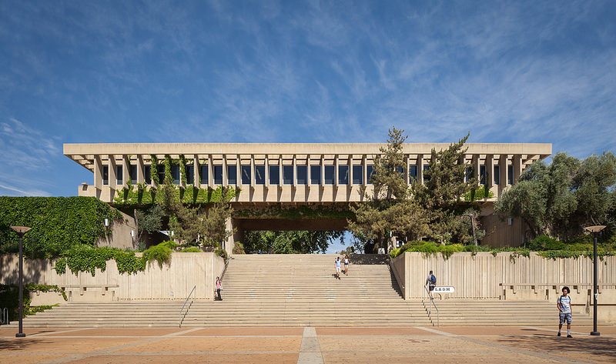
Crafton Hills College
Goal 1: Expand and develop partnerships
Goal 2: Improve College Processes
Goal 3: Implement Targeted Recruitments
Goal 4: Develop Programs to Meet Community Needs

Slide 8
Goal 1: Expand and develop partnerships
Short-Term Approach

Slide 9
Partnerships: Long-term approach
High Schools
Regional Fire Training
Redlands University (basic skills math)
Early, Middle, Online College
Non-Credit options through EDCT Partnerships
Workforce readiness certificate.
Pre-Apprenticeship for Construction Trades
Cooperative Work Experience Program

Slide 10
Goal 2: Improve College Processes
Short-Term Approach

Slide 11
Processes: Long-term approach
Affordable textbooks
Promote Completion
Register in spring for fall
Plan a two-year schedule
Review all pathways, revise scheduling
Determine and implement an optimal drop for non-payment window
Provide full programs in non-traditional formats

Slide 12
Goal 3: Implement Targeted Recruitments
Short-Term Approach
Notes:
In sum, we meet Standard A. While we do have the opportunity to improve our assessment infrastructure to increase those course and program assessment rates, we believe we meet this standard.

Slide 13
Targeted Recruitment: Long-term approach
Re-entry program
Veterans
Working Adults
Individuals with Disabilities

Slide 14
Goal 4: Develop Programs to Meet Community Needs
Short-Term Approach

Slide 15
Meeting community needs: Long-term approach
Expand online education
Develop credit and non-credit pathway options:
career choice, college re-entry, parenting skills, and family financial planning
Develop programs that meet market demands

Slide 16
Summary
 |  |  |  |  |  |  |  |  | FA16 | SP17 | SU17 | FA17
 |  | Goal 1: Expand and Develop Partnerships |  |  |  |  |  |  | 20 | 235 | 220 | 555
 |  | Goal 2: Improve College Processes and Services |  |  |  |  |  |  | 0 | 30 | 5 | 90
 |  | Goal 3: Implement Targeted Recruitments |  |  |  |  |  |  | 25 | 130 | 37 | 145
 |  | Goal 4: Develop/Expand Programs |  |  |  |  |  |  | 15 | 135 | 20 | 135
 |  |  |  |  |  |  | Subtotal |  | 60 | 530 | 282 | 925

