Slide 1
Bookstore 101
The campus bookstores at sbvc
& CHC
Notes:
Title: Bookstore 101
The Campus Bookstores at SBVC & CHC

Slide 2
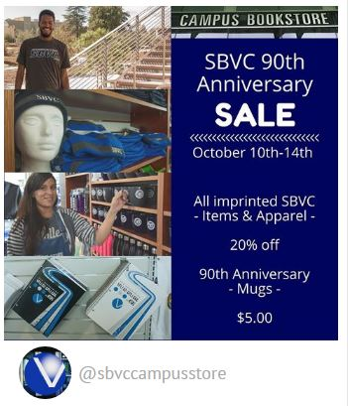
Is “OUT-sourcing” really the BEST option for our community?
Should we ONLY be concerned about the profits & the
bottom-line?
Do we have a higher obligation to those we are supposed to serve?
1
Notes:
Introduction
We need to ask a few questions of ourselves.
Is Outsourcing the Best Practice? Data driven?
People over Profits or Profits over People?
Do we have other obligations?
Institutional Memory is very important in this decision.
Est. 1948, In 2018 celebrating 70 years as part of SBVC!
The students used to own the bookstore.
Remind ourselves:
Who we are
Who we serve
Why we are here
Ask yourself:
Who will the entity you invite in be?
Who will they serve?
Why are they here?

Slide 3
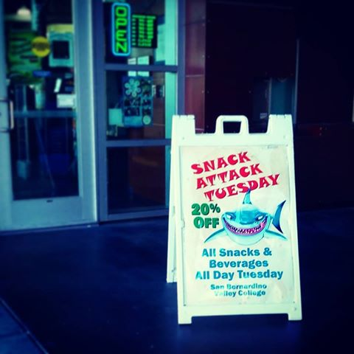
Bookstores are more than places to get textbooks. Lets talk about how bookstores enhance & give back to our district and our campus
community.
2
Serving our campus, our students and our community has been the cornerstone of our work for many years. As a institution shouldn’t we prioritize quality over quantity?
Notes:
More Than Books
Letters of support from campuses & community.
Outside Vendors
Calworks & Workforce Development
Foster Kinship Care Education & Guardian Scholars
List of our events and services that go above and beyond.
A focus on serving our community.
We know the needs of the campuses.
Some things just can’t be taught.
Quality over quantity is something we believe in.
Our personal touch.
Going the extra mile for our campuses.

Slide 4
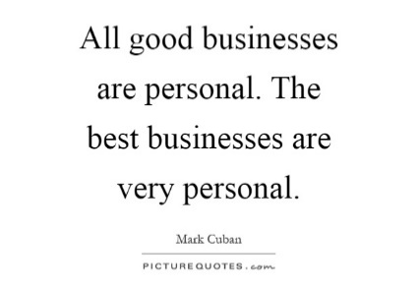
Keeping programs that serve the most needy students in tact is critical to the success of OUR student population.
EOPS/CARES
ValleyBound
SBVC Library
CalWorks
Arts, Lectures & Diversity
The profits are important but they aren’t everything. Lets take a moment to look closely at the actual numbers:
Sales:
Classified Staff:
Management:
District Costs:
Discounts:
Lets also look at:
Current Internal $:
Potential Internal $:
How much would we have to profit?
Notes:
Critical Support
Our students have challenges that a regular business will not care about.
Flexibility when working with special programs is crucial.
The timelines and deadlines require positive relationships with departments/programs.

Slide 5
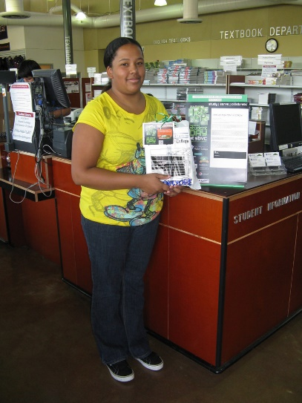
The profits are important but they aren’t everything. Lets take a moment to look closely at the actual numbers:
Sales:
Classified Staff:
Management:
Other Income:
Discounts:
Direct Expenses:
Are there profits left over?
Lets also look at:
Current Internal $:
Indirect Expenses $:
Our students are not the only ones who use our campus store, but they are the priority!
$4,092,963
$807,097
$104,917
$76,842
$282,724
$3,060,340
$19,644
$412,100
$38,000 - $60,000
Notes:
Our Priorities
Students are first, always!
Are we evaluating the bookstore the same as other programs/departments?
Look at the numbers:
Sales are over $4 Million
Staff are less than $1 Million
Other income $76,000
Discounts to Students: Over $200,000
Direct Expenses: Over $3 Million
What is left? $19,000
Spent Internally: Over $400,000
Why is there a big loss?
Charging bookstore for phones, repairs, conferences, mileage, promotions, etc.
Indirect Expenses: $30,000 – 60,000
Examples of what we are doing wrong:
Staples & Non-Instructional Supplies

Slide 6
As we work toward being a safe space, a community space and to improve the image of our campus, we must not forget why we are here.
Education
Service
Employment
Community
In the Inland Empire we know that only through local economic growth, educational access, student success, constant innovation and nurturing our best, brightest, homegrown students will we achieve the dream we promise them.
Notes:
V. Why are we a COMMUNITY COLLEGE?
Not a private
Not a for-profit
Here to serve the community
It’s the colleges that matter most.
Keep the funds as local as possible.
Invest in our community, students & infrastructure.
Push for innovation here with our own human resources.
Focus on the Inland Empire not the corporate empire.

Slide 7
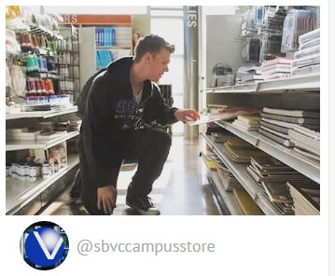
It is so easy to take the road where we follow other for-profit colleges or private institutions and corporations.
Is that who we are?
Is that who we want to be?
Can we do better?
What would it take to bring together our best innovative, creative and problem solving minds to seek better solutions?
The Dream Starts Here!
Lets build the campus store we want to have for our district locally & strive for the best practice not just pass the work along to someone else. Si Se Puede!
Technology has changed the face of campus student stores across the country. We need to evolve not devolve or outsource.
Notes:
Change
Changing is difficult and takes time.
Technology has changed the industry.
We need to evolve.
Campus Stores vs. Bookstores
Keep the personal touch.
Choose Wisely
Take the road less traveled.
Bring our problem solvers to the table.
More shared governance & inclusion.
We can do it, if we come together with a plan.

