Slide 1
Flex Calendar Discussion & Information
Jeremiah A. Gilbert, Ph.D.
District Assembly President
February 23, 2017

Slide 2
Calendar Discussion
May 2014 – The Calendar Committee met and recommended that a memo be drafted to all constituent groups for discussion about the possibilities afforded the district through the Flexible Calendar Program.

Slide 3
Calendar Discussion
May 2015 – The Calendar Committee unanimously agreed to pursue exploration of the options permitted under the state Chancellor’s Office flexible calendar schedule, including the maximum allowable professional development days (15). While another possible calendar exists, called a compressed calendar, the Calendar Committee declined to pursue that option at the time.

Slide 4
Calendar Discussion
May 2015 (Cont.) – Because the academic calendar is part of the CTA contract, the committee requested both CTA and Human Resources begin a dialog about what the ramifications of any change may be.

Slide 5
Calendar Discussion
October 2015 – The committee also requested some guidance from classified representatives familiar with the legal requirements for scheduling. For example, a 3-unit lecture class may meet for 48-54 hours during a given term to award unit credit to the student. An initial review of some classes seems to indicate no change is required in scheduling for most sections.

Slide 6
Compressed Calendar
Compressing a calendar means altering the academic schedule from an 18-week semester to a 16-week semester without loss of instructional time in the classroom.
For instance, if a 3-unit lecture course meets for 3 hours a week in an 18-week semester (for a total of 54 hours), the same 3-unit lecture course would need to meet 3.375 hours a week in a 16-week semester (for a total of 54 hours).

Slide 7
Compressed Calendar
Since no instructional time is lost under a compressed calendar faculty pay would not be negatively affected, but work schedules may change.
Final exams are held on the last day of instruction rather than during a finals week.
Full-time contract classified staff will not likely experience a reduction in their regular annual work schedule as a result of this calendar.

Slide 8
Flex Calendar
We are currently on a Flex Calendar. The Flexible Calendar Schedule defines academic calendars as
  Consisting of at least 175 instructional service days (we currently have 177)
  Allows for up to 15 of those days to be dedicated to professional development (we currently have 7)
  Provides for regular apportionment during days dedicated to professional development

Slide 9
Flex Calendar
Using the maximum number of professional development days would move the colleges to a 16-week instructional calendar.
A review of California colleges and districts reveals that most of the colleges, through compressed calendars, flex calendars, adjusting term multipliers, and professional development days are converging on a shorter calendar like the 16-week calendar the CSU system has adopted.

Slide 10
Flex Calendar: History
In a traditional 18-week semester, faculty do not have time to devote to improvement activities. Once the semester begins, with complex class schedules, finding concurrent times for faculty to meet as groups on large scale topics becomes impossible.

Slide 11
Flex Calendar: History
The flexible calendar allows institutions to develop ways to address the need for getting faculty together to deal with major issues. This also recognizes the professional nature of instruction by giving individual faculty members time to focus on staff, student, and instructional improvement in addition to providing day-to-day classroom instruction.

Slide 12
Flex Calendar: Purpose
The purpose of the flexible calendar program is to provide time for faculty to participate in development activities that are related to “staff, student, and instructional improvement” (Title 5, Section 55720). The flexible calendar program is a component of the staff development program and the major vehicle for faculty participation in development activities.

Slide 13
Flex Calendar: Purpose
Since the flexible calendar program removes time from the instructional program, it is a reasonable expectation that use of this time should foster instructional improvement. In addition, the law provides for staff improvement and student improvement as part of instructional improvement.

Slide 14
Flex Calendar: Configurations
In addition to providing time to conduct these activities, the flexible calendar program also allows institutions some flexibility in scheduling configurations (Title 5, Section 55722), including but not limited to:
  A calendar comprised of two 16-week semesters with an intersession
  Courses scheduled for student enrollment on an open entry-open exit basis
  Courses scheduled independently of any term configuration

Slide 15
Flex and In-Service Days
Our District, and CTA contract, makes a distinction between flex days and in-service days; however, the state Flexible Calendar does not.
  We have locally identified Flex Days on the calendar with programming that faculty may choose to participate in, or may meet their obligation through other activities. Currently we have 4 Flex Days.
  In-Service Days are required days on site. Currently we have 3 In-Service Days: Before Fall and Spring instruction begins along with commencement.

Slide 16
Flex Day Options
Moving to a 16-week instructional calendar would increase the number of flex and/or in-service days. Such flex days could include:
  Work on student learning outcomes
  Accreditation work
  Curricular design and development
  Programmatic review processes
  Dialog within disciplines, divisions, or institutionally about student learning and success

Slide 17
Faculty Feedback on Flex
At a recent SBVC Academic Senate meeting, those present were asked “If the number of Flex Days were increased, what sort of activities would you like to see included?” Feedback included:
  Flex day cluster – fill in the Thanksgiving break
  Teaching demos - teaching strategies and practices
  Teaching / Learning workshops
  Prep for classes (improve/modify them for 16-week calendar)
  Group projects for departments
  Stress-relieving activities
  Diversity & Inclusion - safe space, etc.
  Faculty discussions on effective pedagogy

Slide 18
In-Service Day Options
Required, in-service days could include training on topics such as:
  Equal Employment Opportunity (EEO)
  Title IX
  FERPA
  Distance Education
  Canvas
  Accessibility Issues
  Safety
  Emergency Procedures

Slide 19
Faculty Feedback on In-Service
At a recent SBVC Academic Senate meeting, those present were asked “If the number of In-Service Days were increased, what sort of activities would you like to see included?” Feedback included:
  Department reflection meetings (to review goals and plans, discuss conference reports, discuss statewide/nationwide trends, etc.)
  Something similar to the Great Teaching Retreat format at beginning of semester AND Thanksgiving week
  Keynote speakers
  Community exchange amongst faculty and staff
  Discussions with the Board
  Conference to boost morale / employee engagement

Slide 20
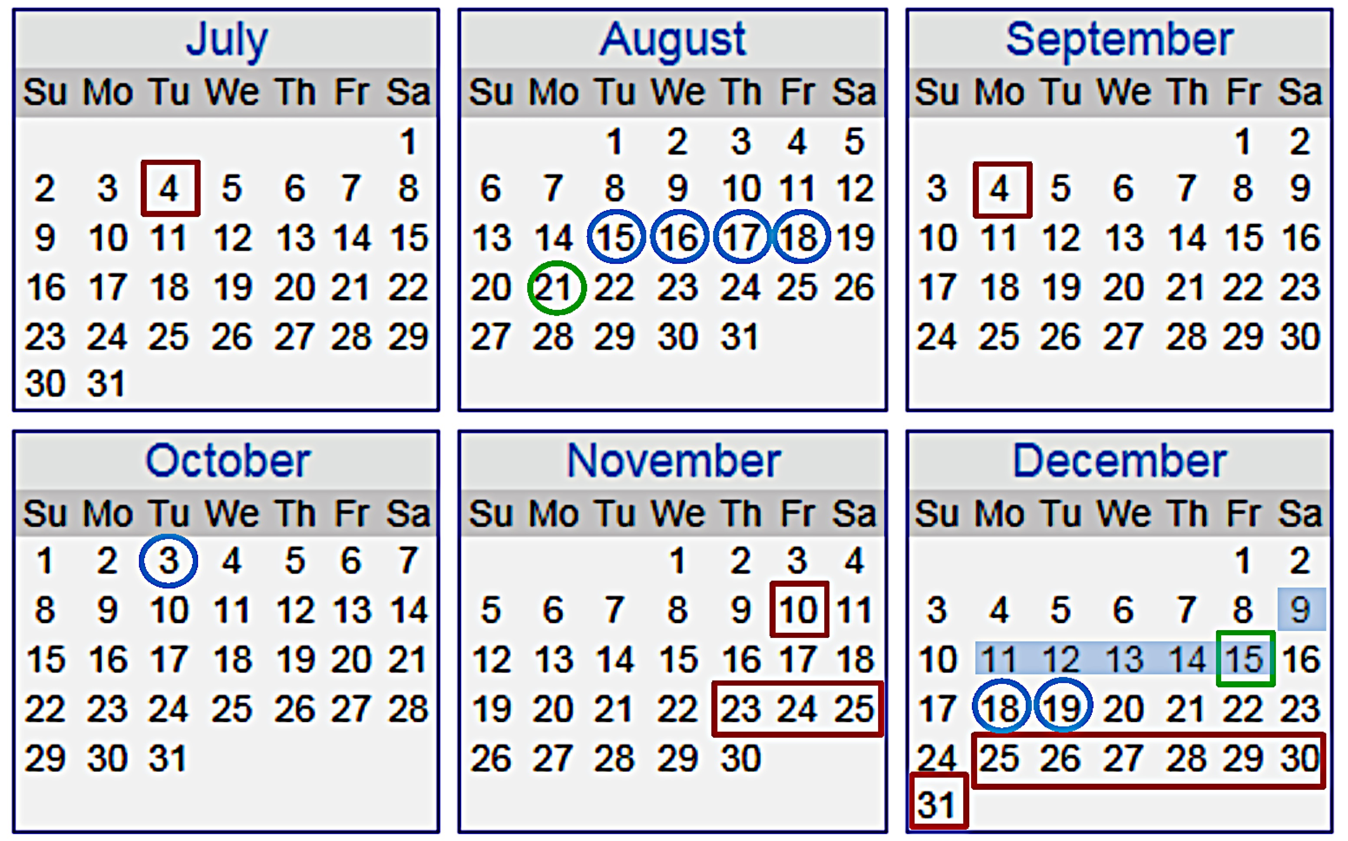
Mock Fall 2017

Slide 21
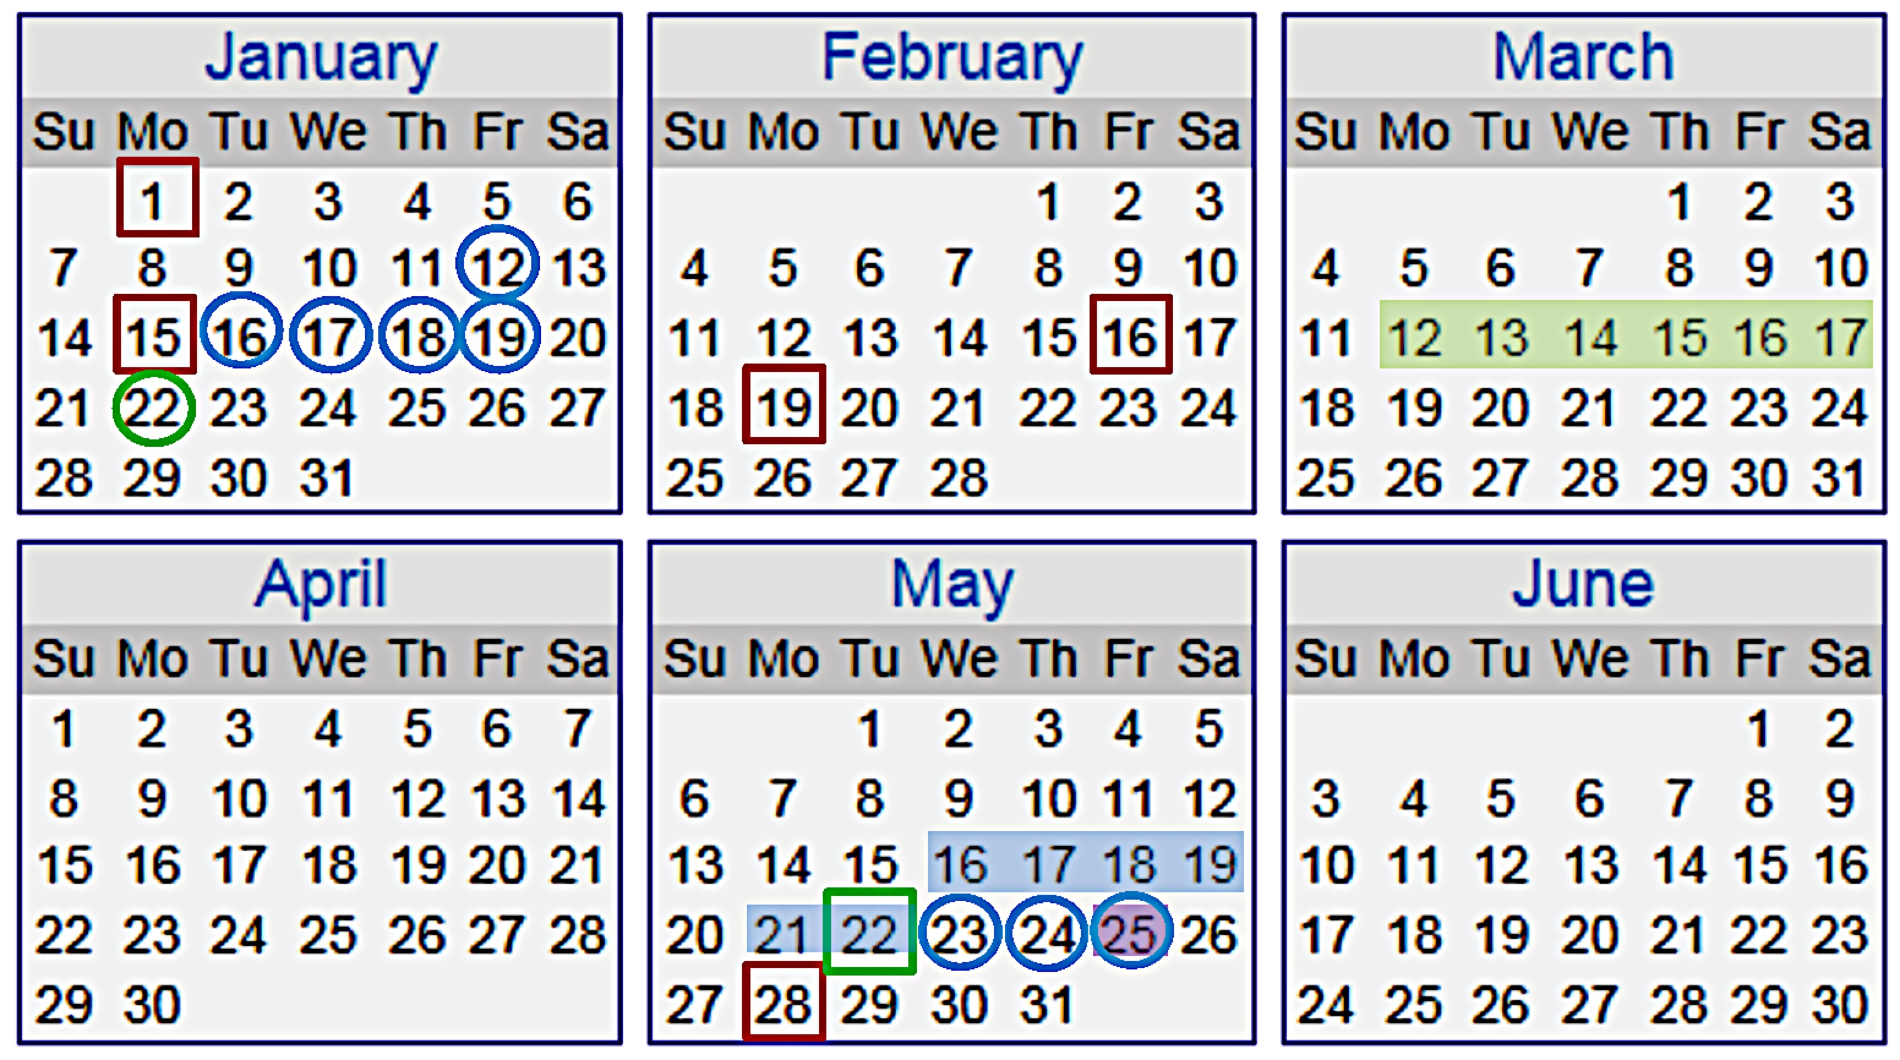
Mock Spring 2018

Slide 22
Student Success
Using data housed by the California Community College Chancellor’s office that shows annual student success and retention rates for each community college, results reveal that success and retention rates change little before and after switching from 18- to 16-week instructional terms.

Slide 23
Student Success: Case Studies
Mt. San Antonio College
 | Retention Rate | Success Rate
18 week (FA03 – SP06) | 83.0% | 66.0%
16 week (FA06 – SP07) | 81.7% | 65.8%
16 week (FA07 – SP09) | 83.0% | 66.1%
Cypress College
 | Retention Rate | Success Rate
18 week (FA08 – SP11) | 84.1% | 70.5%
16 week (FA11 – SP12) | 86.0% | 74.3%
16 week (FA12 – SP14) | 85.8% | 72.7%

Slide 24
Student Success: Case Studies
Fullerton College
 | Retention Rate | Success Rate
18 week (FA03 – SP06) | 82.1% | 66.9%
16 week (FA06 – SP07) | 84.3% | 71.4%
16 week (FA07 – SP09) | 83.4% | 67.7%
Long Beach City College
 | Retention Rate | Success Rate
18 week (FA09 – SP12) | 83.5% | 65.9%
16 week (FA12 – SP13) | 84.9% | 65.5%
16 week (FA13 – SP15) | 85.5% | 64.6%

Slide 25
Flex Calendar Guidelines
The guidelines for the Flexible Calendar Program can be found at: http://extranet.cccco.edu/Portals/1/AA/FlexCalendar/Flex_Calendar_Guidelines_04-07.docx.pdf

