Slide 1
UNDERSTANDING
THE MEDIA
Media Relations and Crisis Communications: A Guide to Working with Reporters

Slide 2
INTRODUCTION TO CERRELL
OUR HISTORY
OUR WORK
OUR TEAM

Slide 3
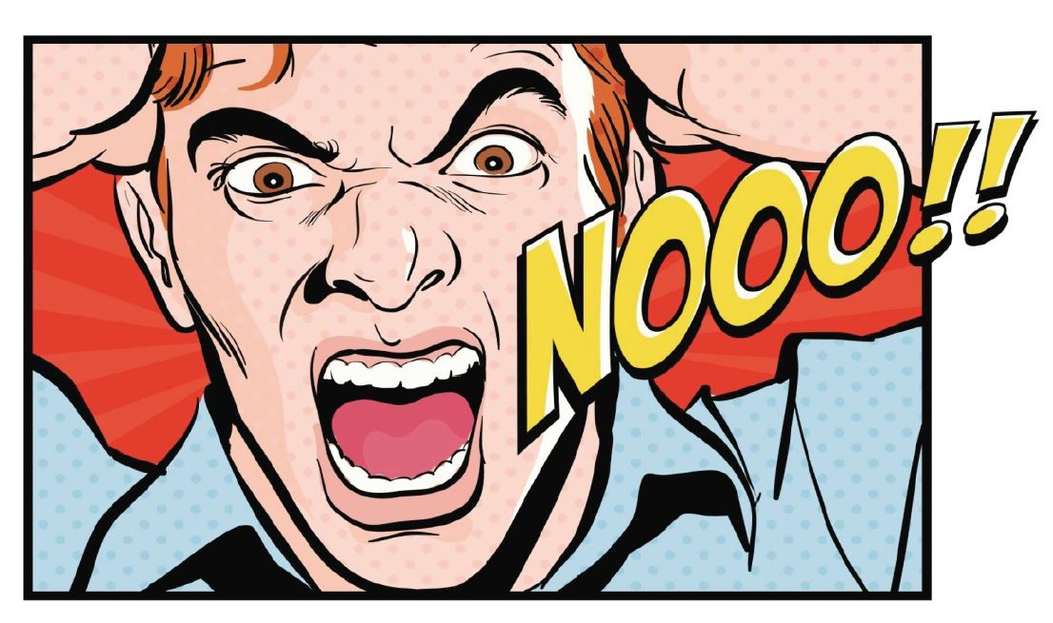
CRISIS COMMUNICATIONS-
OVERVIEW

Slide 4
NUMBER ONE RULE

Slide 5
WHAT IS A CRISIS?
Crisis: A situation that causes negative impacts and/or reactions
Two Categories
NATURAL DISASTER
MAN-MADE

Slide 6
TYPES OF CRISIS
Immediate Emerging Sustained
Natural disasters and major emergencies.
(Weather, terrorist attack, major traffic accidents, oil spill)
Has the environment and conditions to become a crisis.
(This is the most difficult to predict in terms of timing and must be monitored in real time)
Social Media/On-Line
Ongoing – may last for several months or even years.
(Managed instead of active actions)

Slide 7
PHASES OF CRISIS
Pre During Post
Continuous Prep
Plan your response if things go wrong, prepare a readily-implemented strategy, drill as if it was a real crisis.
Active Management
Health and safety of the community, provide timely information, mitigate negative impacts, and protect brand reputation.
Evaluation
What works, what can be improved, make changes. Tweak strategy if necessary

Slide 8
MANAGING A CRISIS

Slide 9
MANAGING A CRISIS

Slide 10
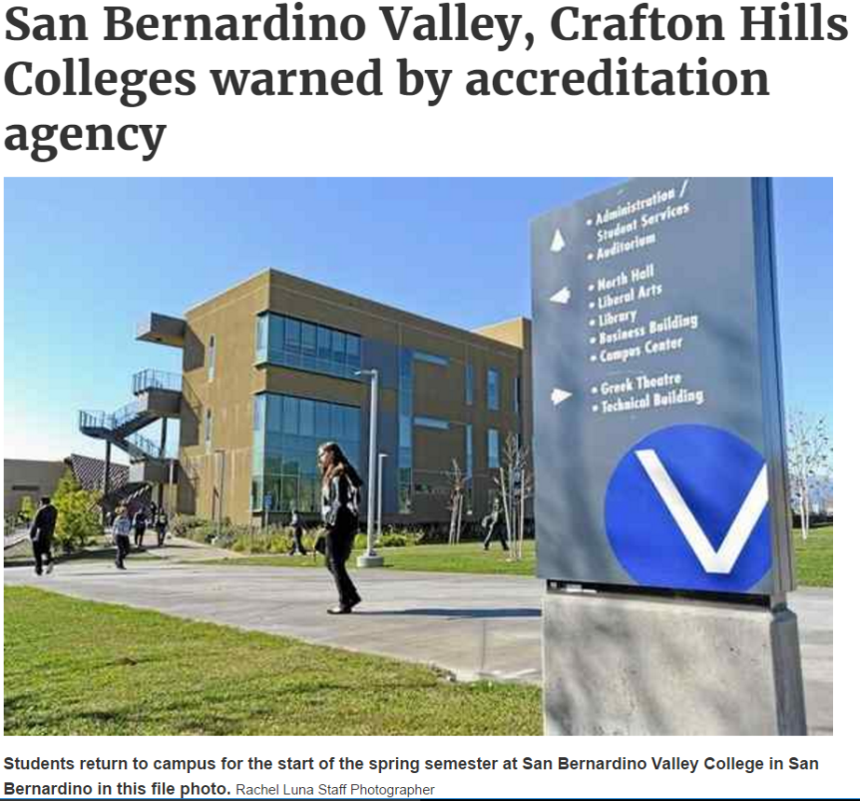
SBVCC-
ACCREDITATION
Lessons learned
(discussion)

Slide 11
UNDERSTANDING
THE MEDIA
HOW TO BE
Media Relations and Crisis Communications: A Guide to Working with Reporters
READY

Slide 12
STEP ONE
ONE
PRACTICE
PRACTICE
PRACTICE

Slide 13
STEP TWO
DEVELOP
DRILL
SCHEDULE.

Slide 14
STEP THREE
MAKE IT REAL
Bring in 3rd party players to make the exercise real and to act as role players.
[Media, elected officials, & community representatives]
[Determine if any emergency responders or government representatives need to participate]

Slide 15
STEP FOUR
EVALUATE
Debrief &
Lessons Learned.
“Hot Wash”

Slide 16
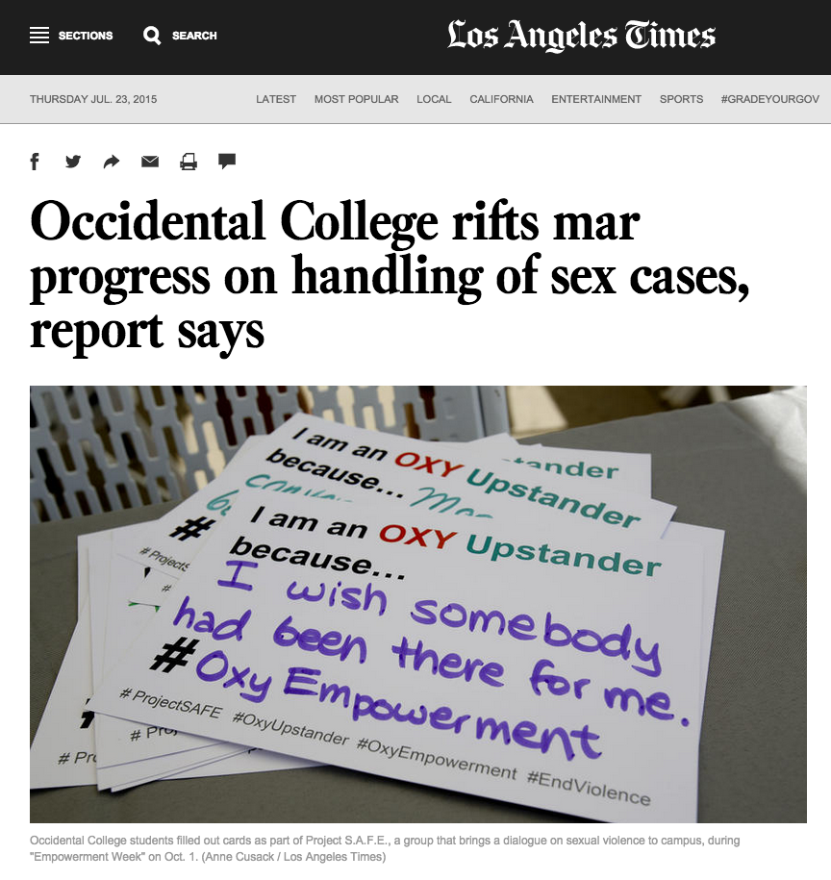
FAILURE TO ADDRESS PROBLEM
Occidental College - Sexual Assault
Failed to provide immediate & clear policy changes that addressed problem
Allowed story to fester, lawsuits to mount & new issues
Tried to make story about the reporter
Positive changes never had a chance to cut through narrative

Slide 17
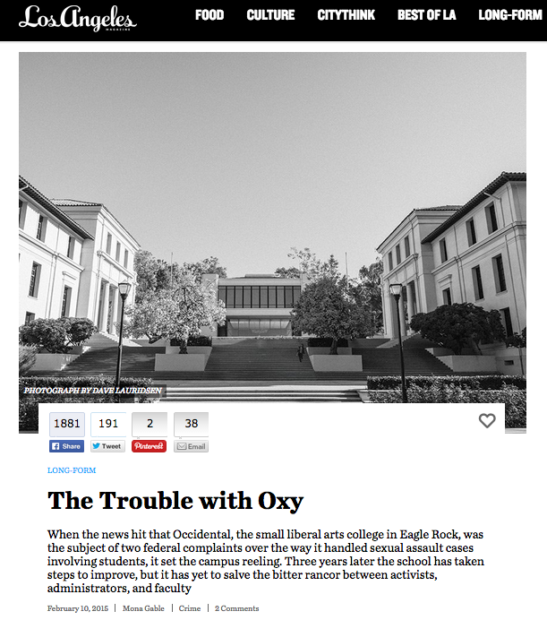
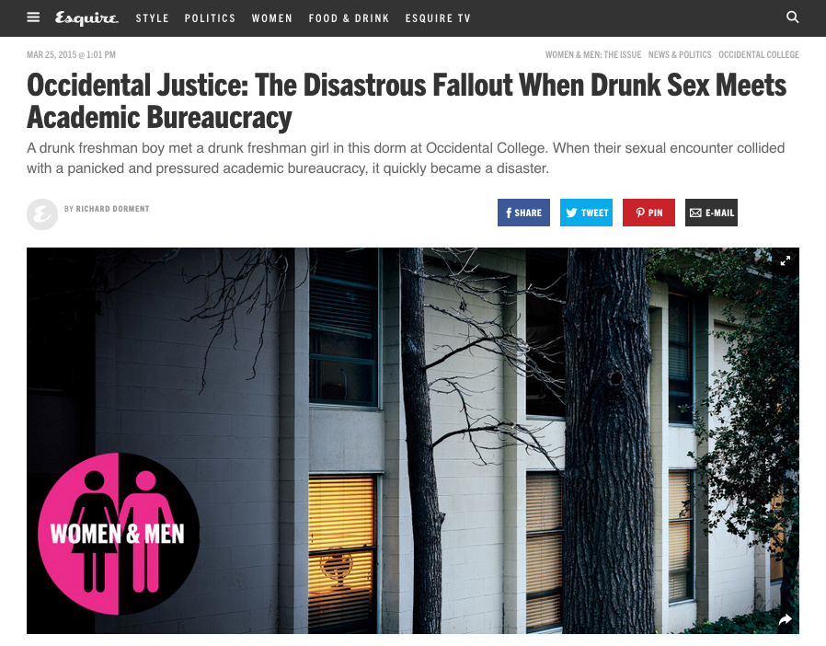
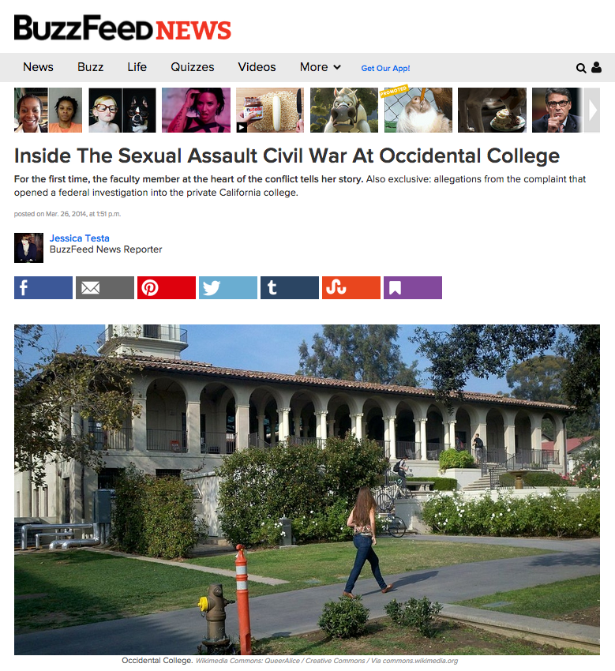
FAILURE TO ADDRESS PROBLEM

Slide 18
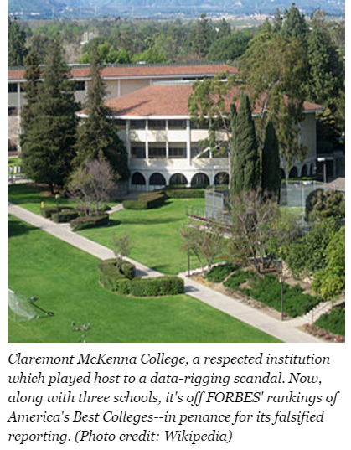
ADDRESSING ADMINISTRATIVE SCANDAL
Claremont McKenna: Falsely reported SAT scores in admissions data
Administrator responsible was quickly forced to resign
School hired law firm to investigate, implemented new accountability procedures
Similar misreporting subsequently discovered at a number of other schools
Given circumstances, Claremont’s response was very effective

Slide 19
UNDERSTANDING
THE MEDIA
KEY
CRISIS
RESPONSE
PLAN COMPONENTS
Media Relations and Crisis Communications: A Guide to Working with Reporters

Slide 20
CRISIS RESPONSE
KEY CRISIS RESPONSE PLAN COMPONENTS
Who Owns The Plan?
Who Is On The Crisis Communication Team?
[Need specific names]
Rank Your Risk
[Determine trigger points that activate crisis team]
Create Initial Internal Contact List

Slide 21
CRISIS RESPONSE
KEY CRISIS RESPONSE PLAN COMPONENTS
Initial Response Statement
[Development of a general first statement that can be distributed within one hour of crisis]
Scalability Of Team, Team Meeting
(Conference Call)
[Determine issues, responses, goals, impact, etc. And respond accordingly]
Map Out The Next 24 Hours
[Crisis specific]

Slide 22
UNDERSTANDING
THE MEDIA
KEY
MESSAGE
DEVELOPMENT
Media Relations and Crisis Communications: A Guide to Working with Reporters

Slide 23
KEY MESSAGE DEVELOPMENT
A CLEAR, STRONG, MESSAGE CAN FRAME THE STORY
STRONG MESSAGES ARE NOT
CREATED IN A VACUUM
Consider outside perception

Slide 24
MESSAGING-
DELIVER WITH CONVICTION
Be direct, clear & on point.
Deliver with passion.

Slide 25
KEY MESSAGE DEVELOPMENT
HOW DO YOU CREATE A STRONG MESSAGE?
Not defensive
Accurate – get the facts right
Take accountability. Express empathy
Sound human, not a pr flack – or a lawyer
Responsive to issues and concerns
Demonstrate action
Consider legal concerns – but find a balance
“Own” your information, let others own theirs

Slide 26
KEY MESSAGE DEVELOPMENT
STRONG: NBA RESPONDS TO DONALD STERLING AUDIOTAPE
“The views are offensive… I am personally distraught… I am banning Donald Sterling for life.”
NEUTRAL/WEAK: WELLS FARGO RESPONDS TO EMPLOYEES
OPENING FAKE ACCOUNTS.
“Wells Fargo is committed to putting our customers’ interests first 100 percent of the time, and we regret and take responsibility for any instances where customers may have received a product that they did not request.”

Slide 27
CASE STUDY:
OSTRICH SYNDROME
Penn State - Sandusky Scandal
Wouldn’t admit there was a problem; first press coverage was more than a year prior to PSU response
Allowed the media to frame its story
Damage was already done by the time they spoke - Appeared to be a cover up

Slide 28
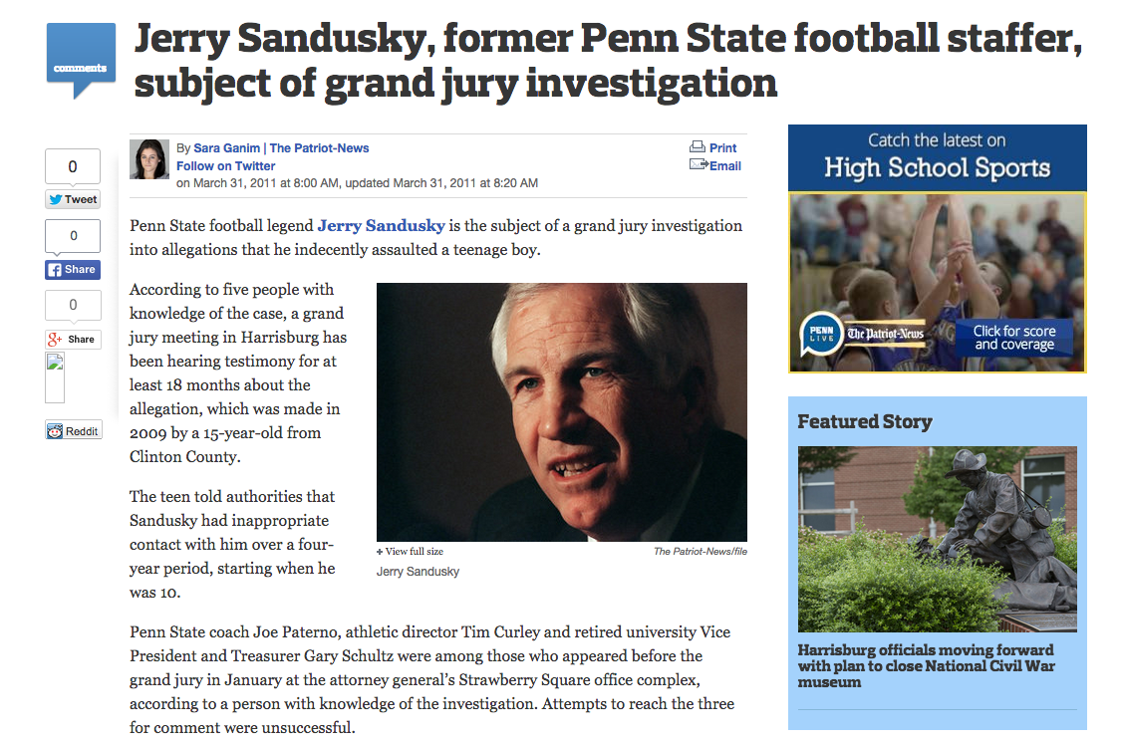
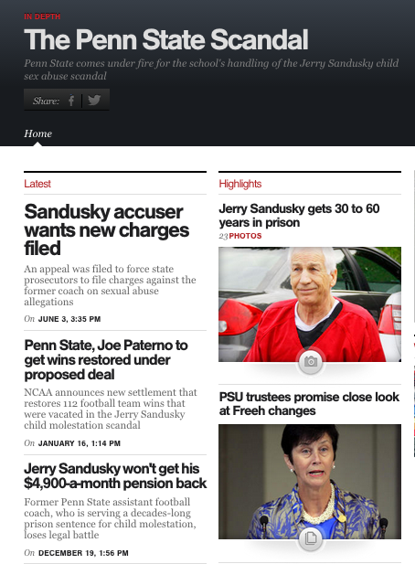
CASE STUDY:
OSTRICH SYNDROME

Slide 29
UNDERSTANDING
THE MEDIA
NAILING
THE
INTERVIEW
Media Relations and Crisis Communications: A Guide to Working with Reporters

Slide 30
INTERVIEW-
THE ART OF BRIDGING
Bridging is the tool you use to get to your messages
and talk about what you want.
That’s a good question, but what we are really talking about is…
We couldn’t agree more, which is why…
I can’t talk about that, but what I can tell you is…
What we really need to focus on is…
I’m not going to speculate. What matters here is…
Let me reemphasize…

Slide 31
INTERVIEW- DOs
Ask for clarification if questions unclear
Ask to repeat your answer for taped interviews
Say you don’t know, but can get that - Then do
Use bridges
Stay on script; use facts
Speak with conviction & emotion
Stay calm
Make eye contact
Take the makeup
Hydrate
Be polite

Slide 32
INTERVIEW- DON’Ts
Repeat negative allegations/questions/information
Use jargon
Speak off the record
Argue with the reporter/get defensive
Get heated
Let reporters put words in your mouth
Give a “no comment”
Answer hypothetical questions
Avoid all semblance of the original question

Slide 33
INTERVIEW-
PICKING THE SETTING
Visual settings matter for TV & photos
Should be clean, representative of issue/project
Interview settings should be on your terms, and free from background distractions that will draw focus away from you
Listen to & work with the camera people; show them equal respect

Slide 34
CRISIS RESPONSE
THREE DO’S OF CRISIS COMMUNICATIONS
Establish a crisis communications team with clear responsibilities and accountabilities
Establish a risk matrix
Develop top 5 crisis scenarios and holding statements/key messages for the scenarios

Slide 35
CRISIS RESPONSE
THREE DONT’S OF CRISIS COMMUNICATIONS
Don’t wait until a crisis happens because it will happen
Don’t wait longer than an hour to make an initial response statement
Don’t speculate and provide unverified information when providing responses to questions

Slide 36
GROUP EXERCISES
KEY QUESTIONS
What level is the crisis?
Why did you make this determination?
What type of crisis?
Who are immediate stakeholders?
What is your initial statement?
What are the key messages you want to convey to stakeholders (may be the same message but different delivery)

Slide 37
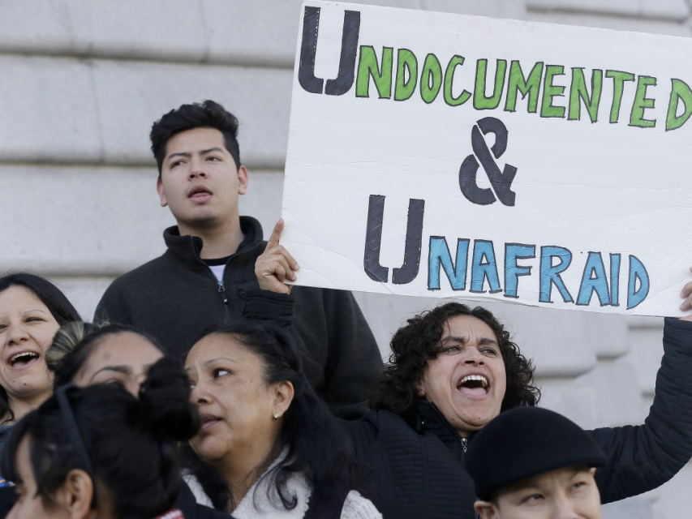
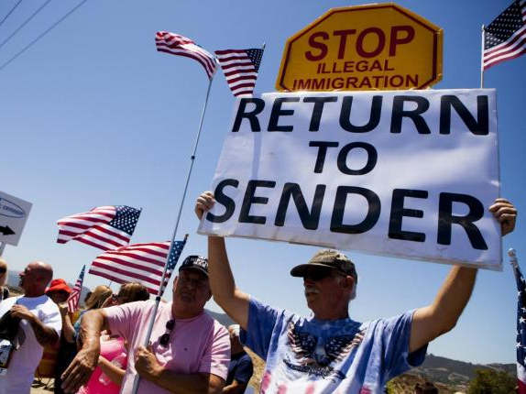
GROUP EXERCISE #1
DETENTION OF UNDOCUMENTED STUDENTS

Slide 38
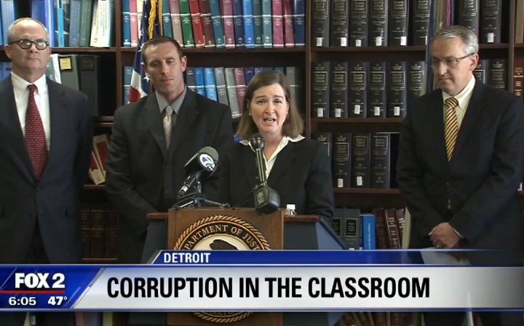
GROUP EXERCISE #2
MISUSE OF PUBLIC FUNDS

Slide 39
NUMBER ONE RULE

Slide 40
UNDERSTANDING
THE MEDIA
Media Relations and Crisis Communications: A Guide to Working with Reporters
MEDIA RELATIONS
101

Slide 41
MEDIA RELATIONS-
THE BASICS
WHAT??
Any engagement, proactively or reactively, with a member of the media
WHY??
It’s about crafting perceptions, not just of the public but of the reporter – and perception is everything
WHEN??
Media relations begins from the moment any person speaks or answers a call from a reporter
HOW??
Ignoring makes things worse, and responsiveness is a must – but
making the most of that initial contact requires careful planning

Slide 42
MEDIA RELATIONS-
PROACTIVE VS. REACTIVE
PROACTIVE
REACTIVE
Pitching reporters on positive press
Preparing and circulating a statement when you know bad news is coming
Reaching out to outlets via phone, email
Editorial board meetings and media kits
Fielding media inquiries
Creating messaging around existing conversation
Challenging assumptions
Interviews

Slide 43
MEDIA RELATIONS-
UNDERSTANDING REPORTERS
THE MINDSET & TEMPERAMENT
Motivated by getting information that tells a story or educates. Want to get to the facts. Expects you to be responsive, polite, reliable, trustworthy.
APPROACH
Widely different approaches- from aggressive to friendly to getting information & telling stories. Type of media outlet can inform strategy.
OBJECTIVE
Presenting a compelling story that is informative & unique. Uncovering information that exposes the truth.

Slide 44
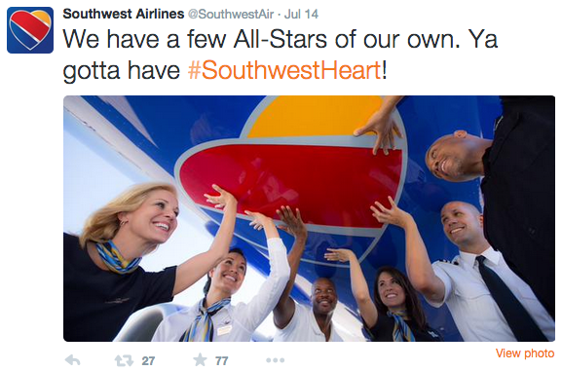
MEDIA RELATIONS-
DOING IT RIGHT
Well known for corporate culture & corporate transparency
Developed a robust & available media relations program that is responsive to media
Dedicated C-suite comms specialist & team wide effort to network/spend time with reporters
Finds ways to showcase the good, & embraces the bad

Slide 45
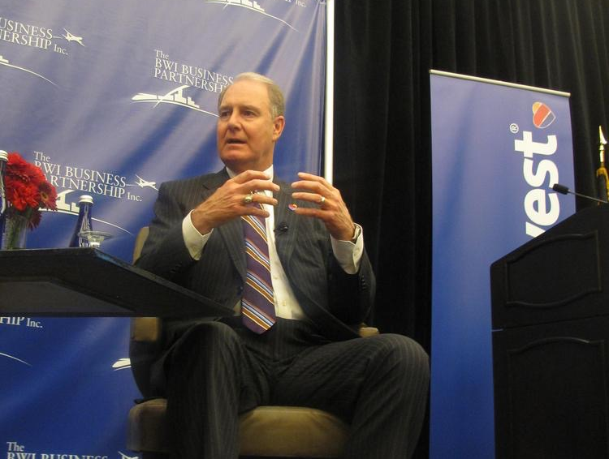
MEDIA RELATIONS-
DOING IT RIGHT
“Kelly began his handwritten missive by thanking the correspondent for a ‘thoughtful and professional letter’ and added ‘I really appreciate it.’ Kelly went on and tried to address briefly the concerns of the letter’s author.”

Slide 46
MEDIA RELATIONS-
PLANNING DRIVES SUCCESS
Good communication doesn’t just happen -
it starts with a written plan.
Lets you think about the entire landscape
Gives you clear direction & rationale for making decisions
Allows you to make proactive decisions
Prevents you from being caught flat-footed

Slide 47
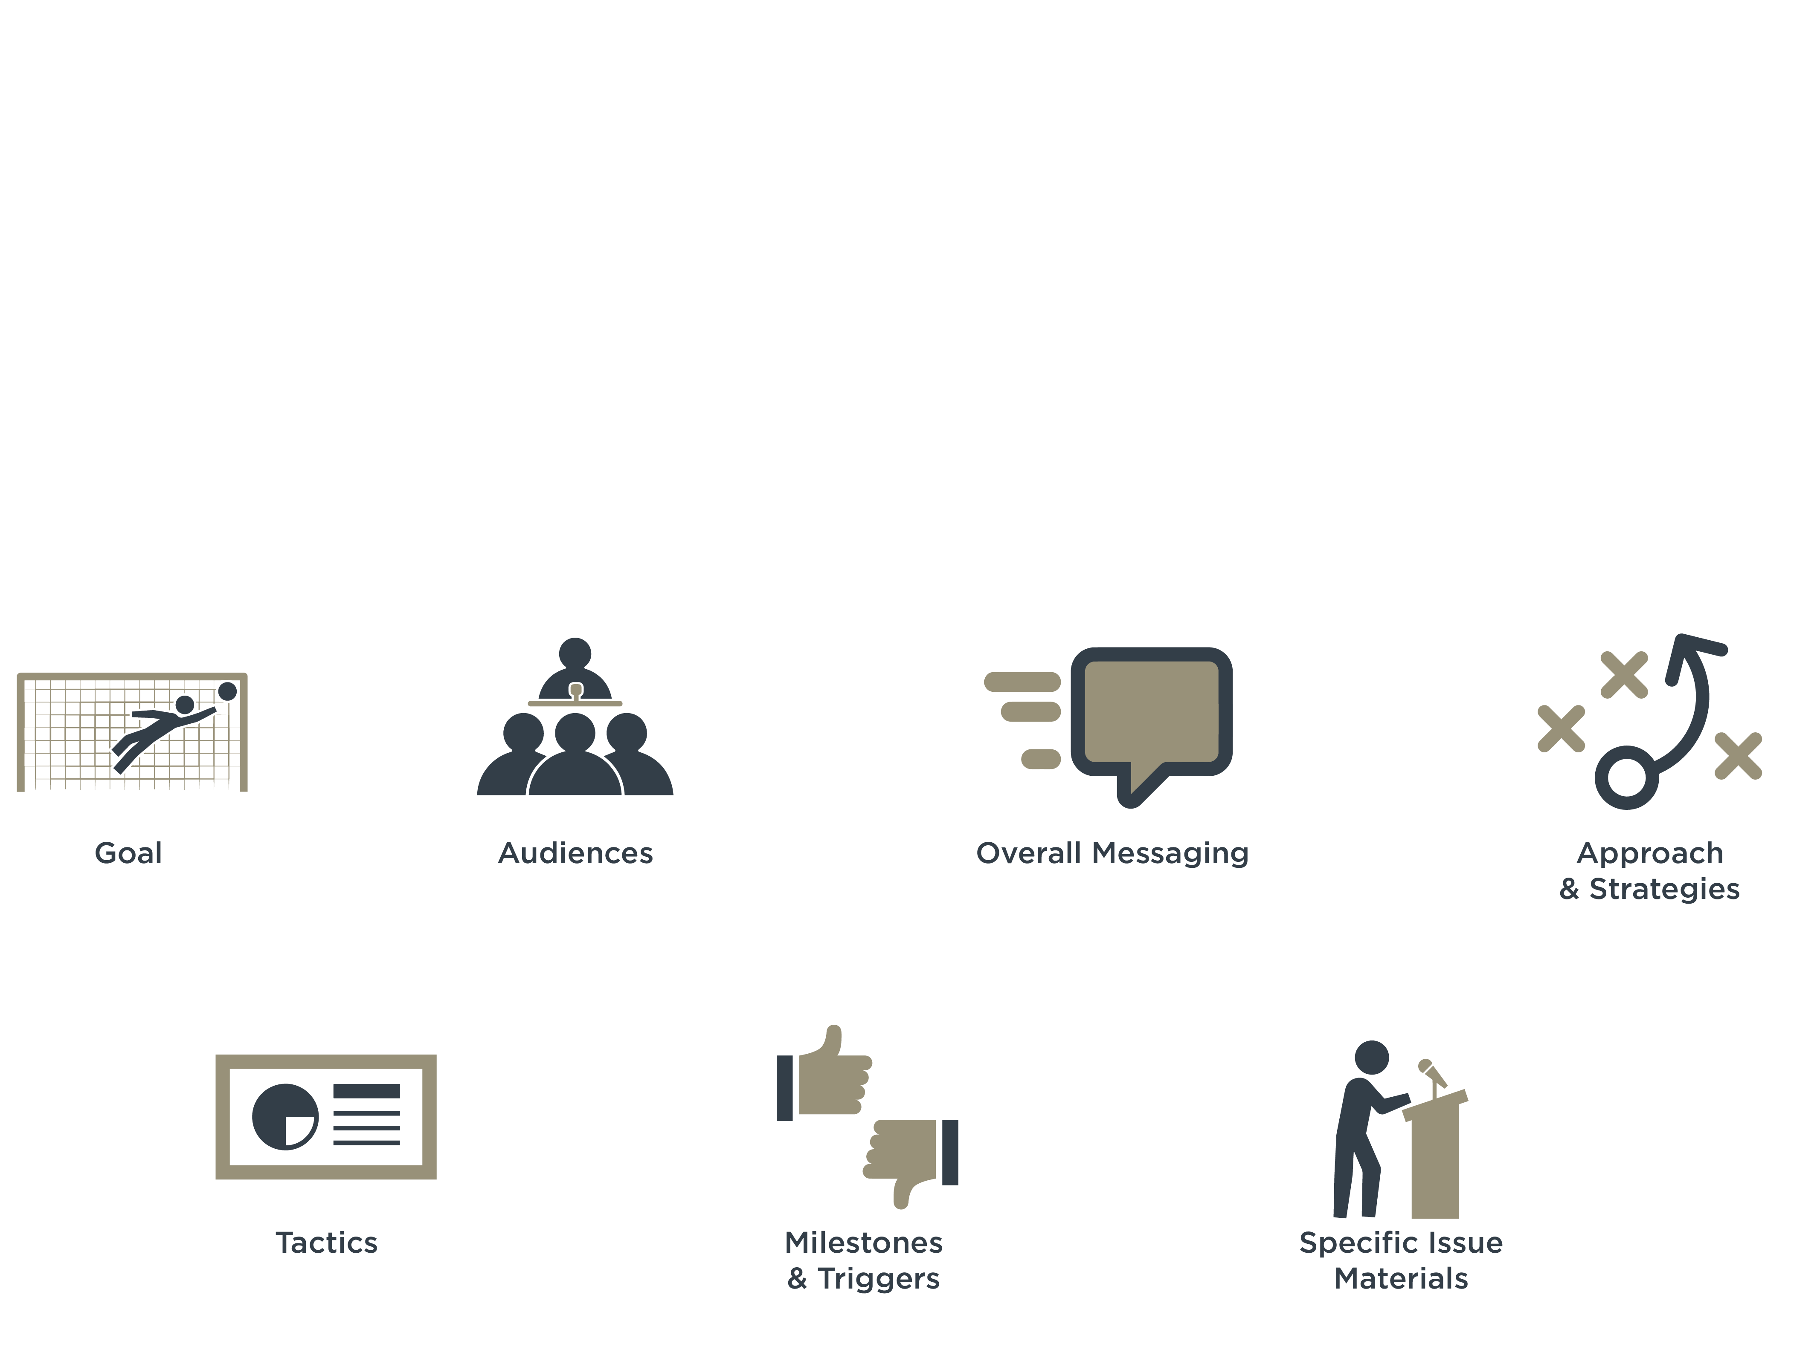
MEDIA RELATIONS-
PLANNING DRIVES SUCCESS
Elements of a Communication Plan
Notes:
Elements of a Communication Plan
Goal—what’s your bottom line
Audiences—who are you trying to reach & what motivates
Overall Messaging—the absolute heart and soul of your program
Approach/Strategies—broad areas of focus to reach goal; conscious decision about how you’ll communicate
Tactics—the granular tools that are in your arsenal
Milestones & Triggers—what are the positive milestones that you’d want to celebrate; what are the red flags that might cause issues
Specific Issue Materials—call out sections on areas of significant interest/exposure with key messages & tailored approach

Slide 48
UNDERSTANDING
THE MEDIA
Media Relations and Crisis Communications: A Guide to Working with Reporters
RESPONDING
TO MEDIA
INQUIRIES

Slide 49
MEDIA INQUIRIES
THE BASICS
DO YOUR HOMEWORK
STAY ON SCRIPT, MESSAGING IS YOUR SAVIOR
KNOW YOUR BEST LINES BEFORE YOU SAY THEM
DON’T BE AFRAID TO SAY “I DON’T KNOW”
DON’T GET CUTE
COMMUNICATIONS TEAM MEMBERS ARE THERE TO HELP YOU – TAKE THAT HELP

Slide 50
MEDIA INQUIRIES
UNDERSTANDING THE OPPORUNITIY
No one else will deliver your message
Only you can increase your credibility
Reporting can’t be done speculatively
Being absent sends negative message
You can inform, change minds and impact
Interviews allow you to tell your story

Slide 51
Getting the Most out of a First Call
GETTING THE MOST OUT OF THE FIRST CALL
Use the first call as your opportunity to gather information & vet the story. Tell the reporter you aren’t able to do the interview now, but want to gather info & call back.

Slide 52
MESSAGING
WHAT IS IT?
The core ideas you want to deliver - Overall or specifically
Specific messaging should relate to overall vision for project/company/etc.
Should be clear, memorable & believable
Intended to connect with audience
Memorable & convincing
Messaging isn’t a guide for all questions, but a framework

Slide 53
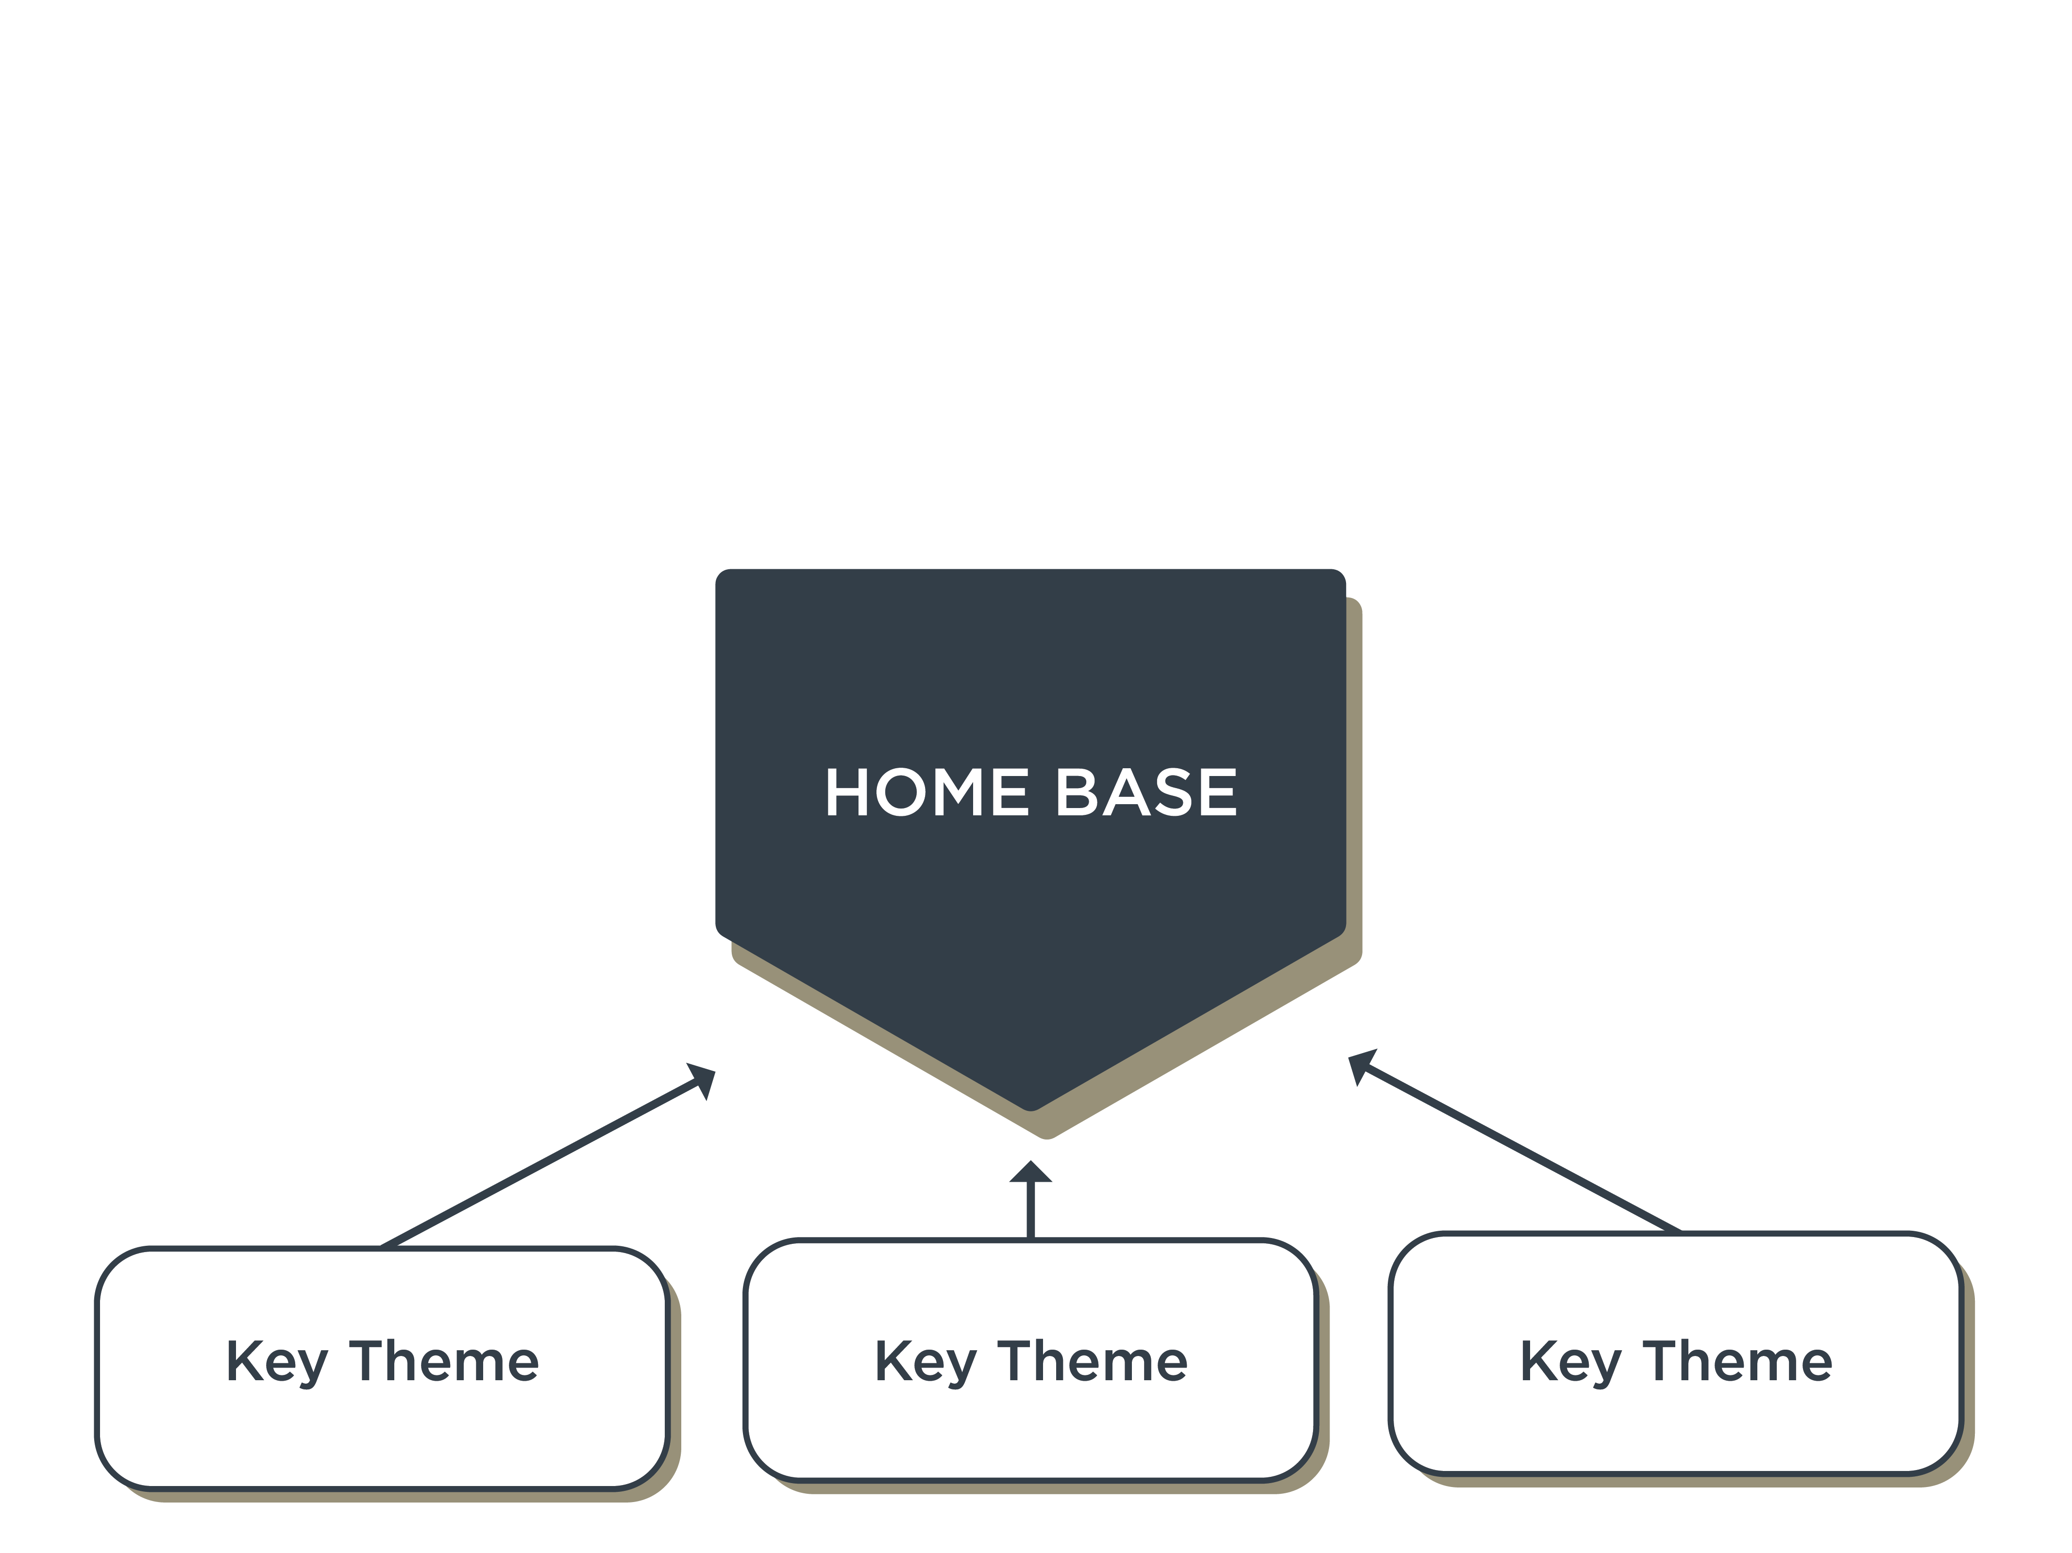
MESSAGING-
HOW IT GETS CREATED
Built around communication/interview goal
Tailored for target audiences, situation & spokesperson; adaptable for medium
Starts with a single core idea (home base) that you can always come back to
Supported by 3-5 key themes with easy to remember factual details

Slide 54
MESSAGING-
INTERNALIZING & PREP
Listen & actively participate in comms briefing
Read, re-read & annotate talking points
Practice in front of a mirror - First with copies of messages and then without
Record yourself on video/audio and play it back
Role play with a colleague

Slide 55
UNDERSTANDING
THE MEDIA
THANK YOU
Media Relations and Crisis Communications: A Guide to Working with Reporters

