Slide 1
SBCCD Collegial Consultation and Institutional Planning
Changing the way we do business

Slide 2
Changing the way we do business
  Challenge: Collegial Consultation
    No clear purpose, charges, membership or relationship to other committees
    Not recognized in Board Policy/Administrative Procedures
    May find themselves working at cross-purposes
    Wasted committee member time
    No clarity on role of committee and scope of topic to be discussed
    No output linked back to planning/consultation

Slide 3
Existing Collegial Consultation Environment
Board of Trustees
Chancellor
Chancellor’s Cabinet
District Assembly
District Calendar Committee
District Applications Workgroup
ACCJC Task Force
District Budget Committee
District Enrollment Management Committee
TESS Executive Committee
District Benefits Committee
District Program Review Committee
District Safety Committee
District Calendar Committee

Slide 4
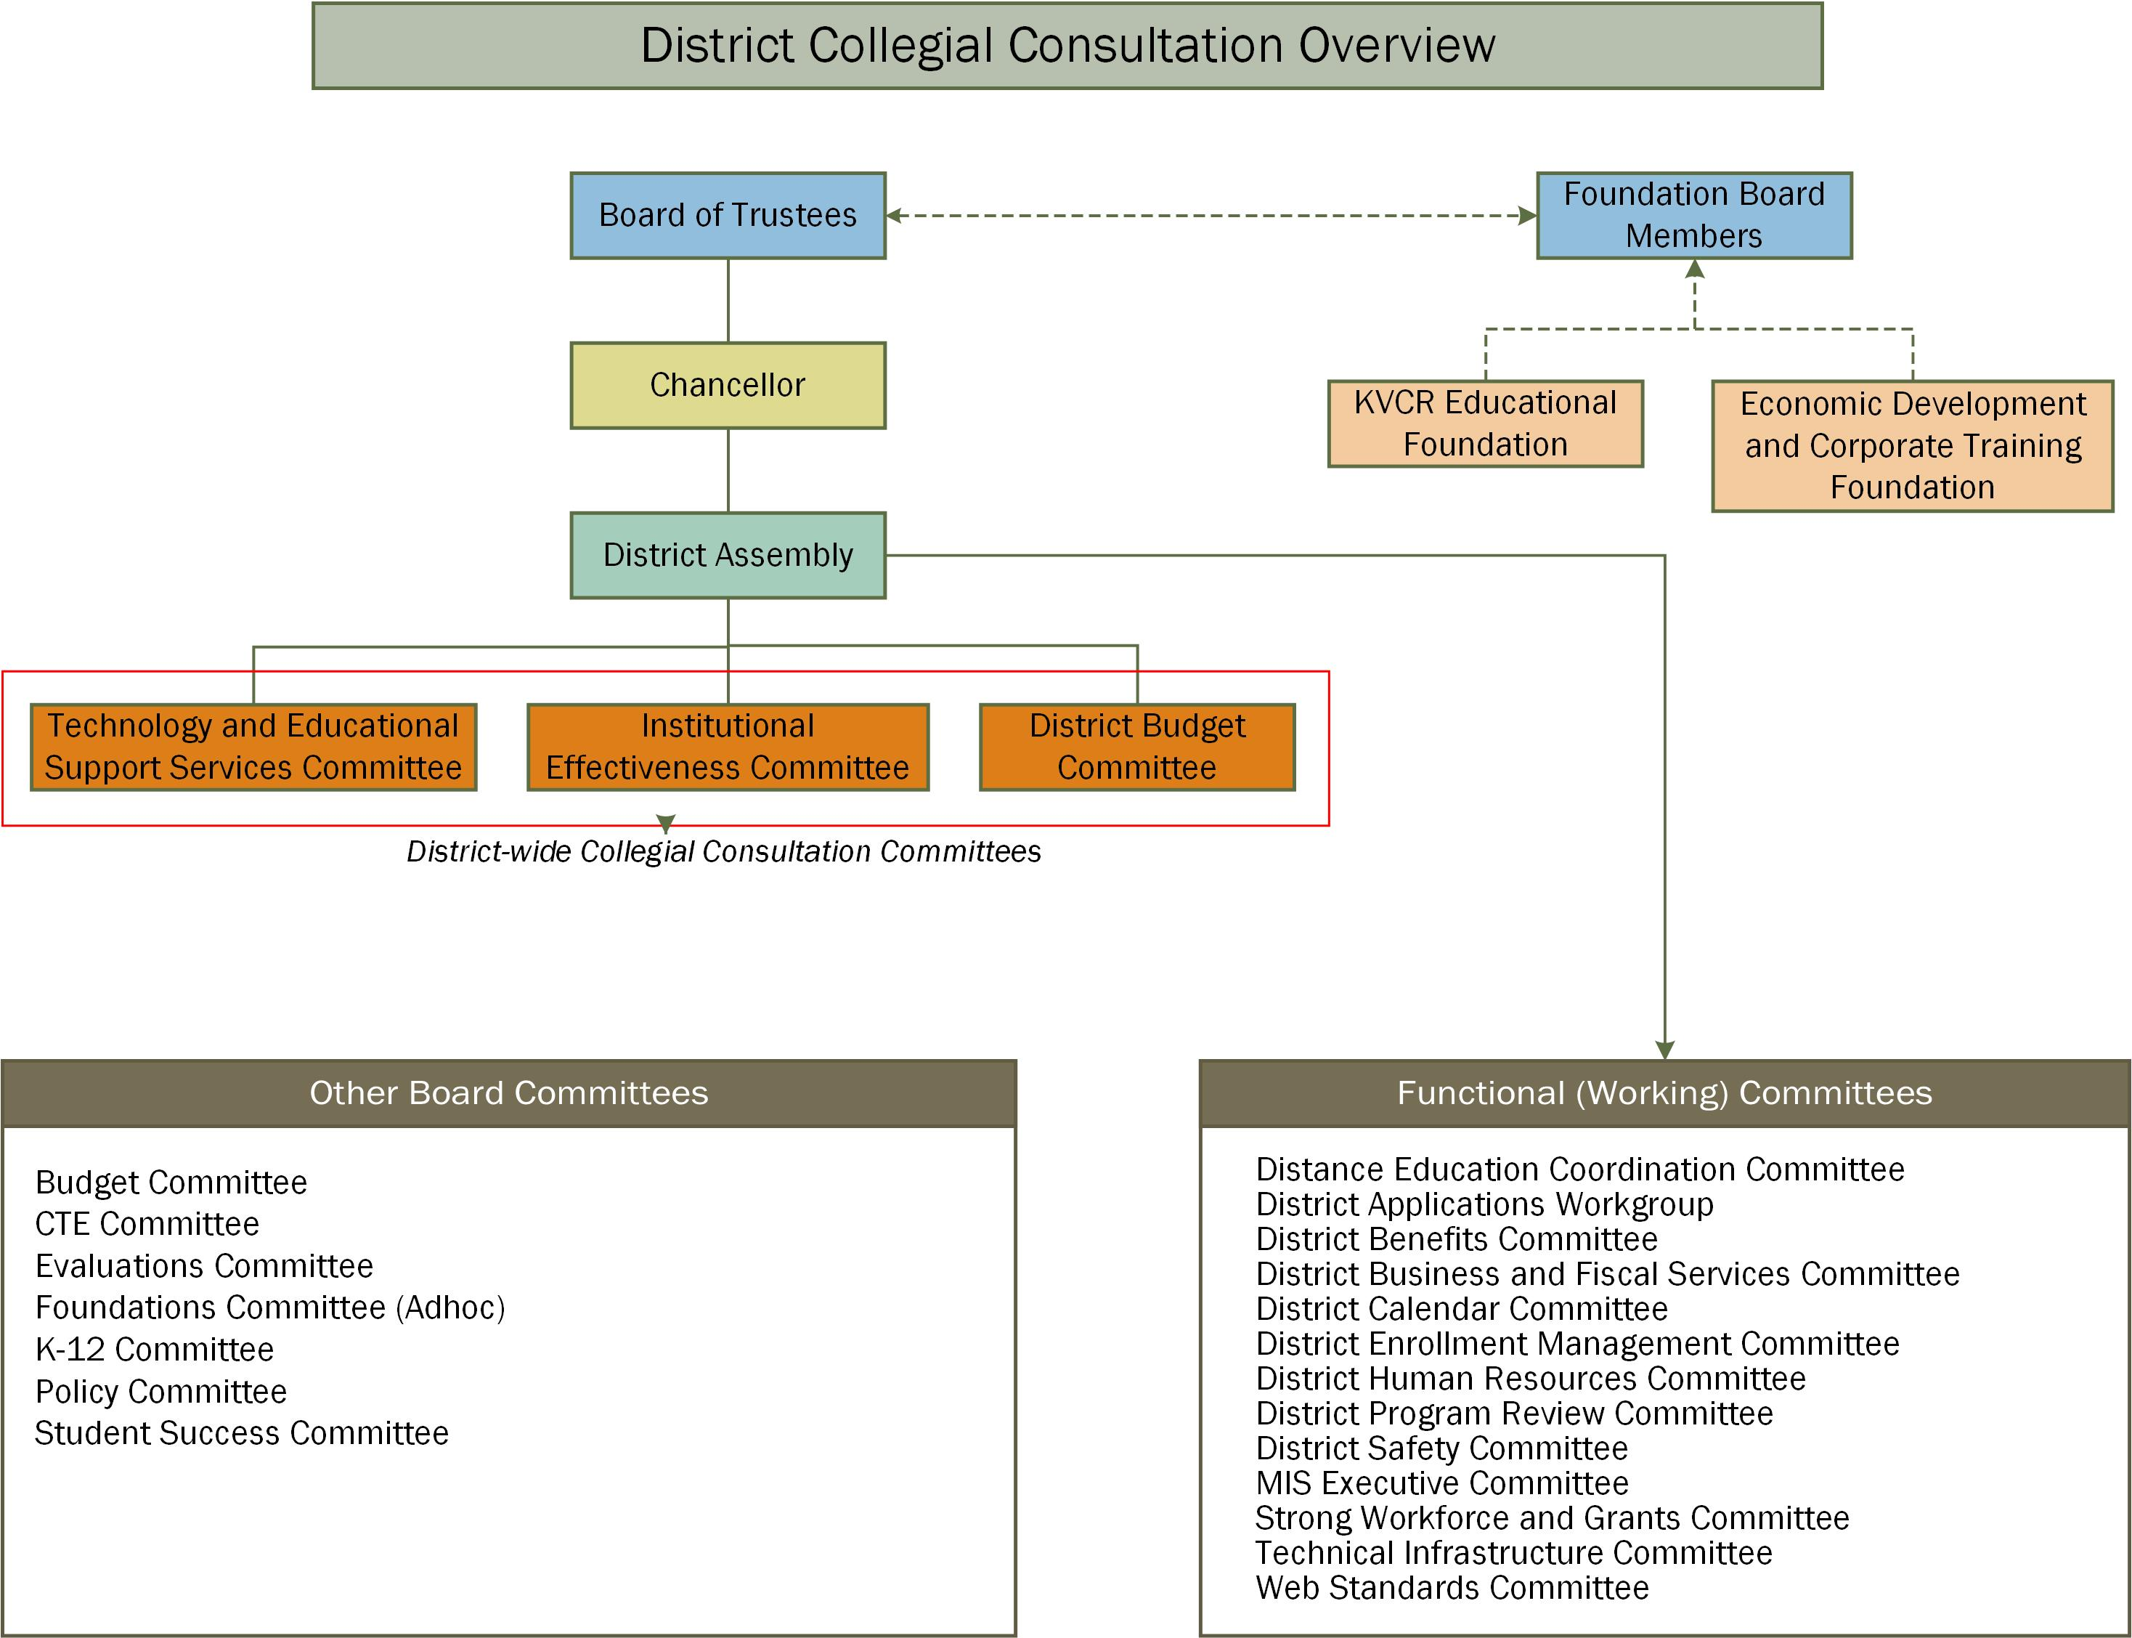

Slide 5
Changing the way we do business
Challenge: Planning Processes
  Planning sequence didn’t make sense:
    Varying timelines for Educational Master Plans;
    Outcomes from colleges were not linked to District and vice-versa
    Budget development was timed to allow colleges to know District assessment in advance, but was not link to planning
    Board planning retreats are not informed of colleges’/District’s progress and/or needs
    Planning in silos….

Slide 6
Two Levels of Planning
  1) Educational Master Plan
      Ed Code requires colleges to have their own Educational Master Plan (EMP)
      Colleges have agreed to a 6-year EMP planning cycle
      Environmental Scan and Realignment done every 3 years
  2) Annual Planning and Program Review
      Culminates with end of year “snapshot” of progress on all plans, challenges, needs, and opportunities

Slide 7
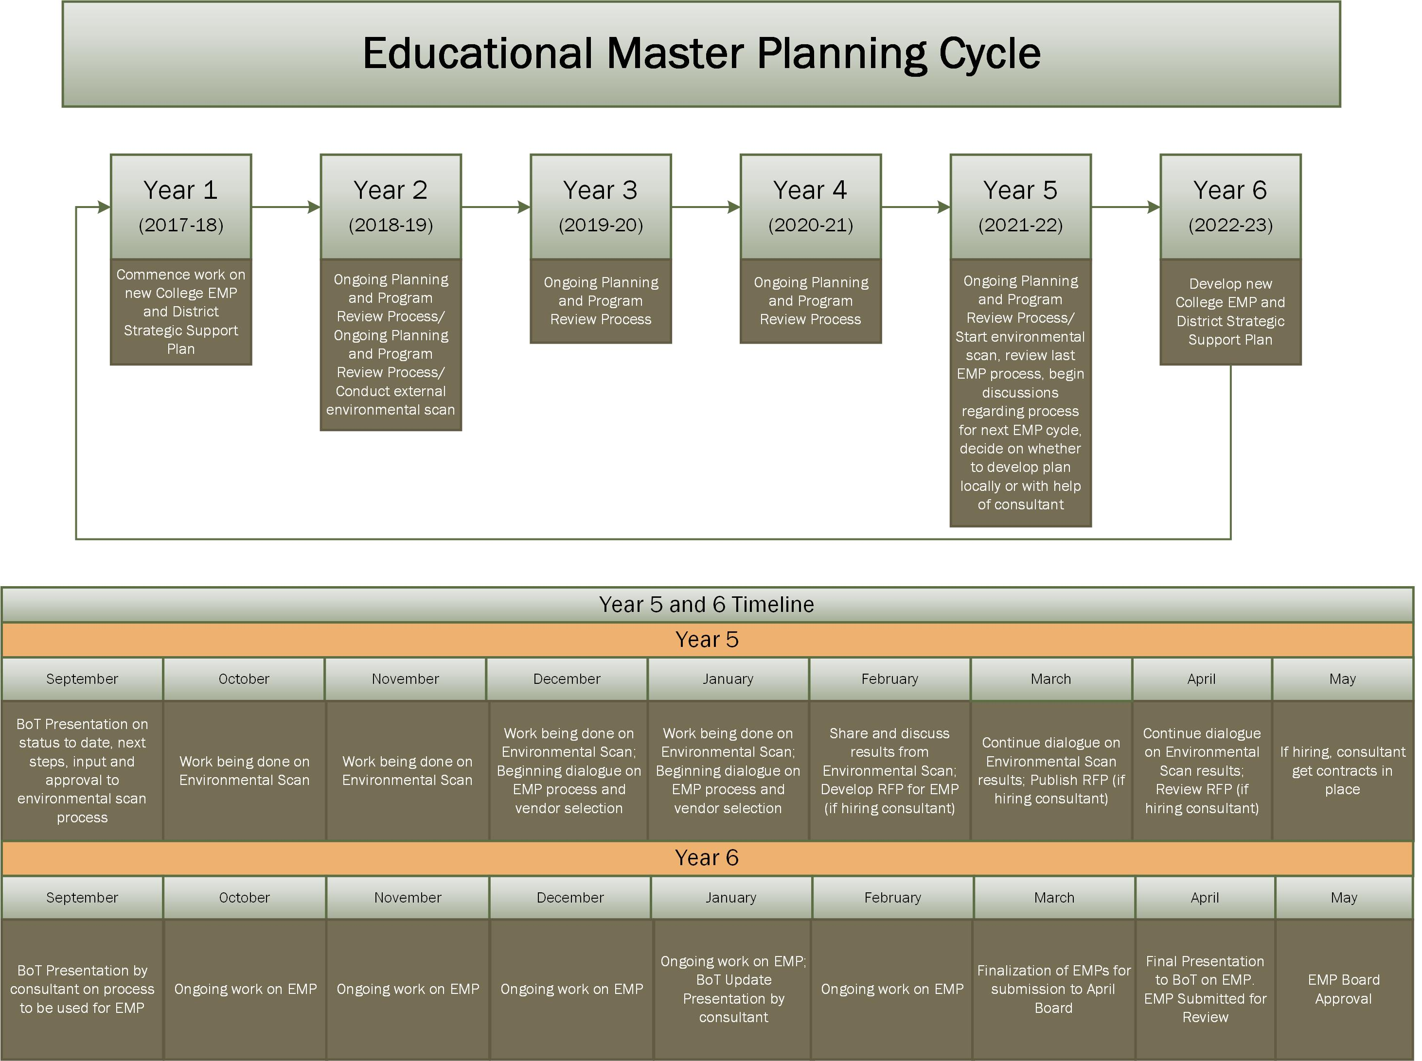

Slide 8
Changing the way we do business
  Challenge: Lack of Integrated Planning
    Colleges and District have different plans;
    Budget Development not directly linked to Program Review or Planning;
    Accreditation requires colleges to have high degree of flexibility in how they plan to meet college’s unique needs
  The DILEMMA! How do we align all entities if they are using different approaches to planning?
  The SOLUTION! The IEPI Integrated Planning Model

Slide 9
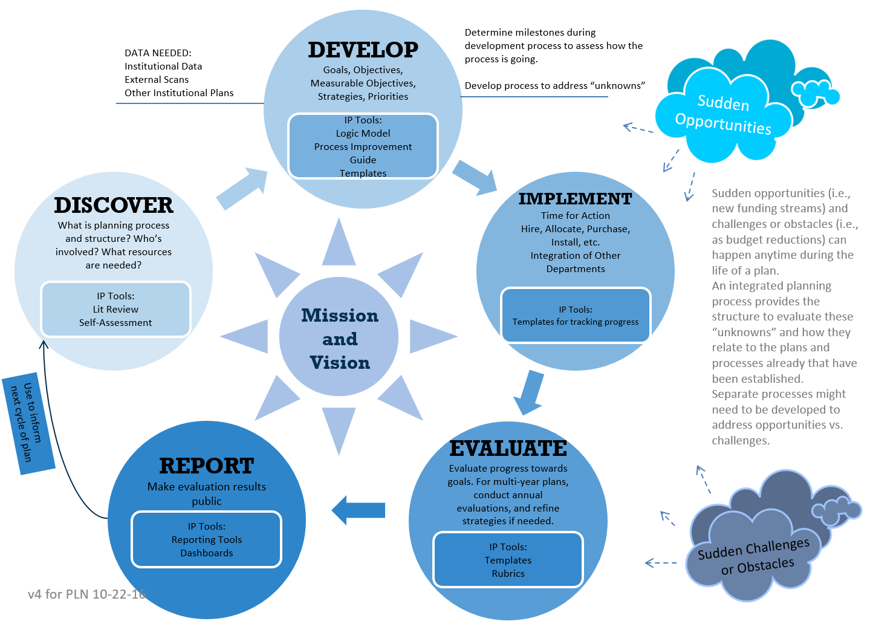

Slide 10
Bringing the Planning Together…

Slide 11
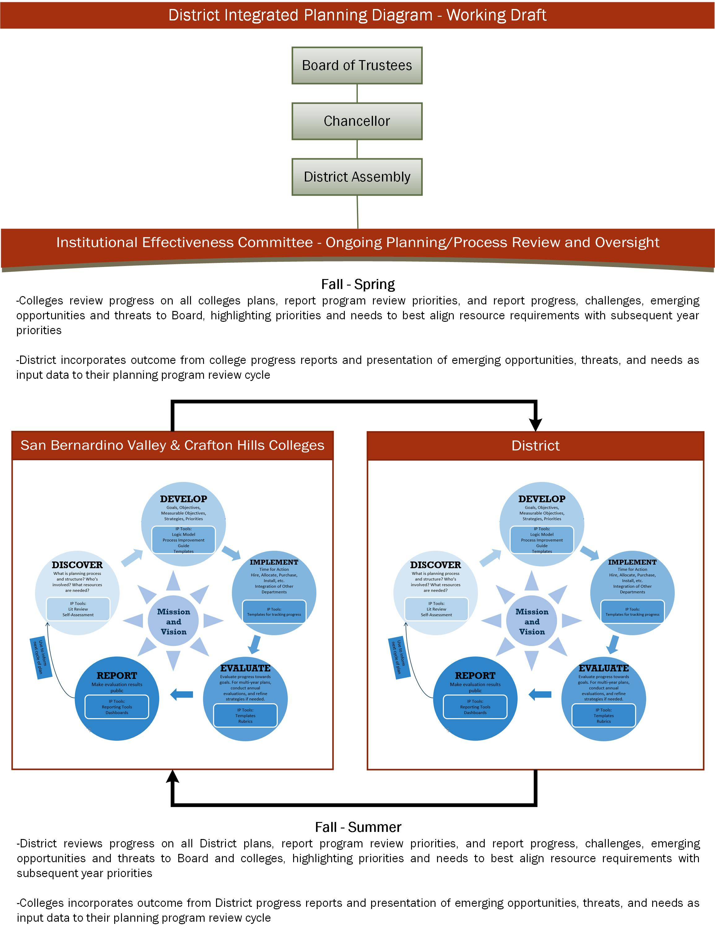

Slide 12
Changing the way we do business
Challenges
  Board Engagement
    Board has not been adequately engaged in the development of District/College planning process;
    Colleges/District is unclear on Board’s expectations on when and how the Board should be engaged in planning

Slide 13
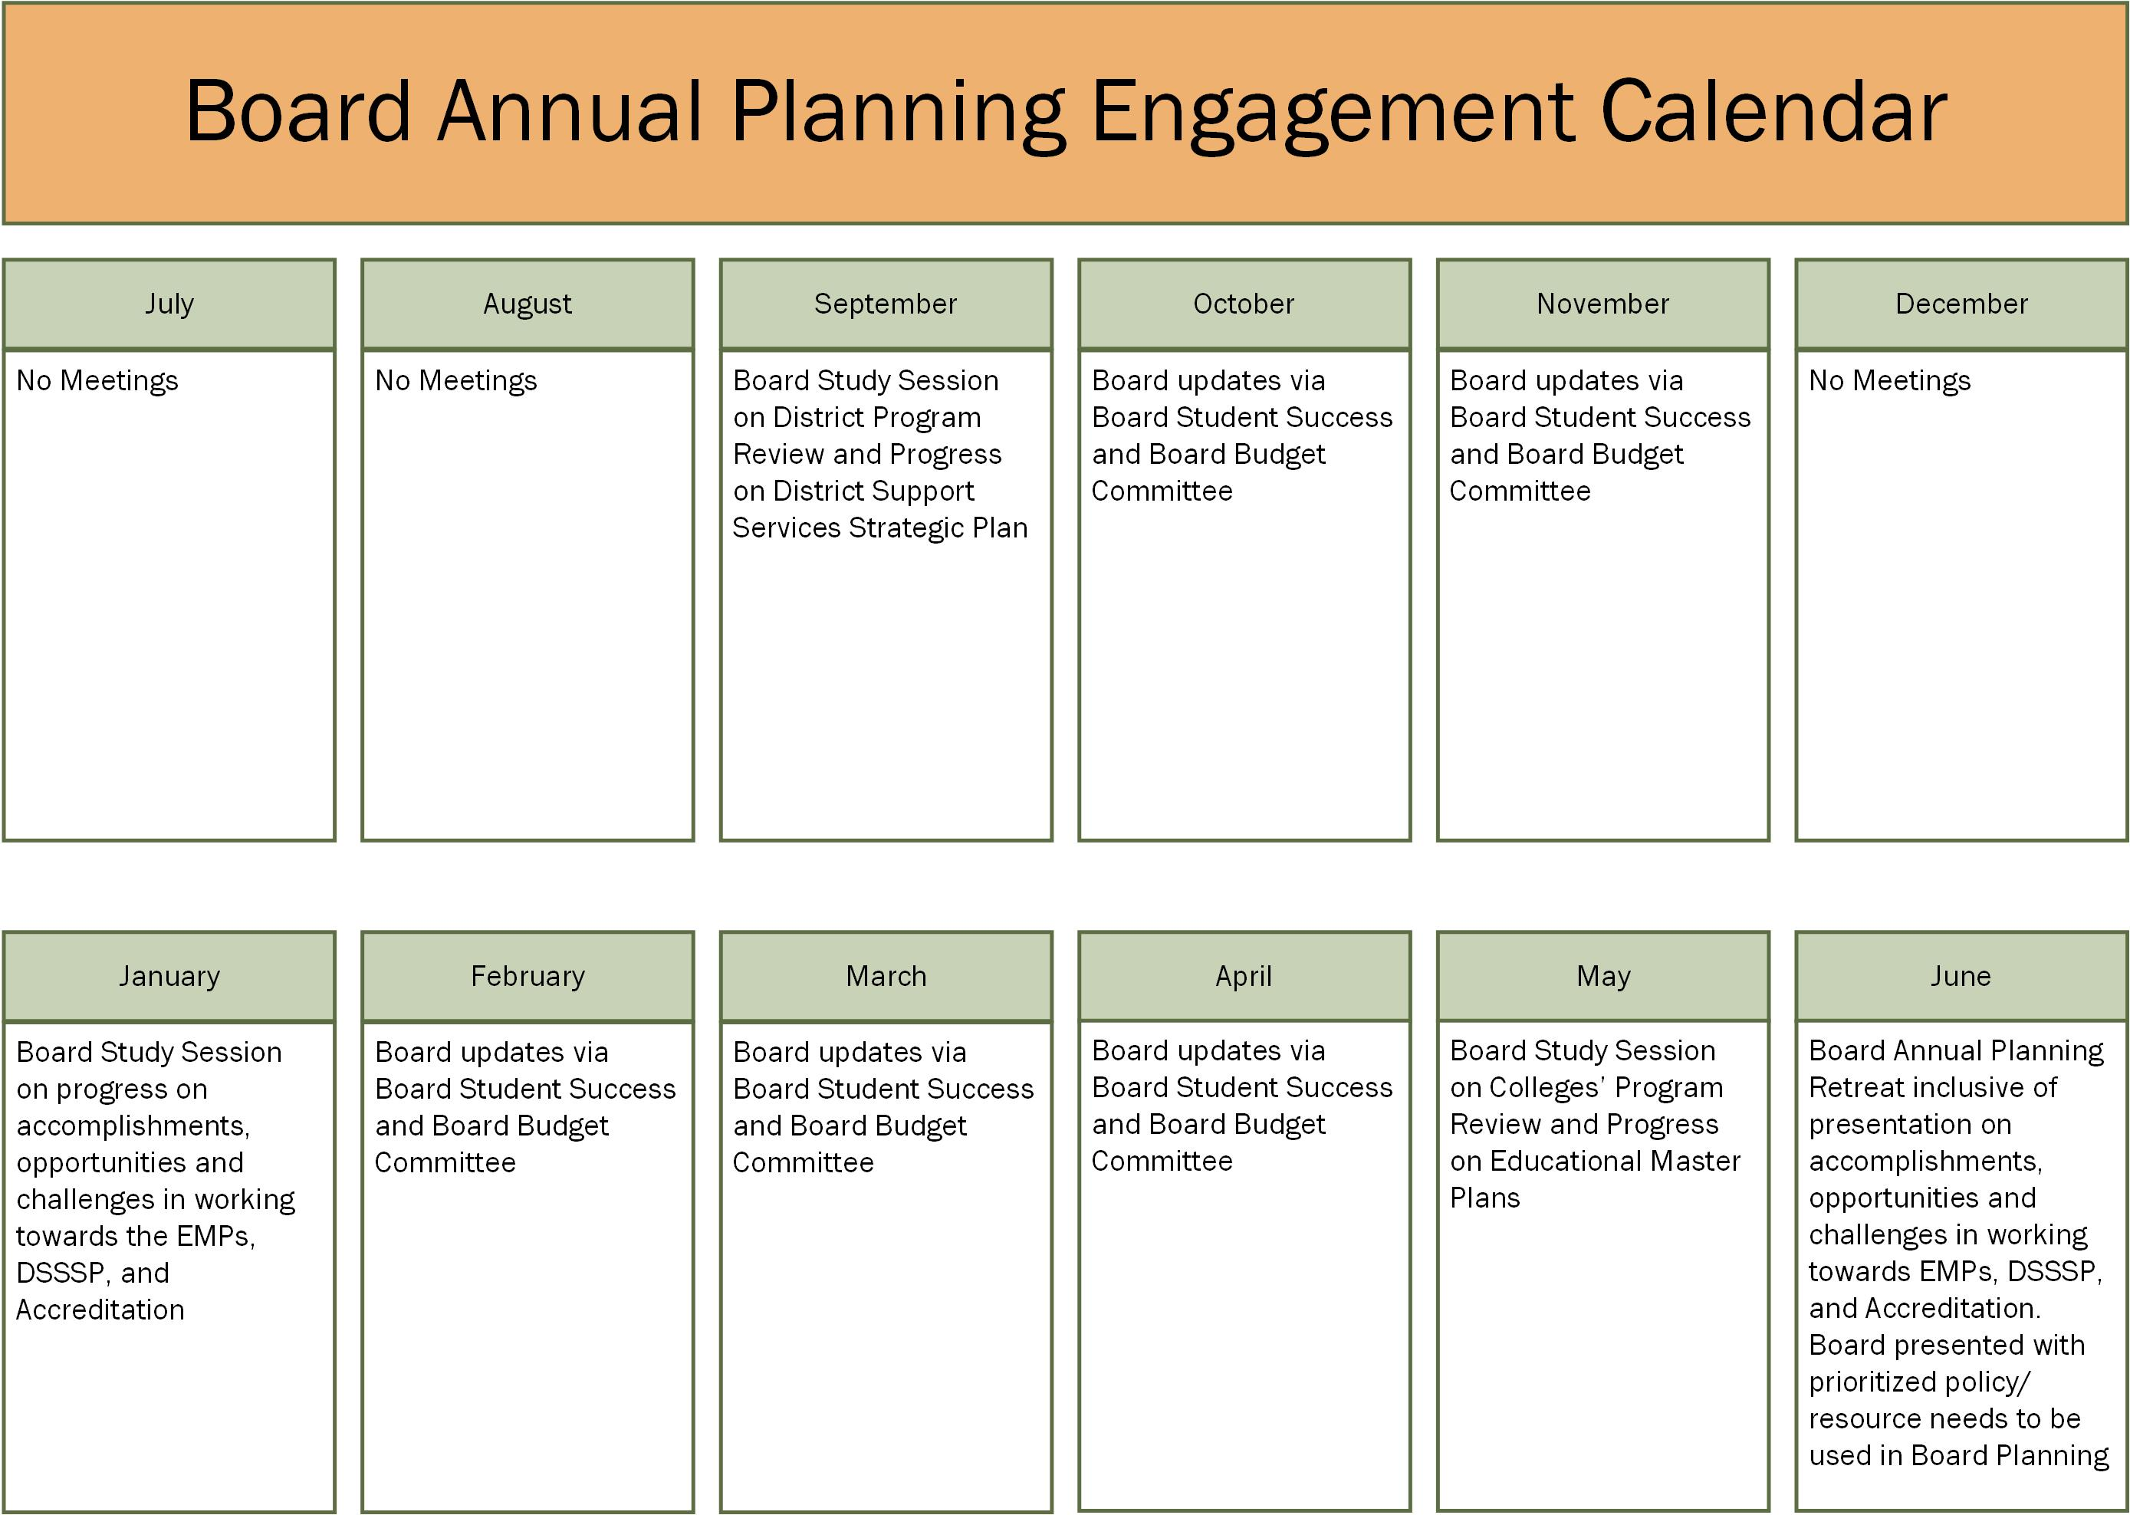

Slide 14
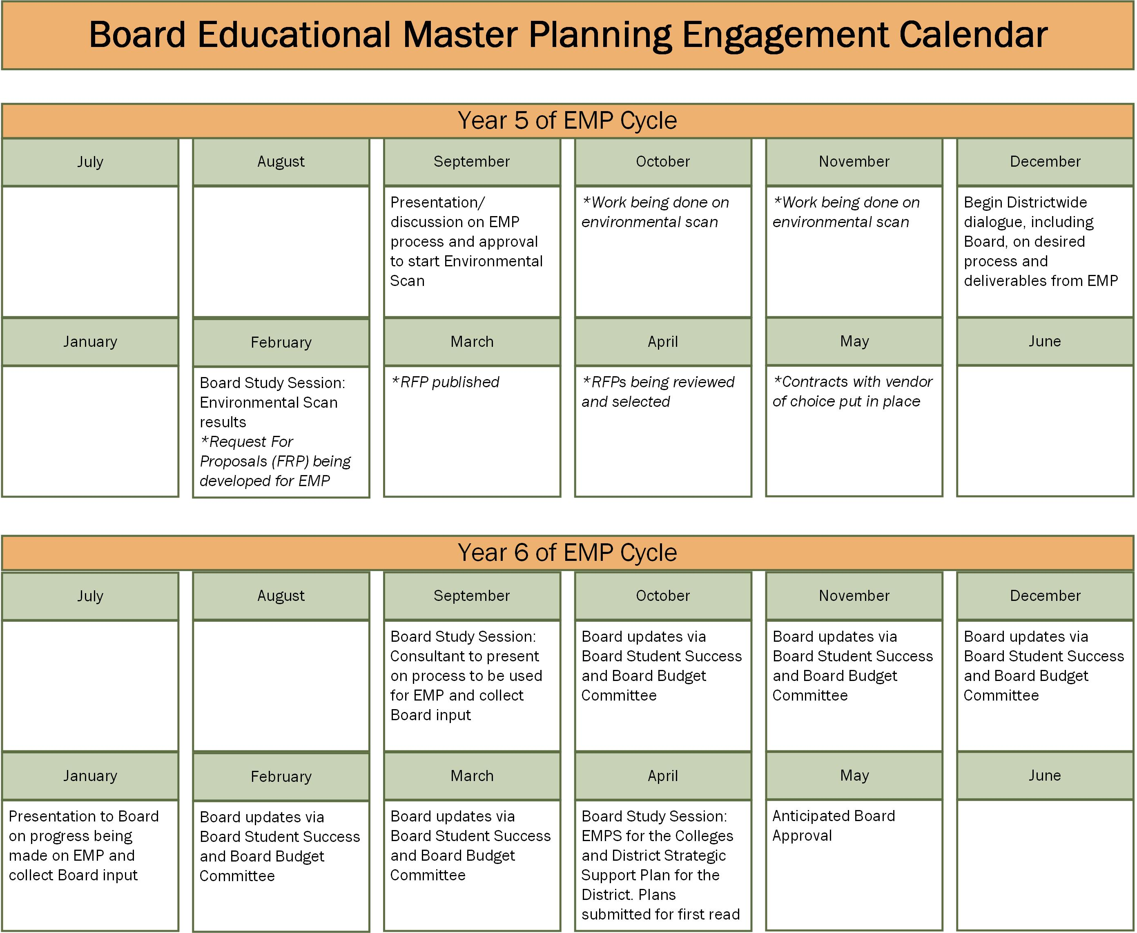

Slide 15
Proposed Board Annual Planning Process
Updates provided in brief, bulleted format that are limited to:
  Accomplishments towards Educational Master Plans, District Strategic Support Plan, Accreditation, and “Board Imperatives;”
  Opportunities
  Challenges
  Prioritized policy/resource needs to better ensure success aligned with areas of focus for upcoming year

Slide 16
Proposed Board Annual Planning Process
Proposed Board Annual Planning Workshop Agenda:
  Review progress on previous year’s Board Goals;
  Review progress on previous year’s Board Imperatives;
  Presentations by key area updates;
  Discussion of District-wide challenges, priorities, and opportunities;
  Development of new Board Imperatives;
  Development of new Board Goals;
  Development of Board Budget Directives

Slide 17
Proposed Board Annual Planning Process
Ongoing Monitoring:
  Board Budget Committee
  Board Student Success Committee
  Mid-year Study Session

Slide 18
Next Steps
All District Committees will formalize their membership and purpose as they related to the District Collegial Consultation Overview;
Will recommend through the District Assembly that the “ACCJC Task Force” be institutionalized as the “District Institutional Effectiveness Committee;
The Board BP/AP outlining District Collegial Consultation will be updated to reflect changes;

Slide 19
Next Steps
Progress to date will be reviewed on September 18th with the IEPI;
Inclusive of feedback from IEPI, will begin using consultative and planning process outlined in this presentation and update as opportunities for improvement present themselves

