Slide 1
CTE and Strong Workforce at CHC & SBVC
August 10, 2017

Slide 2
CTE Programs: What Sets Them Apart
Curriculum elements: clinical and field work
Curriculum approval: Advisories and consortiums
Structure: regions and state levels
Funding: grants, allowable expenses, and reporting
Chancellor’s Office mandates: recent
Costs: investment in machines, equipment
Efficiency
Review frequency
Market driven and changing markets
Changes in past 6 years: Doing what matters, Strong Workforce, accountability, outcomes, data systems, outcomes based funding, more money but more requirements

Slide 3
Career Technical Education (CTE)
We prepare Gainful Employment Disclosures for certificate programs that outline the cost and average time to complete the program.
Link to GE Disclosures:
https://www.valleycollege.edu/about-sbvc/offices/office-research-planning/gainful-employment.php

Slide 4
All CTE Programs are evaluated every two years by the Program Review Committee

Slide 5
Criteria for Evaluating the Effectiveness of CTE Programs Include
Employment opportunities
Demand for workers
Supply of graduates in the region
Program enrollment trends
Program efficiency
Course retention and success rates
Link to evaluation sheets:
https://www.valleycollege.edu/about-sbvc/office-of-president/college_planning_documents/documents/emp-sheets-combined-2015-2016-web-post-reduced.pdf

Slide 6
Strong Workforce Funding at SBVC
In 2015, Strong Workforce funding was available. Seventeen programs applied for funding.

Slide 7
Programs that Applied for Funding
Automotive Technology
Automotive Collision
Automotive Diesel
Culinary Arts
Culinary Arts – Baking
Electrical/Electronics
Food and Nutrition
Human Services
GIS
Graphic Design
Information & Communication Technologies (ICT) Digital Media
Inspection Technology
Machinist Technology
Nursing
Pharmacy technology
Sterile Program
Welding Technology

Slide 8
Criteria for Evaluating Programs for Funding by the Strong Workforce Program (SWP)
Must meet regional supply and demand criteria
Increase the quality of CTE programs, pathways, credentials, licensing, degrees, certificates
Increase the quantity of CTE programs, pathways, credentials, licensing, degrees, certificates

Slide 9
Data Used to Make the Selection
Data for the decision came for Colleague (Datatel)
The Center of Excellence

Slide 10
Nine CTE Programs were Funded by the Strong Workforce Grant Totaling $1,205,021
Automotive Collision ($25,246)
Nursing ($142,678)
Sterile Programs ($2,750)
Culinary Arts – Baking ($250,000)
Culinary Arts ($250,000)
Electrical/Electronics ($250,000)
Graphic Design ($13,000)
ICT Digital Media ($225,000)
Human Services ($40,000)

Slide 11
SBVC Received Regional Funding Totaling $734,107
Regional Mechatronics Technician Training Pathway ($87,607)
Technology combining electronics, telecommunication, and mechanical engineering
Sub-regional Business Incubator and Makerspace Proposal ($230,000)
Business Incubators mentor fledgling entrepreneurs.
Makerspaces combine the best parts of school shop classes, trade schools, R&D labs, and dream garages, all in one place.
Placement and Clinical Site Coordinator ($73,125)
Updating Automotive Labs – Electric Vehicle (EV) & Hybrid Instruction ($104,000)
Regional and District Job Developers Proposals ($239,375)

Slide 12
Meeting the Labor Market Demands Identified in the Strategic Planning
Page 2.48 of SBVC Strategic Plan
https://www.valleycollege.edu/about-sbvc/office-of-president/college_planning_documents/documents/sbvcemp16draft.pdf

Slide 13
Program Effectiveness, Viability, and Recommending Discontinuation
Faculty Driven Process that involves:
Someone on campus identifying a program with weak performance
The formation of an Academic Senate committee to review the program performance data and make a recommendation to the president
Decision by the president

Slide 14
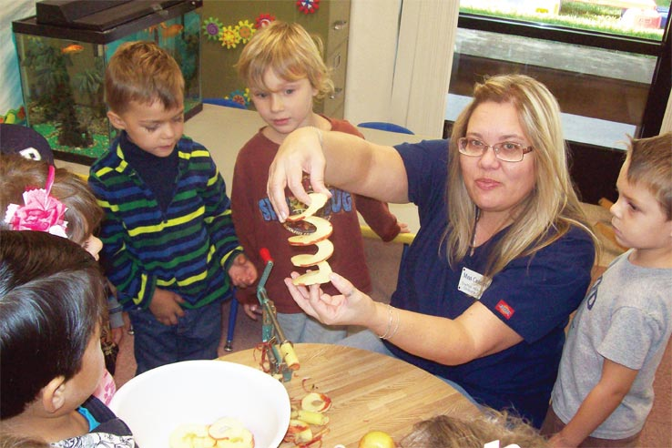
Current Programs and Performance: CHC
Tech Prep Articulation
Business
Computer Information Systems
Allied Health
Emergency Medical Services (EMT and Paramedic)
Basic Firefighter Academy
Fire Technology
Radiologic Technology
Respiratory Care
Child Development: Master Teacher, Site Supervisor, Associate Teacher, Teacher
Notes:
We have a variety of outstanding career and technical education programs at CHC. College isn’t just for the traditional transfer student.

Slide 15
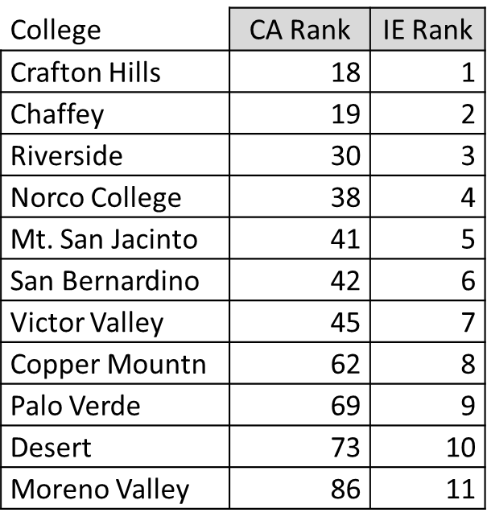
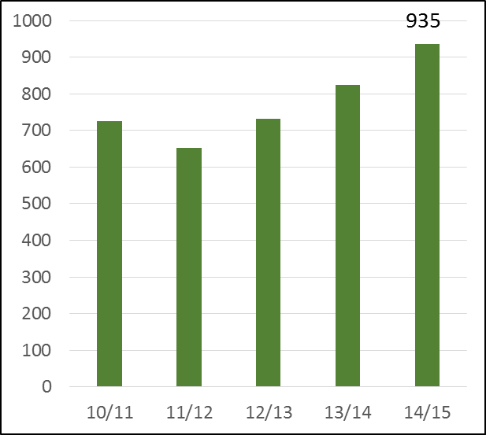
Current Programs and Performance: Completion Rates, State and Region
Degree/Certificate Completion
Completion Rate Comparison
#1 Inland Empire; #18 CA

Slide 16
Current Programs and Performance:
LICENSENSURE PASS RATE (Definition: The rate is determined by dividing the number of students that passed the licensure examination divided by the number of students that took the examination)
Program Name | CIP Code | Institution Set Standard | Performance |  |  | Difference
 |  |  | 2014 | 2015 | 2016 | 2014 | 2015 | 2016
Respiratory Care/Therapy | 1210 | 70% | 78.80% | 88% | 94.40% | 8.80% | 18% | 24.40%
Radiologic Technology | 1225 | 78.60% | 92% | 100% | 88.80% | 13.40% | 21% | 10.20%
Emergency Medical Services | 1250 | 70% | 80.30% | 90% | 72.60% | 10.30% | 20% | 2.60%
Paramedic | 1251 | 70% | 86% | 80% | 86% | +16% | +10% | +16%

Slide 17
Current Programs and Performance:
CERTIFICATE COMPLETION (Students who received one or more certificates may be counted once.)
Standard | 204 | 204 | 204
Performance | 305 | 310 | 339
Difference | 101 | 106 | 135
Analysis of the data: The performance trend data indicates the College has performed above the set standard for the 2014, 2015, and 2016 reporting years. Specifically, the number of students earning a certificate increased from 305 in 2014 to 339 in 2016, an 11% increase. As part of Crafton’s continuous quality improvement process, the College will review the minimum standard in the 2017-2018 academic year.

Slide 18
Career Education and Workforce Development Plan
The purpose of the plan is to strategically respond to:
Identified and projected labor market needs
The need to improve student success.

Slide 19
Industry Growth Projections
Between 2015 and 2025, the top five industries in the service area and region are projected to be:
Healthcare and Social Assistance
Government
Retail Trade
Accommodation and Food Service
Transportation and Warehousing
Digital Communications

Slide 20
Representative Occupations
Of the occupations with the most expected annual openings within the service area between 2015 and 2025, Crafton Hills College may be in a position to provide instruction that would supply workers for the following jobs:
Registered nurses, nursing assistants, licensed practical/vocational nurses, home health aides, medical assistants, medical secretaries,
Elementary & postsecondary teachers, teacher assistants,
Customer service representatives, general and operations managers, first-line supervisors of office/ administrative support/retail sales/food prep. Workers,
Sales representatives in wholesale and manufacturing,
Secretaries/administrative assistants, and accountants/ auditors.

Slide 21
Implications of Environmental Scan and Master Plan:
The following are six selected indicators from the Environmental Scan in the College’s Educational Master Plan that have implications for CTE programs and services:
Much of the employment growth is in areas that require refined “soft-skills”.
Nearly 80% percent of all new jobs created will require an Associate’s degree or less.
The dominate mode of training employees is “on-the-job training”, so the college needs to work closely with private employers to help provide training programs.

Slide 22
Implications of Environmental Scan and Master Plan:
Several of the industries projected to add the greatest number of jobs by 2025 align with current college programs, including health sciences, business, and child development.
Roughly, 84% of regional jobs are in the mid-wage level. These are jobs that are often accessible with an associate’s degree, even those at the higher end of the scale. Two of the growth areas also correspond to the emerging programs in digital communication and logistics.
The college’s majority age demographic (20-24 years old), which is consistent with CTE programs, and declining face-to-face enrollment suggests alternative scheduling patterns are needed.

Slide 23
Development of new or expansion of existing programs
Potential new programs: Digital communication certificate and logistics certificate.
Currently exploring: Physical Therapy Assistant program and an expansion of the Public Safety program and training facilities.

