Slide 1




Title IX SBCCD

Slide 2
Purpose for Presentation
Provide an overview of Title IX at SBCCD

Slide 3
Title IX Defined
Federal civil rights law prohibits discrimination on the basis of gender in federally financed education programs

Slide 4
Different Forms of Sexual Harassment
Sexual misconduct, violence, harassment
Rape, sexual assault, or battery
Sexual coercion
Gender discrimination or bullying

Slide 5
Policies and Procedures
BP/AP 3430 – Prohibition of Harassment
BP/AP 3435 – Discrimination and Harassment Resolution Process
BP/AP 3510 – Workplace Violence
BP/AP 3515 – Reporting a Crime
BP/AP 3540 – Sexual and Other Assaults on Campus
BP/AP 5500 – Standards of Student Conduct

Slide 6
Keeping Students Informed
Website
Posters
Flyers
Brochures
Events
Trainings
Student life programs
Student handbook
Campus Counseling services
Clery Report

Slide 7
Websites

Slide 9

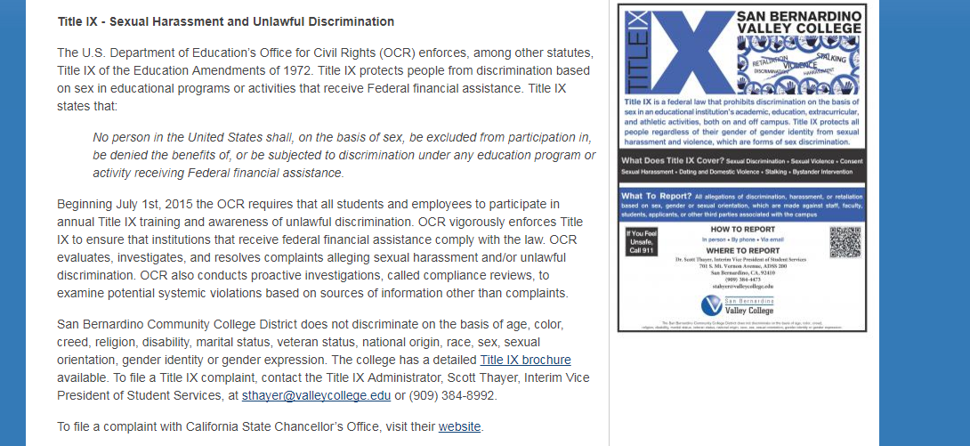

Slide 10
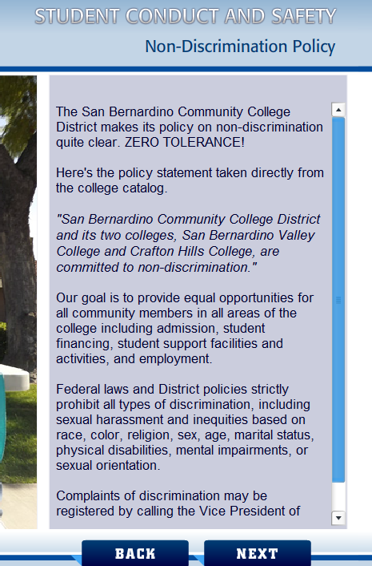
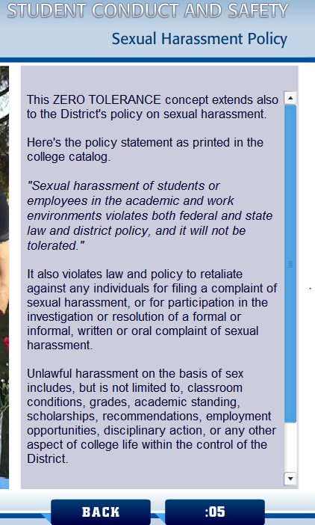
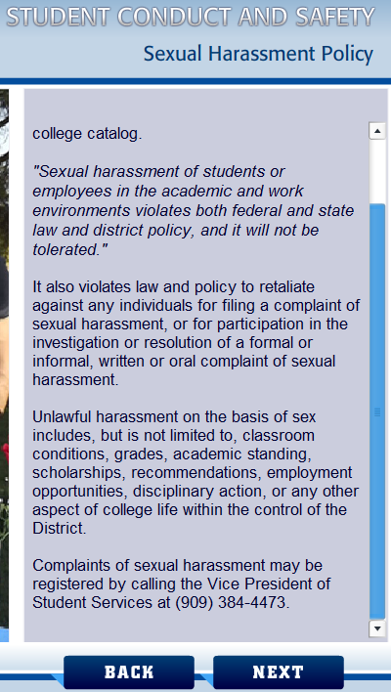

Slide 11
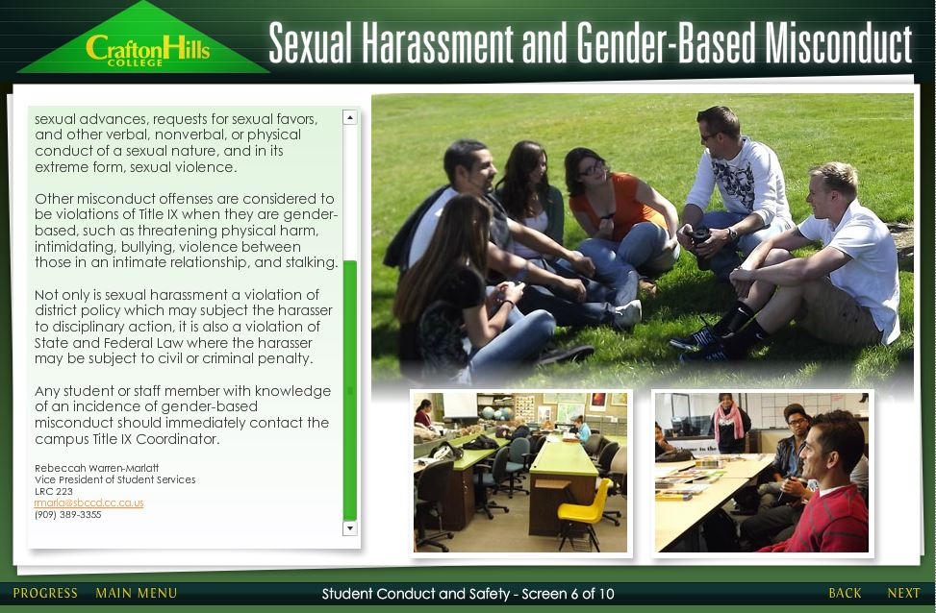
Orientation
Every student must complete an online orientation before they can register for classes.
The orientation addresses discrimination, conduct, and gender based harassment

Slide 12

Posters

Slide 13


Slide 14



Slide 15
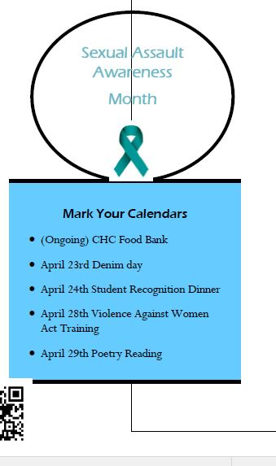
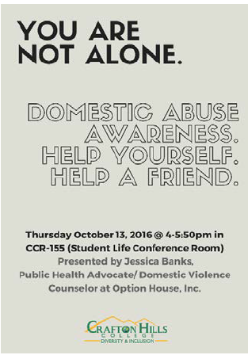
Workshops
District and College workshops take place each year at In-Service, for Part-timers, and for the entire campus
Student Success Planner which addresses Title IX

Slide 16
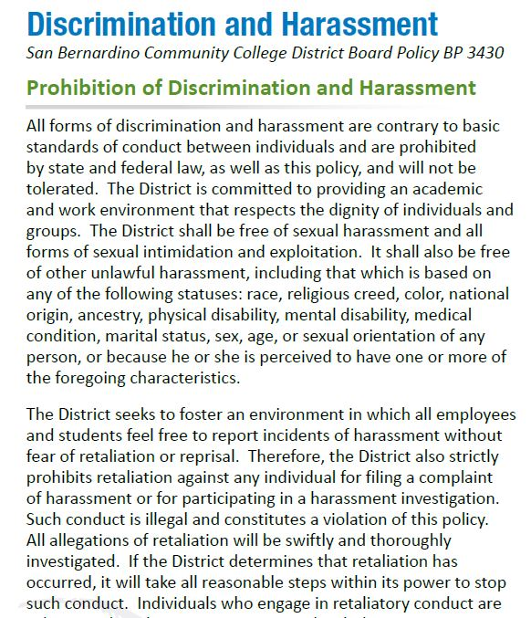
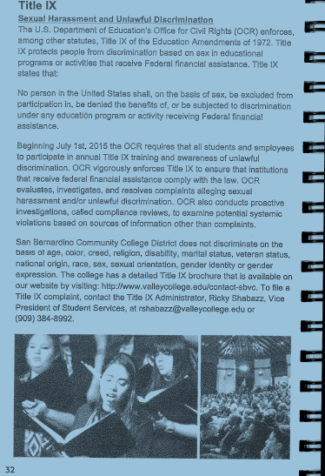
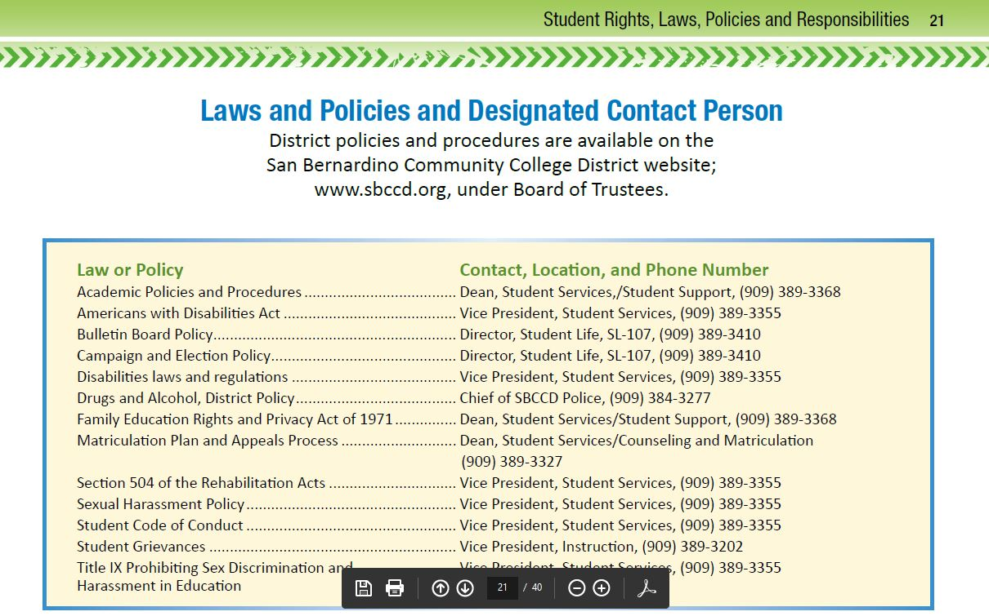
Student Handbooks

Slide 17
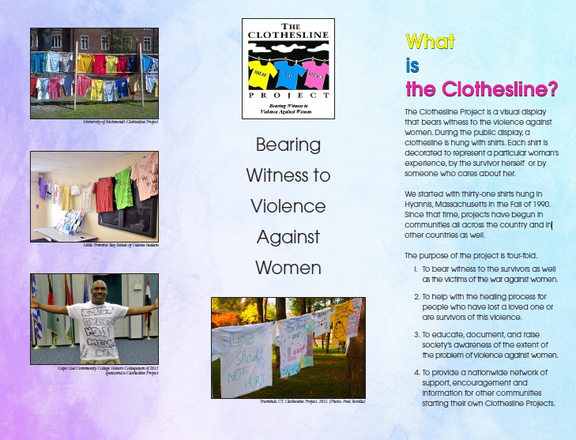
Annual Sexual Assault Awareness Month
April, Sexual Assault Awareness Month (SAAM)
Denim Day
Bob Hall, Nonviolent Sexuality: A Campus Dialogue
Myths and Reality about Date Rape
Posters and light poll banners around campus for at least 40 days
Clotheslines project which passively brings attention to sexual misconduct through visuals in front of the campus center.

Slide 18
Reporting
Campus Police
Behavioral Intervention Team
Scott Thayer, VP of Student Services, SBVC Title IX Officer
Rebeccah Warren-Marlatt, VP of Student Services, CHC Title IX Officer
Joe Opris, HR Manager, District, Title IX Officer

Slide 19
Reporting (Continued)
San Bernardino Valley College Student Health Services 909.384.4495
  Confidential reporting is available, along with counseling. Most services are free or low cost.
Crafton Hills College Health & Wellness Center 909.389.3272
  Confidential reporting is available, along with counseling. Most services are free or low cost.
SBCCD Human Resources 909.382.4040
  HR will help employees file claims and report incidents.

Slide 20
Behavior Intervention Team/Mental Health Initiative
Stable Leadership
Team Members participate in NaBITA (National Behavioral Intervention Team Association) training
Receives reports of disruptive, problematic, or concerning behavior or misconduct
Connects the student with resources

Slide 21

Title IX Investigations Team
Completed NCHERM (National Center for Higher Education Risk Management) training
  Includes Title IX compliance requirements
Participate in periodic training

Slide 22

Collaboration among SBCCD Police, Title IX officials, and Student Conduct Officials
Police Officers are part of the regular meetings for BIT
Sergeant’s have meetings/ phone calls with Student discipline Officers for BIT issues, T9 and general student conduct violations
Agreement with SBSAS to be advocate for student/employee victim.

Slide 23

Maxient
Maxient is the software of choice for managing behavior records at colleges and universities across North America.
Their centralized reporting and recordkeeping helps institutions connect the dots and prevent students from falling through the cracks.
Whether it’s student discipline, academic integrity, care and concern records, Title IX matters, or just an “FYI”, Maxient’s Conduct Manager has us covered for all things related to a student’s conduct and well-being.

Slide 24
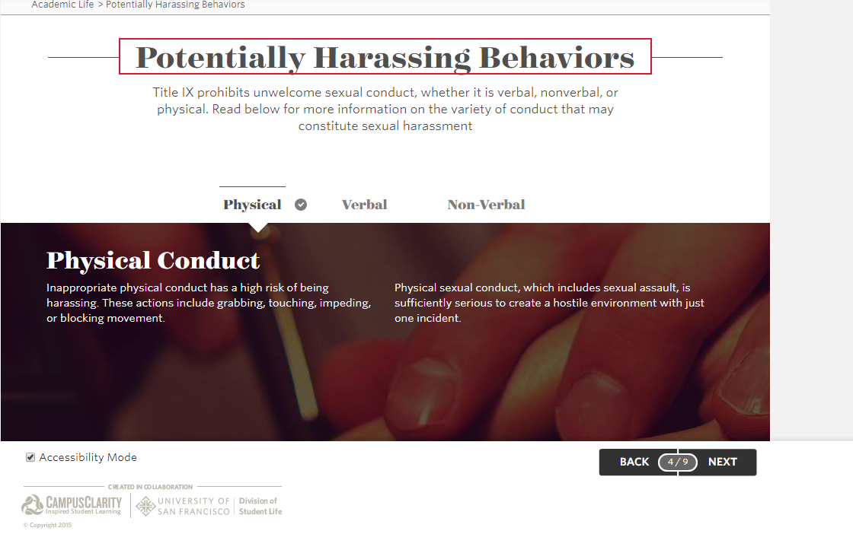
Campus Clarity
CampusClarity is a one-stop-shop to train students, staff, and faculty.
CampusClarity currently helps nearly 200 schools comply with the SaVE Act and Title IX through interactive, engaging online training.

Slide 25
Next Steps
Implement Campus Clarity to all incoming students, students who travel or attend field trips, student senate members, and student club leaders and members
Implement Campus Clarity to all staff and faculty
Link the Title IX information to the front page
Include a fillable reporting form (Maxient)
Create an annual bystander awareness campaign

Slide 26
Next Steps
Live Safe APP – students can use this to let other know where they are walking , (Guardian APP) https://www.livesafemobile.com/
Safe Space for students – location, employees, training – Safe Zone Training
Training for all employees
Internal Title IX handbook
Add policy for Faculty (have certain boundaries or standards with Students in class)
Every Responsible Employee – Job Description updates

Slide 27

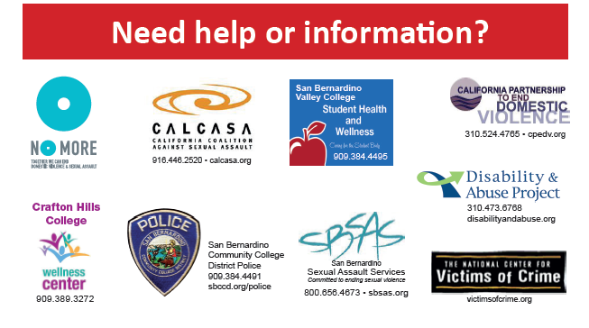
Increase of Information = Increase of Students Complaints
https://nomore.org/campaigns/public-service-announcements/no-more-official-super-bowl-ad/
Notes:
Usually, when people who are not familiar with law enforcement look at crime statistics, they assume that the institutions with the greater number of incidents reported are less safe than the institutions that have a lower number of crimes reported. They don’t understand that when crime stats are higher, it often means the campus in question is realistically dealing with its crime problem and is dedicated to transparency. In essence, more reports of crime very often mean members of the campus community are better informed about threats to their safety. When they have this knowledge, they are more likely to take the steps necessary to protect themselves. Also, if they are confident that their reports of incidents will be taken seriously by campus police and the institution as a whole, they will more likely come forward and make a report if they become a victim of a crime.
For example, campuses that do a good job of reaching out to victims of sexual assault usually have higher rates of sexual assaults reported. This greater number of reports actually means that victims feel more confident in their campus' handling of of this type of crime. Considering that about 20% of women will experience a sexual assault at some point during their college careers, wouldn’t you rather have your daughter attend a school that addresses issues like sexual assault than let her suffer in silence because the campus is unwilling to acknowledge the problem for fear of being mentioned on a list like "25 Most Dangerous Colleges in America?"

