Slide 1
Phase 1 Student Housing Feasibility Study
Market Assessment & Demand Analysis
College Village Overlay District
Yucaipa, California
November 3, 2017

Slide 2
Brookhurst Development & Advisory Corporation
Established in 1996 - National development and advisory firm with offices in Newport Beach, Sacramento, Indianapolis and Houston
Experience in development and governmental advisory services with over $5 billion of higher education and various government projects
Recognized as a foremost expert in alternative delivery options for California government projects including P3s, DBFOM & Lease-Leaseback
Currently under contract to develop CSU’s first P3 project in its 150-year history – CSU San Marcos Extended Learning Complex

Slide 3
SBCCD Student Housing Objectives
Phase I Feasibility Study
Market assessment and demand analysis to ascertain existing demand, and patterns and trends within community college student housing
Assessment of surrounding market conditions, demographic analysis, current enrollment, projected growth and rent obtainable for the new dorm units
Market study of existing off-campus housing
Review of peer benchmark projects (other California community colleges with student housing)
Comprehensive survey of faculty, staff and students

Slide 4
College Village Overlay District – Yucaipa, CA
A collaborative effort between the City of Yucaipa and San Bernardino Community College District/Crafton Hills Community College
49.1 acres of raw undeveloped land primarily comprised of two large parcels, each currently owned by two separate private owners
Primary goal is “to encourage the development of a vibrant, pedestrian-friendly college village that offers a range of housing and nonresidential opportunities, including commercial, public, and institutional uses, to serve the diverse needs of the college, Yucaipa community, and the region."
Objectives include creating a sustainable mix of quasi-public/institutional and educational uses, housing – inclusive of student/faculty housing, and a range of commercial uses to provide economic vitality to the District

Slide 5
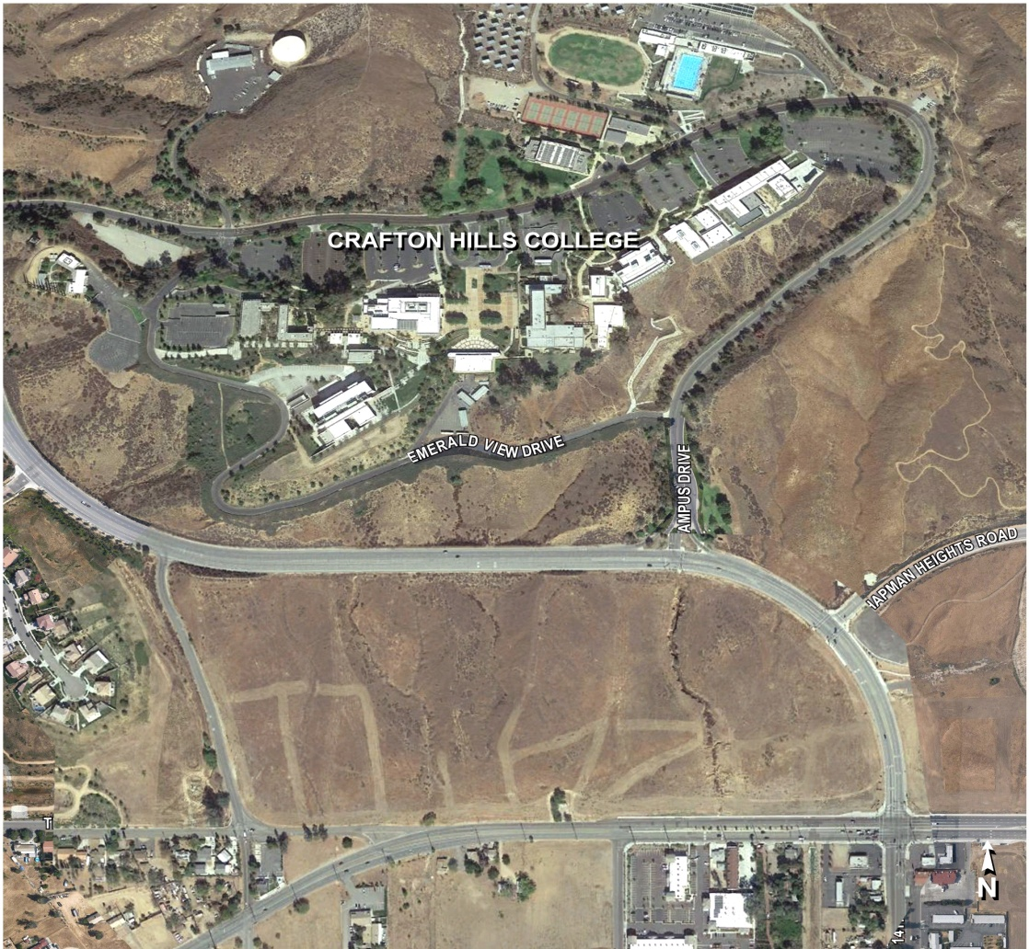
College Village Overlay District – Yucaipa, CA

Slide 6
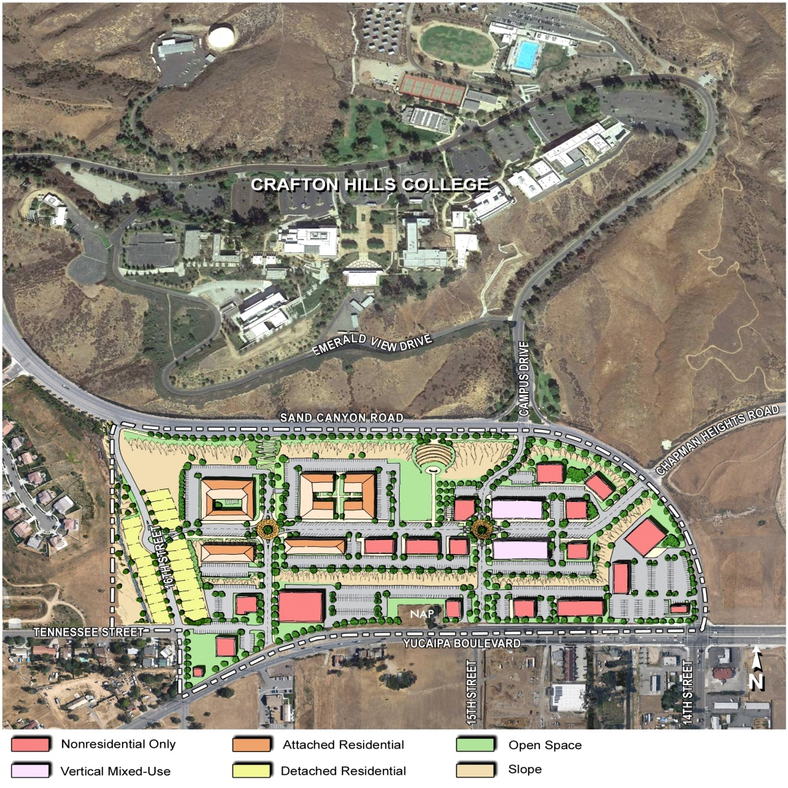
College Village Overlay District – Yucaipa, CA

Slide 7
College Village Overlay District – Yucaipa, CA
Objectives also include:
Promoting infill, transit-oriented development, and other forms of sustainable development that facilitate a dynamic environment for both daytime and nighttime usage that serves the College and community.
Providing enhanced pedestrian amenities and improvements, including benches, special pedestrian-scale lighting, theme paving, sidewalk improvements, and fully accessible ramp improvements at intersections.
Improving transit, bicycle, and pedestrian access from the site to the College and to other local and regional destinations; internal pedestrian pathways should feed into proposed and existing trails at Crafton Hills College and other trails in the area.
Process will require partnerships with public and private entities, including Crafton Hills College and private property owners, to help facilitate development of the College Village site.

Slide 8
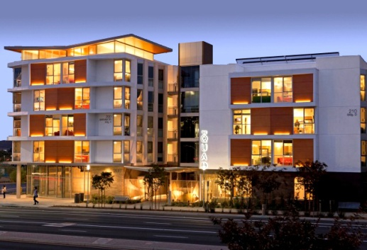
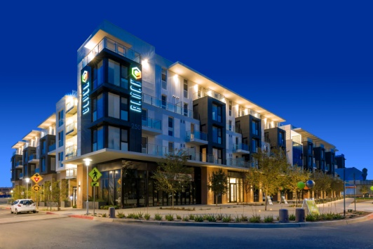
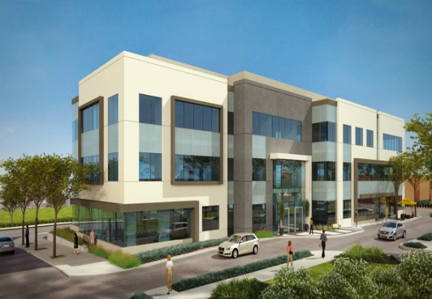
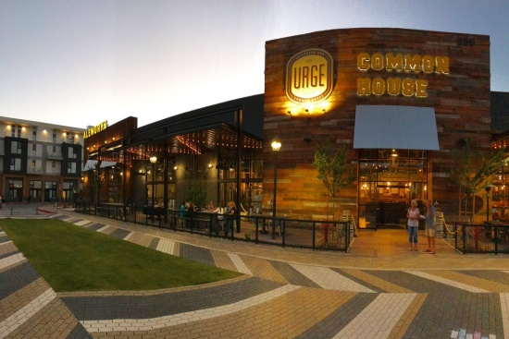
Example Case Study – Urban Village, CSU San Marcos
North City - Urban Villages San Marcos (UVSM) is becoming one of the most dynamic college village districts in California
North City/UVSM current success projects:
846-bed student housing development
200-unit market-rate apartment complex
PIMA office bldg./medical school
Retail “Urge” micro-brewery, restaurant, bowling alley and activity center

Slide 9
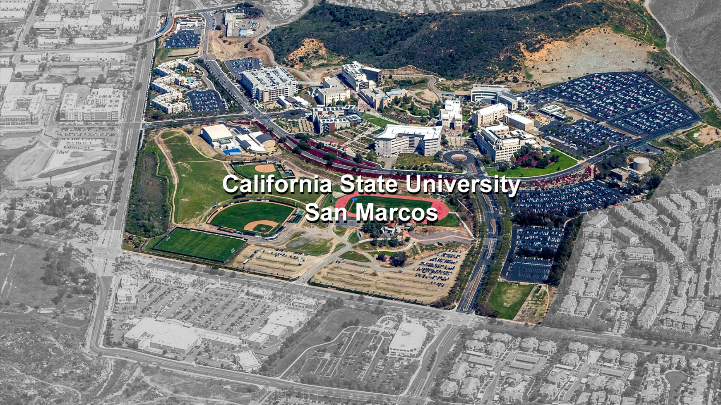
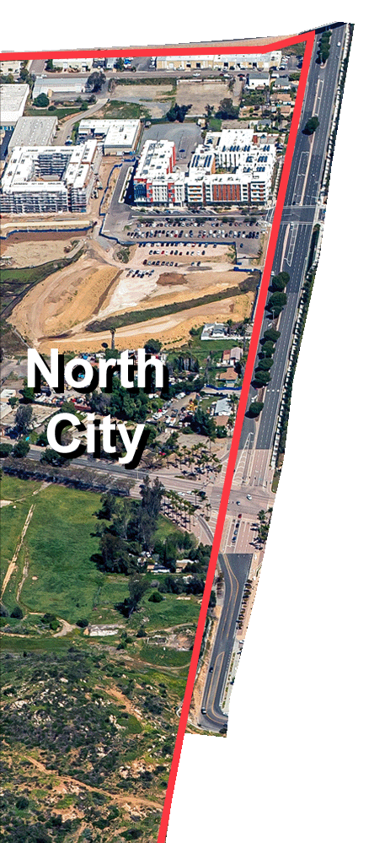
Example Case Study – Urban Village, CSU San Marcos
Future CSU Learning Bldg

Slide 10
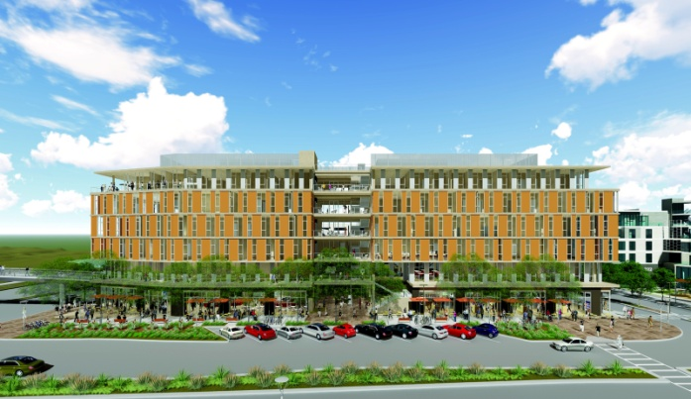
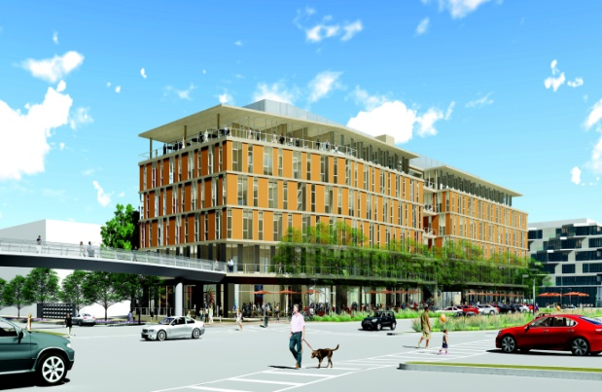
Example Case Study – Urban Village, CSU San Marcos
CSU San Marcos to develop first P3 in CSU’s 150-year history with a Brookhurst Development/UVSM Venture Partnership
New CSU Extended Learning Complex will include:
135,000 S.F. of classroom, laboratory, assembly and office space
706 space parking garage
14,000 S.F. of ground-level retail
Pedestrian bridge to physically connect CSUSM with Urban Village

Slide 11
Existing Conditions Analysis
Key Findings:
CHC’s participation rate of 8 per 1000 residents is substantially below the state average for community colleges of 54 per 1000 residents.
Enrollment decline and limited staffing continues to challenge CHC. Since 1992, full-term enrollment has only grown from 7,725 to 8,056 (4.3%).
The City of Yucaipa is forecasted to see a further residential shift towards the elderly and retirees, more so than its surrounding communities.
The need for CHC to pursue opportunities to enhance enrollment by meeting curriculum and housing needs of the community will become increasingly more important in the future.

Slide 12
Peer Benchmarking Analysis
Key Findings:
10%, or 11 campuses, of California Community College offer student housing, less than 30% national average.
All CA community colleges with student housing are outside primary population centers.
Nine campuses are among the smallest quartile. Average student headcount is 8,056; CHC headcount is 8,860.
60% have occupancy rates at full capacity, and half of those have waiting lists.

Slide 13
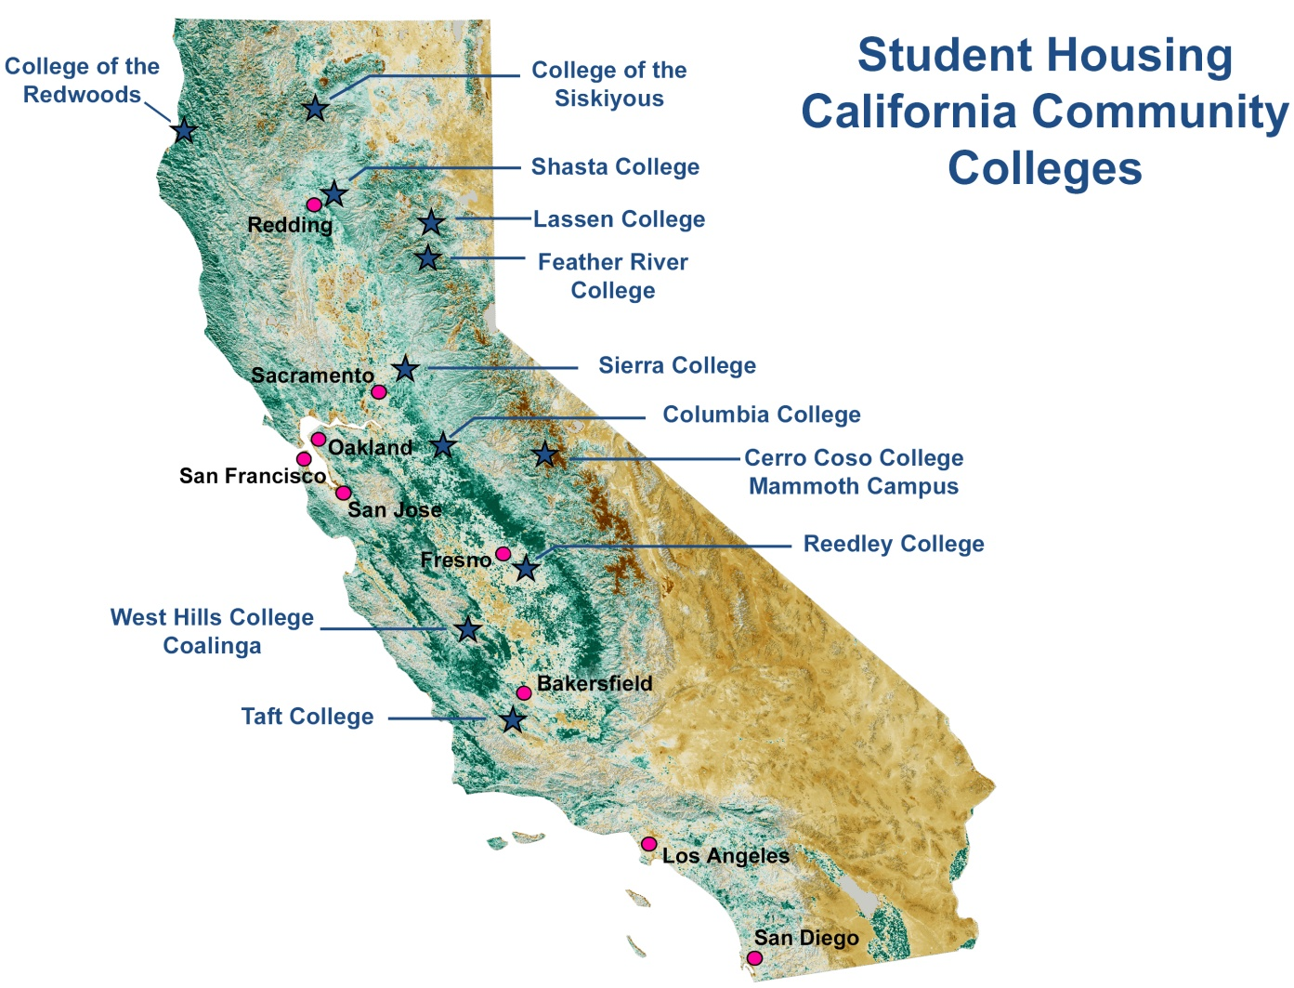
Peer Benchmarking Analysis

Slide 14
Peer Benchmarking Analysis
Key Findings:
Apartment-style options include kitchenette and bathroom; Dorm-styles include shared or communal bathrooms with some also including communal kitchens.
All require adequate electronic and Internet infrastructure, security, parking and are fully furnished. Online operational systems are highly recommended.
Determining food options/meal plans are integral to design and operation of student housing, impacting rental rates, selection of student housing vs. market-rate housing, staffing, and alternative on- and off-campus dining options.

Slide 15
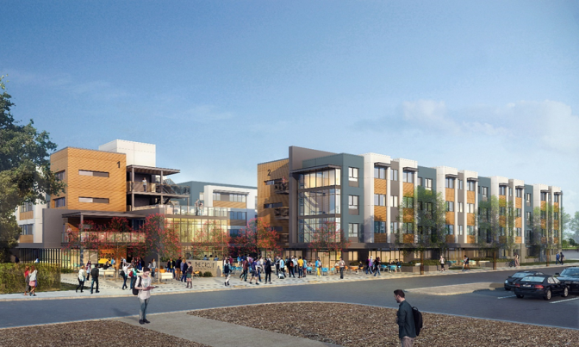
Peer Benchmarking Analysis (Update)
Orange Coast College Student Housing, Costa Mesa
2016 P3 RFP awarded to Servitas
High-density urban environment
817 beds + mixed-use
Long-term ground lease
Financing through tax-exempt bonds
Orange Coast College – Stated Goals
Become a 7-day a week campus through a live/learn environment
Increase GPAs and student retention; extracurricular activity opportunities
Aid in student recruitment by providing affordable housing
P3 - Minimize project costs while creating long-term revenue source

Slide 16
Off-Campus Housing Supply
Key Findings:
Less than 150 existing apartment units in the entire City of Yucaipa are applicable for student/faculty housing, most within only two complexes.
Only 20% of CHC students renting their housing live in Yucaipa; the remainder live in neighboring cities and commute to CHC.
Average rental rates are in the range of $1.63 to $1.89 per square foot per month; student housing costs should not exceed market rates.
Political climate provides favorable circumstances to support development of student housing in the College Village District as opposed to higher density market-rate apartment complexes.

Slide 17
Student/Faculty/Staff Survey
Highly collaborative endeavor between SBCCD and Brookhurst -- Thank you SBCCD!!
Survey sent to all SBCCD students, faculty and staff of both campuses with email requests coming from Presidents Zhou and Rodriguez.
Web-based survey included 52 multiple choice questions to gauge demographics, employment, demand, current housing costs, future academic plans, amenities desired and numerous other factors.
Survey was launched March 20, 2017 and closed June 12, 2017 with 3,165 responses received. Responses are considered “statistically significant” at a 95% confidence level with a 3.5% margin of error.

Slide 18
Student/Faculty/Staff Survey
Key Findings:
86% of CHC students attending CHC do so primarily because it is the closest college to where they live and/work.
80% of CHC students indicated they would be interested in living in student housing adjacent to the campus. 77% of SBVC students also indicated a desire to live in student housing next to CHC, provided that SBCCD could provide shuttles/transportation to SBVC.
81% of SBCCD students are single; 83% are under the age of 29 while 69% are under 24.
More than two-thirds of all SBVC and CHC students indicated they intended to transfer to a 4-year university prior to or upon graduation.

Slide 19
Student/Faculty/Staff Survey
Key Findings:
52% of CHC students are full-time, which is significantly higher than the national average of 40%.
55% of those interested in student housing indicated they would be interested in renting for two years or longer.
Faculty/staff were predictably much older, commuted from much further distances, more likely to have spouses/children, lived in larger dwellings and/or were home owners, and were significantly less interested in housing.
Domestic students showed a slightly higher interest in student housing than foreign students, which is contrary to the popular notion that a primary reason to have community college student housing is to attract foreign students.

Slide 20
Conclusion - Challenges
Land Acquisition: Who will negotiate and purchase the land – private developer, SBCCD, City of Yucaipa or a combination?
Site Development: Significant grading needed; Infrastructure – roads, sewers, utilities.
Entitlements: Who will take the lead on EIR/CEQA processes?
Phasing: How will the student housing project be sequenced in the development of College Village?
The current Yucaipa City Council is adverse to developing market-rate multi-family housing within the College Village District, which could be necessary for financial feasibility of the District’s overall development.

Slide 21
Conclusion - Challenges
Demographic projections for the City of Yucaipa show a decreasing population within the 20 to 29 age group, which currently comprises about 60% of CHC students
The survey revealed that faculty/staff require workforce housing more consistent with the single-family detached housing already in the region. This would require SBCCD to take on financial and market risks of development in which it has no experience
Financial feasibility of student housing currently uncertain

Slide 22
Conclusion - Opportunities
Student housing provides educational benefits:
Potential revenue generated through ground lease and/or dorm fees
A sense of belonging to the college; 24/7 live-learn environment
Increased retention of those outside commuting area
Improved collaborative learning among students
Higher level of student-faculty engagement
Greater openness to diversity
Close proximity allows greater access to campus resources (e.g. library, tutoring, faculty hours)
Removal of campus commuting increases time allocated to scholastics
Higher graduation percentages for under-served minority students

Slide 23
Conclusion - Opportunities
Student housing provides educational benefits:
Improved level of academic and career advisory
Students living in campus student housing typically average higher GPAs compared to those that do not
Demand exists: Significant majority of students surveyed interested in student housing; Yucaipa lacks sufficient student housing near CHC
Environment exists: Favorable current political climate in City of Yucaipa to include student housing and supportive amenities in College Village development

Slide 24
Conclusion - Recommendations
Collaboration needed: Enhanced cooperation & communication among SBCCD, CHC and City of Yucaipa supports success. Recommend steering committee structure including stakeholders such as YCJUSD & CRY-ROP.
Phase I results significant enough to warrant Phase II Feasibility Study – financial analysis.

