Slide 1
“While we [Americans] work every day to produce new goods and to create new wealth, we want most of all to enrich man’s spirit.” – Lyndon B. Johnson
Vision Moving Forward
Board Study Session
March 22, 2018

Slide 2
2
EMPIRE NETWORK KVCR
OUR VISION
1
College-Focused Collaboration KVCR will be a state-of-the-art public media centerpiece in the Inland Empire, producing honest, courageous and balanced news-reporting, inspirational docu-series that educate and entertain, with the SBCCD Inland Empire Film (SBVC) & Digital Media (CHC) Academy serving as incubators for local storytellers, artists and filmmakers throughout the region. With a greater emphasis on diversity and wider audience engagement, KVCR will provide immersive digital public media that cultivates wonder and makes learning interactive and fun, while exposing students to internships in real-world filming, production and editing opportunities.
2
Relentlessly Local KVCR's mission is to educate, inspire and inform, reflecting the limitless potential of the Inland Empire while providing programming and career pathways that unite and celebrate our community. Students and Small-Business owners, Manufacturers and Maker-Spaces, Artists and Athletes, Lawyers and Landscapers, Dentists and Dispatchers...KVCR embraces the diversity of perspectives within range of our signal and we aim to provide a valuable civic and educational service through the medium of entertainment. From a career-inspiring perspective, our aim is to cultivate a local cluster of the entertainment sector, with our own regional flavor.
3
Modernization - Next Generation Broadcasting The modernization of KVCR will enable us to fully deploy the next-generation of broadcast TV, ATSC 3.0, a game-changing standard that enables broadcast protocol to exist in an internet environment. The standard will permit broadcasters like KVCR to offer innovative technologies and services to the public, including interactive, application-based TV and advanced Emergency systems.
4
Develop the Asset An FCC License is an important piece of electromagnetic real estate and it needs to be properly monetized as such. A potential source of revenue from this technological and infrastructure development lies in the opportunity to leverage the large-scale spectrum leasing opportunities that are developing in anticipation of public television stations’ transition to the Next Generation broadcast standard.

Slide 3
3
COLLEGE-FOCUSED COLLABORATION
STEPS TO UNITE THE DISTRICT THROUGH MEDIA
FCC UHF/VHF
Transition
Complete the process of FCC mandated shift from UHF to VHF, along with the construction of new Tower on Box Springs
Tech-Core Modernization
Build Create a technologically advanced infrastructure at KVCR that will enable production resources for staff and students alike to create the highest quality content.
CHC and SBVC
Digital Academy Begin the renovation of CHC and SBVC to accommodate the IE Film & Digital Media Academy with production suites and small soundstages.
SBVC Cohort
Launch Regional recruitment planning initiated for Fall and Spring semesters of the 2018-2019 academic year.
1
3
5
7
2
4
4
6
8
Station Design Design has begun with a full station upgrade to be completed by the end of 2018.
Empire / FNX
Digital With better facilities and opportunities, SBVC and CHC students will have internships waiting for them to shine and further refine their skills.
Empire News Launch
Hiring of Staff for production of weekly ½ hour news program
CHC Cohort
Launch
Multimedia Faculty hiring in FY2017-18, with curriculum, facilities, and recruitment planning in FY2018-19 for Academy launch in Fall 2019.

Slide 4
NEXT GENERATION BROADCASTING
PROJECT TIMELINES - MODERNIZATION AND REPURPOSE
4
Modernization
Build – Board Proposal
Modernization Completion
FCC Transition Deadline
Construction Complete
8/9/2018
1/17/2019
4/12/2019
5/6/2019
2018
2019
Feb
Mar
Apr
May
Jun
Jul
Aug
Sep
Oct
Nov
Dec
Jan
Feb
Mar
Apr
May
Jun
Jul
2/22/2018
Kick-Off
KVCR Design and Build
KVCR Design
2/22 - 6/12
120 days
Build Pre-Qual.
4/16 – 6/7
52 days
Build - Bid
6/13 – 7/24
41 days
Build - Board Proposal
8/9
Modernization Build
9/3 - 1/17/19
136 days
Modernization Completion
12/3
Training and Commissioning
2/1/19 – 3/28/19
56 days
KVCR FCC Deadline
4/12/19
KVCR Building Repurpose
Design Development
3/22 – 4/18
27 days
Contract Documents
4/19 – 6/12
56 days
DSA Submission and Plan Review
6/13 – 9/4
83 days
Bid and Board Proposal
75 days
9/15 – 11/20
Construction
166 days
11/21 – 5/6/19
IE Film & Digital Media Academy
SBVC Faculty Recruit.
90 days
CHC Faculty Recruit.
90 days

Slide 5
5
COLLEGE-FOCUSED COLLABORATION
MEDIA ACADEMIES
KVCR will provide SBVC’s and CHC’s Media Academies with career building opportunities in the following disciplines:
Radio/TV/Film – Camera Operations, Film/TV Direction, Engineering, Film/Sound Design, Productions, Acting, Audio Operations
Graphic Arts – Animation, Art & Design, Still & Moving Image Recording
Electronic Music- Sound Editing, Music Score Creation, Sound Effects Development,
Theatre Arts – Audio Operations, Costume & Wardrobe Design/Creation/Maintenance, Direction, Acting, Lighting Design
Communications Studies – Broadcasting, Marketing, Sales
Library Science – Research, Archiving
English - Journalism, Marketing, Research, Writing
INLAND EMPIRE FILM & DIGITAL MEDIA ACADEMY
Graphic Design - Graphic Designers, Art Directors, Multimedia Artists and Animators, Painting, Coating and Decorating Workers Artists, Virtual Reality, Gaming Design, etc.
Recording Arts Technology/Technician - Audio and Video Equipment Technicians, Sound Engineering Technicians
Technical Theater / Theater Design and Technology - Set and Exhibit Designers,
Photographic and Film/Video Technology/Technician and Assistant - Audio and Video Equipment Technicians
Commercial and Advertising Art -Graphic Designers, Commercial and Industrial Designers Artists, etc.
Prepress/Desktop Publishing and Digital Imaging Design - Prepress Technicians and Workers
Desktop Publishers - Animation/Interactive Technology, Video Graphics and Special Effects
INLAND EMPIRE FILM & DIGITAL MEDIA ACADEMY

Slide 6
COLLEGE-FOCUSED COLLABORATION
MEDIA ACADEMIES – POSSIBLE GROWTH SCENARIO
6
DRAFT – FOR DISCUSSION PURPOSES ONLY
 | FY 2018-2019 | FY 2019-2020 | FY 2020-2021
Possible New Sections | 5 Sections @ 12.5 FTES | 10 Sections @ 25 FTES | 15 Sections @ 38 FTES
Income | $63,750 | $127,500 | $193,800
Cost of Instruction | $16,200 | $32,400 | $48,600
Net | $47,550 | $95,100 | $145,200

Slide 7
7
COLLEGE-FOCUSED COLLABORATION
EMPIRE DIGITAL PATHWAYS
STUDENT DIGITAL MAGAZINE Students demonstrating an aptitude in Journalism and Graphic Design can participate in our site, The Inland.
Empire Digital provides numerous opportunities to develop high-level professional skill-sets in multiple disciplines, with pathways to be interns, paid-interns and fully employed.
DISTANCE EDUCATION Utilizing KVCR and Empire Digital’s digital, live-streaming capability to enhance online course delivery.
How can we help guide?
The Media Academies will also help focus on four specific areas to prepare students for acceptance in University B.A. Programs.
STUDENT ORIGINAL PROGRAMMING San Bernardino and Riverside County school districts can help contribute content for both Television series and Radio Podcasts.
TV and Radio Journalism
TV and Radio Production
EARLY CHILDHOOD EDUCATION Both colleges can connect their Early Childhood Education programs to create education content for pre-school learners.
Writing for Media
Augmented Reality and Virtual Reality

Slide 8
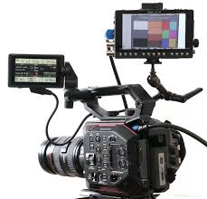
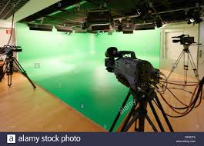
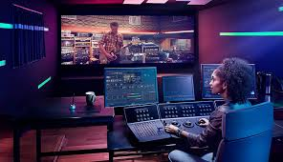
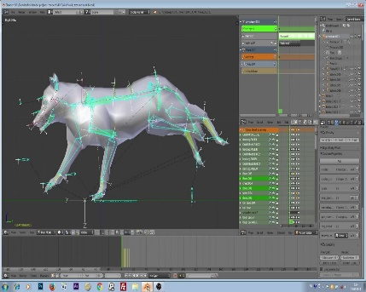
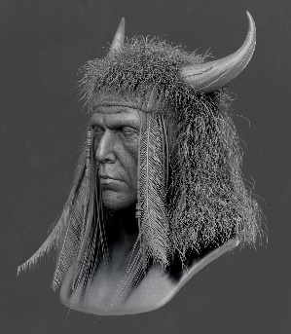
8
COLLEGE-FOCUSED COLLABORATION
EMPIRE DIGITAL CAREER OUTCOMES
CREATING A DIGITAL INCUBATOR
Whether it’s students preparing for professional careers, existing professionals looking to advance their skill-set or entrepreneurs cultivating creative and technical tools for small-businesses,
Empire / KVCR Digital will be a training ground for those in the Inland Empire to flourish in the digital arts.
COMMERCIAL DIGITAL MEDIA
Without having the FCC constraints on media production and programming that KVCR and KVCR face on traditional television, Empire / KVCR Digital will enable the creation of promotional and instructional videos, corporate training, live event coverage and many other possibilities for monetization and opportunities for those who receive training or certification.
Editing and Graphic Arts
Budgeting, Scheduling & Writing
Videography and Production
Color Correction
Audio / Music Production
3D Design / Animation

Slide 9
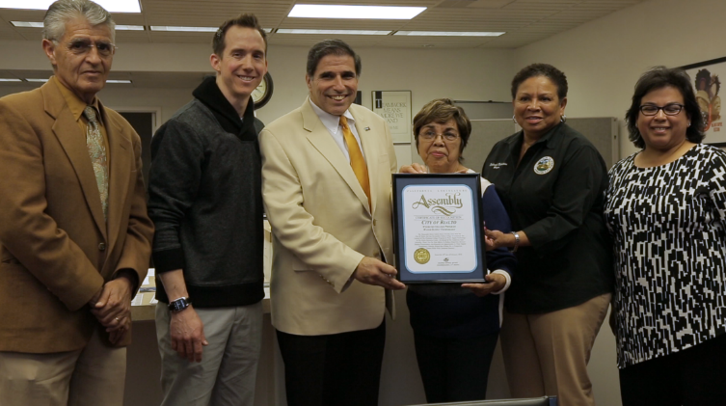
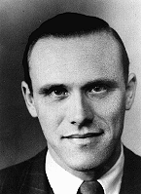
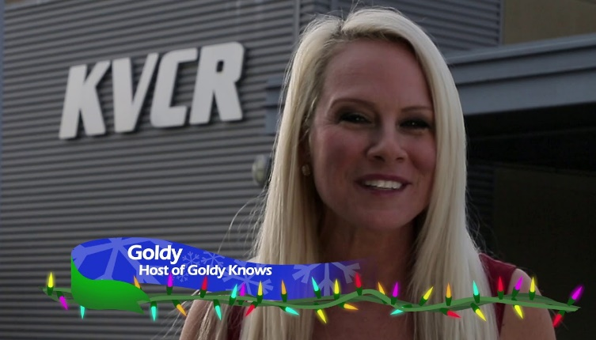
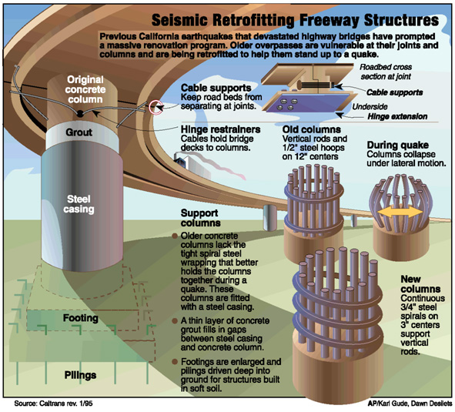
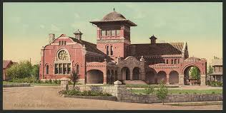
Empire Network Original Series
9
JOHN WEIDNER BIOPIC
The untold story of local legend and Dutch WWII hero Johan Hendrik Weidner who helped saved over 1,300 Jews and Allied troops during WWII.
GOLDY KNOWS
Projected to be a Do-It-Yourself show aiming at National PBS coverage
STATE OF THE EMPIRE
Capturing the weekly stories that impact the Inland Empire.
UNCOVERED IN THE ARCHIVES
Uncovering the hidden history of the Inland Empire with Brad Pomerance
$80,000 Raised for this program thus far!
HOPEFULS
Docu-Series capturing Olympic hopefuls with the promise of changing this region
Airing May 2018
THE WHISTLE
4-part Investigative series examining our preparedness for the “Big One” - $20,000 already raised! Airing June 2018

Slide 10
10
NEXT GENERATION BROADCASTING
ATSC 3.0

Slide 11
11
NEXT GENERATION BROADCASTING
EMPIRE DIGITAL PLATFORM
ATSC 3.0 is the next generation of broadcasting technology, allowing the convergence of TV and Internet that has been in preparation for years—i.e. free mobile wireless TV connectivity. KVCR’s modernization program will enable KVCR and KVCR to transmit in ATSC 3.0 by April of 2019, with most consumer electronic devices ready to receive ATSC 3.0 in mid 2019 and beyond. What does it all mean and why is this revolutionary?
Data / Analytics - Perhaps the greatest benefit of TV/IP convergence is the bi-directional nature of the transmission. For the first time, free to air TV channels will be able to function like the internet and allow KVCR (and partner San Manuel) to monitor viewer engagement—what viewers watch and how long they watch it. The inability to measure Nielsen ratings that has held KVCR Underwriting back will be a thing of the past.
IP Delivery to Mobile Devices – ATSC 3.0 will involve over-the-air transmission of KVCR in IP-integrated delivery. This entails sending free television signals to enabled mobile devices and tablets along with interactivity (menus, info, games) on screen throughout the greater Los Angeles Market Area.
Superior Picture Quality – Viewers of KVCR will experience the channel in HD with HDR (High Dynamic Range). This is a dramatically superior experience visually compared to HD alone with explosive color and gamut.
Audio Enhancement – KVCR will be broadcast with Dolby 7.1 immersive audio along with multiple language tracks. KVCR viewers will be able to view a given program in their native dialect!
Targeted Addressability - ATSC 3.0 “targeting” will allow KVCR to serve ads/sponsorship spots simultaneously to selected households or IP addresses in the LA broadcast market.

Slide 12
12
NEXT GENERATION BROADCASTING
EMPIRE DIGITAL PLATFORM
KVCR DIGITAL / OTT PLATFORM
Coming Summer 2018
Live Stream KVCR
The KVCR digital channel will be Live Streaming 24/7 over the Internet—live events, Pow-Wows, News, etc. to help build a loyal audience.
A KVCR “App” will soon deploy digitally across OTT platforms, making KVCR content available via Roku, Apple TV, Amazon Fire, Google Chromecast, Playstation, Xbox, as well as on all Computers, Tablets and Mobile Devices. Anyone with an internet connection can access KVCR!
Data / Analytics
KVCR will be able to monitor user engagement, monetization, product page views, downloads and more vital data to better inform programming decisions.
Subscription and Transactional VOD
With OTT, there is the possibility of creating exclusive content for a subscription or the latest films/television for a single transaction rental.
First Nations Experience
Global Reach
No longer constrained by terrestrial television alone, an OTT KVCR channel can reach anywhere in the world via internet connectivity.

Slide 13
13
NEXT GENERATION BROADCASTING
EMPIRE DIGITAL PLATFORM
WHAT IS OTT?
OTT (Over-the-Top) refers to online streaming of video through an internet enabled device that doesn’t require a Cable or Satellite TV subscription (like Spectrum, DirecTV, etc.)
At the start of 2018, the broadcast industry is stepping into an “OTT 2.0” era: companies in the space are improving on the technology of the past few years and offering a better replacement to traditional Cable or Free Television. This includes providing:
More original digital content
More direct offerings to viewers
More data
More interactivity
KVCR LIVE STREAMING
The goal of having KVCR available across the U.S. via online streaming through an OTT platform is that every one with an internet connection will be able to view the channel on both a live-streaming basis and through Video On Demand.
SBCCD STUDENT FEES = ENRICHED LEARNING
With a dedicated digital OTT platform containing content that can act as supplementary educational materials for students, a fee can be charged to students for providing them a unique username/password that provides access to material that will be exclusive to them. Student fees will help support KVCR’s ability to acquire future content that provides valuable instructional value, thus creating the potential for SBCCD faculty to capitalize on NextGen KVCR technologies to enrich student learning experiences.
TARGETED “ADVERTISING”
We don’t use the term “Advertising” in public media but the concept of a sponsorship or underwriting spot is the same. As addressable and programmatic TV advertising systems mature, not only will they help KVCR monetize the channel, but they also should be seen as an effective channel for driving viewership as well.
Selling sponsorship spots via these new platforms can enable KVCR to drive awareness and tune in among specific audiences. One important promotional channel for OTT services is on streaming platforms themselves. For example, Roku provides a rich set of advertising and promotional capabilities, building these tools directly into its OS. Content providers on the Roku platform can promote their services to users during new user signup, in the channel store, on the device’s home page through video ads.
Anticipated annual cost to operate KVCR Digital OTT Platform: $36,000

Slide 14
14
COLLEGE-FOCUSED COLLABORATION ◊ DATA-DRIVEN PLANNING ◊ ALTERNATIVE REVENUES
KVCR 2018-2019 PLANNING
A
INTEGRATED PLANNING
Academy - KVCR and Empire Digital will help develop opportunities to complete industry-recognized CTE credentials and stackable certificates in diverse areas for students and professionals who increasingly work in digital realms, and who are likely to produce media and not just consume it. The future professionals coming from our Academy Infrastructure will read, write, think, and communicate in digital, networked environments. KVCR intends to be a closely aligned partner with the Colleges in revising and implementing curricula in response to new technologies.
Empire Digital Co-Location with CHC Digital Media Academy – Just as KVCR is already co-located with SBVC, this will offer new avenues for creative and professional exploration for ALL SBCCD students through structured internships.
Curriculum aligned with Production – KVCR obtains new programming; Students have a place to build their resume by acquiring market-ready skills and expertise, including acquisition of production credits.
B
MARKET RESEARCH
A thorough research effort will be conducted so that we understand the viewing habits and media needs of the diverse demographics of the Inland Empire. This is information that will benefit the programming and acquisition selects, the initiatives we choose to become involved in and the broader approach in our mission for TV and Radio through all distribution means (Over-the-Air and Digital), and further influence the development of new or enhancement of existing curriculum.
C
ALTERNATIVE REVENUE STREAMS
KVCR can potentially generate new revenues through mission related “non-broadcast” uses of the spectrum, such as datacasting. Stations may provide educational datacasting to schools, teachers and homeschooled students. Stations may offer public safety datacasting in partnerships between local public television stations and local public safety organizations, to allow the use of the broadcast spectrum for datacasting services that enable these public safety organizations to communicate with one another and with the public in times of emergency. Other opportunities exist with public Economic Development Agencies for Business Attraction productions and broadcasts.

Slide 15
15
NEXT GENERATION BROADCASTING
GREATER CAPACITY
CHANNELS
With more bandwidth, KVCR will have up to 6 HD Channels available! This translates into the possibility of providing the SBCCD with its own dedicated channel for live and recorded events, student programming, District meetings, distance education platforms…a whole host of additional resources for faculty and students in multiple media and arts programs, as well as the athletic and business departments.
Additional revenue streams can be realized as well by leasing a channel to Non-Commercial broadcasters, or even Subscription Services (Music, Video, Data, Internet of Things, etc.) that use advertisements!
ADVANCED EMERGENCY ALERTING
AEA is a facility in ATSC 3.0 to send urgent information a new way to present alerts and other critical public info.
Opportunities for SBCCD Public Safety and Administration of Justice programs to enhance curriculum.
Supplements and enhances existing alert systems but doesn’t necessarily replace.
Possibility of geo-targeting to narrow areas, even the area around the District.
Possibility of targeting (and encrypting) messaging for groups (first responders, students, gov’t, business, etc.)

Slide 16
16
KVCR EMPIRE NEWS
INLAND EMPIRE’S LEADING NEWS SOURCE
DRAFT – FOR DISCUSSION PURPOSES ONLY
Year 1
$250,000
3 FTE News Staff and 5 paid Interns - Using this model, the News Team would produce a minimum of one ½ hour news program weekly. In addition, the team will produce a minimum of one weekly 1:30 evergreen package for the “IE Scene”.
Year 2
$475,000
5 FTE News Staff and 10 paid Interns - In Year 2, the project will expand further; the News Team will produce a daily news show, five days per week and a weekend headline piece on Saturday and Sunday. The show will include detailed interviews and longer packages of the stories covered during the month.

Slide 17
17
EMPIRE NETWORK KVCR
UNITING THE DISTRICT THROUGH MEDIA
Co-Location on Crafton Hills Campus
Empire
Digital
CHC IE Film & Digital Media Academy
$18,000,000 Investment
($16M Modernization and
$2M Media Academy start-up cost)
Projected Cost to provide state-of-the-art equipment for Media Academy (KVCR/FNX) and meet FCC requirements and future broadcasting standards.
KVCR PBS/NPR
(Empire Network)
SBVC IE Film & Digital Media Academy
Existing SBVC
RTVF Program
Valley College Film/Radio/TV

Slide 18
18
EMPIRE NETWORK KVCR
KVCR FUNDING REQUEST
DRAFT – FOR DISCUSSION PURPOSES
KVCR
Mandated Transition & Modernization | $ 16,000,000
*Operations Support for Three Years (2017-18, 2018-19, 2019-20) | 5,000,000
**Media Academy Start Up (College-based instructional programs) | 2,000,000
KVCR Endowment | 21,000,000
TOTAL KVCR | $ 44,000,000
*Includes estimated start-up costs for KVCR Empire News
**Includes estimated start-up costs for Media Academy Growth

