Slide 1
Transitioning the DIEC to the New Institutional Effectiveness Advisory Committee (IEAC)
April 21, 2021

Slide 2
Purpose and Intention of Chancellor’s Council
ARTICLE 2: PURPOSE
Primary district-wide, participatory governance leadership team
Advises the Chancellor on institutional planning, budgeting, and governance policies and procedures affecting SBCCD educational programs and services
Serve as a conduit for cross-district communication on these issues, soliciting feedback from and disseminating reports and updates to constituency groups.
ARTICLE 3: INTENTION
Advise & make recommendations to the Chancellor regarding district goals, priorities
Promote quality, integrity, accountability and sustainability in carrying out the mission and goals of the district.
Notes:
The purpose of Chancellor's Council fits nicely with the definition of Institutional Effectiveness.

Slide 3
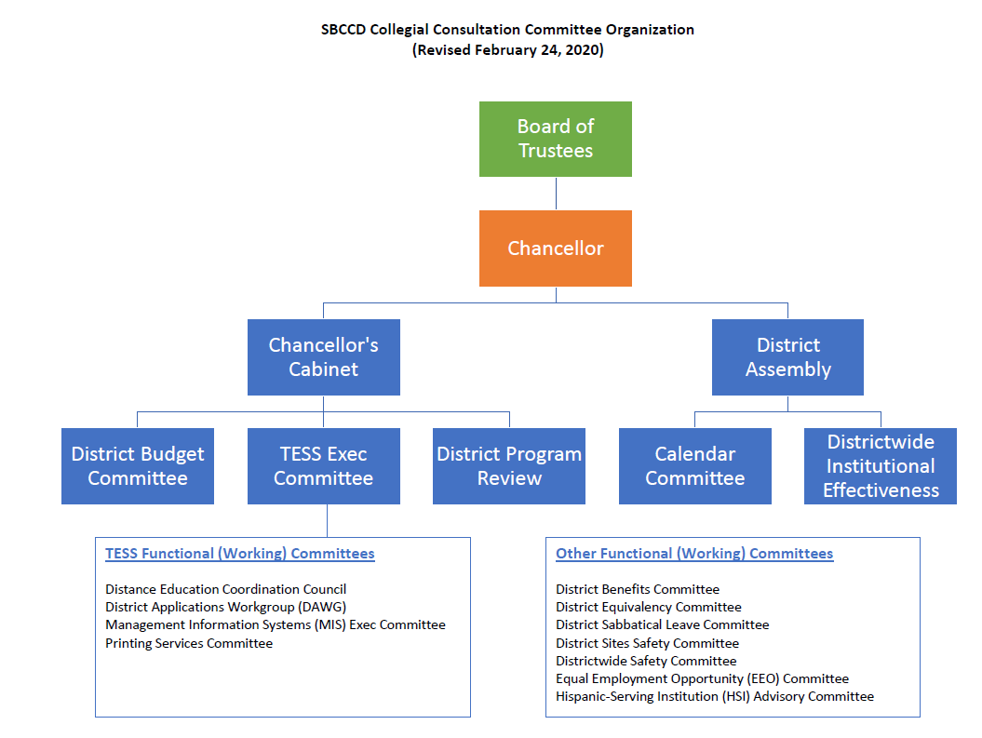
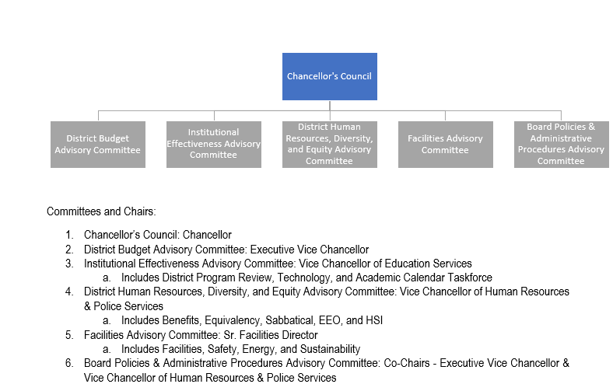
SBCCD Collegial Consultation Committee Organization (Revised February 24, 2020)
SBCCD Collegial Consultation Committee Organization (Revised April 6, 2021)
Notes:
Under the old Collegial Consultation committee organization, District Budget Committee, TESS Executive and Program Review were not fully integrated into the Collegial Consultation framework because they had a direct lead into Chancellors Cabinet.
With the new Chancellors Council framework all district committees will be integrated into the Collegial Consultation process with appropriate feedback loops that allow for participatory governance to take place prior to any agenda item getting to the Chancellor or the Board.

Slide 4
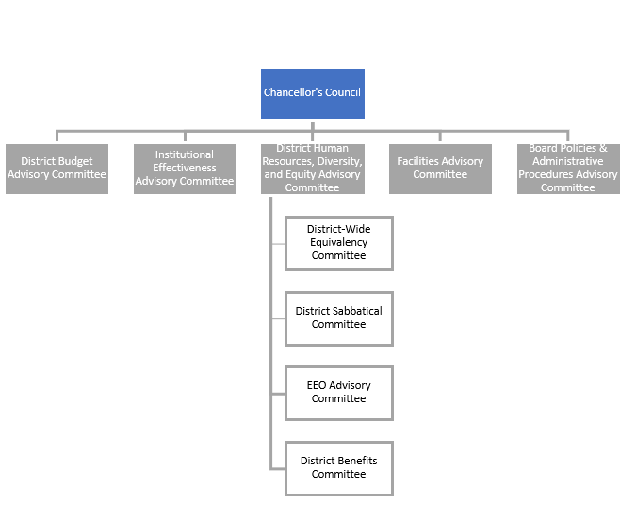
SBCCD Collegial Consultation Committee Organization (Revised February 24, 2020)
SBCCD Collegial Consultation Committee Organization (Revised April 6, 2021)
Notes:
Under the old Collegial Consultation committee organization, District Budget Committee, TESS Executive and Program Review were not fully integrated into the Collegial Consultation framework because they had a direct lead into Chancellors Cabinet.
With the new Chancellors Council framework all district committees will be integrated into the Collegial Consultation process with appropriate feedback loops that allow for participatory governance to take place prior to any agenda item getting to the Chancellor or the Board.

Slide 5
Our Task for Today
Write a charge for the new Institutional Effectiveness Advisory Committee (IEAC) that provides a flexible initial framework for the committee focus
Determine the appropriate subcommittees and reporting structure
Next slide has 3 options
DSPPRC and TESS voted for option 3
Determine the membership (expand, keep the same or contract)

Slide 6
OPTION 1:
OPTION 2:
OPTION 3:
IE Advisory Committee
IEAC + DSPPRC = IEAC
IE Advisory Committee
Institutional Effectiveness
Program Review
TESS Executive
TESS Executive
Calendar Taskforce
Program Review
TESS Executive
Calendar Taskforce
Calendar Taskforce
Combine all committees
TESS subcommittees would remain: DAWG, MIS, Web services, DE, Technical Services
Would need to develop an agenda that was “issue based”
May meet twice a month in year 1
Combine DIEC & DSPPRC
TESS Exec. has standing agenda item
TESS Exec can vet ideas
Provides a space for information sharing
Increase committee efficiency and collegial consultation
Keep TESS Exec, Program Review, Calendar Taskforce separate
Report to IEAC as subcommittees
Provide a standing agenda item
Works because IE is defined as …
Ongoing self-evaluation
Measuring of achievements and outcomes as they relate to the institution's mission
Notes:
Combine all Collegial Consultation Committees into one committee. This would require us to develop an agenda that was segmented to deal with the various issues/topics related to IE, PR, Calendar, TESS. Would require more frequent meetings but possible.
Combine DIEC with the DSPPRC. TESS Exec and Calendar Taskforce as subcommittees.
Make DIEC/IEAC the overarching Collegial Consultation Committee with Program Review, TESS Executive and Calendar Taskforce as its subcommittees. This is the most feasible and provides a solid reporting structure for Collegial Consultation.
Benefits to combining:
One benefit to combining the committees is that we would no longer have important information spread across multiple committees. This also means that one person would not be tasked with serving on 3-4 committees because they are VPI or Senate President, for example.
Downside to combining:
However, if we were to combine all 4 committees we need to make sure we maintain representation from all constituency groups and this may not be feasible. For example, TESS Exec includes the VPSS’s and VPAS’s and it would not make sense to have them on a committee that deals with DSO Program Review.
Also, Program Review requires us to have representation from each District department so trying to merge TESS Exec would make the committee too large.

Slide 7
Districtwide Institutional Effectiveness Committee Charge
District Planning & Program Review Committee Charge
Support the colleges' Institutional Effectiveness processes
Support the accreditation processes at the colleges and ensure that the related accreditation district entities (HR, Business Services, TESS, etc.) are meeting accreditation requirements
Develop and monitor implementation of the Districtwide Support Services Strategic Plan.
Prepare an annual progress report to describe progress in achieving the objectives in the Districtwide Support Services Strategic Plan.
Facilitate communications and resource-sharing across District and Colleges in order to better meet institutional research and planning needs.
Develop mechanisms to assess progress on major district plans and make recommendations to District Assembly
Develop mechanisms to assess effectiveness of district-level committees and make recommendations to District Assembly
To advance continual, sustainable quality improvement at all levels of the District Services to support student success. Toward that end, the committee conducts a thorough and comprehensive review of each unit at the District Services on an annual basis and oversees the annual District Services planning and program review process. The results of planning and program review inform the integrated planning and resource allocation process at the District Services, and are aligned with the district strategic planning process. The committee relies on quantitative and qualitative evidence to evaluate programs, develop recommendations to the Chancellor’s Cabinet, and determine and implement improvements to the District Services Planning and Program Review process.
Academic Calendar Committee Charge
TESS Executive Committee Charge
The Academic Calendar Committee will oversee the development of the annual academic calendar and will review optional calendars or other formats for offering academic programs for the District. The deliberations from this committee will be reported to District Assembly where a recommendation will be made to the Chancellor for Board Action on any calendar.
Develop, monitor, and update the Technology Strategic Plan and District IT Prioritization Process, ensuring alignment between the District-wide use of technology and the Board of Trustee’s imperatives; Review, prioritize and monitor District-wide IT projects in support of academic and student success.
Notes:
Please review the charges of the 4 committees that will now make up the charge of the IEAC. Keep in mind that TESS Executive, DSPPRC and Calendar Taskforce will now report to IEAC.
Our task is to find components of the charges of the three subcommittees that we believe should be included in the IEAC charge in order to make its connection and oversight of these subcommittees clear and effective.
Items in yellow represent their key functions (see next slide for a more concise summary)

Slide 8
District IE Committee
Support colleges in improving student success
Develop, monitor, report on DSO strategic plan
District Program Review Committee
Support colleges in improving student success
Review each District Support Operations department on an annual basis
TESS Executive Committee
Develop, monitor, and update the Technology Strategic Plan
Calendar Taskforce
Support colleges in improving student success
Support College Institutional Effectiveness
Facilitate communication and resource sharing
Develop and review District IT Prioritization Process
Explore the feasibility of a compressed calendar
Align resource request with institutional needs
Create, review, improve district program review process
Support District accreditation
Support colleges in improving student success
Develop academic calendar
Primary Committee Functions:
The primary function of these committees must be incorporated into the new IEAC charge
Notes:
I added “support colleges in improving student success” to DIEC, TESS Exec and Calendar Taskforce.

Slide 9
New IEAC Charge:
The Institutional Effectiveness Advisory Committee (IEAC) aids in the districtwide integration of institutional planning, resource allocation, program review and the technology strategic plan. We support student success by:
Supporting the colleges' Institutional Effectiveness processes.
Supporting the accreditation processes at the colleges and ensuring that the related accreditation district entities (HR, Business Services, TESS) are meeting accreditation requirements.
Providing Program Review support by reviewing program assessment results in light of District Support Operations (DSO) strategic goals to recommend a set of institutional priorities for inclusion into integrated planning and resource allocation.
Ensuring that the colleges Educational Master Plans inform the development of the DSO Strategic Plan.
Developing and monitor implementation of the DSO Strategic Plan, ensuring that the District Strategic Plans aligns with the DSO Plan.
Developing mechanisms to assess progress on major district plans (i.e., TESS Technology Strategic Plan) and make recommendations (what would these be?) to Chancellor Council.
Preparing an annual progress report to describe progress in achieving the objectives in the Districtwide Support Services Strategic Plan(s).
Facilitating communications and resource-sharing across District and Colleges in order to better meet institutional research and planning needs.
Developing mechanisms to assess effectiveness of district-level committees and make recommendations (what would these be?) to Chancellor Council.
Participating (broadly construed) in deliberations related to the development of the annual academic calendar.
Notes:
I added the parts in yellow. The opening paragraph is purposefully written very broadly. It gives us the flexibility to make changes as we get a better feel for the actual work we would undertake as a committee.

Slide 10
New IEAC Membership
Mimic representation from Chancellor’s Council?
Remove the VC of HR and Police Services, EVC Business and Fiscal Services, Chancellor, Black/Latino faculty and Staff?
Individuals with broad understanding of Institutional Effectiveness
Could invite people as experts based on the topic under consideration
Is it advantageous to have redundancy across committees?
Develop deeper and broader understanding of districtwide issues
Increase effectiveness in their committee work
Minimizes diffusion of responsibility
May cause burnout

Slide 11
Current Committee Membership Rosters
Institutional Effectiveness
Program Review
TESS Executive
Academic Calendar Taskforce
Executive Vice Chancellor
Vice Chancellor of HR and Police
Chief Technology Officer
Dean of IR from each college
Academic Senate Pres. or designee
PDC rep. or designee, each college
Classified Senate rep., each college
Two CSEA representatives
One CTA representative
One student rep. from each college
ALO from each college
Accreditation Committee chair, each college
Director of Research, Planning and Institutional Effectiveness (chair)
One manager and support staff from each DSO department
1 faculty from CHC and SBVC ( Planning and Program Review Committee membership preferred)
1 classified staff member from CHC and SBVC (Planning and Program Review Committee members preferred)
2 CSEA members
1 CTA member
1 Student Senate representative from Crafton and SBVC (2 total)
CTO, TESS (District) - Chair
Co-Chair - Elected
Academic Senate President (CHC, SBVC)
Business Manager (District)
Campus Director, Tech Serv. (CHC, SBVC)
Classified Staff (CHC, District, SBVC)
Director, District Comp. Services (District)
Director, Fiscal Services (District)
Director, Human Resources (District)
Director, Marketing (CHC, District, SBVC)
Dean, Research and Planning (CHC, SBVC)
Executive Director, EDCT (District)
President, KVCR (District)
Vice-President of Instruction (CHC, SBVC)
VP Student Services (CHC, SBVC)
VP Administrative Services (CHC, SBVC)
President, District Assembly (co-chair)
Director or Rep from HR (co-chair)
District Director of Research, Planning & Institutional Effectiveness (co-chair)
2 Managers from each campus (appointed by the college presidents)
1 Classified staff from each campus (appointed by CSEA)
2 Faculty from each campus including Professional Development Coordinators or designees (appointed by the Academic Senates)
1 CTA representative
Director of Internal Audit & Advisory Services
1 representative from Administrative Applications for coordination with the State for calendar compliance (appointed by Director, Administrative Applications)
Notes:
Here are the 4 membership rosters. The one highlighted in yellow has been added (we’ll discuss at the meeting).
The ones that are crossed out will also be a point of conversation.

Slide 12
IEAC Membership | Comments
Vice Chancellor of Education Services | New - Chair
Executive Vice Chancellor | Remove?
Vice Chancellor of HR and Police (or rep) | Remove?
Chief Technology Officer | Currently on DIEC
Deans/Director of IR from college and district | Currently on DIEC
Academic Senate Presidents or designee | Currently on DIEC
PDC representative each college | Currently on DIEC
Classified Senate representative, each college | Currently on DIEC
Two CSEA representatives | Currently on DIEC
One CTA representative | Currently on DIEC
One student representative from each college | Currently on DIEC
ALO from each college | Currently on DIEC
Accreditation Committee chair, each college | Currently on DIEC
Director of Facilities and Construction (or rep) | New Addition
VP of Instruction, each college | New Addition
Manager from 1 from each college and 1 from DSO | New Addition
EDCT, KVCR, Confidential Group representation | New Addition
Notes:
We will use this slide to fill in the roster. I have suggested a few but this is open to discussion.

Slide 13
Cabinet Request: Purpose of Subcommittees
DSPPRC
To ensure DSO departments and services receive continual quality review
Development of a district-wide program review process
TESS Exec.
Scope
Calendar
Take from charge
Membership
Notes:
Cabinet asked us to report back on two items. We will complete as a group.
Committees incorporated into IEAC - None
Subcommittees and their justification/purpose

