Slide 1
Policies & Procedures Advisory Committee
August 25, 2023

Slide 2
Meetings
2nd Monday, 3 p.m. via Zoom, Non-Brown Act Honor agenda and be prepared to participate Keep discussions focused on the issues Encourage full and open participation Welcome and solicit diverse opinions and viewpoints Practice active listening skills

Slide 3
Representation
Maintain focus based on SBCCD strategic priorities rather than personal, constituency or college interests. Represent constituency with accuracy and truthfulness, presenting information completely and not selectively withholding information. Communicate a clear understanding of the issues and any PPAC recommendations to your constituency. Solicit input from and disseminate information to your constituency group. Ensure that interactions within and outside meetings are consistent with expectations of discretion and respect for individual and institutional integrity. Honor and acknowledge contributions of individuals as well as the accomplishments of the whole team, regardless of the level of controversy in the discussion or its outcome.

Slide 4
Quorum
50%+1 of appointed voting members (not 50% of appointed members plus vacancies), and Two members from each site (CHC, SBVC, and DSO members), and One faculty member from each site (CHC and SBVC), and Three out of the four Constituent Groups represented (students, classified, faculty, management).

Slide 5
PPAC members are charged with
updating, creating, developing, and
systematically reviewing
Board Policies and
Administrative Procedures.

Slide 6
Board Policies (BPs)
Authorized by law or determined to be necessary for efficient operation
Require BOT approval
Administrative Procedures (APs)
Methods used to implement BPs
Consistent with the intent of BPs
Presented to the BOT for information

Slide 7
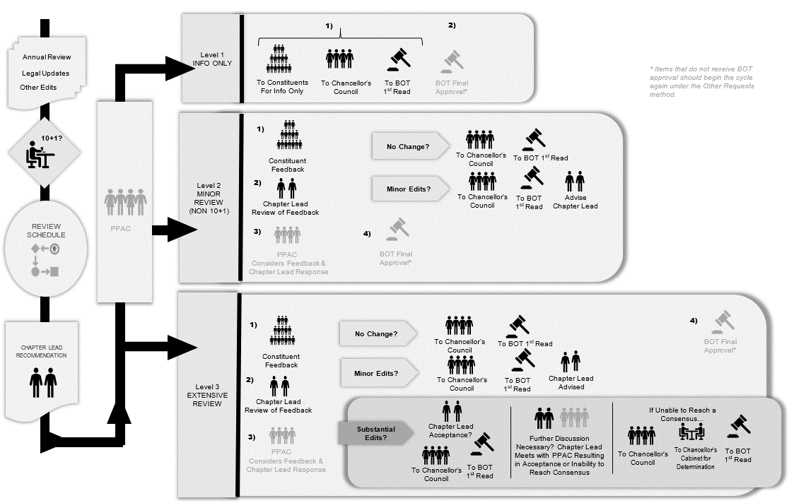
SBCCD Policies & Procedures (P&Ps)
Governed by P&P 2410

Slide 8
SBCCD Policies & Procedures (P&Ps)
Are separated by chapters with assigned leads who are charged with facilitating general correctness and operational feasibility of the P&Ps.
Are reviewed in pairs, when applicable, to ensure the AP supports the direction of the BP.
Are, if related to academic and professional matters, designated as “10+1,” allowing for appropriate Academic Senate review.

Slide 9
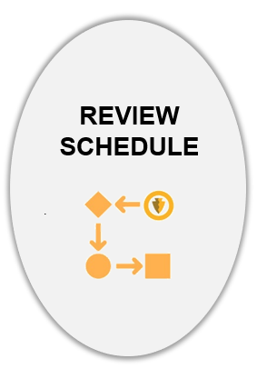
P&P Review Schedule
Annual Review
Legal Updates
Other Requests
Initiated each academic year

Slide 10
P&P Review Schedule
Annual Review
Legal Updates
Other Requests
Each academic year, the PPAC Co-Chairs will initiate review of 10% of SBCCD’s P&Ps
SBCCD keeps current with legal mandates and accreditation standards through Legal Updates from the Community College League of California.
Other requests for review may be Chapter Lead-initiated, or come from a trustee, a staff member, or a student.

Slide 11
P&P Review Schedule
Annual Review
Legal Updates
Other Requests
Initiated each academic year

Slide 12
P&P Review Schedule
10+1 or Academic and Professional
Relating to policy development and implementation matters for the following:
Curriculum, including establishing prerequisites and placing courses within disciplines;
Degree and certificate requirements;
Grading policies;
Educational program development;
Standards or policies regarding student preparation and success;
District and college governance structures, as related to faculty roles;
Faculty roles and involvement in accreditation processes, including self-study and annual reports;
Policies for faculty professional development activities;
Processes for program review;
Processes for institutional planning and budget development; and
Other academic and professional matters as are mutually agreed upon between the governing board and the academic senate.
Ensures the right of our Academic Senates to assume primary responsibility for making recommendations in the areas of curriculum and academic standards

Slide 13
P&P Review Schedule
Annual Review
Legal Updates
Other Requests
Initiated each academic year

Slide 14
P&P Review Schedule
Discussed at PPAC
Presented to the BOT
Updated and maintained throughout the year

Slide 15
Chapter Lead Review & Recommendation

Slide 16
Chapter Lead Review & Recommendation
Chapter Leads
Will be assigned the task of reviewing P&Ps from the Review List.
Are encouraged to collaborate with appropriate constituent groups.
Will make Chapter Lead Recommendations based on correctness and operational feasibility.

Slide 17
Constituent Feedback to Final Approval
Level
1
Level
2
Level
3
Chapter Lead Recommendations are assigned a Review Level rating of 1, 2, or 3 and placed on the PPAC agenda

Slide 18
Constituent Feedback to Final Approval
Level
1
INFO ONLY
Generally consists of Chapter Lead Recommendations for P&Ps which are:
Reviewed with no changes,
Reviewed with only minor clerical edits or legal reference changes, or
Chapters 1 and 2 BOT P&Ps which are not designated 10+1.
Review Process

Slide 19
Constituent Feedback to Final Approval
Level
1
Level
2
Level
3
Chapter Lead Recommendations are assigned a Review Level rating of 1, 2, or 3 and placed on the PPAC agenda

Slide 20
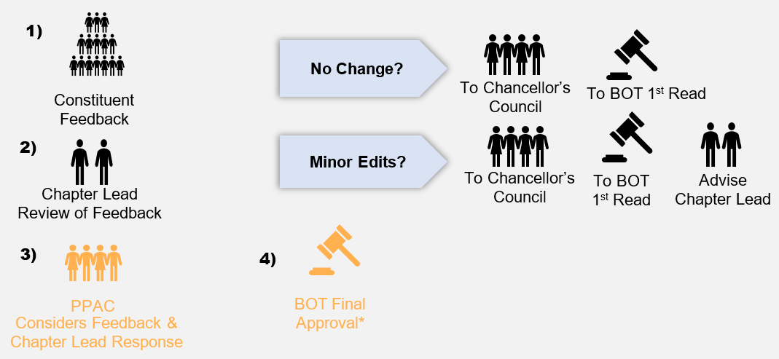
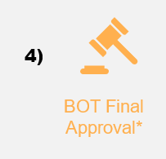
Constituent Feedback to Final Approval
Level
2
MINOR REVIEW (NON 10+1)
Generally consists of Chapter Lead Recommendations on:
Existing P&Ps which are simple and non-controversial.
New P&Ps that are simple and non-controversial.
Review Process

Slide 21
Constituent Feedback to Final Approval
Level
1
Level
2
Level
3
Chapter Lead Recommendations are assigned a Review Level rating of 1, 2, or 3 and placed on the PPAC agenda

Slide 22
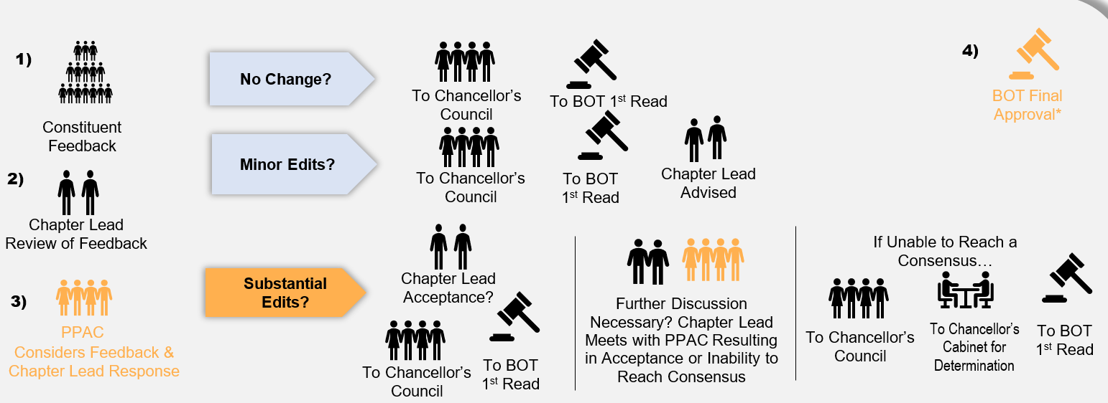
Constituent Feedback to Final Approval
Level
3
EXTENSIVE REVIEW
Generally consists of Chapter Lead Recommendations on:
Existing P&Ps with substantial changes and/or subject to 10+1.
New P&Ps that are controversial, complex and/or subject to 10+1.
Review Process

Slide 23
2022-23 PPAC Wins
Productively convened and conducted business 8 times
Developed efficiencies and provided feedback to improve our processes
Successfully processed 57 items from the 2022-23 annual review list, including 10 academic and professional items

Slide 24
2023-24 PPAC Targets
Continue developing PPAC efficiencies and refining the process
Train incoming members
Clear backlog of CCLC Legal Updates 39, 40, 41, and 42
Raise awareness of P&P recommendation process
Anticipate two new CCLC Legal Updates, and return to 10% review cycle

Slide 25
Board Policies & Procedures Ad-Hoc Committee
Board Policies & Procedures Ad-Hoc Committee
B
BPPAC
P
P
A
C

Slide 26
How are P&Ps reviewed?
Policies & Procedures Advisory Committee (PPAC)
Charged with updating, creating, developing, and systematically reviewing Board Policies and Administrative Procedures
Reports to Chancellor’s Council
Forwards to Board of Trustees for approval
BPPAC

Slide 27
Chapter Leads
Separated by chapters with assigned leads who are charged with facilitating general correctness and operational feasibility
Chapters Leads | 1. The District BOT Chancellor | 2. Board of Trustees BOT Chancellor | 3. General Institution Chancellor, Chancellor’s Cabinet
4. Academic Affairs Chancellor’s Designee & Academic Senate Presidents | 5. Student Services Chancellor’s Designee & Academic Senate Presidents | 6. Business & Fiscal Services Executive Vice Chancellor & Vice Presidents of Admin Services | 7. Human Resources Vice Chancellor of Human Resources & Police Services
BPPAC

Slide 28
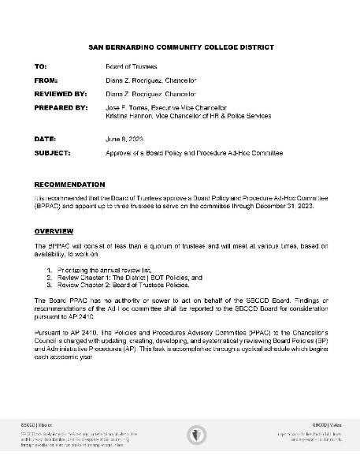
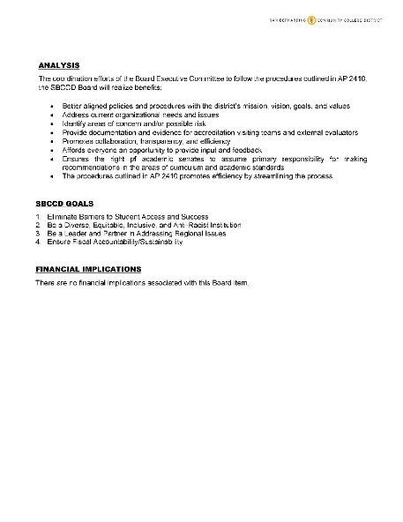
Board Policies & Procedures Ad-Hoc Committee Charge
The BPPAC will consist of less than a quorum of trustees and will meet at various times, based on availability, to work on:
Prioritizing the annual review list,
Reviewing Chapter 1: The District policies, and
Reviewing Chapter 2: Board of Trustees policies.
BPPAC

Slide 29
Process for Chapter 1 and Chapter 2
1. The District | 2. Board of Trustees*
Level
1
*P&P 2410 and 2510 are 10+1 and need to be assigned a different review level.
BPPAC

Slide 30
Looking forward to another great year!
Thank you, PPAC.

